Slide 1
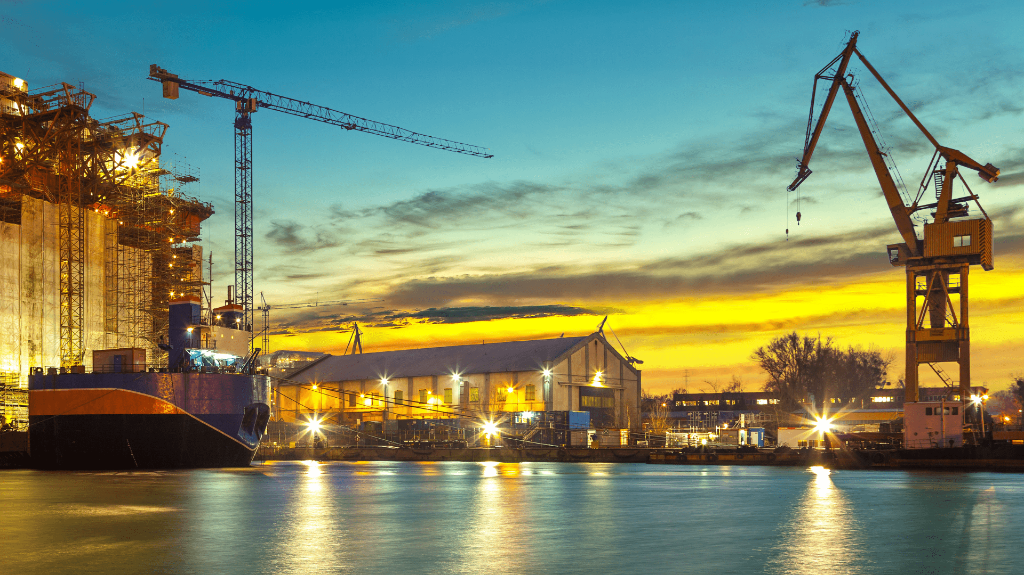
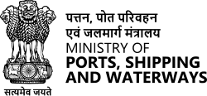
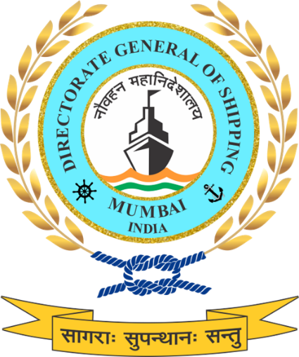
Ship Building & Repair - Catalyst for Economic Growth
INMEX | SMM
Director General of Maritime Administration
10-12th September 2025 | Bombay Exhibition Centre, Mumbai

Slide 2
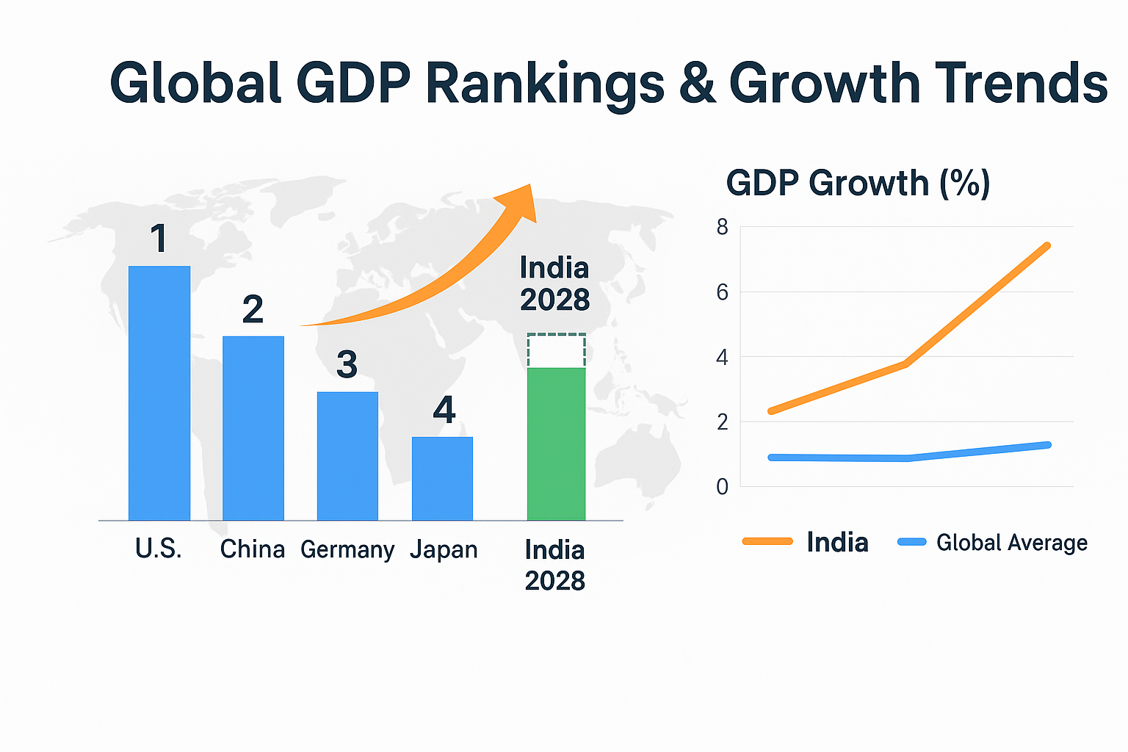
India’s Economic Growth
India became the world’s 4th largest economy in August 2025 with $4.19 Trillion GDP, 6.5% growth in FY25, and projected 6.3–6.7% annual growth through coming years.
India’s economic outlook remains strong, driven by record infrastructure spending, reforms, improved logistics, and green initiatives, with policymakers targeting $5 Trillion GDP by 2027–28, sustaining high growth and global economic influence.
India’s GDP growth is fueled by consumption, demographics, exports, FDI, and infrastructure; IMF projects India will surpass Germany by 2028, becoming the world’s 3rd largest economy with sustained reforms.

Slide 3
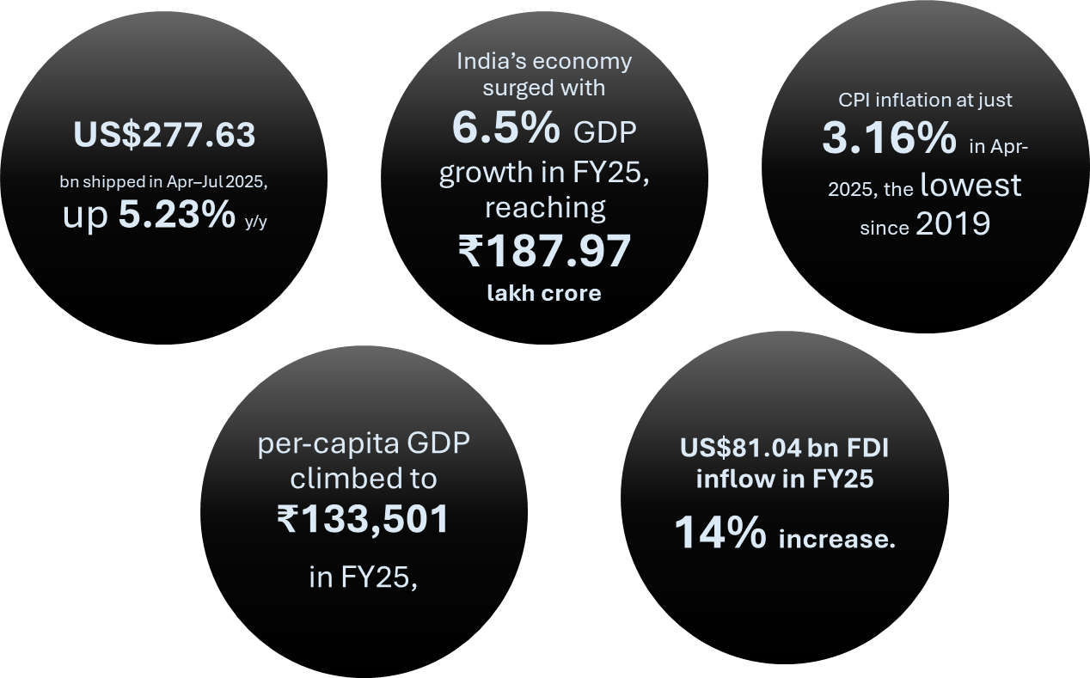
India’s Economic Growth
Cumulative Exports
Consumer Price Index
Towards Viksit Bharat 2047
Foreign Direct Investment

Slide 4
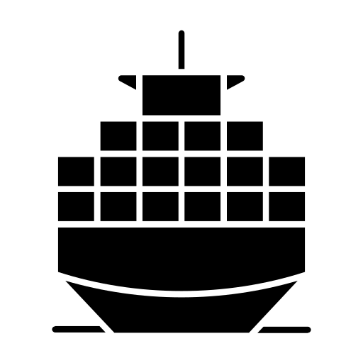

Contribution of the Blue Economy
Towards Viksit Bharat 2047
India and its Blue Economy
India’s Infrastructure Leverages
95%
65%
12
200+
11,098 km
By trade volume
By trade value
Major Ports
Non-major Ports
Total length of India’s coastline
India’s Vessel Advantage
India is emerging as the leader of the Blue Economy in the world with multiple initiatives focusing on infrastructure, business and the overall economy
India has 1,520+ merchant vessels with 13 mn+ GT capacity
Port-led Development
Ports for Prosperity
Policy reforms driving EoDB, modern infrastructure and multi-modal logistics
India ranks 18th globally in flag registration and 19th globally in carrying capacity

Slide 5
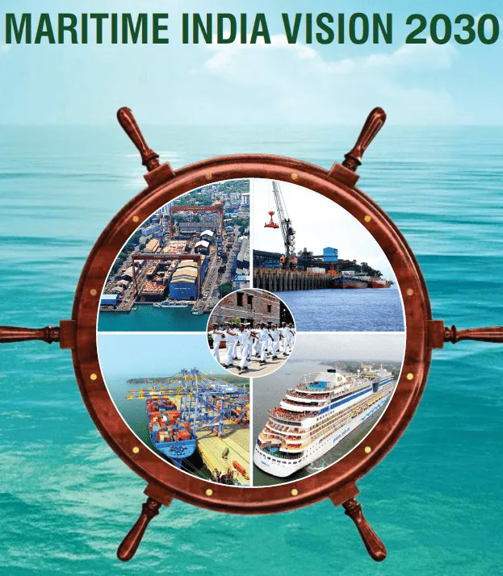
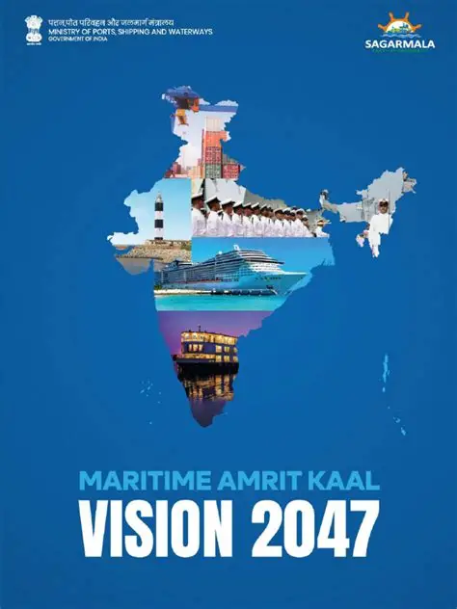
India’s Vision for the Maritime Sector
Maritime India Vision (MIV) 2030
Production Targets: Increase from current 30k GT to 500k+ GT annually by 2030
Maritime Amrit Kaal Vision 2047
Advanced phase targeting Top 5 global position in shipbuilding and maintaining 1 position in ship recycling
Investment: INR 20,000+ Crores
Employment Generation: 1,00,000+ additional jobs (direct and indirect)
Position India Globally in the Top 10 Shipbuilding, repair nations
69% Indian-Built Ships Share (up from current 5%)
300+ Strategic Initiatives across 11 key maritime areas
Financial Assistance: 20-30% assistance for green vessels (including retrofitting)

Slide 6





Why Shipbuilding is Critical?
Mother Industry for Heavy Engineering
Increasing Indian Tonnage in Energy imports
Employment Generation
Reduce Dependability & Outflow of FOREX
Creation of Strategic Assets

Slide 7
Global Shipbuilding Scenario
Global ship building market is estimated ton be approx. USD 70 Billion.
Primary dominance is shown by China, South Korea and Japan.
India currently ranks 16th among global shipbuilding nations
Vessel Type | Approx. Share of Global Orders (2024)
Container Ships 🚢 | ~38–40%
Gas Carriers (LNG/LPG) ⛽ | ~15–18%
Tankers 🛢️ | ~20–22%
Bulk Carriers ⚓ | ~18–20%
Passenger & Cruise 🛳️ | ~5%

Slide 8
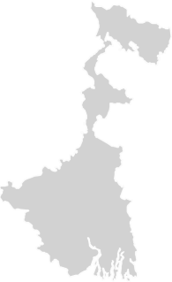
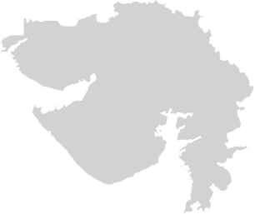
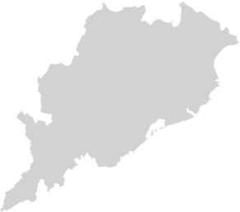
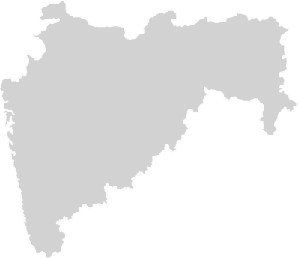
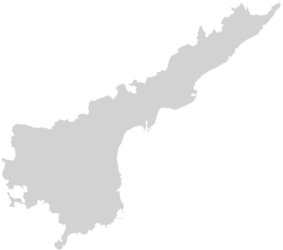



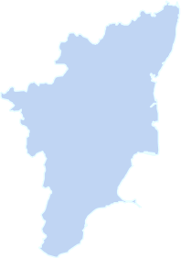
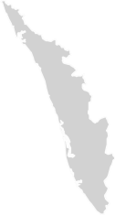
Shipbuilding Scenario in India
53*
30,000
GT
State-wise Shipbuilding capacities
Annual Tonnage Produced
Total Number of Shipyards
Gujarat
936300 DWT
West Bengal
44000 DWT
*Annual Report, MoPSW
Maharashtra
94300 DWT
Goa
130000 DWT
Andhra Pradesh
80000 DWT
Karnataka
41000 DWT
Tamil Nadu
26000 DWT
Kerala
253600 DWT
*Top 5 Reporting companies

Slide 9




Challenges faced by Indian Shipbuilding Industry
Structural and Financial challenges
Operational gaps
Lack of access to low-cost, long-term capital; high cost of working capital (~10.5% interest).
Inverted GST duty structure leading to blocked input tax credits.
Restoration of customs duties increasing shipbuilding costs by 4.5–5.25%.
Limited number of shipyards focused on commercial shipbuilding.
Weak ancillary industry; 50–60% of components still imported.
Lack of standardized indigenous ship designs and design repositories.
Shortage of skilled labour across technical disciplines.
Absence of a centralized shipyard database for visibility and planning.
Market & Policy Limitations
Strategic & Emerging Issues
High cost and lack of support for green vessels and decarbonization.
Cybersecurity vulnerabilities and outdated digital infrastructure.
Low domestic demand; preference for second-hand foreign vessels.
No dedicated maritime financing institutions or credit schemes.

Slide 10
Global Leaders
China
South Korea
Japan
% global SB market share
% global SB market share
% global SB market share
52-56%
30-35%
25-30%
20-25%
25-30%
28-30%
24-25%
5-6%
7-11%
2000
2019
2025
2000
2019
2025
2000
2019
2025
Cabotage only for Chinese flag, Chinese-built vessels
• Foreign flag, Chinese built
vessels allowed in
Shanghai
Free Trade Zone
17% subsidy on prices for Chinese Ship buyers
Soft-loans, tax exemptions for local shipbuilders
Cabotage only for South Korean flag vessels
Financial support to promote new ship demand - reimbursement up-to
60% of cost of new vessels (2018)
Easy financing options for shipbuilders, bailout support
Cabotage only for Japanese flag vessels
Subsidy for scrapping old vessels given to owners/operators
Tax benefits to promote
shipbuilding, fleet modernization e.g. depreciation up to 60% in 5
years on Japanese owned ships

Slide 11


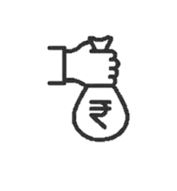
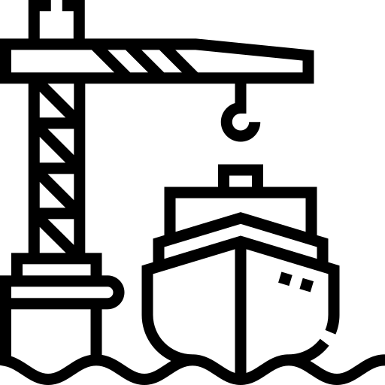




Proposed Interventions to boost Shipbuilding
Shipbuilding Financial Assistance Policy (SBFA)
Developing shipbuilding clusters
Maritime Development Fund (MDF)
National Ship Building Mission
Comprehensive Ship Building Portal
Strategic Business Unit for Ship Building
Subsidies for green conversion
Removal of Operational & Taxation Hurdles

Slide 12
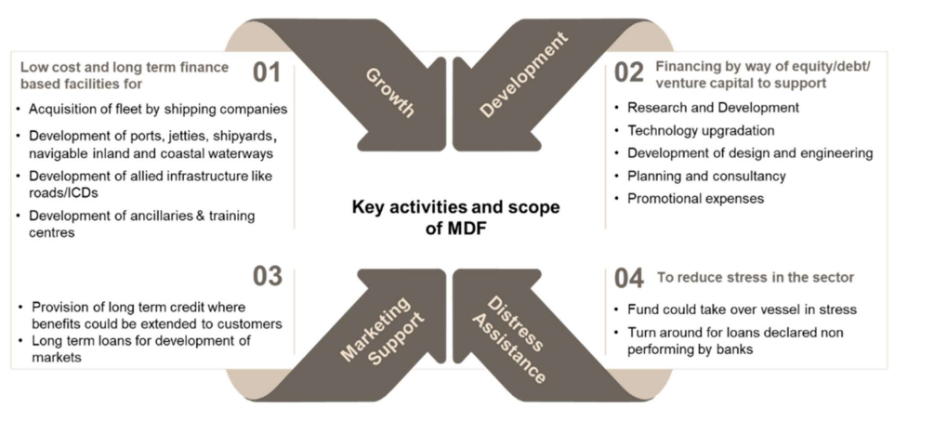
Maritime Development Fund

Slide 13

Sagarmala Projects
Objective: Reduce logistics costs for both domestic and EXIM cargo.
Total Projects: 839
Investment Value: ~INR 5.79 Lakh Crore
Timeline: Implementation targeted by 2035
Project Status: 272 projects worth ~INR 1.41 Lakh Cr. have been completed and 214 projects worth ~INR 1.62 Lakh Cr. are under implementation.
5 Pillars
Coastal Community Development
Coastal Shipping & (IWT)
Port Connectivity
Port-led Industrialization
Port Modernization

Slide 14
Ship Building Finance Assistance Scheme
SBFA – Key Highlights
SBFAP 1.0 (2016 – 2026)
Financial Assistance:
20% of the lower of Contract Price, Fair Price, or Actual Payment
Rate reduces by 3% every 3 years
Green Vessel Incentives:
30% for Methanol/Ammonia/Hydrogen-fueled vessels
SBFAS 2.0 (2026 – 2036)
Total Allocation: ₹18,090 crore
Subsidy Rates:
Standard vessels: 14–15%; Large vessels (>₹100 crores): 20% ; Green fuel: 30% ; Electric/ hybrid: 20%
For FY 2025–26, the figures presented are as of 09 September 2025
527.98 Cr
186
Total amount released
Total Vessels Supported

Slide 15
Removal of Operational & Taxation Hurdles
Below mentioned are the Taxation anomalies hampering Indian Tonnage vis a vis Global Maritime.
Sr. No. | Operating Parameters for a coastal voyage | Indian flag ship | Foreign flag ship
1 | Direct Tax - Seafarers’ wages taxation | Wages of Indian seafarers working on Indian flag ships in coastal waters are subject to Income tax and TDS provisions. | No tax on wages earned by Indian or Foreign seafarers working on foreign flag ships operating in coastal waters of India even for Indians working on foreign flag ships on the coast
2 | Direct tax – Tonnage Tax Rate | Rate of tonnage tax is higher under the Indian Income tax High rate of tax on income OR Tonnage tax + training obligation | Lower rate of tonnage tax
3 | Direct Tax – Cadet Training Cost | Free Cadet training provided by Indian Ships under Tonnage Tax Scheme – We train 1.5 cadets for every 10 persons on board our vessels | No such training obligation on foreign ships by their maritime administration
4 | IGST on import of ships | 5% on the value of the ship | No GST on the acquisition of ships in their country Even if the foreign ship is operating in India no GST applies
5 | Inability to offset input GST on goods procured | 5% of the value of the goods (Bunkers, stores, spares) gets blocked in the Indian shipping company | Does not apply
6 | GST on (freight) transport of cargoes between two Indian ports | 5% on the value of the service | Does not apply – no GST is payable on coastal provided by foreign flag vessel

Slide 16
Removal of Operational & Taxation Hurdles
Below mentioned are the Taxation anomalies hampering Indian Tonnage vis a vis Global Maritime.
Sr. No. | Operating Parameters for a coastal voyage | Indian flag ship | Foreign flag ship
7 | GST payable on maintenance, repair or overhaul (MRO) services procured overseas | From June 2021, the Indian flag shipping industry must pay 5% GST on Reverse charge basis on the dry docking and repair services procured abroad. | In most countries Ships are exempt from application of GST - Does not apply. Foreign ships are able to get MRO services in India without payment of levy.
8 | 5% IGST payable to Customs on the sum of (a) dry docking expenditure incurred outside India, plus (b) cost of insurance (c) freight (to &fro) | Despite paying GST on Reverse charge basis on MRO services availed overseas, Customs require Indian ship to pay this amount again under IGST. This levy is payable a second time on the same MRO service on conversion of the vessel to coastal and this amounts to double taxation. | Does not apply – since almost all maritime nations do not apply GST to Ships.
9 | GST on Export freight services | Export freight services provided by Indian ship is liable to 5% GST | Does not apply.
10 | GST on Import freight services | Export freight services provided by Indian ship is liable to 5% GST | Does not apply.

Slide 17
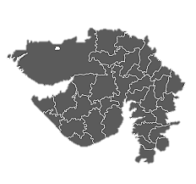
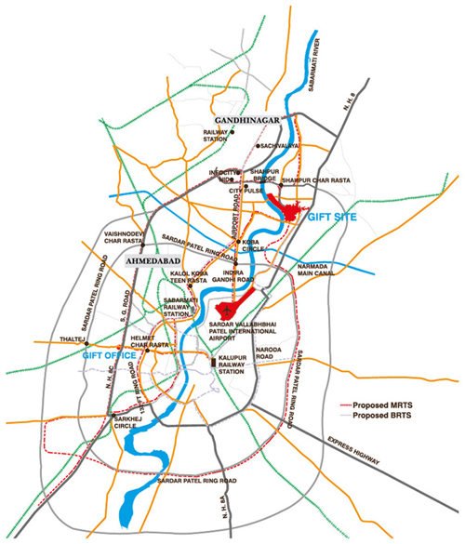

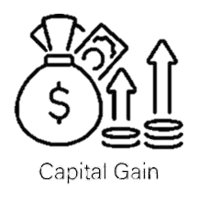
GIFT City: Opportunities for Maritime Sector
GIFT IFSC – Key Highlights
India’s First IFSC: GIFT City is a pioneering smart city and the country’s first operational International Financial Services Centre.
Strategic Location: Positioned between Ahmedabad and Gandhinagar, with access to major trade corridors and international airport.
Unified Regulation: IFSCA streamlines oversight across financial sectors, enhancing ease of doing business.
GIFT CITY
Strategic Advantage of GIFT City in the Maritime Sector
10-Year Tax Holiday
Capital Gains Exemption:
Maritime entities in GIFT IFSC enjoy full income tax exemption for any 10 consecutive years within the first 15 years of operation, boosting profitability and long-term investment.
GIFT IFSC entities enjoy exemption on capital gains from ship sale and lease transactions, reducing asset turnover costs and encouraging fleet reinvestment.

Slide 18
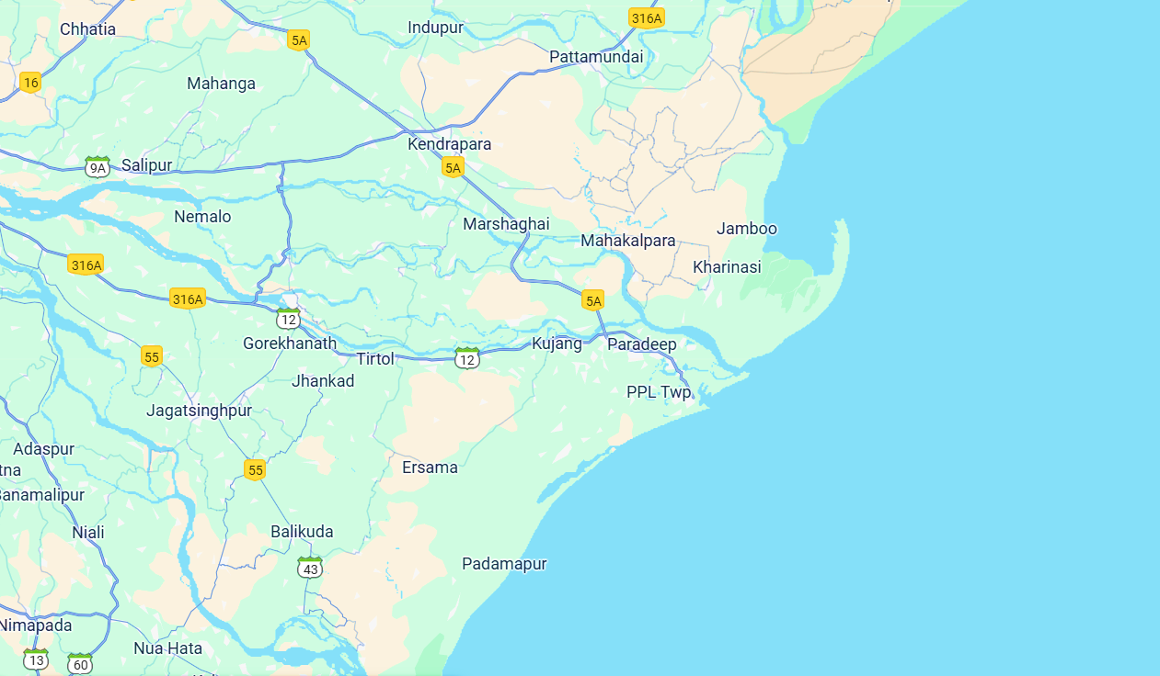
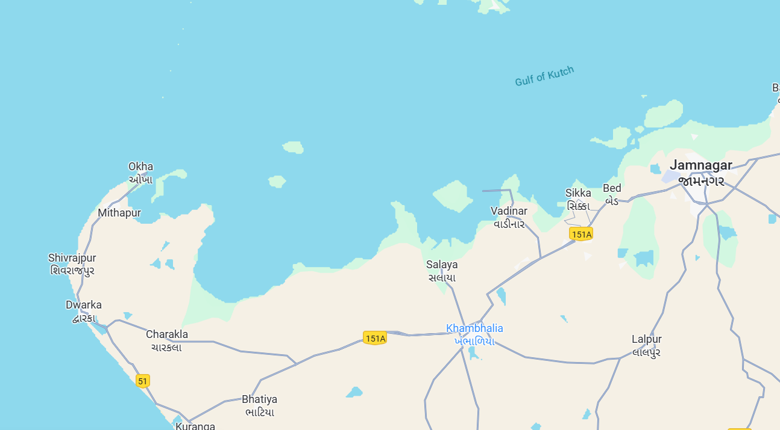
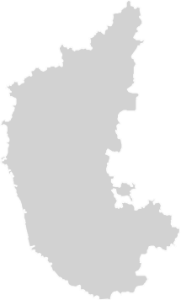
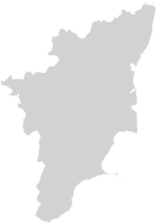
Proposed Shipbuilding and Ship repair Clusters
The locations shown have been identified for potential shipbuilding cluster development, and preliminary site visits are currently underway to assess feasibility and infrastructure readiness.
Kandla
Vadinar
Kendrapara
Dighi
Jaigad
Krishnapatanam
~ 2,000 acres of land identified on the northern bank of Mahanadi river for Shipbuilding and Repair Cluster in Kendrapara, Odisha
Site identified for Vadinar Ship Repair Cluster in Gujarat
Dugarajapatanam
Tuticorin

Slide 19
Business Development Unit for Ship building
Scope
Stage One - Blueprinting- Design the roadmap for attracting investments and set up the shipbuilding cell
Baseline Assessment for:
  Shipbuilding and ship repair market in India.
  Policies and supply market drivers.
  Investments
  Technological collaborations, capacity building interventions, inter-departmental initiatives and regulatory support.
  Central & State Gov. initiatives.
Analysis of emerging market opportunities in Shipbuilding.
Socio-economic benefits.
Stage Two - Implementation support- Handhold the shipbuilding cell to deliver the Objectives of Project
Setup and operationalize the working model of the shipbuilding cell.
Assistance in investment attractions.
Evaluation of proposals / counter-proposals and key business terms.
Strategic support to the Shipbuilding on emerging trends, geopolitical shifts, or investment realignment opportunities.
Refine the investment blueprint and institutional roadmap.

Slide 20




Comprehensive Shipbuilding Portal
Objectives
Modules
Vision
Establish a state-of-the-art portal as a central hub for information, collaboration, and innovation in Indian shipbuilding and repair industry
1. Increase global competitiveness of Indian shipbuilding industry
Capability Insights
Display capabilities, projects & achievements, CAF
1
Collaboration Hub
Interactive tools for industry professionals to network.- QnA, Posts & Closed Groups
2. Enhanced collaboration between stakeholders (design agency, shipyards, ancillaries and equipment suppliers, regulators etc.).
2
Training & Certifications
Information on Training courses and Institutes
3. Workforce development through training and certification.
3
Finance & Insurance
Information on funding schemes and insurance solutions
4
4. To promote R&D and innovation.
Innovation Centre
Showcase innovative technologies and R&D projects.
5
Technical Library
Repository of technical documents, standards, and guidelines.
6
5. To provide centralized access to technical information, standards, and guidelines.
Regulatory & Compliance
Updates on maritime regulations and safety standards.
7
6. To provide assistance on financial schemes.
Industry Directory
Comprehensive listing of shipbuilding stakeholders.
8

Slide 21
Role of State Government and Maritime Boards
Policy Framework and Incentives
Land Management and Facilitation
Maritime Boards manages leases covering more than 200 hectares dedicated to shipbuilding and repairs.
Maharashtra approved a shipbuilding policy in 2025 aimed at creating 40,000 direct jobs in the sector by 2030 through financial incentives and infrastructure grants totalling over ₹4,000 crore.
Gujarat and Andhra Pradesh have announced plans to develop shipyard infrastructure with investments exceeding ₹3,000 crore.
Employment and Skill Development
Promotion of Innovation and R&D
Sagarmala Programme and Deen Dayal Upadhyaya Grameen Kaushalya Yojana (DDU-GKY), targeting to train and employ over 10,000 coastal youth annually in maritime skills.
In 2025, around 25% increase in patent filings related to shipbuilding technologies driven by coordinated government and Maritime Board initiatives.

Slide 22

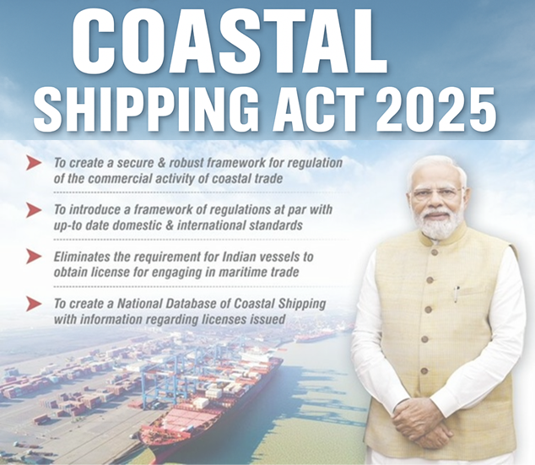
Coastal Shipping and possibilities
“Coastal Shipping Bill, 2025 aims to boost coastal cargo up to 230 million metric tonnes by 2030”: Sarbananda Sonowal
“National Coastal and Inland Shipping Strategic Plan to Steer Future Infrastructure and Policy Under new Act”: Sarbananda Sonowal
In a landmark move to strengthen India’s coastal economy, the Coastal Shipping Bill, 2025 was passed by the Rajya Sabha, marking a significant step toward unlocking the vast potential of India’s 11,098 km coastline, which spans nine coastal states and four union territories.
The bill was introduced by Sarbananda Sonowal, Union Minister of Ports, Shipping & Waterways.
Previously approved by the Lok Sabha on April 3, 2025, the legislation aims to modernize and simplify the legal framework governing coastal shipping.
It replaces Part XIV of the Merchant Shipping Act, 1958 with a progressive, globally aligned law that reflects contemporary cabotage standards and supports the growth of coastal trade.

Slide 23
Coastal Shipping and possibilities
The Coastal Shipping Bill, 2025, passed by both Houses of Parliament, marks a major reform in India’s maritime sector.
It replaces outdated provisions of the Merchant Shipping Act, 1958, introducing a modern legal framework aligned with global cabotage standards.
The Bill includes 6 chapters and 42 clauses, simplifying licensing and regulating foreign vessels in coastal trade.
It mandates a National Coastal and Inland Shipping Strategic Plan to guide infrastructure and policy development.
A National Database for Coastal Shipping will provide real-time, transparent data to support investment and planning.
The legislation aims to boost Indian ship participation, reduce reliance on foreign vessels, and curb foreign exchange outflow.
It supports the vision of Atmanirbhar Bharat and Viksit Bharat, promoting local economic growth and employment in coastal regions.
With this Bill, India completes a trio of key maritime reforms alongside the Merchant Shipping Bill and Carriage of Goods by Sea Bill, paving the way for a modern, efficient, and self-reliant maritime ecosystem.

Slide 24


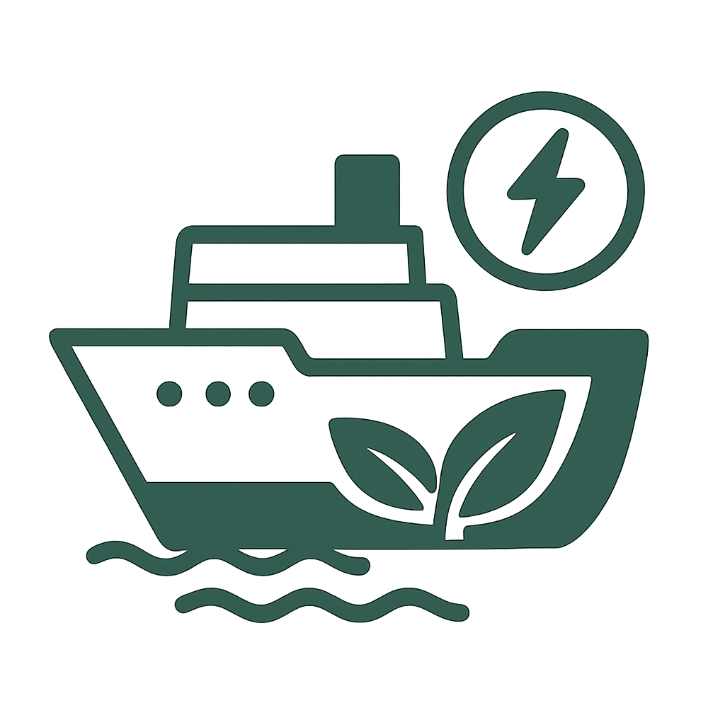

Success Stories – Cochin Shipyard
International Ship Lift Facility
Cochin Water Metro
One of the largest ship-lift facilities in Asia, enabling multiple ship repairs simultaneously.
Built a first-of-its-kind electric-hybrid ferry system in India.
Provides eco-friendly urban transport across Kochi backwaters.
A model for sustainable public transport in coastal cities
Hybrid & Green Vessels
Promotion of Innovation and R&D
Designed and built hybrid-electric vessels, supporting India’s green shipping agenda.
Collaborated with global players (e.g., HD Hyundai, Fincantieri).
Exported specialized vessels to Norway, Germany, and other European markets.
Expanding footprint in offshore support vessels and fishing vessels

Slide 25





Role of DGMA and stakeholders cooperation solicited
Regulatory Oversight:
DGS ensures maritime safety, security, and compliance with international regulations
and standards.
Policy Implementation:
DGS facilitates the execution of national maritime policies and supports modernization of the sector.
Industry Collaboration:
Private shipyards and maritime industries are encouraged to partner with DGS to drive innovation and improve operational efficiency.
Institutional Support:
Industrial and financial institutions play a key role in funding maritime infrastructure and promoting sustainable development
Academic Engagement:
Academia supports the sector through research, skill development, and specialized
training for maritime professionals.

Slide 26
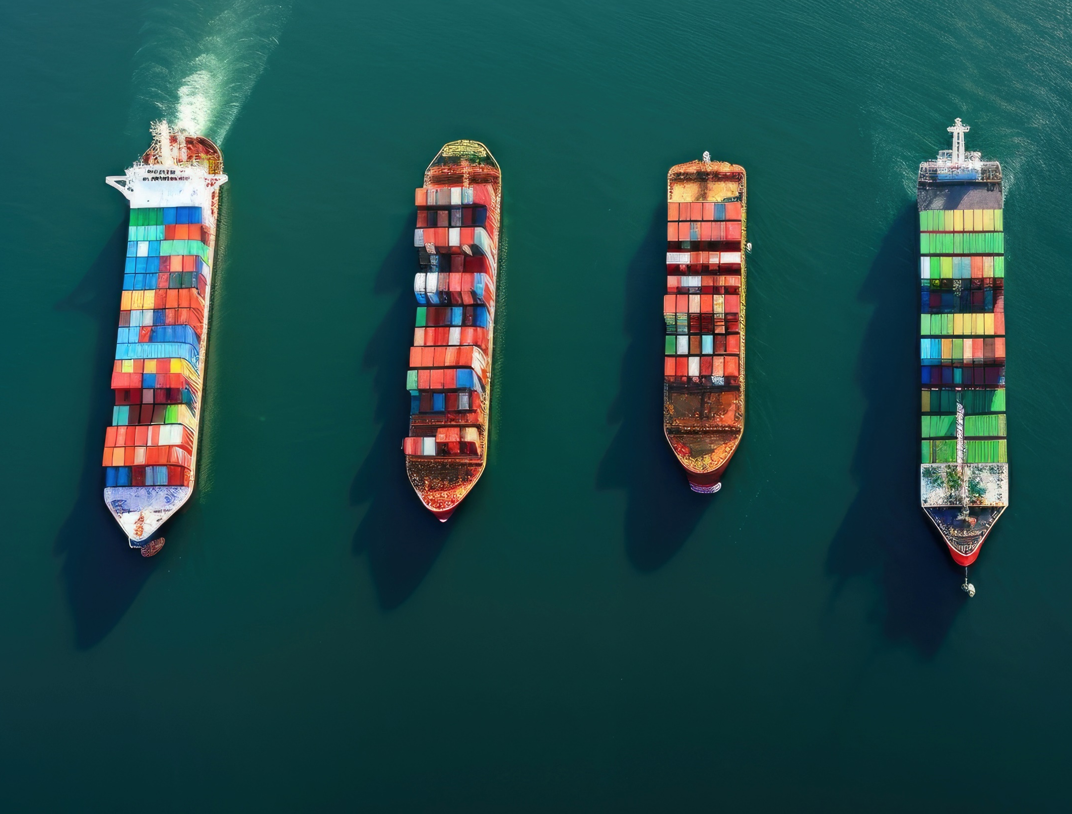

सागरा: सुपन्थान: सन्तु /
“Let the oceans have safe passages”

