Slide 1
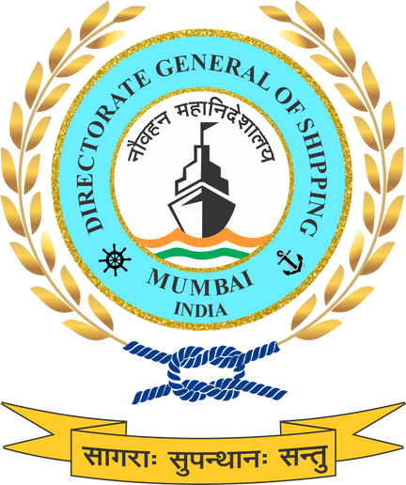




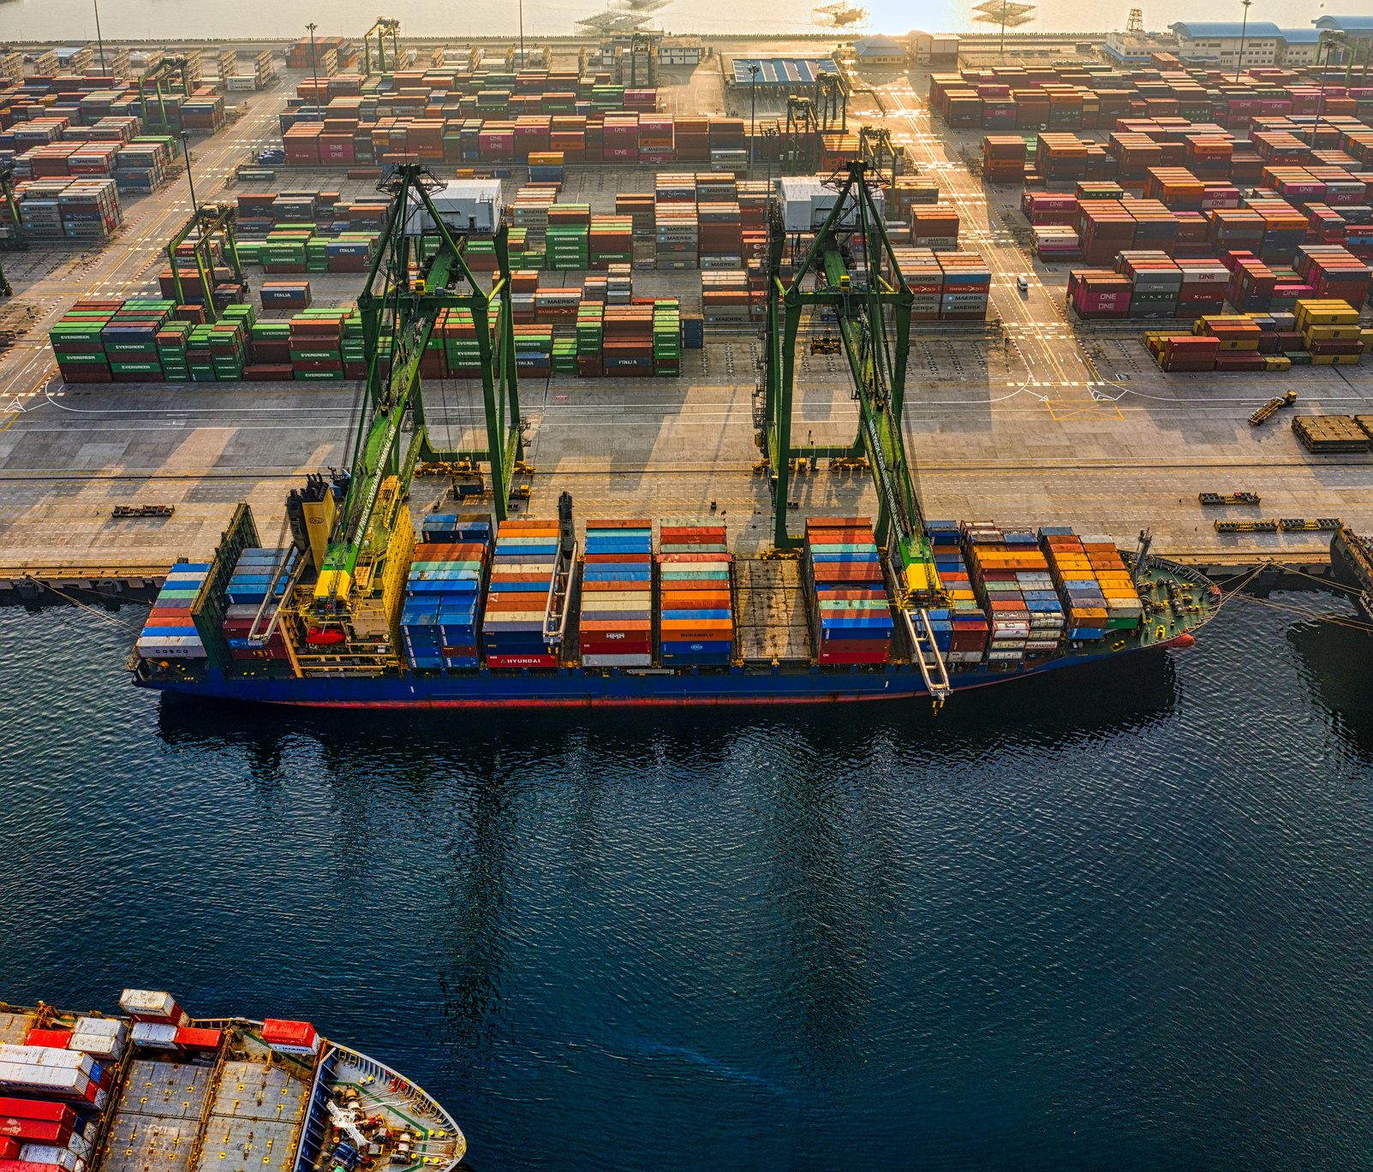
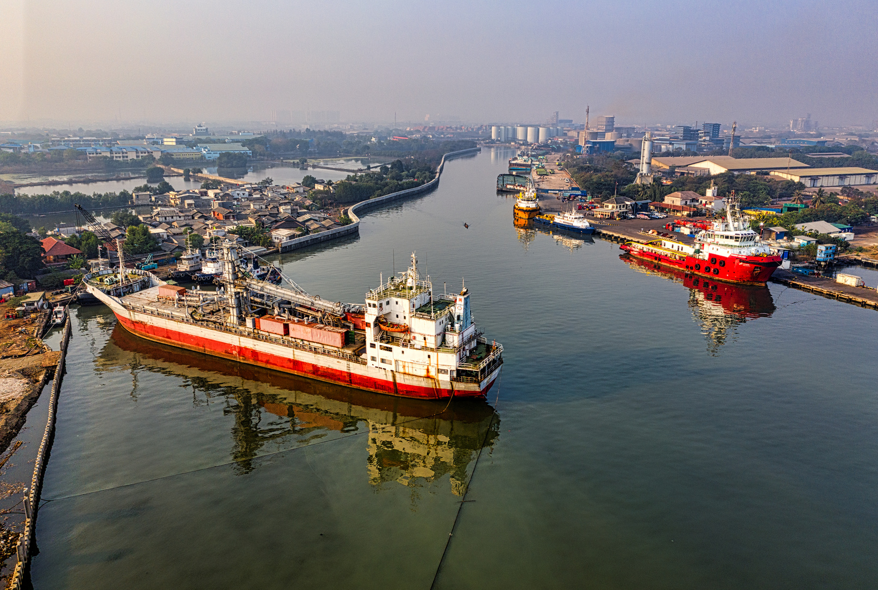
राष्ट्रीय हरित पोत-परिवहन नीति
NATIONAL GREEN SHIPPING POLICY
A Unified National Policy for India’s Maritime Decarbonisation
14 Jan 2026

Slide 2




WHY NATIONAL GREEN SHIPPING POLICY (NGSP) — NOW
India’s maritime sector is expanding rapidly.
NGSP ensures this growth is future-ready, climate-aligned, and globally credible—starting now, not later.
Global Policy & Regulatory Shift
Why India Needs NGSP Now
IMO Revised GHG Strategy (2023) – net-zero shipping ~2050
01
Domestic actions exist but are fragmented and non-binding
No national emissions baseline, alternative fuel pathway or sector-wide MRV
Regional policies like EU Fit for 55 / FuelEU Maritime / EU ETS extending to shipping
02
A unified national framework aligned with global regimes and India’s net-zero pathway needed as no harmonised definition of green for ships, ports, or fuels
Norway, Korea, Japan, Singapore implementing national green shipping frameworks
03
Carbon intensity, fuel standards, and MRV becoming trade and finance prerequisites
Risk of carbon lock-in as port and fleet capacity expands
04

Slide 3


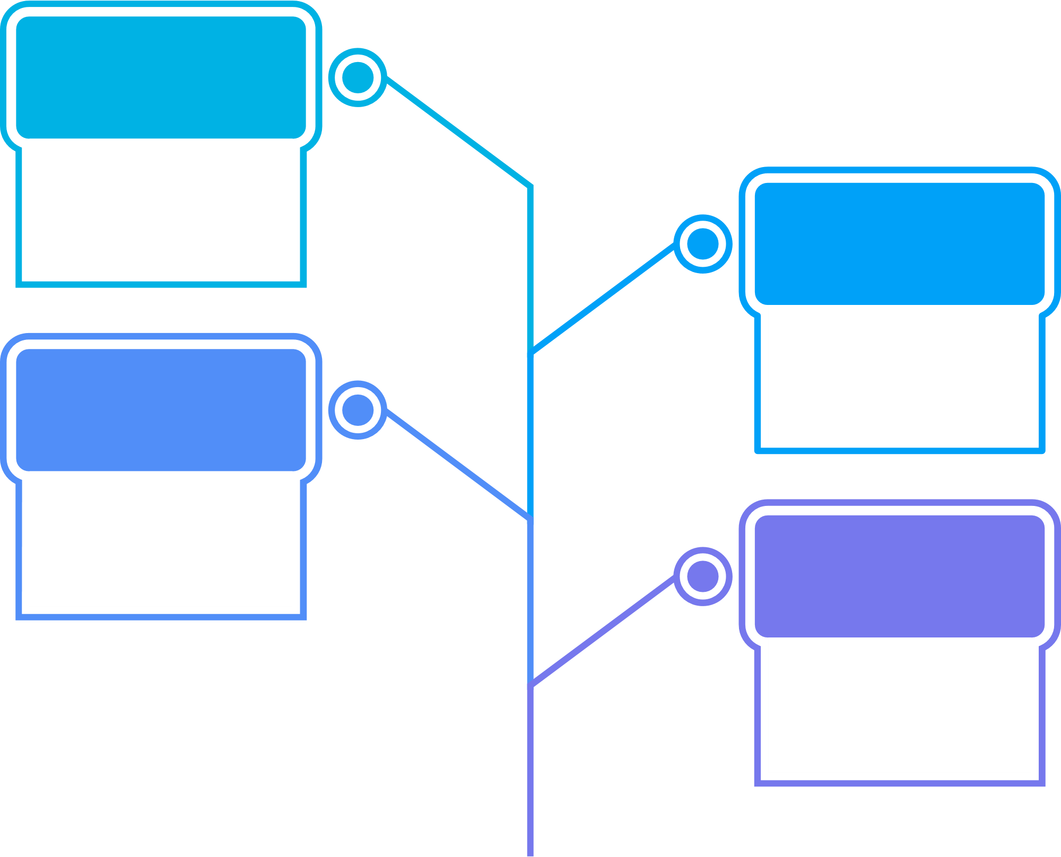

This workshop will be consolidated into a pillar-wise National Action Plan, validated through inter-ministerial review in February 2026, and operationalised with assigned ministerial responsibilities by mid-March 2026.
India@ Net Zero Workshop
This Multi-Ministerial Action Plan & Governance Workshop will provide the institutional and coordination backbone to operationalise the NGSP.
Jan
14-15
2026
Final version of NGSP submitted
Aug
After considering comments and suggestions from stakeholder the amended version was submitted to MoPSW and DGS
20
1st Draft of NGSP Shared
July
23
NGSP first draft was shared with stakeholders and requested comments by 5th August 2025
Seven Sector-Specific Consultations
June
Inputs were gathered through technical presentations and moderated discussions, written submissions and structured questionnaires, and stakeholder feedback forms and interaction notes.
23-27
National Multi-Stakeholder Consultation
June
130+ stakeholders across the maritime ecosystem attended.
11
Gap Analysis of LR Document Submitted
June
NCoEGPS conducted a gap analysis identifying the need for harmonised ‘green’ definitions, emissions baselining and Monitoring and Reporting frameworks, financing and governance mechanisms, and explicit coverage of coastal shipping, marine tourism, and inland waterways.
02
LR Consulative Document Released
Feb
A consultative document prepared by Lloyd’s Register for DGS provided global benchmarking and conceptual pathways that served as the foundation for NGSP formulation.
20
2025
POLICY ORIGIN & DEVELOPMENT PROCESS
From LR Consultative Document to National Policy

Slide 4














SEVEN GREEN MARITIME PILLARS
01
Green Shipping
Low- and zero-emission vessels, retrofits, lifecycle emissions
In the spirit of the ancient Saptasagara (Seven Seas) that symbolized India’s historic maritime reach, the NGSP 2025 anchors its strategy on seven interlinked foundational pillars critical to achieving a green maritime future.
02
Green Ports
Renewable energy, OPS, Zero Emission Port Zones (ZEPZs)
03
Green Ship Recycling
Circular economy, worker safety, HKC compliance
Green Finance
04
De-risking investments, unlocking climate finance
05
Green Skill Development & HR
Workforce readiness and inclusion
06
Green Fuels
Domestic production, bunkering, lifecycle standards, GFI
07
Green Technology
Innovation, indigenisation, digitalisation

Slide 5








Unified Architecture
From Standards to Market Signals
NGSP establishes a nationally unified framework that integrates the entire maritime lifecycle—from design and operation to recycling
The policy operationalises “green” through clear definitions, tiered certification, and aligned technology pathways
HOW NGSP ADDS VALUE & FAST-TRACKS GREEN TRANSITION
Execution-Ready Governance
Institutional Architecture & Governance
Define boundaries, deliverables, responsibilities, and ensure overall project clarity.
National Green Shipping Coordination Cell (NGSCC) as a permanent nodal body for Rolling National Green Maritime Implementation Plan (NGMIP)
From Vision & Guidelines to an Executable National Transition Framework
Data-Driven Accountability
Innovation, Technology & Global Cooperation
Innovation sandboxes and pilot corridors
Structured bilateral and multilateral cooperation
A national emissions baseline (2021) and sector-wide MRV system anchor decision-making in verified data.

Slide 6
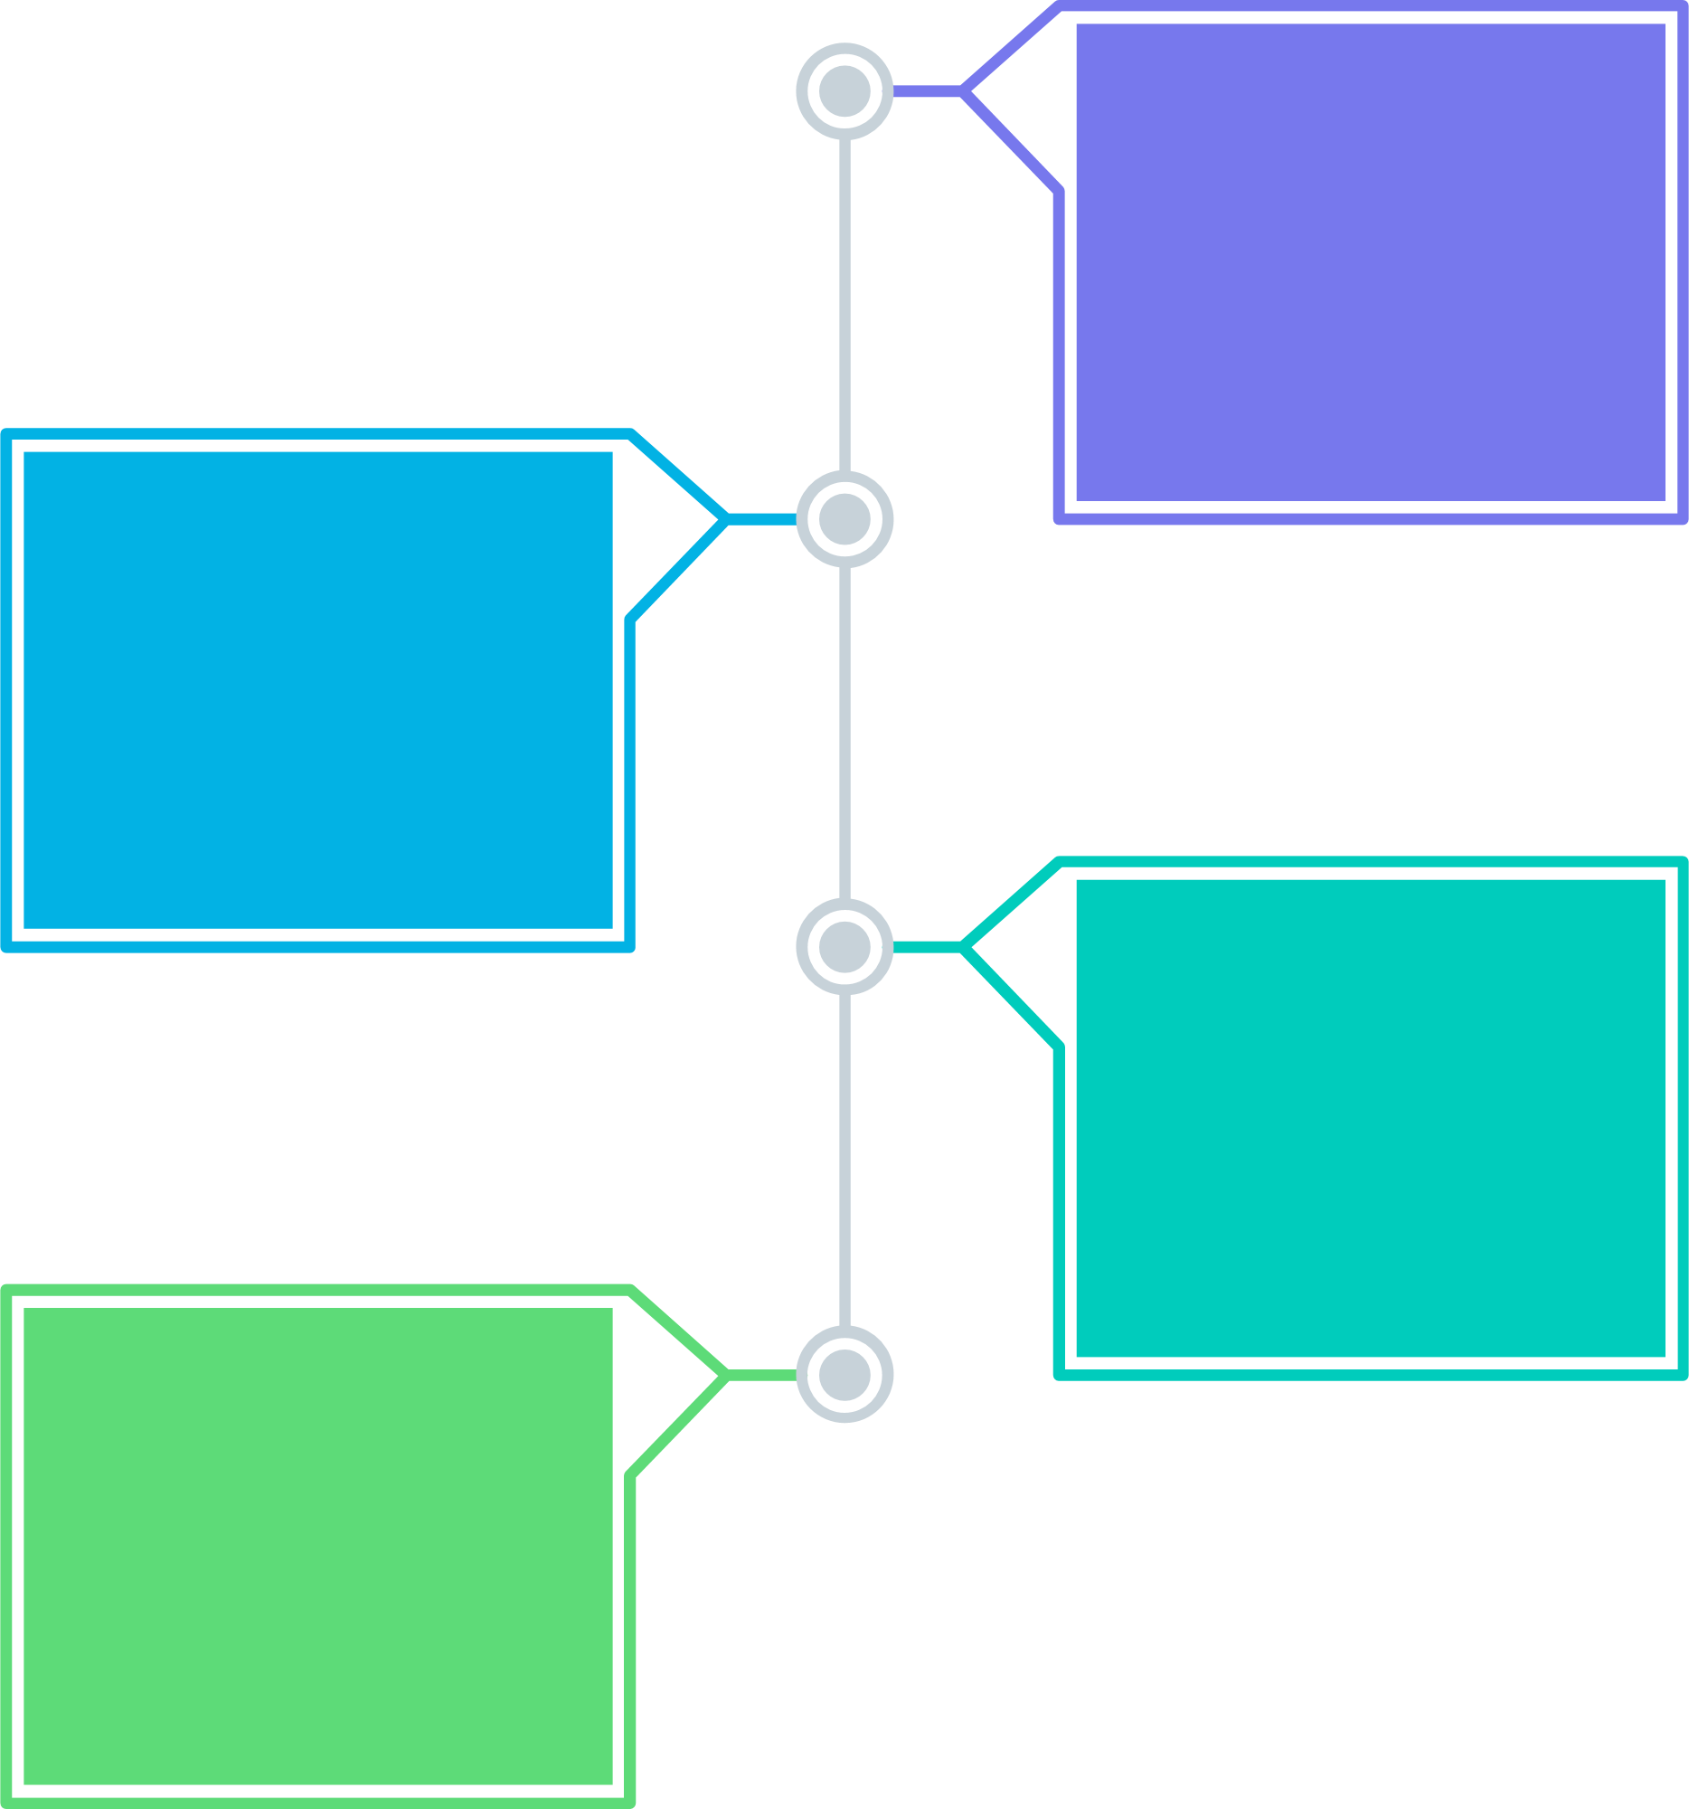



Implementation Roadmap Phase 1 : Foundation (to 2030
Implementation Roadmap Phase 3 : Net-Zero Transition (2040–2070)
National emissions baseline finalised
M&R systems operational across ports, ships, and IWT
Pilot green corridors and certification frameworks
Early fuel switching and vessel retrofitting
100% zero-emission-capable newbuilds post-2045
Sectoral net-zero (ports + Indian-flag shipping) by 2070
100% transition to low / zero-emission fuels nationwide
Indian M&R systems integrated with global carbon markets (with equity safeguards)
EMISSIONS BASELINE & SMART DECARBONISATION TARGETS
02
04
Anchoring India’s Maritime Net-Zero Transition (2025–2070)
National Emissions Baseline (2021)
Implementation Roadmap Phase 2 : Scale & Institutionalisation (2030–2040)
Calendar Year 2021 adopted as India’s national maritime emissions baseline
Covers ship-sourced emissions and port / terminal operational emissions
Aligned with CBDR-RC, post-COVID recovery, MIV 2030, and India’s decarbonisation trajectory
Separate baselines for:
Shipping-side emissions (Well-to-wake where data permits)
Port-side emissions (Scopes 1, 2, and material Scope 3)
OPS at 100% berths of major ports by 2035
Port Scope 1–2 emissions intensity –50% vs 2021 baseline
≥30% clean fuel adoption across domestic maritime by 2040
≥60% of national cargo throughput under Green Port Certification
Zero-Emission Port Zones at top-10 ports by 2038
01
03

Slide 7




NATIONAL GREEN SHIPPING COORDINATION CELL (NGSCC)
A Federated, Adaptive Governance Framework for NGSP
National Green Maritime Implementation Plan (NGMIP)
Institutional Design
Robust Monitoring, Reporting & Verification
To be established within MoPSW as the central nodal authority
Supported by a existing Green Cell in MoPSW
Core functions:
Cross-ministerial convergence (MoEFCC, MNRE, MoPNG, MoF, MSDE)
Coordination of all seven green pillars
Oversight of MRV, certification, incentives, and reporting
India’s representation in IMO and regional green shipping forums
Rolling 5-year implementation plans
Prepared and monitored by NGSCC
Includes:
Pillar-wise actions and targets
Port- and State-wise milestones
Fund allocation via SMFCL
Technology and skilling milestones
Phased transition aligned with IMO ~2050 and India ~2070 pathways
Digital Monitoring and reporting
Annual Maritime Sustainability Report (AMSR)
Green Port Performance Index (GPPI) and similar Index linking initiatives as per NGMIP to incentives and finance
Mandatory third-party verification (DGS / IMU / IRS ecosystem)

Slide 8
3
Are the Monitoring and reporting-driven feedback loops between NGSCC and NGMIP strong enough to enable real course correction?
Under NGSP, emissions and performance data from ships, ports, IWT and terminals feed into the National MRV system, the Annual Maritime Sustainability Report (AMSR), and then into NGMIP revisions under NGSCC oversight. Do stakeholders believe this data-to-decision pipeline will be fast, independent and binding enough to trigger changes in funding, regulation and targets when implementation falls behind?
STAKEHOLDER INPUTS REQUIRED ON
1
Is the proposed mandate and institutional positioning of the NGSCC—built as an extension of MoPSW’s existing Green Cell—sufficient to deliver real cross-ministerial convergence?
NGSP proposes the National Green Shipping Coordination Cell (NGSCC) as a strengthened, permanent extension of the Green Cell already operating within MoPSW, responsible for coordinating MoEFCC, MNRE, MoF, MSDE, DGS, IWAI, ports and State Maritime Boards. Do stakeholders believe this upgraded Green Cell model will have enough statutory authority, data access, and convening power to resolve conflicts and align action across shipping, ports, fuels, finance, skills and climate ministries in India’s federal governance system?
4
Is the federated execution model under NGMIP realistic for India’s diverse port, coastal and inland waterway system?
NGSP assigns execution to ports, State Maritime Boards and IWAI, while the NGSCC (as the MoPSW Green Cell extension) coordinates targets, reporting and incentives at national level. Can this multi-level model ensure uniform compliance, MRV quality and delivery across major ports, non-major ports, inland waterways and cruise terminals, or will institutional capacity gaps undermine national coherence?
2
Will the Rolling 5-Year National Green Maritime Implementation Plan (NGMIP), overseen by the NGSCC, provide both investment certainty and policy adaptability?
NGMIP is designed as a rolling, biennially updated five-year plan that converts NGSP into port-wise, state-wise and pillar-wise targets, funding flows and technology milestones. Is this structure robust enough to give long-term predictability to ports, shipowners and fuel suppliers while still allowing India to adjust to evolving IMO rules, global carbon markets and technology costs?
5
Will the financial and incentive linkages managed by NGSCC make NGMIP targets commercially enforceable?
NGSP links Green Compliance Index (GCI) scores and MRV performance to SMFCL finance, port tariff incentives, and green procurement eligibility, with NGSCC acting as the governance and verification gatekeeper. Is this incentive architecture strong enough to shift real investment, fleet decisions and port operations in India, or does it risk remaining a reporting framework without sufficient financial leverage?

Slide 9

THANK YOU

