Slide 1
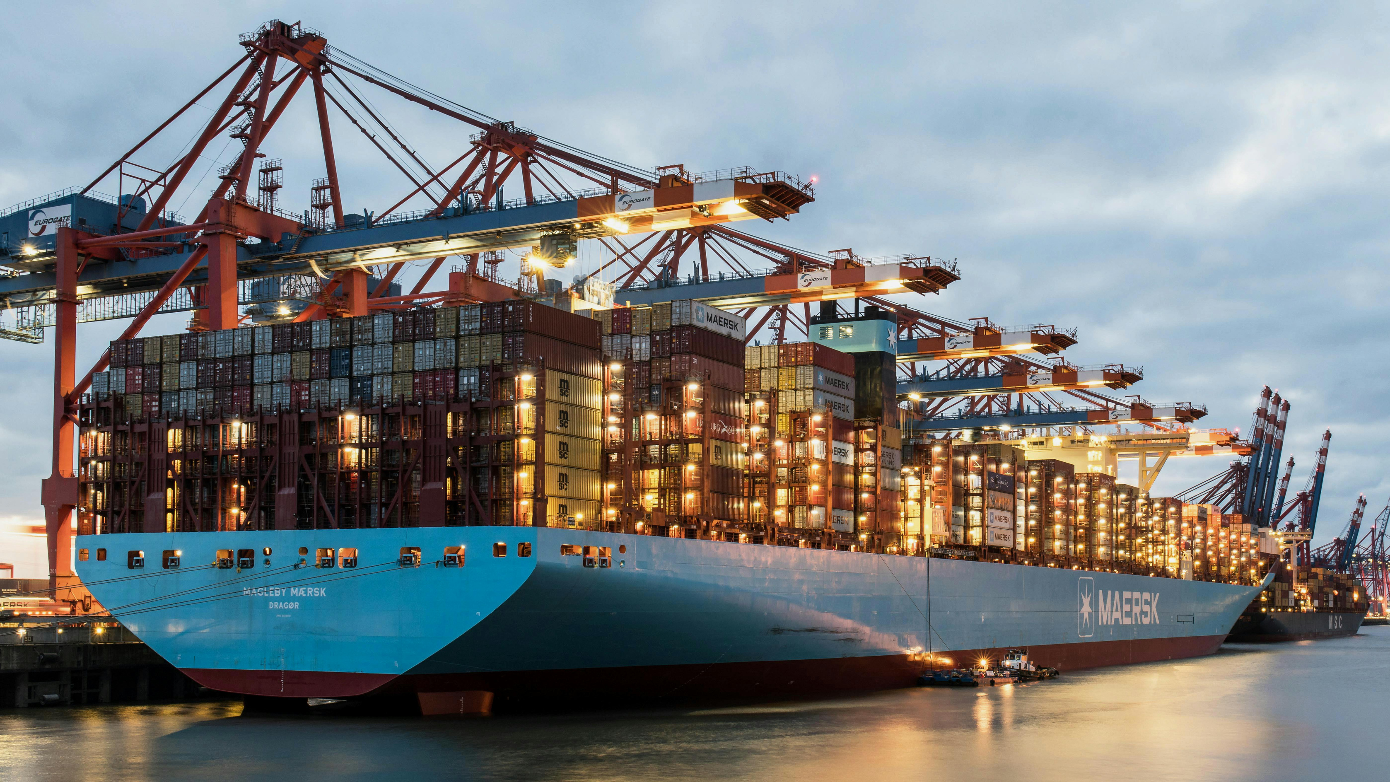

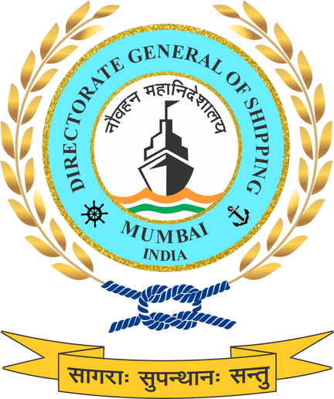

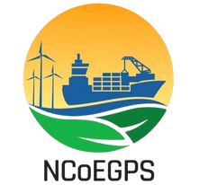
GREEN FINANCE: De – risking Maritime Sustainability
Operationalising Green Finance through lifecycle-aligned standards, risk‑mitigation frameworks, and phased capital deployment under NGSP.

Slide 2
Green Finance – Overview
Working Definition for the Indian Maritime Context
In the context of India’s maritime sector, green finance is being defined as:
“A structured and verifiable financial mechanism—including green bonds, loans, public-private partnerships, and ESG investments—dedicated to the funding of environmentally sustainable maritime projects. This includes projects such as green ship construction, repair and retrofitting, port electrification, clean fuel infrastructure, energy-efficient terminal equipment, and circular economy-driven ship recycling. Green finance in India shall align with international principles (e.g., ICMA Green Bond Principles, IFC Performance Standards, EU Taxonomy, IMO Zero-Net Framework), while being responsive to national sustainability priorities and regulatory frameworks.”
Purpose
Strategic Role in NGSP
To mobilize sustainable investments for activities such as:
Green shipbuilding, retrofitting, and repair facilities
Electrification and renewable energy integration in ports
Development of clean fuel infrastructure
Circular economy initiatives like green ship recycling and waste-to-energy projects
Acts as a core enabler of India’s net-zero 2070 pathway for the maritime sector.
Encourages financial innovation and investor confidence through standardized metrics and certification frameworks.
Connects India’s maritime ecosystem with global green capital markets and sustainable finance mechanisms.

Slide 3
Policy Rationale and Alignment
Regulatory Framework
Compliance with international standards (ICMA, CBI, IFC, ISO) and adaptation under the Indian Securities and Exchange Board (SEBI) ESG disclosure mandates.
Maritime Specific Application
Prioritization of funding for decarbonization of ships, electrification of ports, alternative bunkering infrastructure (e.g., LNG, green hydrogen), and development of R&D in green propulsion systems.
Financial Innovation
Use of blended finance, viability gap funding (VGF), and maritime green finance platforms for de-risking early-stage technologies.
Institutional Anchoring
Development of a National Maritime Green Finance Framework to define eligibility, verification, and impact monitoring protocols.

Slide 4
Proposed Green Finance Instruments
INSTRUMENT | PURPOSE | POTENTIAL ANCHORS
Green Maritime Bonds | Port retrofits, green fuel bunkering, emission digitalization | SMFCL, DVC, State Maritime Boards
ESG Linked Port Finance | Loans with performance based rates | EXIM Bank, SIDBI
Maritime Climate Credit Facility | Advance payments linked to carbon savings | Ministry of Finance
Green MSME Maritime Grants | Credit lines for small scale shipyards, startups | NABARD, NSIC
Blue Economy Impact Funds | Investment in recycling, ecotourism | NIIF, Climate Fund Managers
Sovereign Green Guarantee Scheme | Risk-sharing for first-mover clean fuel projects | MoPSW

Slide 5

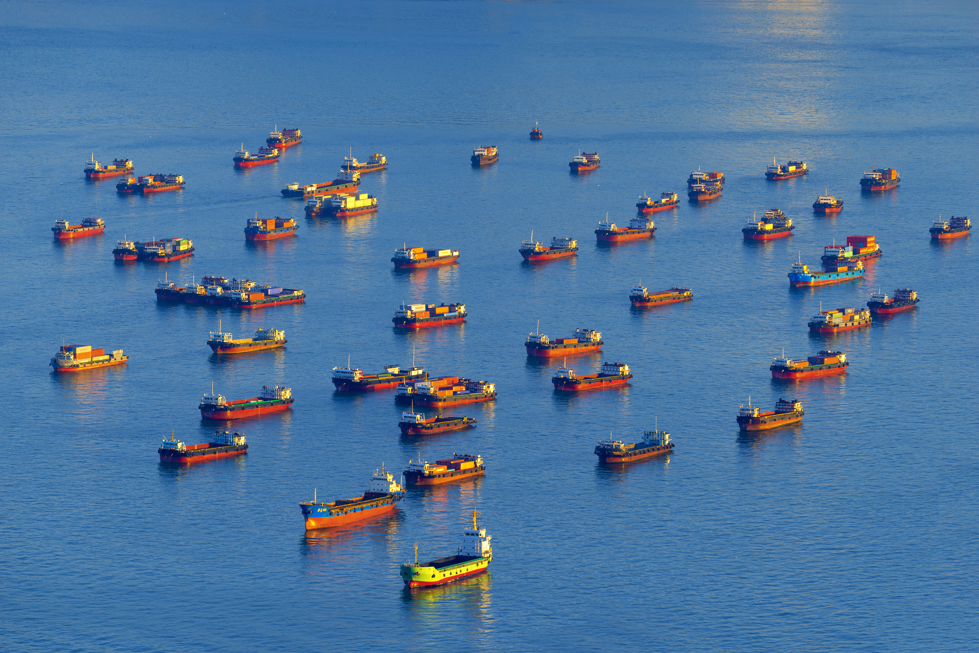
Integration with ESG & Carbon Markets
To scale Green Finance, NGSP proposes a Maritime ESG Taxonomy that:
Defines “green” vs “transitional” vs “brown” activities for finance eligibility.
Aligns with the EU Taxonomy, ICMA Green Bond Principles, and IFC Performance Standards.
Enables classification and tagging of all MoPSW and port projects as per ESG criteria.
In addition, a Maritime Carbon Credit Registry will be developed (linked with MoEFCC) to allow:
Emission offsets from green fuel use, OPS, zero-emission vessels, and ship recycling.
Port-wise GHG reduction accounting under a national MRV framework.
Participation in international offset markets and carbon trading under Article 6 of the Paris Agreement.

Slide 6
Timeline | Key Actions | Outcomes
Short Term (2025-2030) | Operationalize ESG-linked finance via SMFCL; pilot MRV platforms; initiate green bond programs; early-stage blended finance tools | Defined baselines, pilot corridors, green finance ecosystem established
Mid Term (2030-2040) | Expand green fuel hubs (Paradip, VOCPA); mandatory green certification; launch carbon market and ZEPZs; integrate financial taxonomy nationally | System-wide decarbonization and global alignment
Long Term (2040-2047) | Establish India as global green finance hub; export maritime financial models; full integration with international carbon markets | Global competitiveness and domestic innovation leadership

Slide 7

Capacity Building & Institutional Strengthening
Capacity-Building Priorities:
Training port and financial managers on ESG-based project appraisal and blended finance structuring.
Dedicated Public–Private Green Finance Taskforce (banks, IFIs, shipyards, regulators).
Establish Green Finance Centres of Excellence at major ports.
Continuous learning via NCoEGPS and NSDC-supported certification programs.
Outcome: India positioned as a maritime green finance hub in the Indo-Pacific — enabling sustainable capital access and resilient infrastructure growth.

Slide 8
STAKEHOLDER INPUTS REQUIRED ON
3. Monitoring and Reporting, ESG and Bankability
Green finance eligibility under NGSP is linked to MRV, certification, and performance tracking. Will the proposed MRV-linked ESG and Green Compliance frameworks be credible and robust enough for banks, IFIs, and investors to price risk and structure long-tenor maritime finance products?
1. Eligibility & Taxonomy
Are the proposed Maritime ESG Taxonomy and the classification of “green”, “transitional”, and “brown” activities sufficiently granular and aligned with India’s maritime realities to guide lending, public procurement, and capital market instruments without creating regulatory uncertainty for projects such as retrofits, port electrification, and alternative fuels?
4. Carbon Markets & Revenue Streams
NGSP proposes a Maritime Carbon Credit Registry linked to MoEFCC and Article 6 markets, allowing credits from green fuels, zero-emission vessels, ports, and ship recycling. Is this carbon-market architecture realistic in terms of data integrity, verification, and global acceptance, and can it generate bankable revenue streams for Indian maritime projects?
2. De-Risking Early-Stage Technologies
NGSP proposes blended finance, VGF, and public–private green finance platforms to support technologies such as green fuels, zero-emission vessels, and advanced port equipment. Are these risk-mitigation tools adequate to crowd in private capital for first-of-a-kind maritime projects in India, or are additional guarantees, offtake mechanisms, or tariff-based support needed?
5. Institutional & Capacity Readiness
The NGSP relies on SMFCL, ports, financial institutions, etc. capacity building to implement green finance at scale. Do current Indian maritime and financial institutions have sufficient ESG, climate-risk, and project-appraisal capability to operationalise this framework, or is deeper institutional strengthening required before large-scale green capital can flow?

Slide 9
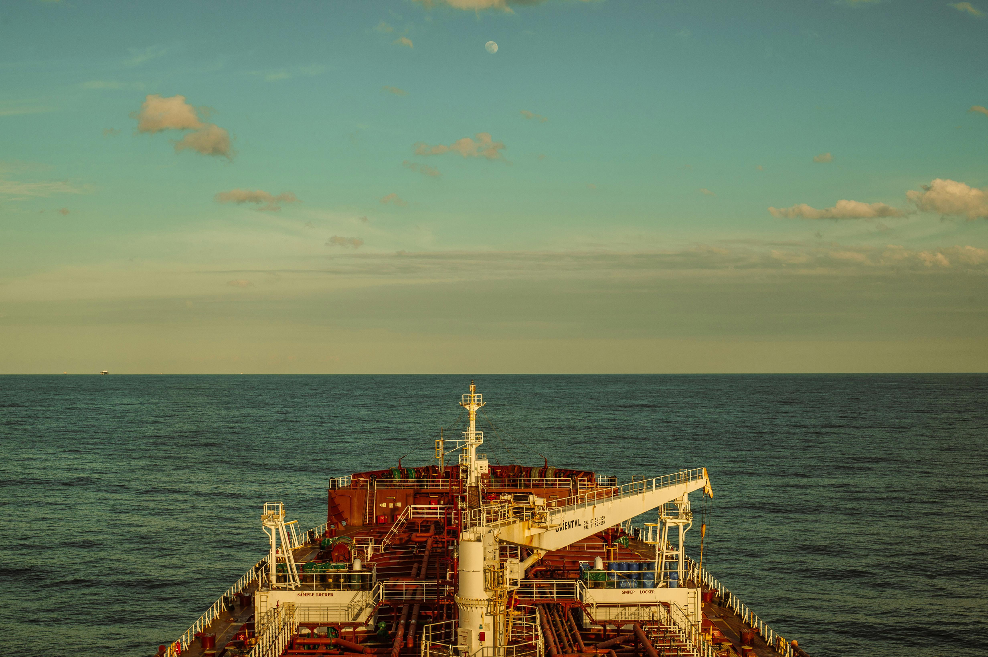
THANK YOU

