Slide 1
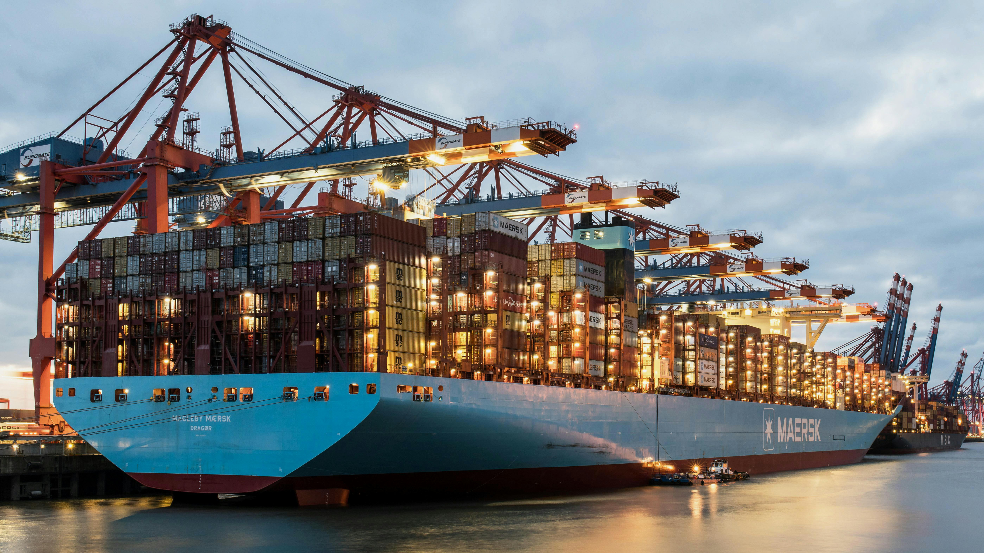

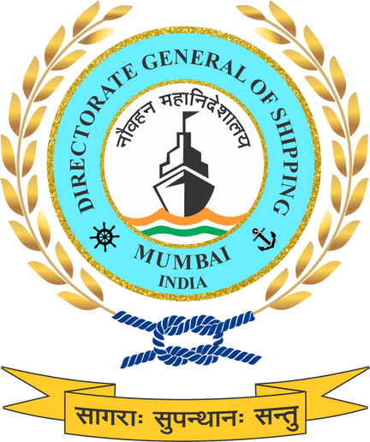


GREEN FUELS & ALTERNATE ENERGY PATHWAYS FOR MARITIME SECTOR
Operationalising fuel transition through lifecycle standards, safety frameworks, and phased deployment under NGSP.

Slide 2
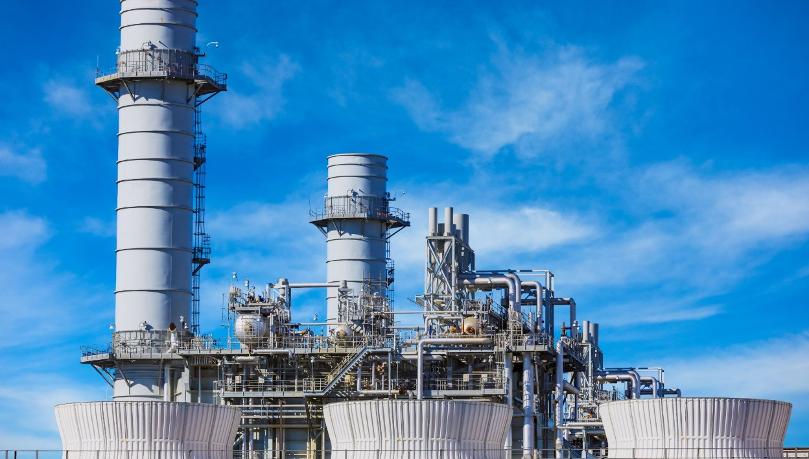

What is Green Fuel?
Working Definition of Green Fuel (As per NGSP)
“Green fuels alternative marine energy sources – such as Biofuels, Green Hydrogen, Green Ammonia, e-methanol, ethanol, renewable LNG etc produced from renewable energy or sustainable biomass using acceptable sustainable practices”.
Key defining elements:
Lifecycle emissions assessment (well-to-wake)
Feedstock sustainability and supply-chain transparency
Compatibility with maritime safety and regulatory standards
Supports the replacement of fossil based Marine fuels
Contributes directly to Harit Sagar and Harit Nauka guidelines
NGSP avoids fuel lock-in and adopts a technology-neutral approach, allowing multiple fuel pathways subject to lifecycle performance.

Slide 3
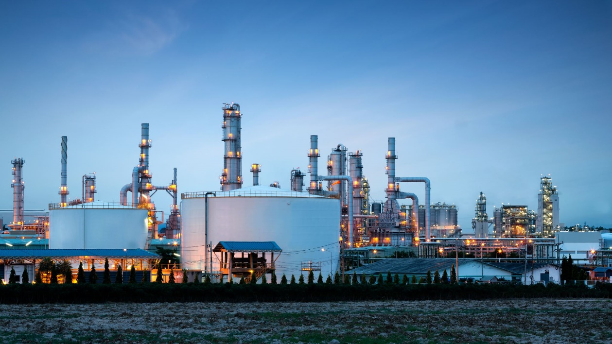
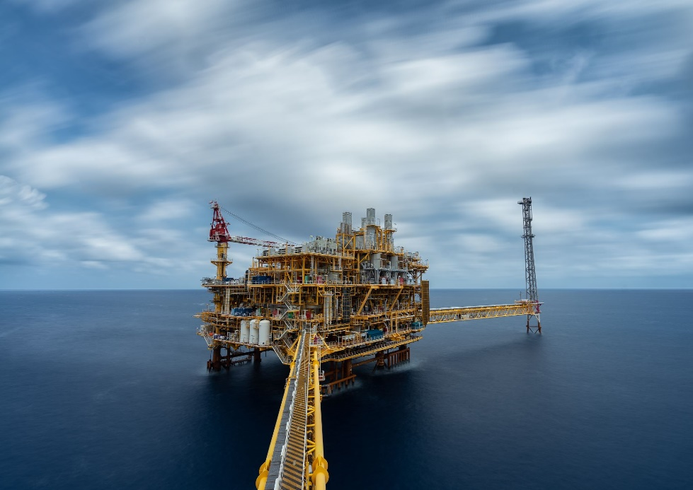
Policy Focus & Scope
NGSP identifies Green Fuels as a core pillar of India’s maritime decarbonisation strategy.
The policy addresses fuel transition across the entire maritime ecosystem, including:
International and domestic shipping
Coastal and inland waterways
Port and terminal operations
Auxiliary and service vessels
Green fuels are addressed not in isolation, but as part of a systems transition, aligned with:
Green Shipping
Green Ports
Green Technology
Green Finance
Green Skills
Fuel transition must be safe, lifecycle-based, technology-neutral, and phased.

Slide 4
Green Fuel Pathways Recognised
NGSP recognises a portfolio approach, including:
Advanced biofuels (including drop-in fuels)
Green methanol
Green ammonia
Green hydrogen
Battery-electric energy (where operationally feasible)
Policy logic:
Different fuels serve different vessel types, routes, and time horizons
Early transition through drop-in and hybrid solutions
Progressive movement toward zero-emission fuels as infrastructure matures
Integration with ports:
Fuel transition is explicitly linked to bunkering readiness, storage safety, and port infrastructure planning.

Slide 5
Green Fuel Transition Phase-wise Plan
Short Term Measures (2025-2030)
Medium Term Measures (2030-2040)
Long Term Measures (2040-2070)
Use of 10 -15 % clean fuel in Coastal & IWT fleet
Pilot deployment of:
Drop-in biofuels
Dual-fuel and fuel-flexible vessels
Development of fuel safety codes and operational guidelines
Initiation of multi-fuel bunkering pilots at selected ports
Integration of fuel data into Monitoring and Reporting systems
Use of 30% clean fuel in Indian Flagged Fleet
Green Fuel hubs expanded at Major and selected non-major ports
Mandatory consideration of fuel flexibility in newbuild standards
Integration of fuel lifecycle emissions into:
Green Ship Certification (Proposed)
Green Port Performance Index
Alignment with national hydrogen and alternative fuel missions
Financial de-risking through green finance instruments linked to fuel performance
Use of 70% clean Fuel across all vessel types
Predominant use of low- and zero-emission fuels across Indian shipping
Full integration of fuel lifecycle accounting into:
National carbon markets
Monitoring and reporting frameworks
Alignment with India’s net-zero by 2070 trajectory
Ports function as energy nodes, supporting shipping, hinterland, and industrial clusters

Slide 6
Implementation, Governance & Skills
Oversight through the National Green Shipping Coordination Cell (NGSCC).
Inclusion of Green fuel Pillar in:
National Green Maritime Implementation Plan (NGMIP)
Monitoring and Reporting systems and Annual Maritime Sustainability Reporting
Capacity building & green skilling:
Fuel handling and safety training
Emergency response and risk management
Lifecycle emissions accounting
Inclusion of MSMEs, coastal operators, and IWT segments
Under NGSP, green fuels are not treated as a standalone intervention, but as a system enabler that connects ships, ports, technology, finance, and skills into a coherent, lifecycle-based maritime decarbonisation pathway.

Slide 7
Questions:
Which aspects of the NGSP green fuel roadmap are most unclear or need more detail?
Do you think the fuel transition targets (10–15% by 2030, 30% by 2040, 70% by 2070) are realistic? If not, what adjustments would you suggest?
Are the proposed financial instruments (Maritime Green Transition Fund, tax holidays, green bonds) sufficient to de-risk investments? What additional incentives would you recommend?
Top three barriers: fuel availability, bunkering safety, crew skills, MRV admin load, capex, finance access. (Rank 1–5)
Should carbon pricing be introduced earlier or later than 2030? Why?
Readiness to become a green-fuel hub (Paradip, Chennai, Kandla, Ennore, Kochi etc
Comment on constraints..?
What improvements are needed in the policy’s approach to multi-fuel bunkering terminals and OPS (Onshore Power Supply)?

Slide 8

THANK YOU

