Slide 1


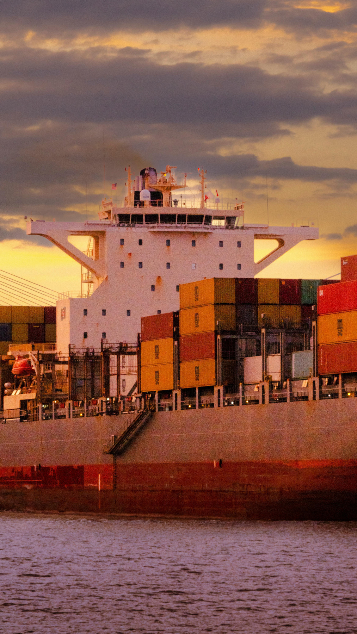


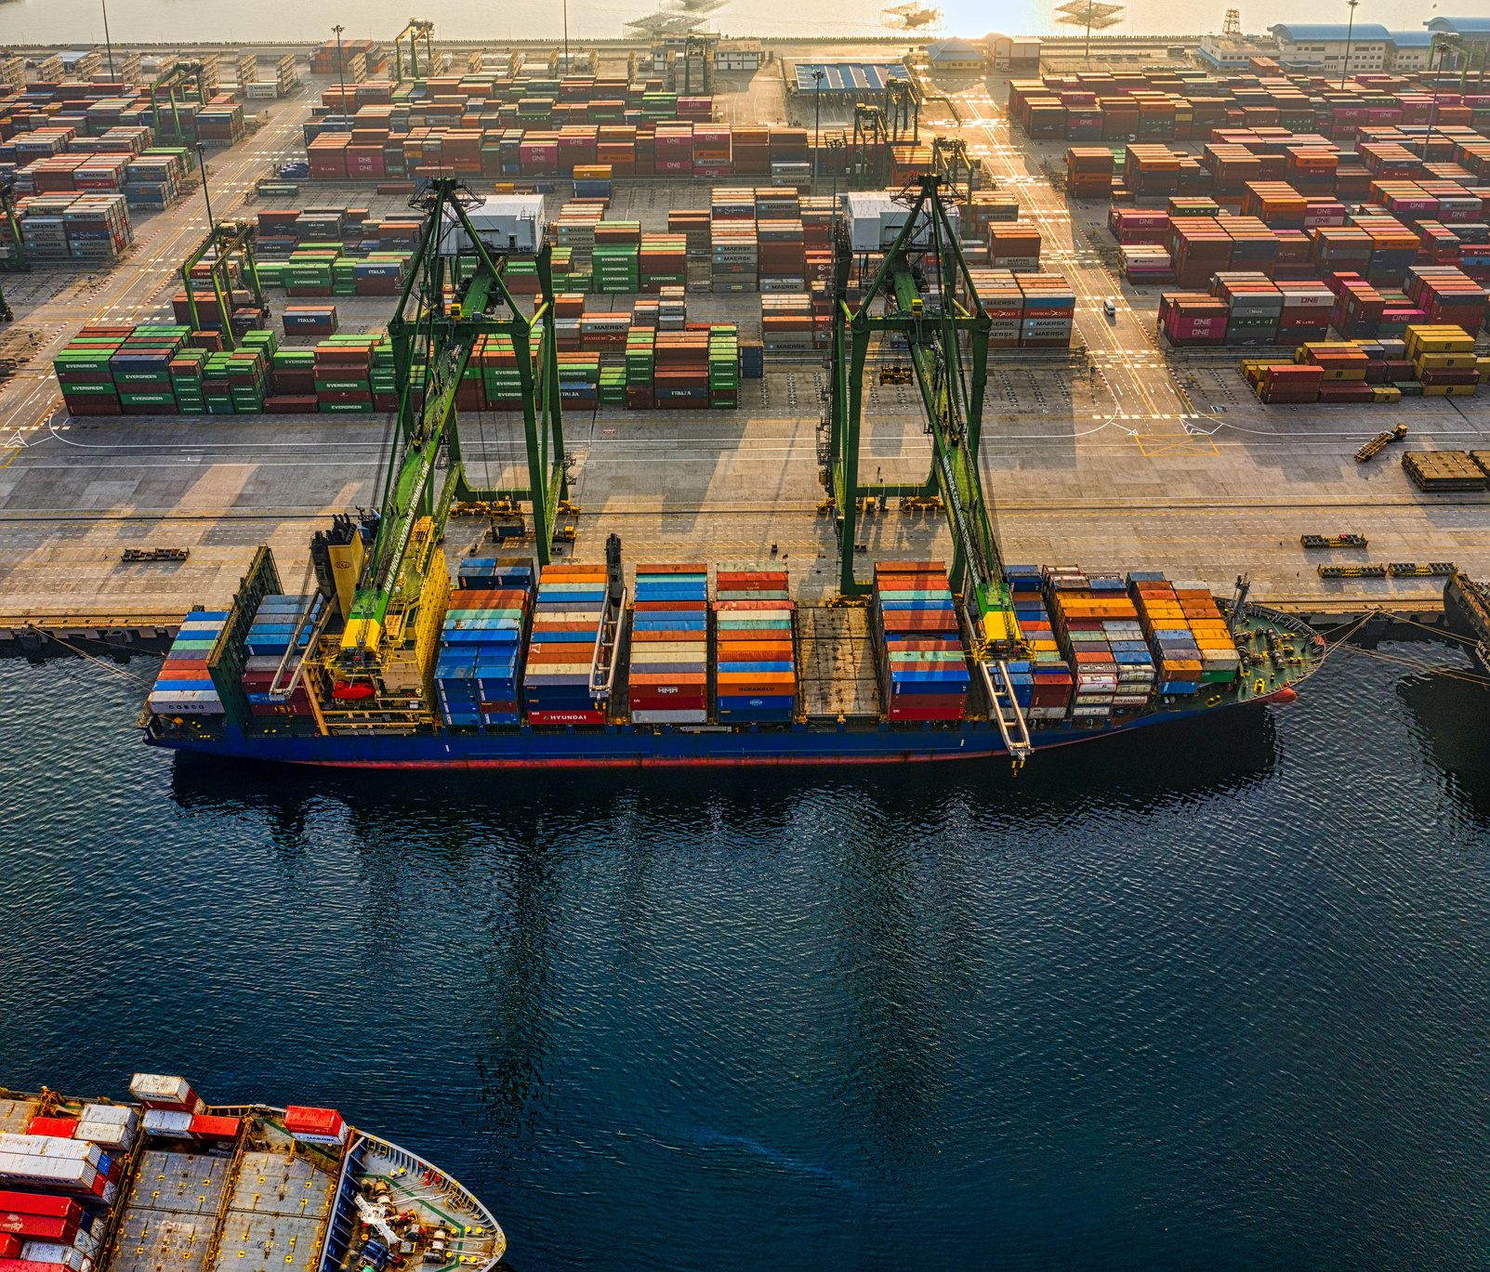
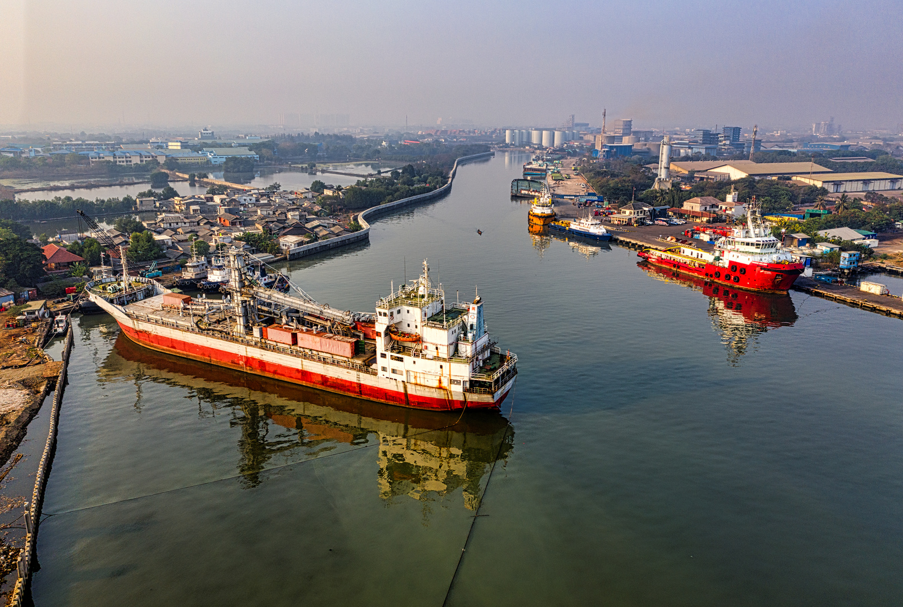
राष्ट्रीय हरित पोत-परिवहन नीति
NATIONAL GREEN SHIPPING POLICY
Green Ports & Port-led Decarbonization
15 Jan 2026

Slide 2




GREEN PORTS IN NGSP: CONTEXT AND RATIONALE
What?
Why ports matter?
Gap
NGSP Logic
Sustainable port governance
Infrastructure
Operations
Emissions at berth
Onshore Power Supply (OPS)
Fuels
Cargo
Logistics
No common baselines
Monitoring, Reporting, and Verification (MRV)
Benchmarks
Targets
MRV
Comparability
Scale

Slide 3
GREEN PORTS PILLAR – STRATEGY AND CORE ENABLERS
Core Enablers
Onshore Power Supply (OPS) Port and terminal electrification Renewable energy integration Green fuel bunkering readiness Digital MRV and energy management Circular resource systems Zero-Emission Port Zones (ZEPZ)
What these enable?
Reduction of vessel and port-side emissions Enablement of fuel transition and clean energy uptake Standardized measurement and benchmarking Readiness for net-zero shipping corridors

Slide 4
GREEN PORTS PILLAR – PHASED TARGETS AND OUTCOMES
Short Term
(to 2030)
OPS at priority berths
Mid Term
(2030-2040)
Full OPS coverage
Long Term
(2040-2047)
Near-zero emission port operations
Port-level emissions baseline and MRV
≥60% renewable energy at major ports
Electrified port operations
Operational green fuel bunkering
Net-zero shipping and logistics corridors

Slide 5
GREEN PORTS PILLAR – IMPLEMENTATION RESPONSIBILITIES UNDER NGSP
Derived from NGSP institutional framework
Policy & Oversight MoPSW
National Coordination & MRV NGSP nodal mechanism
Policy Ownership
Inter-ministerial coordination
MRV frameworks & benchmarks National monitoring and reporting
Technical Support & Capacity NCoEGPS / Centres of Excellence
Technical toolkits, pilot programs, and model frameworks Capacity building, training support, and implementation guidance

Slide 6
GREEN PORTS PILLAR – IMPLEMENTATION RESPONSIBILITIES UNDER NGSP
Derived from NGSP institutional framework
Regulation & Compliance DGS, SPCBs, Standards bodies
Execution Port Authorities & State Maritime Boards
Standards development and certification Compliance oversight and verification
OPS and electrification deployment through appropriate PPPs MRV data submission and project facilitation mechanisms
Including private participation, green finance, and multilateral support, as applicable

Slide 7
INDICATIVE INVESTMENT – BASIS AND SCOPE
Indicative investment of ₹60,000–90,000 crore reflects an order-of-magnitude estimate for enabling port-led decarbonization through phased implementation up to 2047.
What the estimate covers?
Shore power systems and port electrification (berths, terminals, equipment) Renewable energy integration and grid interface upgrades Green fuel bunkering readiness and safety systems Digital MRV, emissions accounting, and energy management systems
Key assumptions
Phased rollout across major and non-major ports based on readiness Differentiated requirements across cargo types and port profiles Blended financing through PPPs, green finance, VGF, and multilateral funding
This is a strategic planning estimate intended to indicate scale, not a project-level cost or budgetary commitment.

Slide 8
CAPACITY BUILDING FOR PORT-LED DECARBONIZATION
Human Capacity
Institutional Capacity
Technical and Operational Capacity
Training for port officials and terminal operators
Strengthening port authorities and state maritime boards
SOPs for OPS, green bunkering, and electrified equipment
Skills in OPS, electrification, green fuels and MRV
Dedicated green port cells and nodal officers
Standard toolkits and safety protocols

Slide 9
CAPACITY BUILDING FOR PORT-LED DECARBONIZATION
Digital and Data Capacity
Emissions accounting and MRV systems
Ecosystem & Inclusion
Engagement of MSMEs and service providers
Integration with NLP-Marine and port MIS
Training of local workforce and communities

Slide 10
STAKEHOLDER INPUTS REQUIRED ON
1
Institutional positioning and mandate for Green Ports under NGSP
Is the proposed positioning of the Green Ports pillar within NGSP, anchored through MoPSW and implemented by ports and State Maritime Boards, adequate to drive coordinated action across shipping, ports, energy, environment, and logistics agencies? Do stakeholders believe the current institutional arrangement provides sufficient authority, clarity of roles, and coordination mechanisms to operationalize port-led decarbonization at scale?
4
Financing pathways and private sector participation
What is the present mode of finance?
Are the proposed financing pathways, including PPPs, green finance, VGF, and multilateral funding, adequate to mobilize private investment for Green Port infrastructure?
What additional incentives, risk-mitigation instruments, or policy signals may be required to crowd in long-term capital and ensure bankability of projects such as OPS and electrification?
2
Scope and standardization of port-level MRV and benchmarking
Is the proposed approach to port-level emissions baselines, Monitoring, Reporting and Verification (MRV), and benchmarking sufficient to ensure data consistency, comparability, and credibility across major, non-major, and inland ports?
What level of standardization versus flexibility should be retained to reflect port diversity while maintaining national coherence?
5
Capacity development and readiness of port institutions
3
What initiatives are being currently carried out by the ports?
Is the proposed approach to capacity building, covering human, technical, institutional, and digital capabilities, sufficient to support sustained implementation of the Green Ports pillar?
Where do stakeholders see the most critical gaps—skills, SOPs, digital systems, or governance—and how should these be prioritized under NGSP?
Phased targets and feasibility of implementation timelines
What is the present level of readiness at the ports?
Are the proposed short-, mid-, and long-term targets for OPS deployment, port electrification, renewable energy integration, and green fuel readiness realistic and implementable across different port categories?
Do stakeholders see risks related to technology readiness, grid availability, or cost escalation that may require recalibration of timelines?

Slide 11

Thank you

