Slide 1
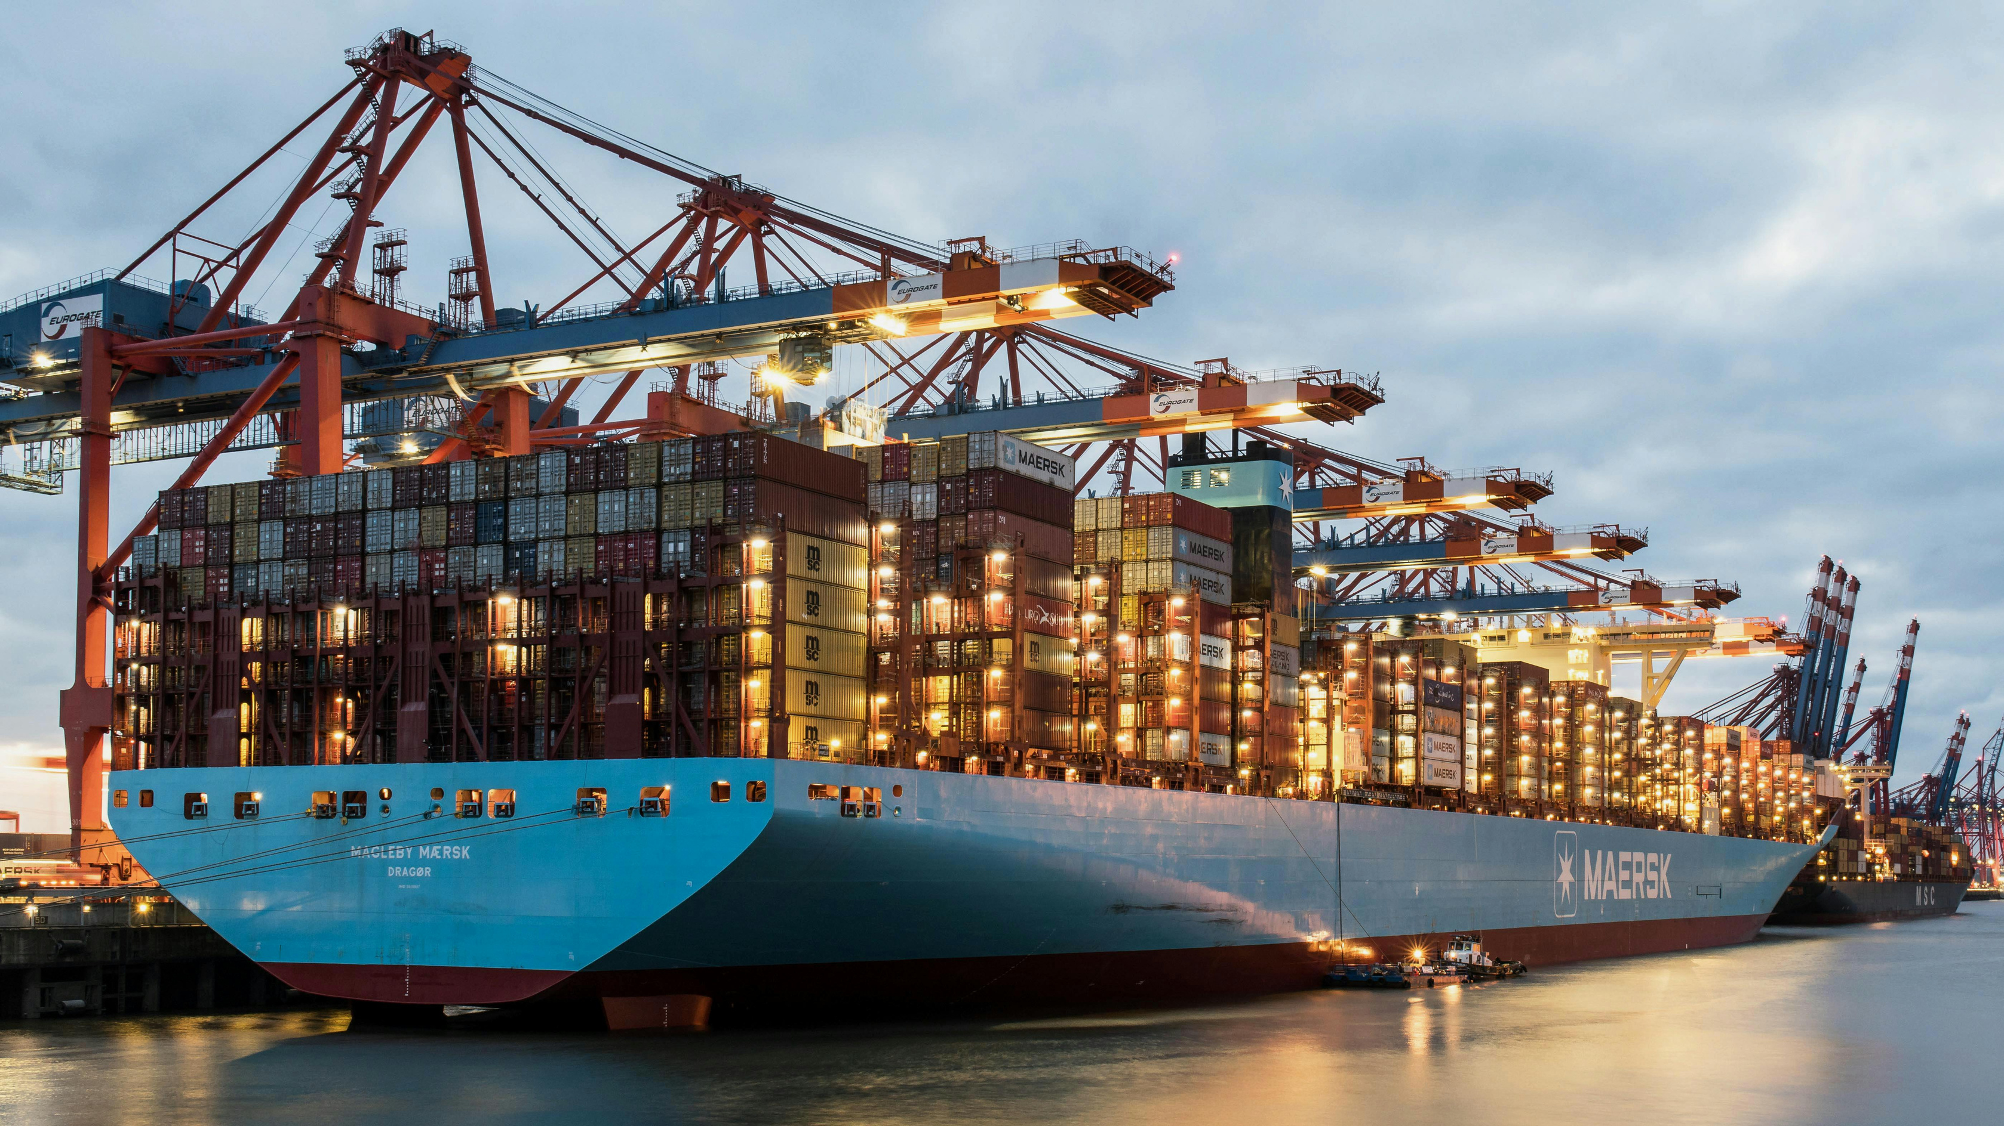

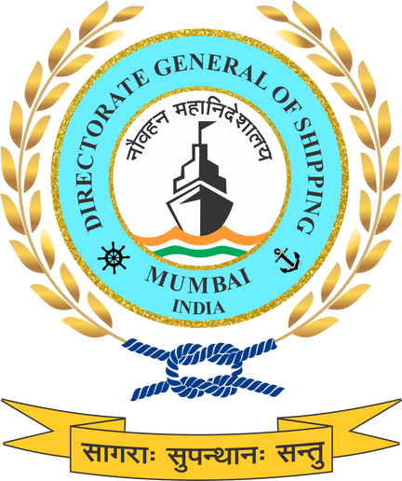


GREEN SHIP RECYCLING & CIRCULAR ECONOMY IN MARITIME ECOSYSTEM
Positioning ship recycling as a critical end-of-life pillar that closes the maritime decarbonisation loop through safety, circularity, and global credibility.

Slide 2















SEVEN GREEN MARITIME PILLARS
01
Green Shipping
Low- and zero-emission vessels, retrofits, lifecycle emissions
02
Green Ports
Renewable energy, OPS, Zero Emission Port Zones (ZEPZs)
Green Ship Recycling
03
Circular economy, worker safety, HKC compliance
Green Finance
04
De-risking investments, unlocking climate finance
05
Green Skill Development & HR
Workforce readiness and inclusion
06
Green Fuels
Domestic production, bunkering, lifecycle standards, GFI
07
Green Technology
Innovation, indigenisation, digitalisation

Slide 3

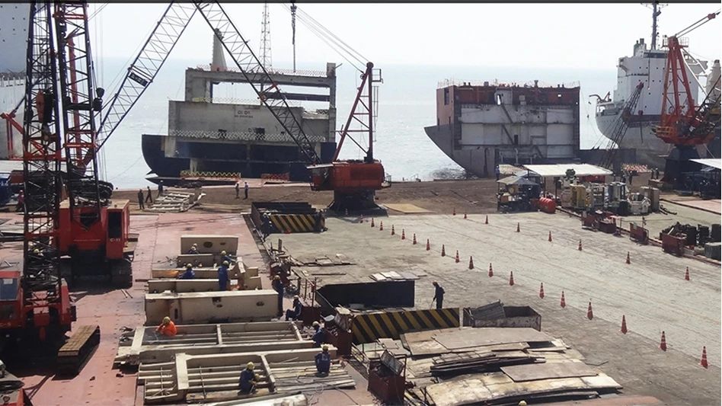
Why Ship Recycling is Central to the Maritime Ecosystem
Ship recycling represents the end-of-life anchor of the maritime lifecycle—linking vessel design, operation, materials recovery, and emissions accountability.
India is a 2nd largest ship recycling hub, making this sector strategically critical for:
  Lifecycle emissions reduction
  Circular economy integration
  ESG credibility of Indian shipping and ship recycling yards in global markets.
Without a structured policy framework, gains made in green ships and green ports risk being offset at end-of-life, creating lifecycle carbon and environmental leakage.
NGSP formally integrates ship recycling into national maritime decarbonization plan, aligning safety, environment, and material recovery outcomes.

Slide 4

Policy Drivers for Ship Recycling in India
NATIONAL POLICY DRIVERS
Maritime Amrit Kaal Vision 2047
Maritime India Vision 2030
The Recycling of Ships Act, 2019
Ship Breaking Code, 2013
Gujarat Maritime Board Ship Recycling Regulations, 2015
INTERNATIONAL POLICY DRIVERS
Hong Kong Convention
EU-SRR
Basel Convention
NGSP extends beyond compliance—embedding ship recycling into a lifecycle framework that connects ship design, operation, and end-of-life management.

Slide 5


NGSP Approach to Green Ship Recycling
A transition from volume-based dismantling to a circular, transparent, and performance-driven recycling ecosystem.
Introduction of a Green Ship Recycling Certification Framework, 1st of its kind that can be used to quantify sustainability in Ship Recycling linked to:
Environmental safeguards
Worker safety and welfare
Hazardous material control
Digital traceability and reporting
Formal alignment with:
Recycling of Ships Act, 2019
Hong Kong International Convention (HKC) (in force from June 2025)
Integration of ship recycling into:
National Monitoring and reporting architecture
Carbon accounting and circular material recovery pathways

Slide 6
Green Ship Recycling Phase-wise Plan
Short Term Measures (2026-2030)
Medium Term Measures (2030-2040)
Long Term Measures (2040-2070)
Phase-wise yard modernization
Strengthening through Insurance and worker welfare mechanisms
Planning and pilot implementation of Green Ship Recycling Certification Framework
Digital onboarding of ship recycling under NLP-Marine architecture for:
  Compliance tracking
  Audit records
  Regulatory oversight
Expansion of Green Ship Recycling Certification with performance-based tiers.
Integration of ship recycling data with Circular economy and material recovery frameworks
Formal linkage between:
  Recycling yards
  Secondary steel rerolling
  Extended Producer Responsibility (EPR) principles
Development of carbon accounting methodologies for:
  Avoided emissions through material recovery
  Lifecycle emissions reduction recognition
Transition to best-in-class green recycling clusters
Zero-discharge systems
Digitally monitored compliance
Advanced material recovery processes
Alignment of ship design, operation, and recycling standards
End-to-end lifecycle decarbonisation
Net-zero consistency by 2070

Slide 7



Governance, Implementation & System Integration
Oversight through the National Green Shipping Coordination Cell (NGSCC).
Inclusion of ship recycling in:
National Green Maritime Implementation Plan (NGMIP)
Monitoring and Reporting systems and Annual Maritime Sustainability Reporting
Strong emphasis on just transition:
Formalization of workforce
Skill development for recyclers and MSMEs
Improved health, safety, and livelihood security
Green ship recycling under NGSP completes the maritime decarbonisation cycle—from green ships to green end-of-life, ensuring India’s maritime growth is sustainable, credible, and globally respected.

Slide 8

THANK YOU

Slide 9
QUESTIONS
How can NGSP better prevent lifecycle leakage, where gains from green ships and green ports are diluted at end-of-life?
Are the proposed certification parameters—environmental safeguards, worker welfare, hazardous material control, and digital reporting—sufficiently measurable and auditable
Are the short-, medium-, and long-term timelines (2026–2070) realistic for yard modernisation, particularly for smaller and mid-sized yards?
Are existing skill development frameworks sufficient for emerging requirements such as hazardous material handling, digital compliance, and environmental monitoring?
How will data integrity, third-party verification, and audit credibility be ensured in digital IHM, SRP, and compliance reporting?
Is India ready to develop credible carbon accounting methodologies for avoided emissions through ship recycling?

