Slide 1
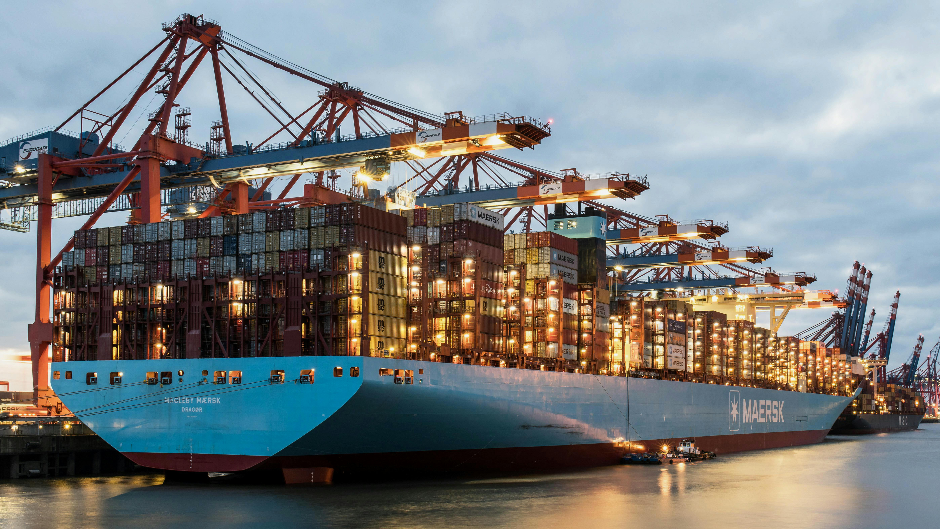

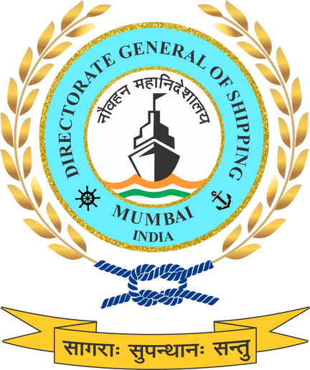


GREEN SHIPS AND GREEN TECHNOLOGY TRANSITION
Operationalising India’s green shipping transition through technology-enabled, standards-driven action.

Slide 2



POLICY FOCUS AND SCOPE
The National Green Shipping Policy (NGSP) 2025 positions Green Shipping and Green Technology as core enablers of India’s maritime decarbonisation pathway.
The policy addresses the entire vessel lifecycle—design, construction, operation, retrofitting, and end-of-life—supported by technology adoption, standards, and institutional mechanisms.
This framework applies across domestic, coastal, inland waterways, and cruise segments, ensuring system-wide alignment

Slide 3

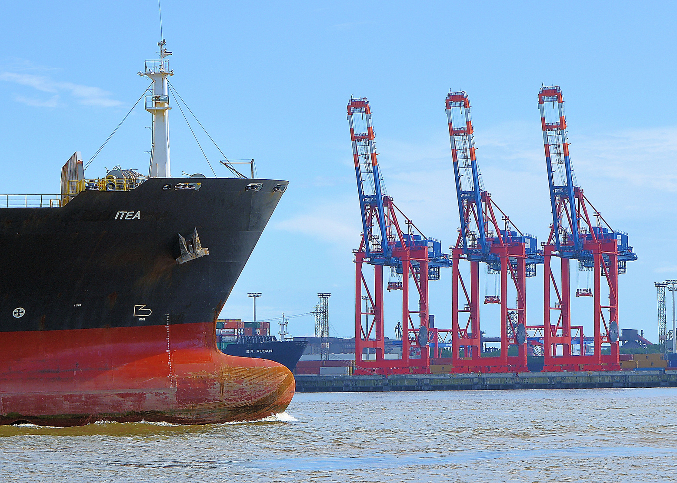



DEFINITION OF A GREEN SHIP & INTERLINKING WITH TECHNOLOGY
Working Definition for the Indian Maritime Context of Green Ship
In alignment with international best practices and tailored to India's technological, regulatory, and operational landscape, a green ship in the Indian context is being defined as:
“A ship that integrates advanced technologies, low- or zero-emission energy systems, and operational best practices to reduce emissions, fuel consumption, and environmental pollution. The ship shall be compliant with applicable national and international regulatory standards and shall contribute toward India’s maritime decarbonization goals. It includes retrofitted ships and newbuilds, operating on low-emission/green fuels/ green technologies.”
Lifecycle thinking is embedded—covering construction emissions, operational performance, and recycling impacts—to avoid carbon leakage

Slide 4
GREEN SHIPPING MEASURES
Short-Term (to 2030)
Medium-Term Measures (2030–2040)
Long-Term Measures (2040–2070)
Establish national Green Ship definitions and certification framework applicable to newbuilds and retrofits
Promote hybrid, electric, dual-fuel, and drop-in fuel solutions, particularly for coastal, inland, and auxiliary vessels
Implement operational efficiency measures including Just-in-Time (JIT) arrivals, voyage optimisation, and digital performance monitoring
Initiate pilot green corridors and demonstration projects for low- and zero-emission vessels
Integrate emissions reporting
Scale deployment of fuel-flexible and low-emission newbuilds aligned with evolving IMO requirements
Strengthen carbon-intensity thresholds for ships through tiered compliance mechanisms
Expand fleet-wide retrofitting programmes supported by green finance and incentive structures
Embed lifecycle emissions accounting into ship certification, registry, and compliance processes
Mainstream green ship standards across domestic, coastal, and inland waterways fleets
Transition towards zero-emission-capable vessels as the default for newbuilds
Achieve system-wide adoption of low- and zero-emission fuels across Indian shipping
Fully integrate advanced digital systems for real-time emissions tracking and compliance
Align national green ship standards with global net-zero shipping pathways
Support a complete lifecycle approach

Slide 5




GREEN TECHNOLOGY: PRIORITY AREAS UNDER NGSP
NGSP identifies green technology as a cross-cutting enabler across shipping and ports.
Priority technologies include:
Hybrid and electric propulsion systems
Hydrogen, methanol and ammonia-ready vessels
Wind- and solar-assisted propulsion
Onboard energy-efficiency and emissions-control systems
AI-based voyage optimisation, digital twins, and real-time emissions monitoring
Emphasis on indigenisation, R&D, and pilot deployments through Centres of Excellence and shipyards.

Slide 6



IMPLEMENTATION & GOVERNANCE LINKAGES
Green Shipping and Green Technology implementation is anchored through:
NGSCC as the central coordination body
DGS for regulation, certification, and compliance
NCoEGPS, IMU, IITs, IRS for technical backstopping and validation
Measures are operationalised through the National Green Maritime Implementation Plan (NGMIP) with phased targets.
Compliance is linked to finance eligibility, port incentives, and public procurement

Slide 7





CAPACITY BUILDING & GREEN SKILLING
NGSP recognises that technology adoption requires parallel workforce transformation.
Targeted skilling areas include:
Alternative fuel handling and safety
Hybrid/electric propulsion maintenance
Digital MRV systems and emissions reporting
Green ship design and retrofit engineering
Implementation through IMU, SCGJ, NSDC, NCoEGPS and regional skill clusters, ensuring inclusion of MSMEs and coastal/IWT operators

Slide 8
STAKEHOLDER INPUTS REQUIRED ON
1. Green Ship Definition & Certification
The NGSP defines a Green Ship based on lifecycle performance, fuel type, and operational efficiency, covering both newbuilds and retrofits across coastal, inland, and cruise segments . Are the proposed definitions and tiered certification frameworks sufficiently clear and implementable for Indian operators, shipyards, and regulators, or do they require further differentiation by vessel type and service segment?
2. Phased Technology Transition Pathway
The NGSP proposes a phased transition—from hybrid, electric, and drop-in fuels in the short term, to fuel-flexible newbuilds in the medium term, and zero-emission-capable fleets in the long term . Is this sequencing technically and commercially realistic for India’s fleet profile, particularly for coastal, inland waterways, and auxiliary vessels, or are additional transition windows needed?
3. Retrofitting vs Newbuild Strategy
The policy embeds retrofitting into the Green Ship framework alongside newbuilds and links both to carbon-intensity thresholds and lifecycle accounting . Does the proposed balance between retrofitting and newbuilds adequately reflect India’s ageing fleet and capital constraints, and are the incentive and finance linkages strong enough to drive uptake?
4. Technology Readiness & Indigenisation
NGSP prioritises hydrogen-, methanol- and ammonia-ready vessels, hybrid propulsion, digital MRV, and indigenisation through shipyards and Centres of Excellence . Are India’s current shipbuilding, repair, and technology ecosystems sufficiently prepared to support this technology roadmap, or should certain technologies be prioritised for domestic scaling first?
5. Governance, Compliance & Market Signals
Implementation is anchored through the NGSCC, and the National Green Maritime Implementation Plan (NGMIP), with compliance linked to finance, port incentives, and public procurement. Will these governance and incentive linkages be strong enough to convert green technology standards into real investment and fleet-level change, or are additional regulatory or fiscal triggers required?

Slide 9

THANK YOU

