Slide 1
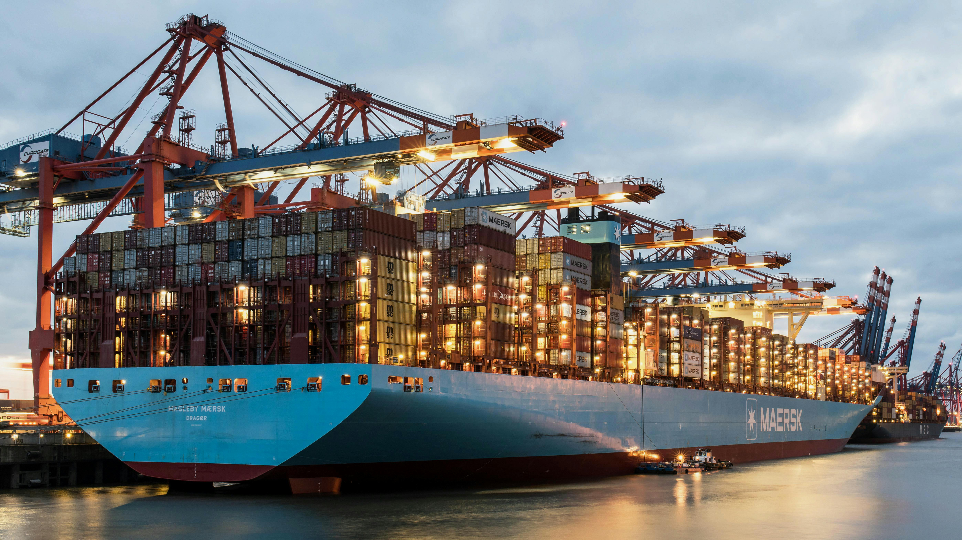
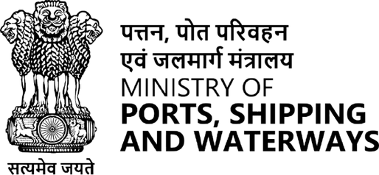
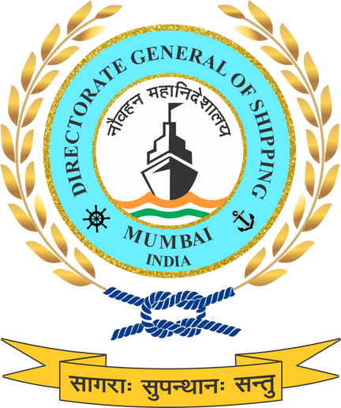

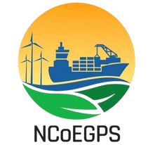
International Maritime Decarbonization Initiatives and Global Collaboration

Slide 2
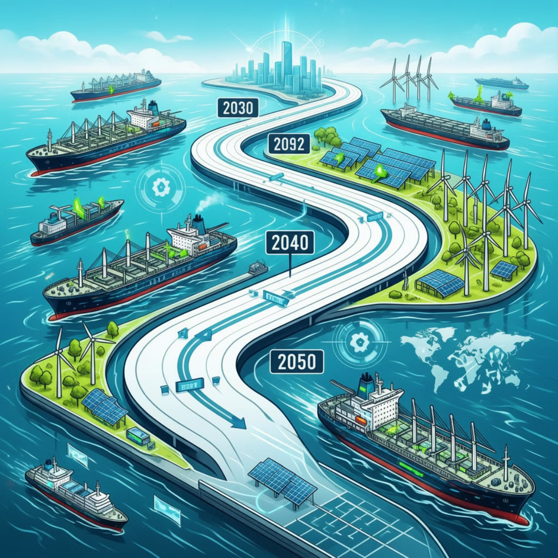
Global Maritime Decarbonization:
IMO Trajectory
The International Maritime Organisation (IMO) has set an ambitious course towards net-zero greenhouse gas emissions from international shipping by or around 2050. This landmark revised 2023 GHG Strategy introduces enhanced interim checkpoints for 2030 and 2040, ensuring progressive action.
A lifecycle (well-to-wake) approach now governs fuels and energy assessments, whilst growing regulatory frameworks, including the Carbon Intensity Indicator (CII), Energy Efficiency Existing Ship Index (EEXI), and forthcoming GHG Fuel Intensity (GFI) standards, are reshaping operational norms.
Achieving these targets demands robust global cooperation, capacity building, and technology transfer across nations.

Slide 3
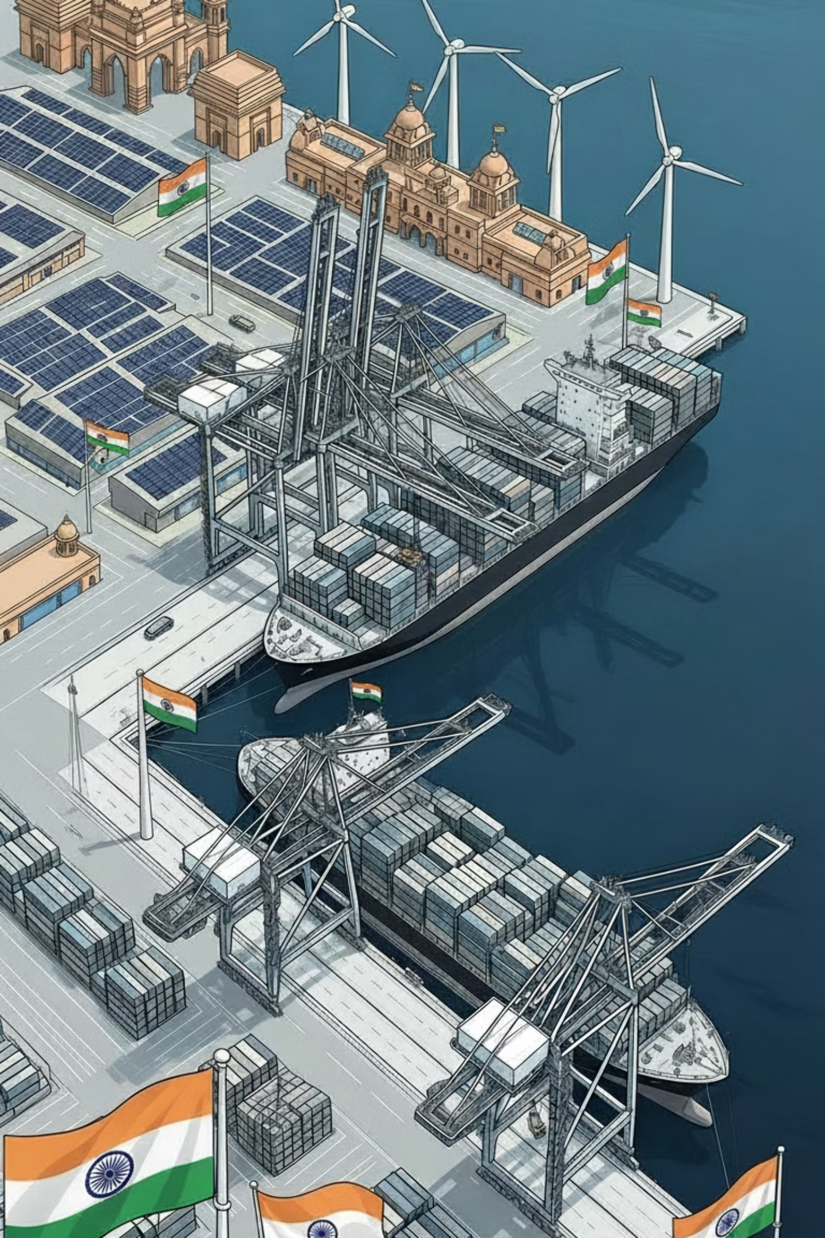




India's Strategic Positioning
Maritime Trade Dominance
India handles approximately 95% of trade by volume through maritime transport, making shipping decarbonization critical to national economic resilience.
Net-Zero Alignment
With our net-zero target set for 2070, calibrated alignment with the IMO 2050 pathway ensures progressive action whilst respecting national development priorities.
Green Infrastructure
Our extensive coastline, expanding port network, and inland waterways present significant decarbonization opportunities, powered by India's strong renewable energy base.
Unifying Framework
The NGSP serves as a comprehensive national framework bridging domestic climate action with global maritime climate goals and international commitments.

Slide 4
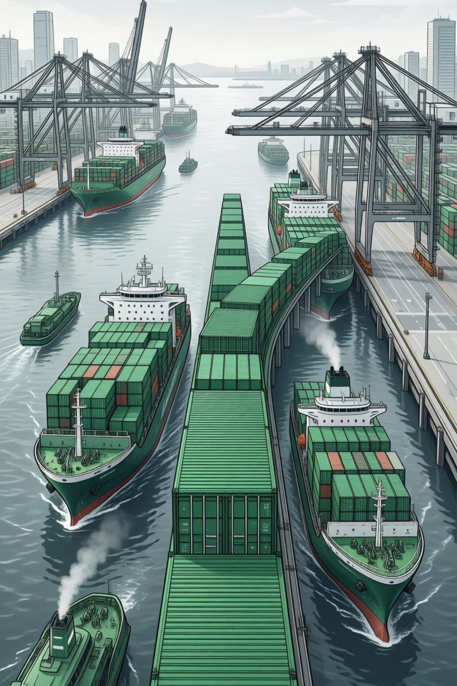
International Green Shipping Initiatives
Green Shipping Corridors
Establishing zero and low-emission maritime routes between key ports, creating pathways for transformative change in international shipping operations.
IMO GreenVoyage2050
India's selection as a pilot lead country positions us at the forefront of global maritime climate action, demonstrating leadership in the Indian Ocean region.
Deployment Platform
Corridors serve as integrated platforms for alternative fuel deployment, port infrastructure readiness, and robust monitoring, reporting, and verification (MRV) systems.
Regional Leadership
Significant opportunities exist for India-led regional corridors across the Indian Ocean, aligned with bilateral and multilateral climate partnerships.

Slide 5
Cooperation, Capacity Building, Inclusivity & Technology Transfer
Strategic Partnerships
Technology Transfer
Capacity Building
Bilateral and multilateral cooperation with IMO, UN agencies, and partner countries to accelerate maritime decarbonization efforts.
Facilitating access to cutting-edge technologies for alternative fuels, onshore power supply (OPS), vessel efficiency, and digital MRV systems.
Comprehensive programmes for ports, shipyards, regulators, and workforce to build technical expertise and operational readiness.
Gender-responsive skilling and leadership development.
Knowledge-Sharing Ecosystem
Inclusive Transition
Establishing Centre of Excellence for maritime innovation
Digital platforms for best practice exchange
Research and development collaboration
Supporting MSMEs in adopting green technologies
Protecting coastal communities and livelihoods
Formalizing and upskilling informal sector

Slide 6
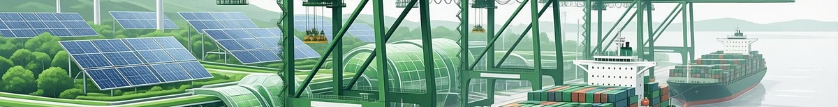




Way Forward: India as a Global Maritime Climate Leader
Operationalising NGSP
Phased implementation with robust monitoring, reporting, and verification frameworks to ensure accountability and progress tracking.
Green Finance Mobilisation
Leveraging international climate funds, green bonds, and innovative financing mechanisms to support maritime decarbonization investments.
Scaling Best Practices
Transforming successful pilots into national standards and regional benchmarks, demonstrating replicable models for other nations.​
Global Hub Positioning
Establishing India as a leading centre for green ship manufacturing, alternative fuel production, maritime skills development, and sustainable shipping innovation.
Contributing to accelerated, inclusive, and equitable maritime decarbonization, securing India's position as a responsible maritime power and climate leader.

Slide 7
Stakeholder Inputs Required on:
1
Most large ports and shipping companies here are already navigating multiple international decarbonization regimes. Where does the draft NGSP need to be clearer to help manage compliance with multiple international requirements?
2
When this policy is taken into international forums or bilateral discussions, it effectively becomes India’s reference document. From your perspective, does the draft project sufficient credibility and seriousness of intent for long-term international collaboration, or are there areas that need strengthening?
3
The draft positions green shipping corridors as a central instrument for international decarbonization. From an implementation standpoint, what additional clarity would be required in the policy to move corridors from a concept to something industry can realistically participate in?
4
International initiatives often fail not on ambition, but on coordination. Does the draft NGSP sufficiently clarify how decision-making, accountability, and coordination will work when Indian stakeholders are part of cross-border decarbonization initiatives?
5
International decarbonization brings new certification, safety, and operational requirements. Does the draft adequately reflect the scale of capacity building required for large fleets and ports, or are there gaps we should address before finalization?

Slide 8
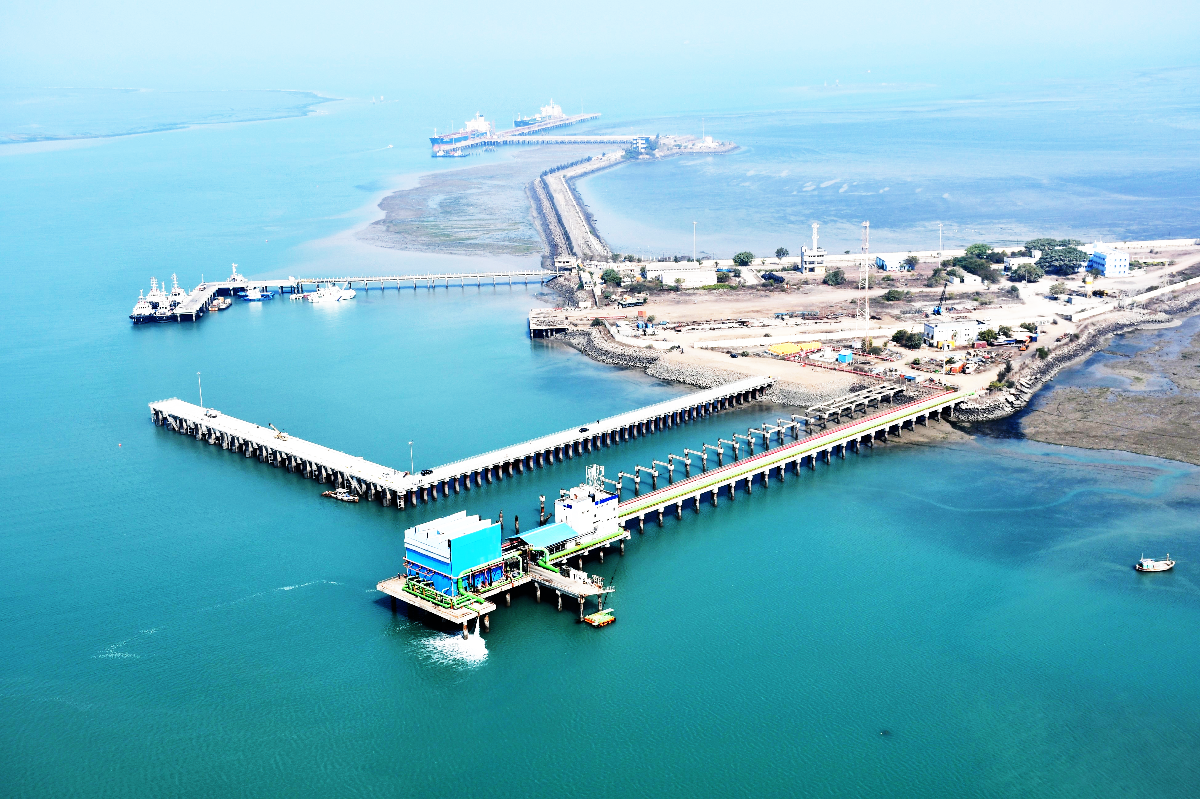

THANK YOU

