Slide 1
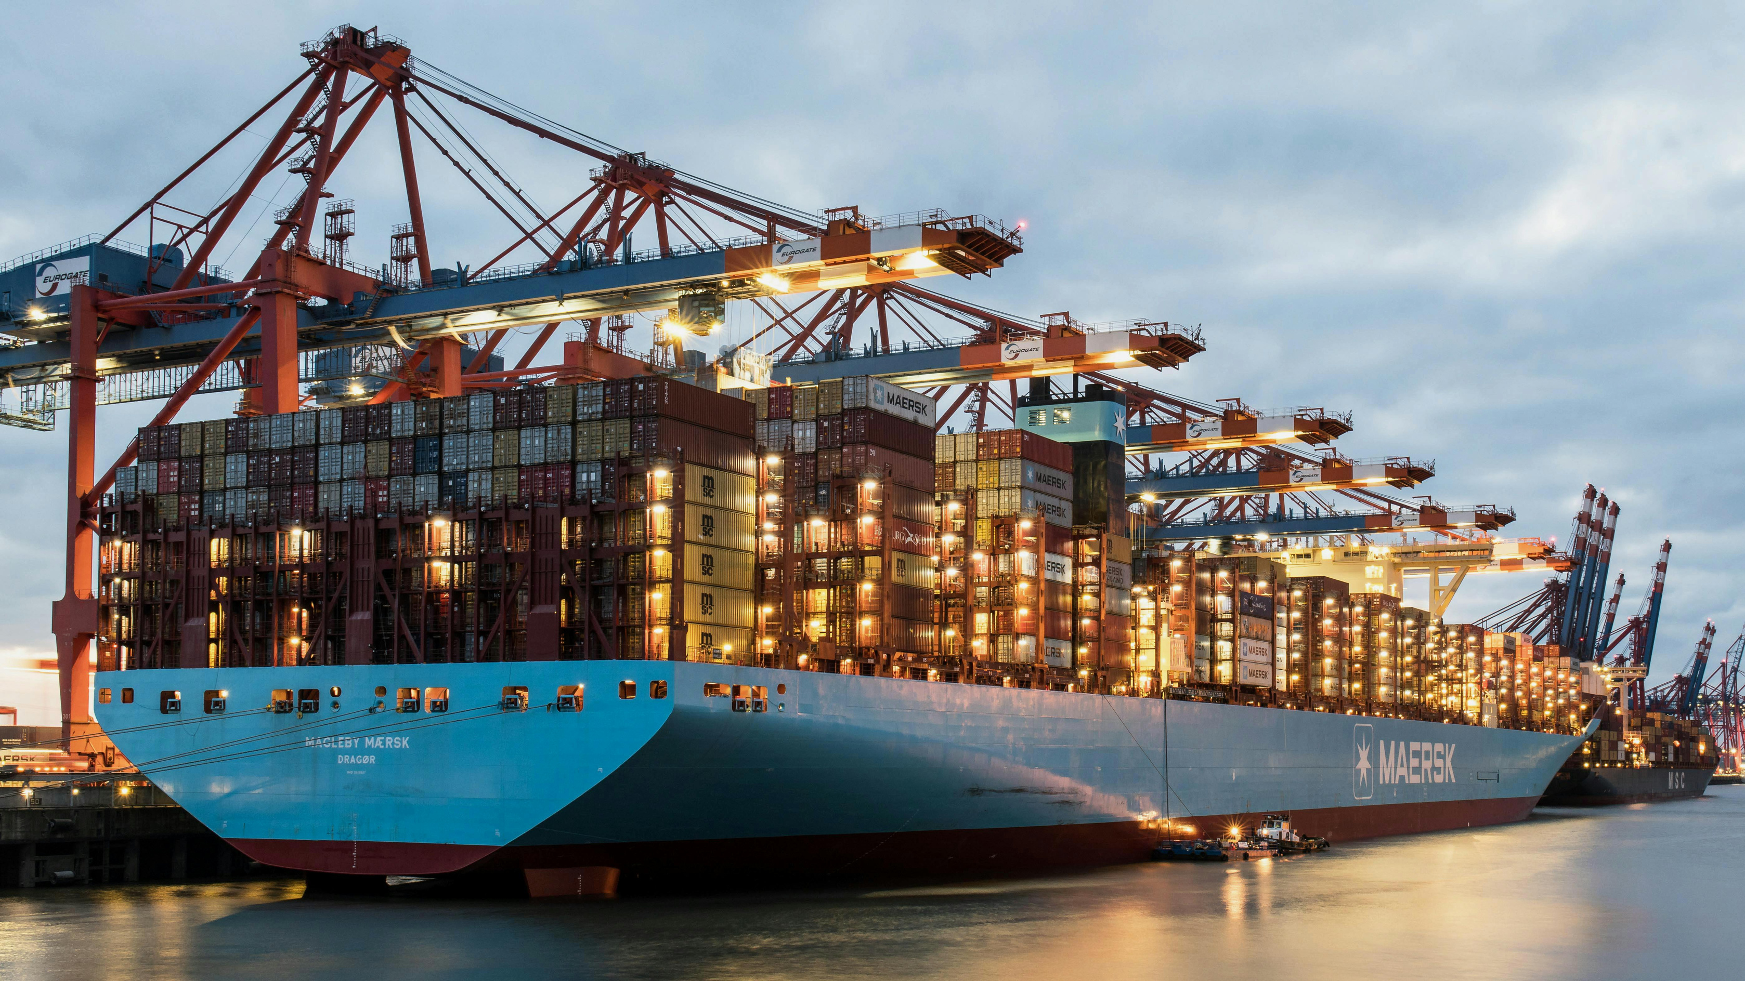
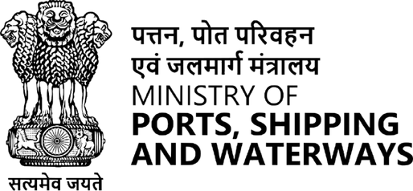
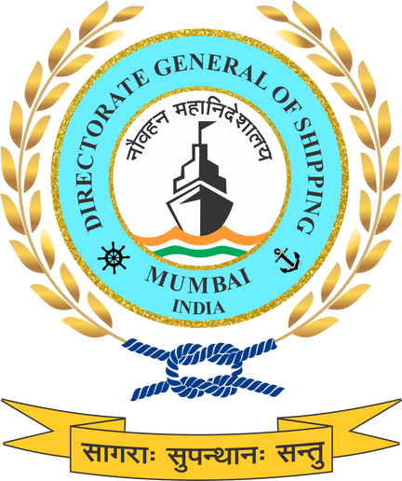

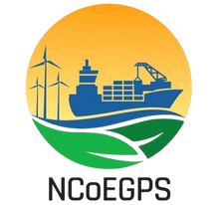
POLLUTION PREVENTION FROM MARITIME ACTIVITIES
Safeguarding Oceans Through Responsible Maritime Operations

Slide 2
TYPES OF MARITIME POLLUTION
Maritime pollution refers to the introduction of harmful substances and energy into the marine environment due to shipping, port operations, and offshore activities.
OIL POLLUTION
AIR EMISSIONS
GARBAGE POLLUTION
SEWAGE AND WASTEWATER
CHEMICAL POLLUTION
UNDERWATER NOISE
ANTI FOULING PAINTS
BALLAST WATER
PLASTIC POLLUTION
With over 90% of global trade carried by sea, unmanaged maritime activities pose serious risks to marine ecosystems, coastal communities, and climate stability.

Slide 3
IMPACTS OF MARITIME POLLUTION
Marine ecosystem degradation & biodiversity loss
Deterioration of coastal air & water quality
Climate change & ocean acidification
Economic risks to ports, fisheries & trade
Compliance & competitiveness risks for India

Slide 4
POLICY FRAMEWORK FOR POLLUTION PREVENTION
Regulatory & Standards Framework
Alignment with IMO conventions (MARPOL I–VI, Ballast Water, HKC)
Operational definitions of Green Ships, Green Ports, and Green Fuels
Phased elevation of emission and pollution limits
Integration with Merchant Shipping legislation & port regulations
Economic & Financial Instruments
Access to green finance for pollution-reduction investments
Incentives for compliant ships and ports (tariff rebates, priority berthing)
Support for retrofitting, clean technologies, and waste management systems
De-risking early adoption through public–private mechanisms

Slide 5
Technology & Infrastructure Measures
Adoption of pollution control systems (OWS, STPs, ballast water treatment)
Port electrification, OPS (cold ironing), and zero-discharge systems
Cleaner propulsion, fuel switching, and energy-efficient ship design
Digital tools for real-time monitoring and optimization
Monitoring, Reporting & Verification
Establishment of national emissions and pollution baselines
Sector-wide Monitoring, Reporting &Verification systems integrated with NLP-Marine
Lifecycle approach covering construction, operation, and recycling
Performance-linked compliance and transparency

Slide 6
Short-Term
(to 2030)
Mid-Term
(2030–2040)
Long-Term
(2040–2070)
Strict enforcement of MARPOL and related IMO conventions
Adoption of energy efficiency measures (EEXI, CII, SEEMP)
Installation and proper operation of pollution control equipment
Use of low-sulphur fuels and drop-in cleaner fuels
Pilot implementation of shore power supply (OPS) at major ports
Strengthening port reception facilities and waste management systems
Establishment of baseline emissions and pollution inventories
Development of Green Ports and Zero-Emission Port Zones (ZEPZs)
Fleet retrofitting for emission reduction technologies
Expansion of alternative fuel infrastructure
Digitized Monitoring, Reporting and Verification systems
Incentive mechanisms for environmentally compliant vessels and ports
Advancement of technologies in waste management and resource efficiency
Integration of pollution prevention across ship lifecycle stages
Transition to zero-emission and near-zero-pollution vessels
Large-scale adoption of green fuels and advanced propulsion systems
Full electrification and de-carbonization of port operations
Circular economy approach in shipbuilding and ship recycling
Alignment with national climate commitments and IMO net-zero.
Establishment of India as a Global Green Maritime Hub

Slide 7
CAPACITY BUILDING & GREEN SKILLING
Creation of a Future-Ready Maritime Workforce
Support for Green Technologies & Innovation
Just Transition for Coastal Communities
Green Skilling for:
Seafarers, Port Officers, Workers, Shipbuilders and recyclers & administrative workforce
Adoption of Alternate Fuels and Propulsion Systems
Operation and maintenance of pollution-control technologies
Digital monitoring & controlling
Workforce training and upskilling.
Coastal and port-dependent communities gain access to new green jobs
MSMEs and informal maritime sectors are integrated into the transition
Institutional Strengthening & Knowledge Ecosystem
Enhanced Global Competitiveness
Enabling Effective Policy Delivery
NGSP proposes:
Center of Excellence
Partnerships with maritime training institutes, academia, and industry
Green competency frameworks
Enhance the international credibility of Indian ports, ships, and workforce
Create global hub for green maritime services
Improve compliance with evolving IMO
Effective implementation of:
NGSP measures
Data-driven monitoring, reporting, and verification
Governance

Slide 8
STAKEHOLDER INPUTS REQUIRED ON
3. MRV, Digitalisation and Transparency
NGSP proposes sector-wide Monitoring integrated with NLP-Marine or similar digital platform, digitised reporting, and performance-linked incentives for compliant ships and ports Pollution Prevention.
Will the proposed MRV and digital reporting systems be robust and granular enough to capture pollution from ships, ports, inland waterways, and cruise terminals in a credible and enforceable way?
1. From Convention Compliance to National Enforcement
NGSP aligns India’s maritime pollution control with IMO conventions (MARPOL I–VI, Ballast Water, Hong Kong Convention) and proposes performance-linked compliance through national MRV and certification systems Pollution Prevention.
Do India’s existing inspection systems, Port State Control regime, and port-level enforcement mechanisms provide a sufficient foundation to move from convention-driven compliance to measurable, performance-based environmental management across major ports, non-major ports, and inland terminals — and if not, what regulatory, institutional, or capacity enhancements are required?
4. Infrastructure Readiness for Waste, OPS and Clean Operations
Are all India’s ports—particularly non-major ports and inland waterway terminals—adequately equipped and financed to implement NGSP-mandated pollution-control infrastructure such as port reception facilities? Further, have any shipowners reported, through IMO’s GISIS, cases where Indian ports were unable to accept MARPOL-defined garbage or other waste streams?
2. Lifecycle Pollution Management
The NGSP and this session adopt a lifecycle approach—covering ship construction, operation, and recycling—and link pollution prevention to Green Ship, Green Port and Green Recycling standards Pollution Prevention.
Can Indian shipyards, ports, and recycling yards realistically implement this lifecycle-based pollution accountability, or are additional regulatory and technical support mechanisms required?
5. Skills, Compliance and Just Transition
NGSP embeds green skilling, just transition, and MSME inclusion in pollution-control operations—from OWS and ballast systems to digital monitoring and waste management Pollution Prevention.
Is India’s current maritime workforce, training ecosystem, and MSME base ready to meet these pollution-control and compliance requirements, or does NGSP need stronger capacity-building and transition support?

Slide 9
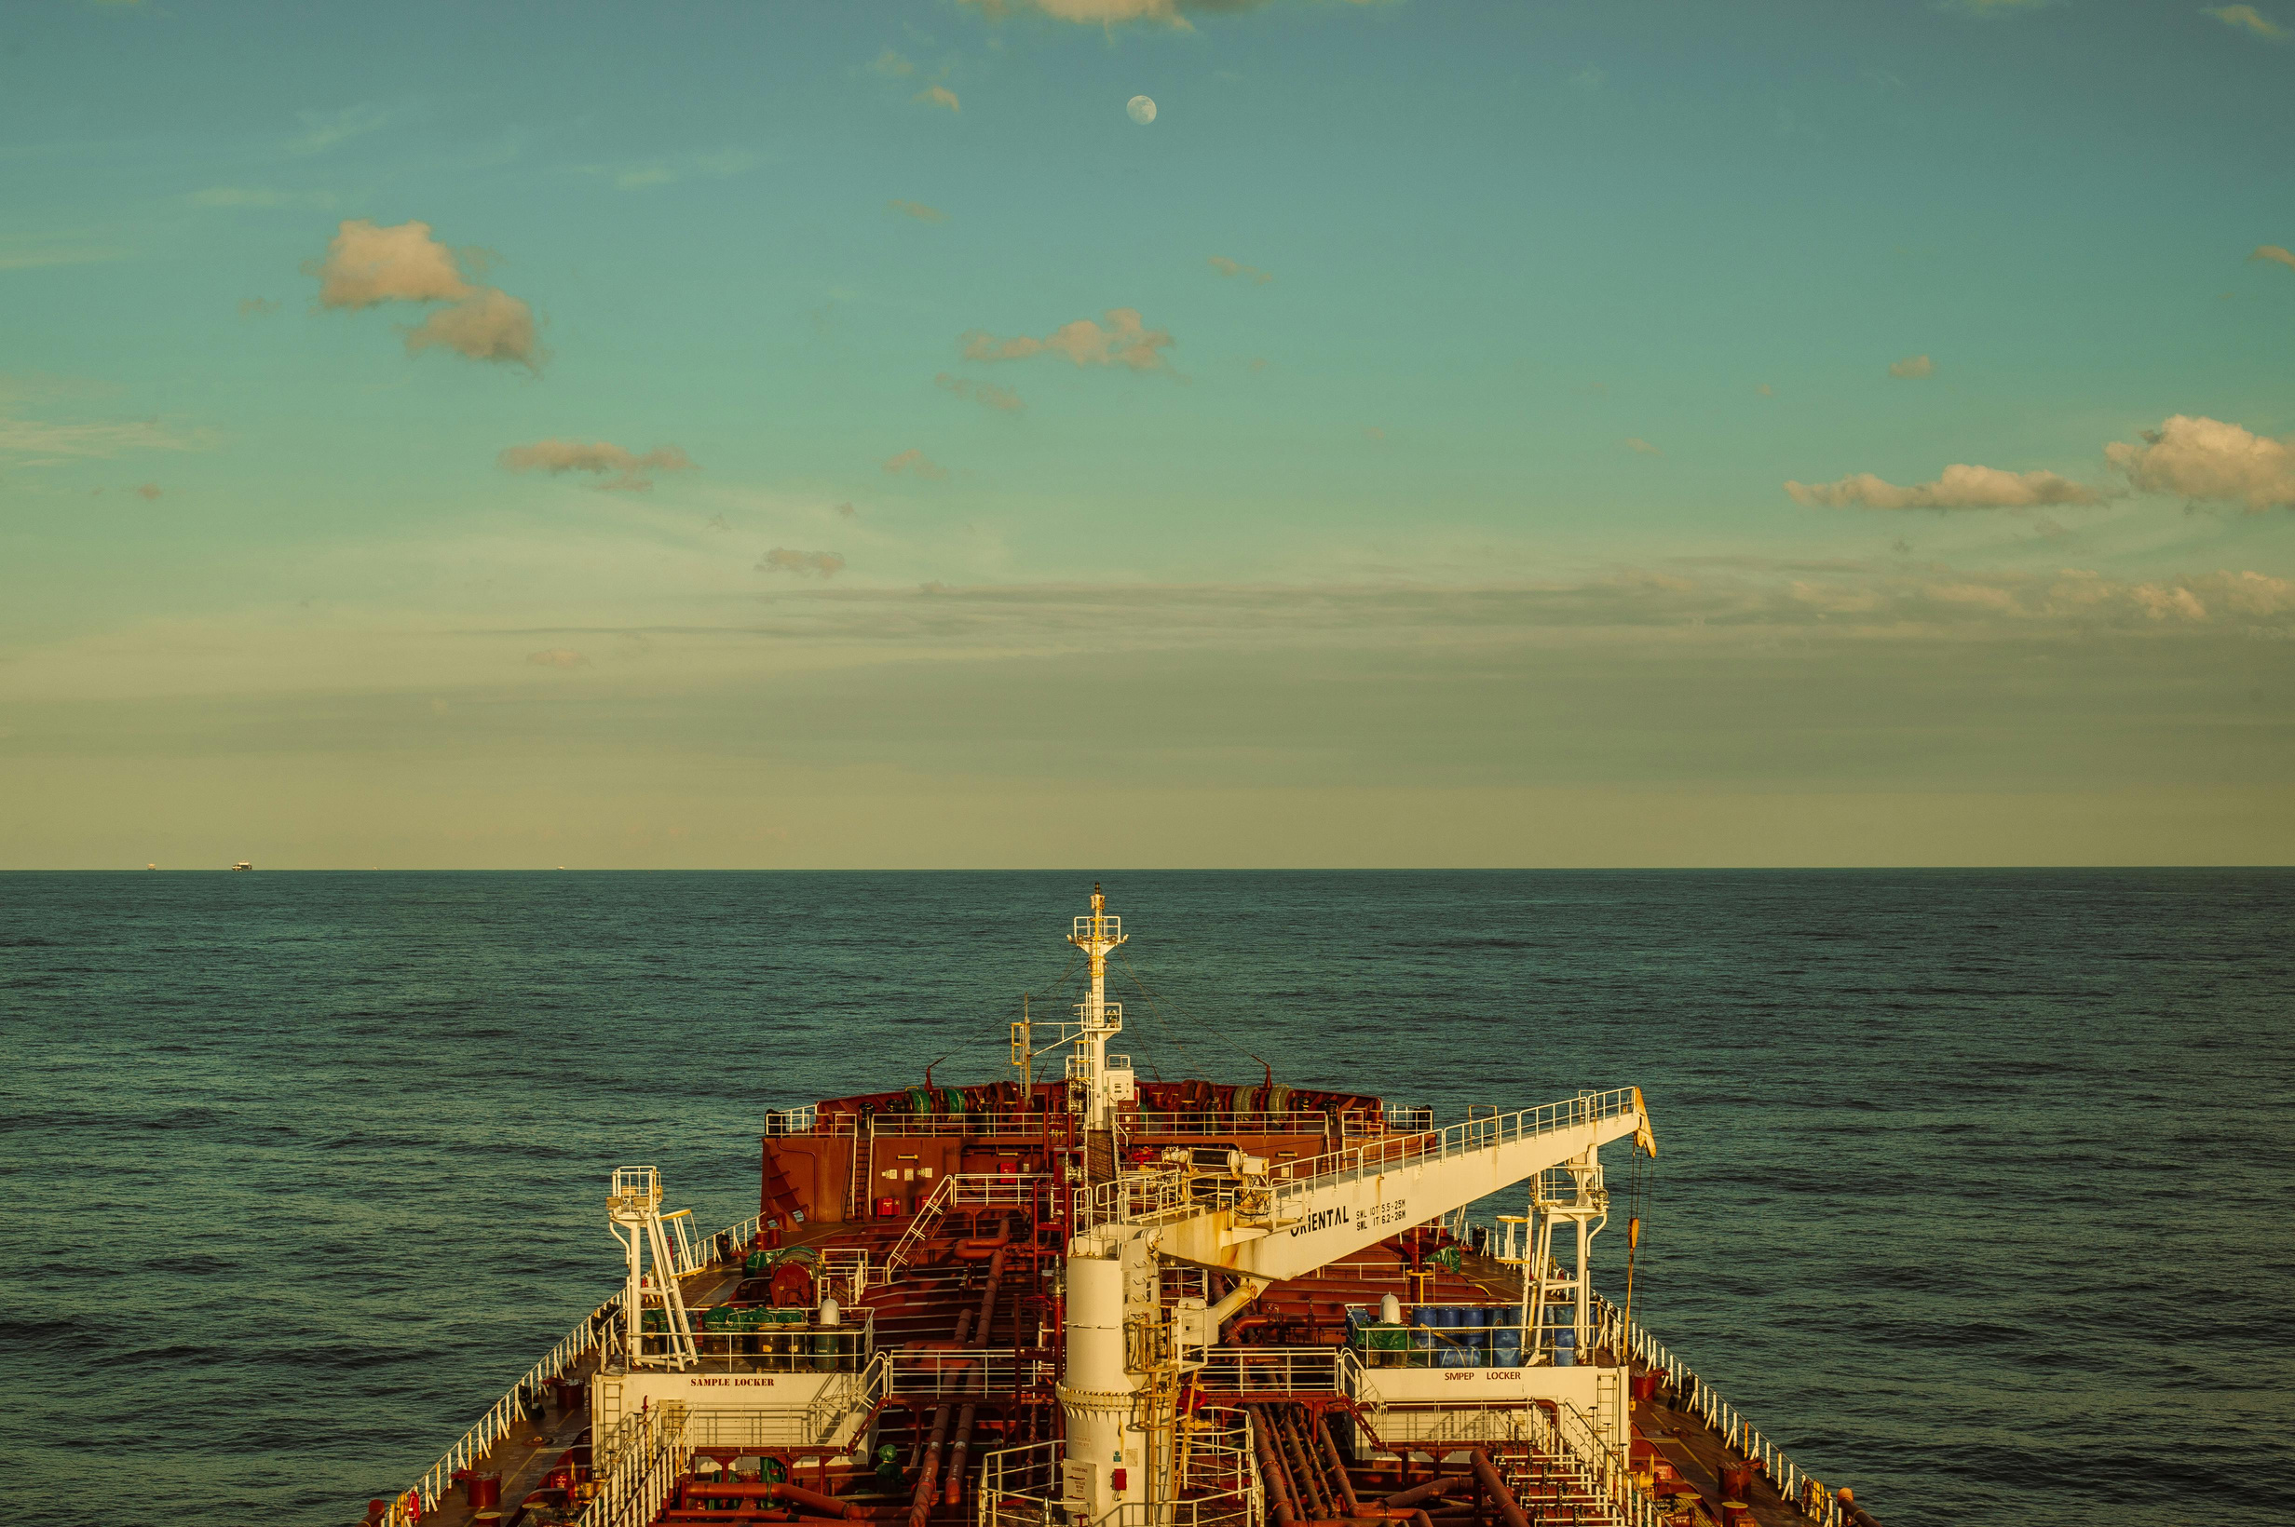
THANK YOU

