Slide 1


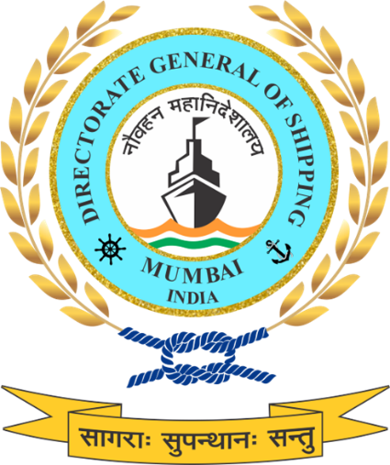
INDIA @ Net Zero
National Green Shipping Policy (NGSP) – Multi-
Ministerial Action Plan & Governance Workshop
Session 2: Green Recycling & Circular Economy in Maritime
14-15 January 2026| India Habitat Centre, New Delhi

Slide 2
Green Shipping Initiatives
Structured Roadmap for decarbonization
NGSP
NPSC metrics include Green Port Index (GPI), Port Readiness Level (PRL), Smart Port Shore Power Index (SPSPI), Environmental Ship Index (ESI), and GHG Emissions Inventory to benchmark sustainability and readiness of Indian ports
National Port Sustainability Council (NPSC)
Alternate Fuel Transition
Guidelines for LNG, Biofuels, Methanol, Ammonia
Green Shipping
Ship Recycling
Sustainability Indexing of Ships
Structure to rate ships on their environmental performance, linked to age norms.
With the Hong Kong Convention now in force, India leads globally with 115 compliant yards at Alang.
Shore Power (OPS))
Use of clean shore electricity by ships while berthed at port, reducing fuel combustion & emissions.

Slide 3

Ship Recycling
Process of dismantling end-of-life ships to recover steel and other valuable materials.
India is a global leader, with Alang–Sosiya in Gujarat being the world’s largest ship recycling cluster.
Governed internationally by the Hong Kong Convention (HKC), which came into force on 26 June 2025.
Integral to the circular economy, reducing the demand for virgin raw materials.
India’s Role & Importance
Handles 30% - 35% of global ship recycling tonnage annually.
Provides 20 - 25% of India’s ferrous scrap requirement, reducing dependence on imports.
India is the only country with 115+ HKC Compliant Recycling Yards.
Supplies input material for the Green Steel ecosystem, boosting India’s low-carbon transition.
Generates direct employment for 15000+ workers and indirect livelihood opportunities for thousands more in logistics, scrap processing, and allied services.
Strengthens India’s position in global maritime sustainability.

Slide 4





Objectives of the Session
Yard Modernization
Compliance
Circular Economy
Workers Welfare
Digitalization
Indicative action points related to
Regulatory compliance
Operational practices
Phased infrastructure upgrades
Adoption of relevant ISO management system standards
Effective governance of Inventory of Hazardous Materials (IHM) implementation
Environmentally sound waste management practices
Integration of ship recycling activities with CE.
Green steel value chains
Workforce safety trainings
Skill development trainings for workers
Medical facilities
Establishment of
Ship Recycling Transparency and Reporting System
(SRTRS)
Digital MRV and certification systems

Slide 5
Strategic Priorities under NGSP
Yard Modernisation
Green Ship Recycling Compliance Tiers (GSRC-Tiers): For all registered recycling facilities based on their adherence to HKC/EUSRR protocols, occupational safety standards, and environmental safeguards
Technology Modernization and Infrastructure Support: Promote technology in dismantling, AI-based waste sorting, emission control systems, common smelting facility and Pay-per-Use advanced equipment
Utilisation of the Ferrous Scrap Development Fund (FSDF) : Allocation of FSDF grants/loans for upgrading shipbreaking yards, funding R&D .
Digitalization
Ship Recycling Transparency and Reporting System (SRTRS): Mandatory reporting platform to track hazardous waste flows, worker safety practices, and carbon intensity. Real-time monitoring via IoT sensors, blockchain-based IHM tracking
Digital Sustainability certificates: For each recycled ship, covering IHM removal, waste handling, and material recovery efficiency aligned with ESG reporting norms and enabling access to Green Finance Instruments
Trainings and worker welfare
National-level training module: Introduced under Green Skills pillar, building competencies in safe cutting techniques, hazardous waste handling and spill prevention
Worker Welfare : Safety records ,mitigation of occupational hazard , medical facilities, insurance and welfare funds for ship recycling yard workers.
Carbon Registry & Circular economy
Circular Economy and Green Steel Linkages: Recovery loops, supported by guidelines on safe rerolling and EPR-based traceability for select machinery/components (e.g., engines, pumps, compressors, valves etc.)
Ship Recycling Carbon Accounting & Reduction Program: Dedicated carbon accounting and reduction framework for the ship recycling sector

Slide 6
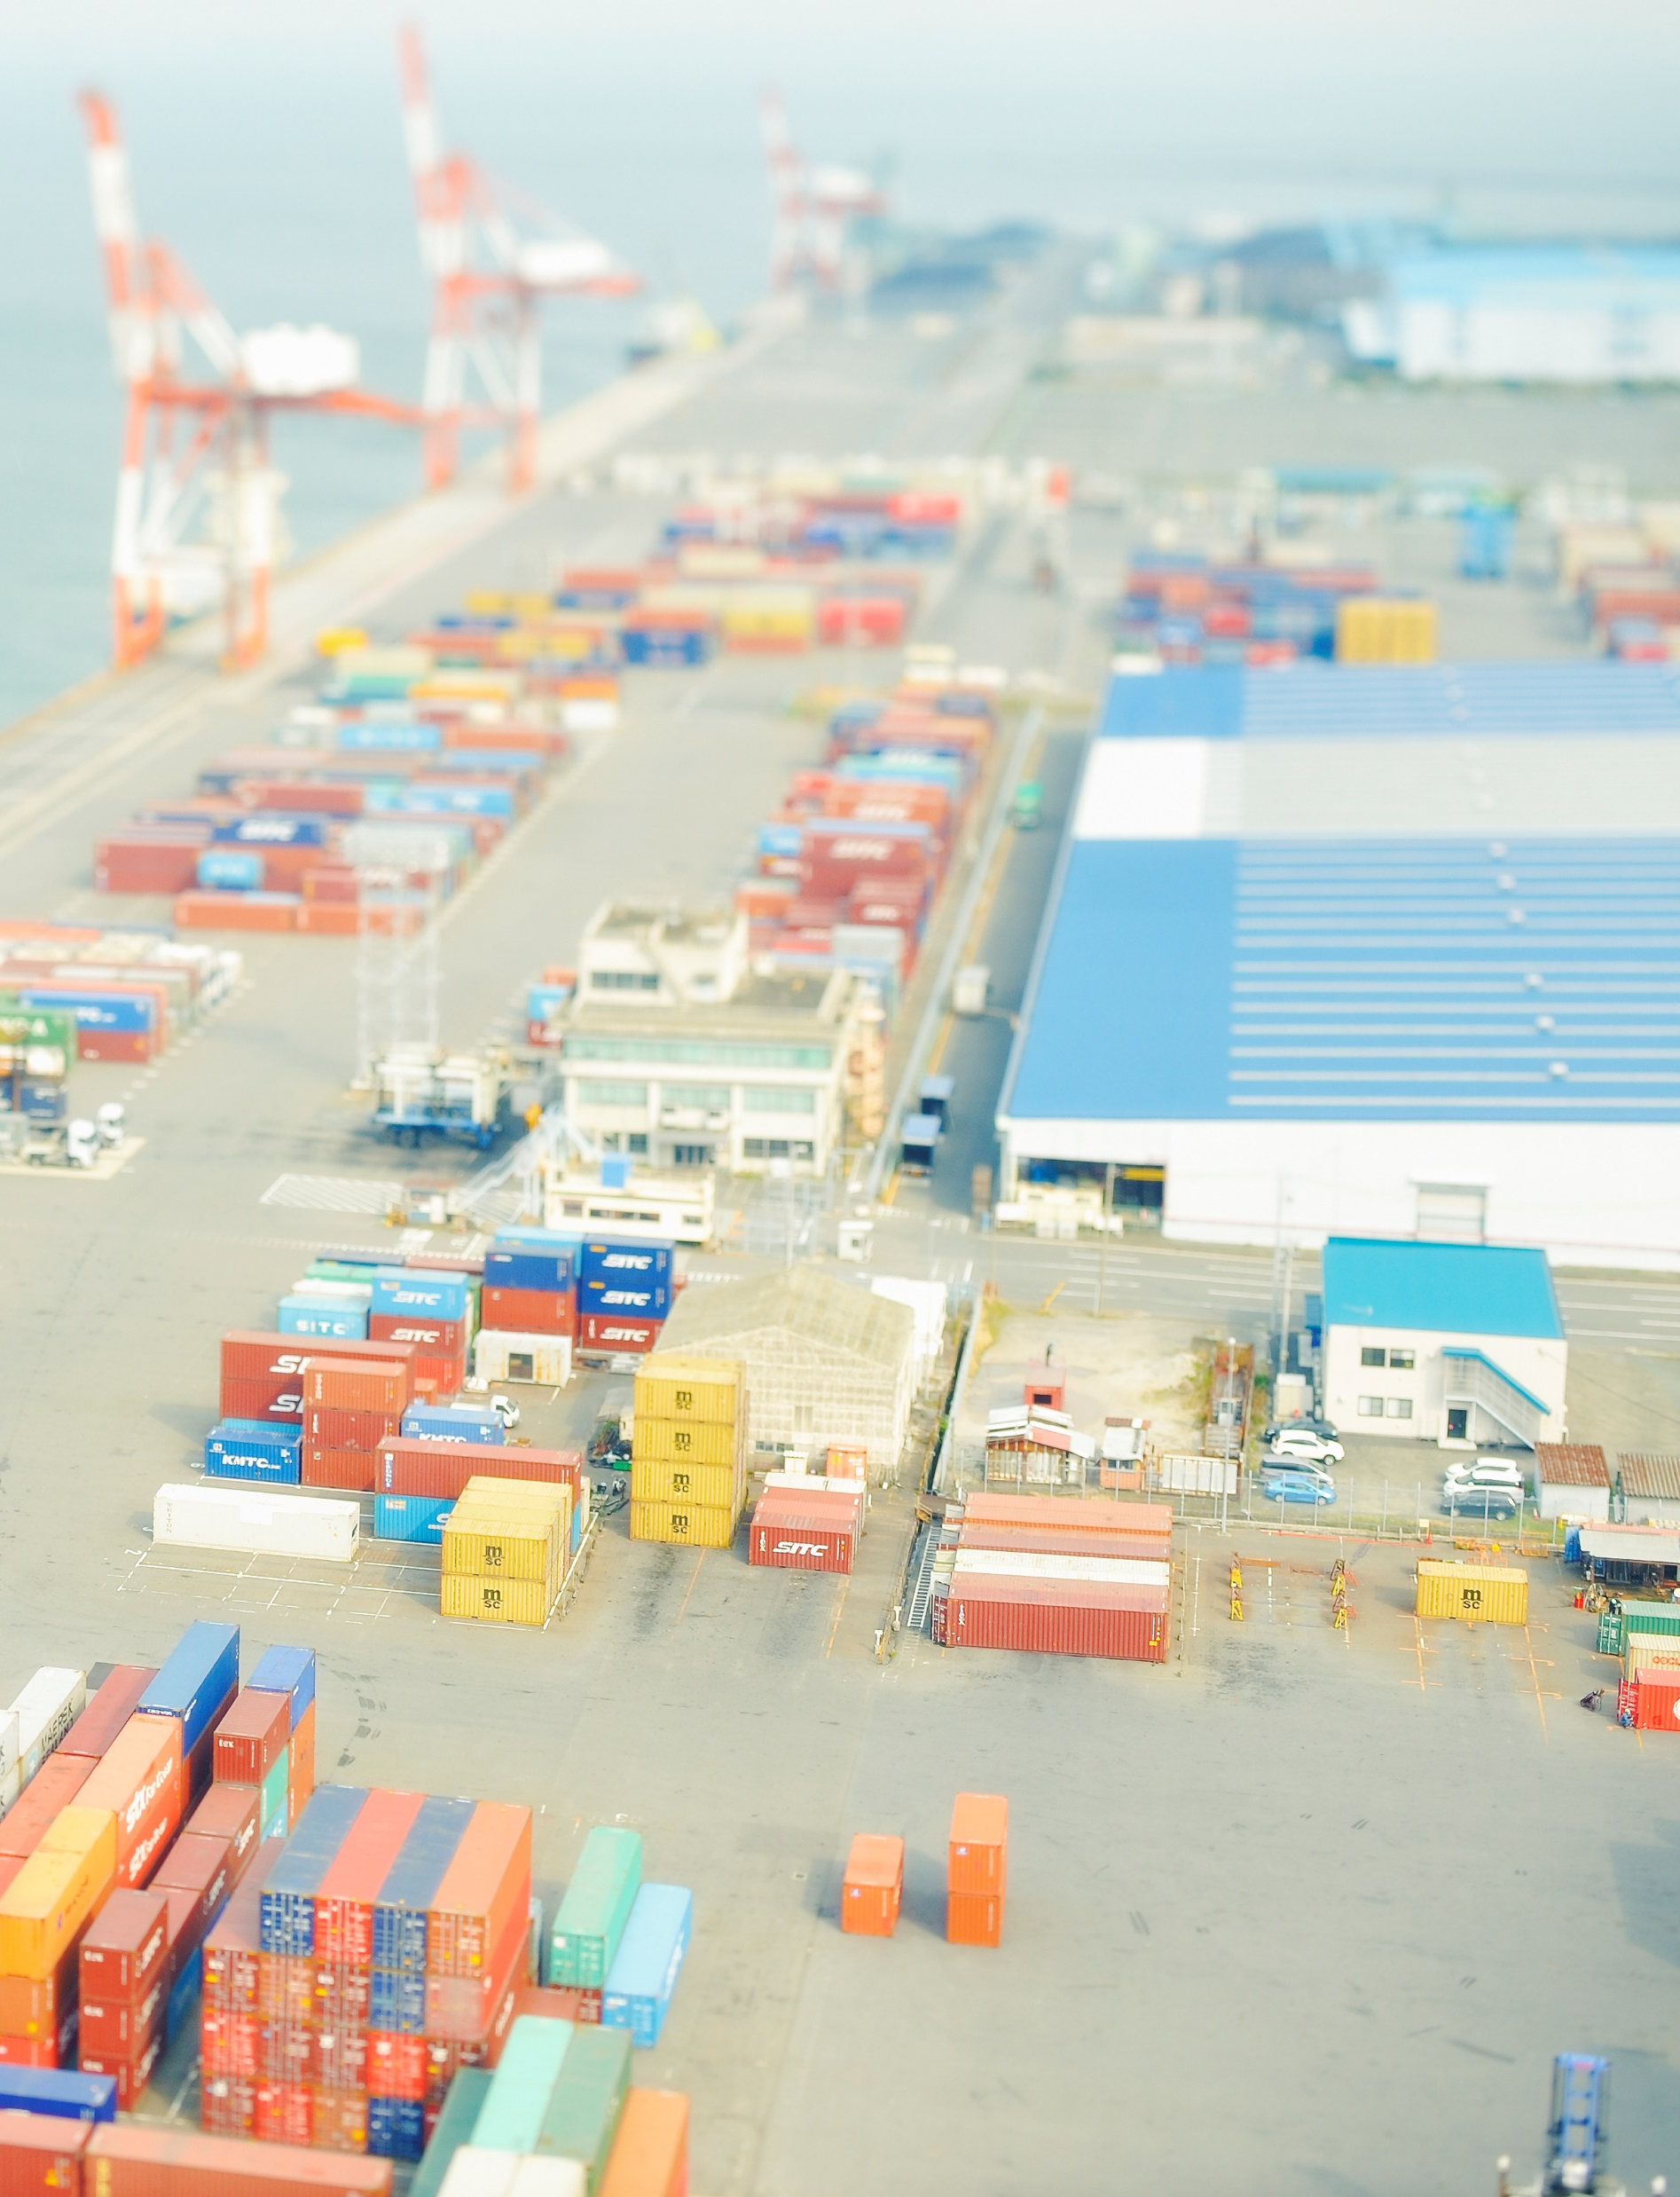
Indicative Action Pathway
6 Months
2 Years
5 Years
Short Term
Medium Term
Long Term
Achieve 100% Inventory of Hazardous Materials (IHM) compliance..
Create a National Ship Recycling Database integrated into the NLP-Marine platform for real-time reporting of recycling activity, IHM data, and end-of- life material recovery rates.
Develop an End-of-Life Ship Circular Economy Roadmap to maximise steel and non-ferrous metal recovery, promote material reuse, and link to the domestic sector.
Provide targeted financial incentives (credit lines, tax rebates) for yards adopting advanced containment systems and other forms of Ship recycling methods.
Integrate third-party environmental auditing into recycling yard certification.
Align with global best practices for workers safety, medical facilities, environmental protection, and automation in dismantling
Constitute SRCARP Steering Committee under NGSCC with DGS ,GMB, IRS, Classification Societies, NABL-accredited labs, SRIA and technical support by Academia

Slide 7

Indicative Action Pathway
6 Months
2 Years
5 Years
Short Term
Medium Term
Long Term
Upgrade all Indian ship recycling facilities to be fully HKC-compliant with certified infrastructure, trained workforce, and documented environmental safeguards
Collect energy data, including process logs, transport emissions, waste handling records and publish the National Ship Recycling Carbon Baseline Report
Establish a Green Ship Recycling Park at Alang with centralised hazardous waste management.
Develop bilateral agreements with ship- owning nations to channel end-of-life vessels to certified Indian yards under transparent green contracts
Establish a National Training & Certification Scheme for green ship recycling workers covering occupational health, hazardous waste handling, and emergency response
Design SRTRS digital platform architecture and finalise carbon accounting methodology (aligned with ISO 14067 and GHG Protocol).

Slide 8
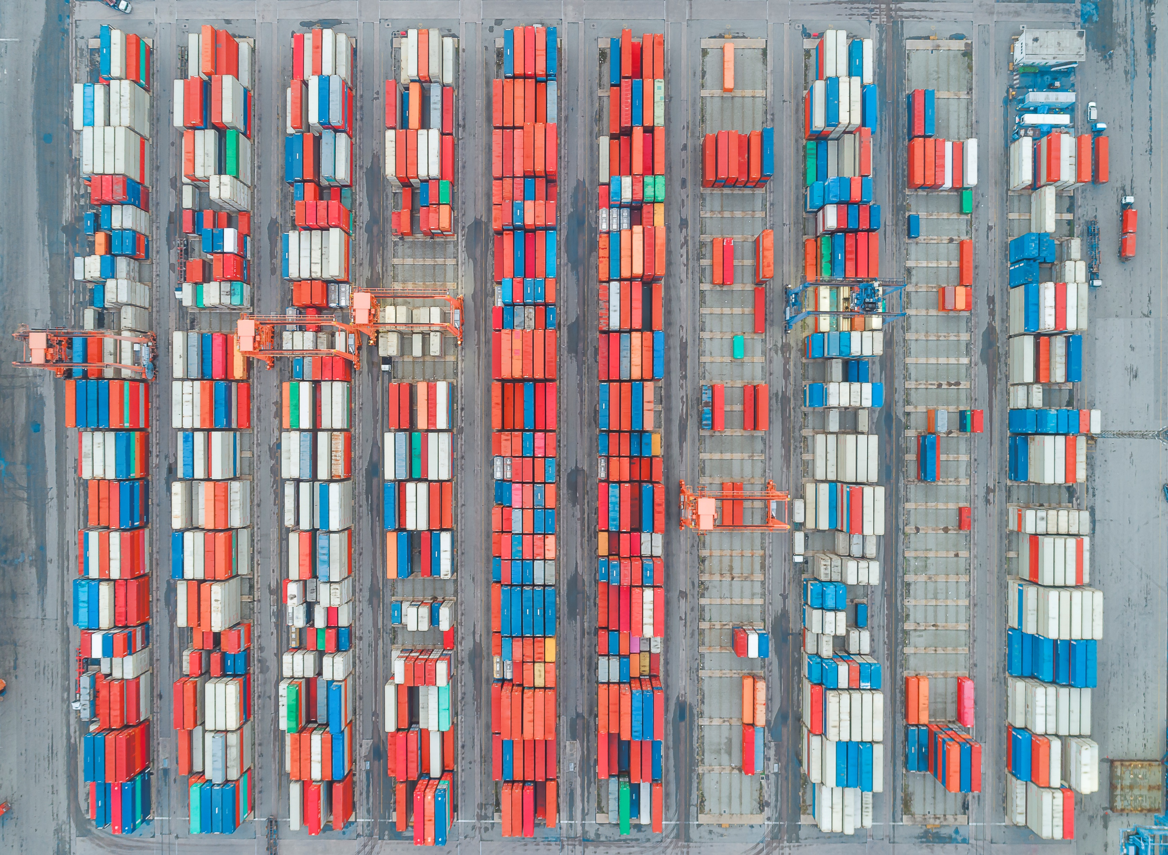
Indicative Action Pathway
6 Months
2 Years
5 Years
Short Term
Medium Term
Long Term
Establish a centralised hazardous waste treatment and disposal facility at Alang for asbestos, PCBs, and heavy metal residues and other identified hazardous wastes
Facilitate technology transfer partnerships for mechanised cutting, remote-operated cranes, and AI-based hazard detection
Achieve zero wastewater discharge from ship recycling facilities through advanced effluent treatment
Pilot digital twin monitoring for high-volume yards to track dismantling progress, emissions, and waste streams in real time
Mandate minimum material recovery rates (target: 98% by mass for steel) for all recycled ships
Fund pilots for: Renewable-powered plasma cutting systems; Heat recovery integration in dismantling processes; Shared compressed-air systems to replace diesel compressors.

Slide 9
Stakeholder Mapping
Outcome Area | Lead Ministry / Authority | Supporting Agencies | Industry Stakeholders
HKC-aligned regulatory framework and national coordination | MoPSW/DGS (National Authority ) | SMBs/ ROsMoEFCC | Ship recycling yard owners
HKC-compliant infrastructure and yard modernisation | MoPSW/ SMBs | ROs/ SPCBs | Ship recycling yards, EPC contractors
Inventory of Hazardous Materials (IHM) compliance and enforcement | MoPSW /DGS (National Authority) | ROs/SMBs | Shipowners, recycling yards, IHM service providers
Centralised hazardous waste management and TSDF integration (Alang) | MoPSW/SMB | SPCBs/CPCB | TSDF operators, recycling yards
Green Ship Recycling Park development (shared facilities model) | MoPSW/SMB | SPCBs | Ship recycling industry, utilities providers
Digital monitoring, reporting, and national recycling database (NLP-Marine integration) | MoPSW/DGS(National Authority ) | GMB / SMBs, NCoEGPS | Yards, shipowners, technology providers
Circular economy integration and green steel linkage | MoPSW/DGS (National Authority) | MoEFCC, Ministry of Steel/ GMB / SMBs | Steel rerollers, recyclers, manufacturing sector
Carbon accounting and emissions disclosure for ship recycling | MoPSW/DGS(National Authority ) | MoEFCC, GMB / SMBs | Ship recycling yards, auditors
Financial incentives and investment enablement for green technologies | Ministry of Finance | MoPSW, NITI Aayog, SMB | Yard owners, financiers, equipment suppliers

Slide 10
Stakeholder Mapping
Outcome Area | Lead Ministry / Authority | Supporting Agencies | Industry Stakeholders
Workforce safety, training, and certification for green ship recycling | MoPSW/SMB | DGS,IMU, SCGJ | Yard operators, training providers
International cooperation and green contracting for end-of-life vessels | MoPSW/DGS | MEA, SMB | Shipowners, flag states
Third-party environmental auditing and public disclosure | MoPSW/DGS | GMB / SMBs, Accredited auditors | Recycling yards, certification bodies
Advanced monitoring and digital twin deployment for high-volume yards | MoPSW/ SMBs | DGS/Technology partners | Tech providers, large recycling yards
Wastewater, effluent, and zero-discharge compliance | MoEFCC/SPCB | GMB / SMBs | Ship recycling yards
Material recovery efficiency and minimum recovery rate enforcement | MoPSW/SMB | DGS/MoS/ MoEFCC | Recycling yards, steel processors
Technology transfer, mechanisation, and automation adoption | MoPSW/SMB | DGS/Classification Societies/ Industry partners | Equipment OEMs, ship recycling yards

Slide 11
Key Decisions Expected
Alignment on yard level upgrades and minimum infrastructure changes like impermeable floors, drainage, waste handling needed to comply with HKC requirements.
Consensus on a phased ISO adoption roadmap, including triggers for mandatory compliance. Sequencing and timelines for ISO adoption
Agreement on a standardised IHM governance framework, including verification, accreditation, and digital traceability. Allocation of responsibilities across shipowners, flag states, recyclers, and authorities.
Alignment on standards for hazardous waste segregation, storage, and disposal as well as targets or benchmarks for material recovery and recycling efficiency.
Confirm roles and responsibilities across various Ministries and Regulators.

Slide 12

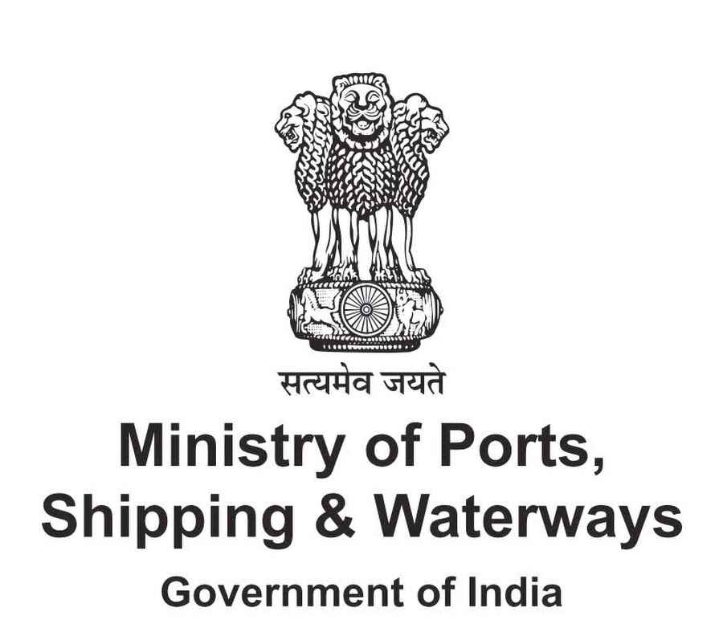
संगच्छध्वं
संवदध्वं
सं वो मनांसि जानताम्।
“Move together,
speak together,
may your minds
be in harmony.”
(Rigveda 10.191.2)

