Slide 1
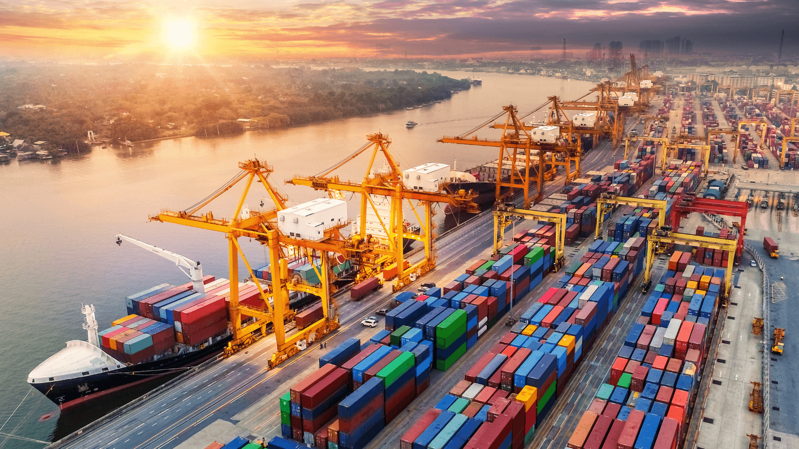
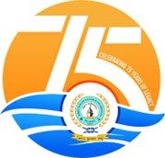
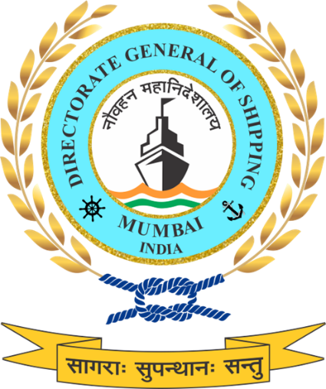
Stepping Stone towards a Safe & Sustainable Ocean Economy in India
Directorate General of Shipping
3rd November 2025 | UN Ocean Centre Workshop | IMEI, Navi Mumbai
Notes:
“A very good morning to everyone present here.”
It is a privilege to represent the Directorate General of Shipping, Ministry of Ports, Shipping and Waterways, at this UN Ocean Centre Workshop.
India’s maritime sector today stands at a crucial juncture, where economic growth and environmental stewardship must go hand in hand. Our oceans are not just trade highways but vital ecosystems that sustain livelihoods, biodiversity, and global climate balance.
This presentation, titled “Stepping Stone towards a Safe and Sustainable Ocean Economy in India,” highlights the multi-dimensional efforts being undertaken by the Directorate General of Shipping to promote:
Safety and sustainability across the maritime value chain,
Cleaner and greener shipping practices, and
Capacity building for coastal and offshore stakeholders.
Through progressive initiatives, from green shipping and alternative fuels to fisheries safety, waste reduction, and decarbonization, India is aligning its national maritime agenda with global frameworks such as MARPOL, the IMO Initial GHG Strategy, and the Sustainable Development Goals (SDGs 13, 14, and 17).
“The journey toward a sustainable ocean economy begins with collaboration — between nations, industries, and institutions. Today’s workshop is one such collective step forward.”

Slide 2
Directorate General of Shipping
India’s Maritime Regulator
Established: 3 September 1949 as an attached office under Ministry of Commerce; now functions under the Ministry of Ports, Shipping & Waterways (MoPSW).
Mandate: Formulates and enforces shipping policies and legislations in India.
Global Role: Serves as India’s Maritime Administration, representing the country at the IMO and other international maritime forums.
Presence: Headquarters in Mumbai, supported by 14 Mercantile Marine Departments (MMDs) PAN India.
Core Functions :
⚖️ Policy & Regulation :
Formulates shipping policy, enforces national & international legislations.
🚢 Ship Safety :
Surveys, inspections, and certification of vessels.
👨‍✈️ Seafarers
Training, competency certification, and welfare.
🌍 Environment & Green Shipping :
Implements MARPOL, promotes decarbonisation & alternate fuels.
🛠️ Ship Recycling :
Regulates and monitors yards, ensures HKC compliance.
🤝 International Engagement :
Represents India at IMO & global maritime forums.
Key Wings & Branches :
Engineering
Nautical
Naval Architecture
Coastal Shipping
Crew
Shipping Development
Administration
Training
Notes:
Directorate General of Shipping
(India’s Maritime Regulator)
“Good morning distinguished delegates, colleagues, and members of the United Nations Ocean Centre.”
Allow me to briefly introduce the Directorate General of Shipping, the apex maritime regulatory authority of India.
Established in 1949, the Directorate has evolved over the decades from a small office under the Ministry of Commerce into a full-fledged maritime administration under the Ministry of Ports, Shipping and Waterways. It continues to serve as the central institution responsible for formulating, implementing, and enforcing national and international shipping policies and legislation in India.
Our mandate is broad and holistic — covering every dimension of India’s maritime domain. We are responsible for ship safety, seafarer training and welfare, environmental protection, and the promotion of green and sustainable shipping practices. At the same time, we ensure compliance with conventions of the International Maritime Organization (IMO) and other global instruments.
From our headquarters in Mumbai, we operate through a network of 14 Mercantile Marine Departments strategically located across the country — from Kandla and Kochi to Kolkata, Chennai, and Port Blair. These MMDs act as our field arms for inspections, surveys, certification, and maritime governance, ensuring that the standards we uphold in New Delhi and Mumbai are implemented uniformly across all Indian ports and coasts.
The Directorate’s work is organized across key functional wings and branches - Engineering, Nautical, Naval Architecture, Crew, Administration, Coastal Shipping, and Training. Together, these verticals form the operational backbone of India’s maritime ecosystem.
Our core functions reflect both our regulatory mandate and developmental vision:
We formulate and enforce policy, keeping pace with global maritime law.
We ensure ship safety through surveys, inspections, and certification.
We oversee seafarers’ training, competency, and welfare, enabling India to remain one of the top seafarer-supplying nations in the world.
We are driving the green shipping transition, implementing MARPOL and promoting alternate fuels and decarbonization.
We also regulate ship recycling, with India leading globally in Hong Kong Convention–compliant yards.
And finally, we play a pivotal role in international engagement, representing India at the IMO and multiple global maritime forums.
In essence, the Directorate General of Shipping stands at the confluence of policy, regulation, sustainability, and international cooperation — ensuring that India’s maritime growth remains both safe and sustainable, aligned with the UN Sustainable Development Goals and the vision of a Viksit Bharat by 2047.
“We are not just regulators; we are enablers of India’s maritime future.”

Slide 3
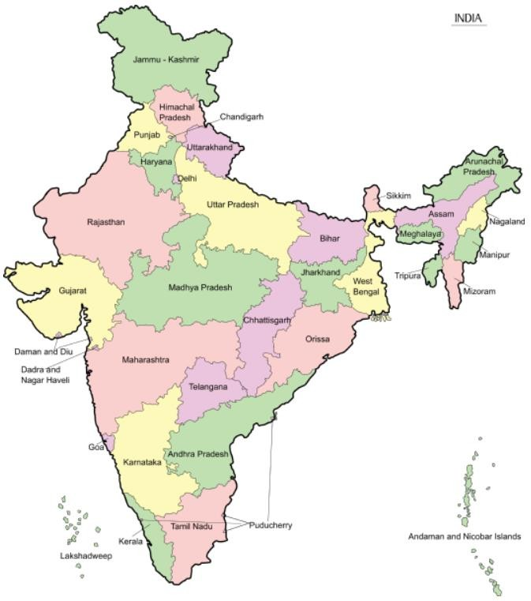













Mercantile Marine Departments
MMD,
Kandla
MMD
Noida
MMD,
Jamnagar
DGS & MMD,
Mumbai
MMD,
Goa
MMD
Kolkata & MMD Haldia
MMD,
Paradip
MMD,
Vizag
MMD,
Mangalore
MMD,
Kochi
MMD,
Chennai
MMD,
Andaman & Nicobar
MMD,
Tuticorin
Notes:
Mercantile Marine Departments
“This map illustrates the national footprint of the Directorate General of Shipping through its network of Mercantile Marine Departments, or MMDs.”
The Directorate operates through 14 Mercantile Marine Departments strategically located along India’s vast coastline and inland regions. These offices act as the operational arms of the Directorate, ensuring that all statutory functions related to safety, certification, inspection, training, and compliance are executed efficiently and uniformly across the country.
From Kandla and Jamnagar in the west, to Kolkata, Haldia, and Paradip in the east, and from Tuticorin and Kochi in the south to Noida in the north, each MMD serves as a crucial link in India’s maritime administration framework. The presence of an MMD in the Andaman and Nicobar Islands also ensures regulatory coverage of India’s strategic island territories.
Each of these departments is headed by a Principal Officer, supported by technical and administrative staff from diverse disciplines—engineering, nautical, and naval architecture—working in close coordination with the Directorate in Mumbai.
Their role is not merely administrative but also regulatory and service-oriented. They conduct surveys of Indian and foreign ships, issue certificates of competency to seafarers, carry out port State and flag State inspections, and ensure the implementation of international maritime conventions such as SOLAS, MARPOL, and STCW at the regional level.
Together, this network ensures nationwide maritime governance, providing accessibility and uniformity in the enforcement of shipping laws and safety standards, irrespective of where a vessel or seafarer is located in India.
“In short, these MMDs form the backbone of our field operations — ensuring that every port and coastal state in India remains connected to the Directorate’s regulatory framework, and that the standards we uphold internationally are implemented locally with equal rigour.”

Slide 4
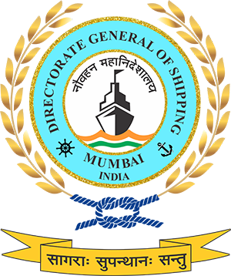
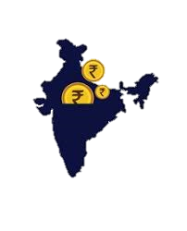


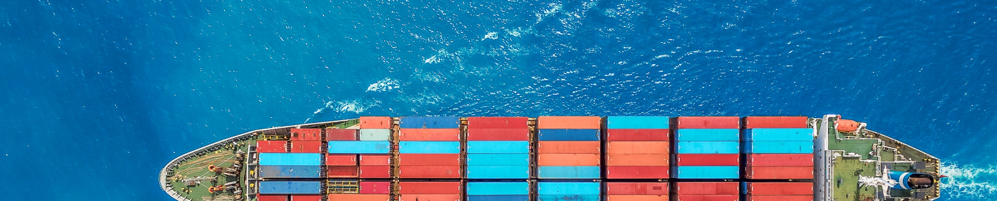

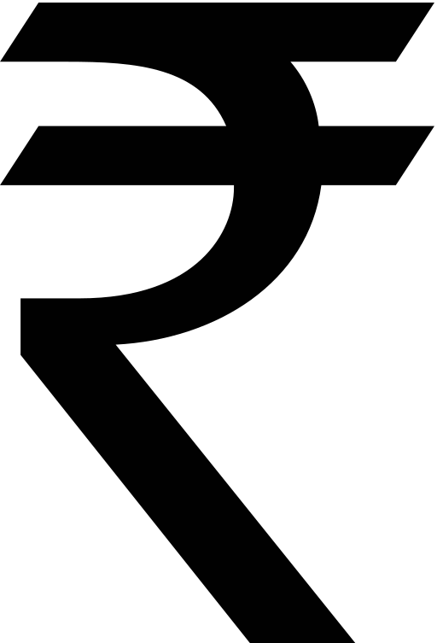
India's Economic Growth and the Significance of Maritime Domain
$5 Trillion
by 2027-28
$4.19 Trillion
6.5 %
(FY 25)
Indian GDP
GDP Growth
GDP Target
World’s 4th largest economy
projected 6.3–6.7% annual growth through coming years
IMF projects India will surpass Germany by 2028, becoming the world’s 3rd largest economy
The Maritime sector facilitates
95%
70%
Maritime sector contributes to 4-5% of the GDP
Trade by Volume
Trade by Value
Notes:
India’s Economic Growth and the Significance of Maritime Domain
India today stands as the world’s fourth largest economy with a GDP of USD 4.19 trillion, recording a growth rate of 6.5% in FY 2025. With a projected growth trajectory of 6.3 - 6.7% annually, the nation is firmly on course to achieve the USD 5 trillion milestone by 2027 - 28. The International Monetary Fund projects that by 2028, India will surpass Germany to emerge as the world’s third largest economy, underscoring its growing global economic stature.
The maritime sector has been a critical enabler of this economic rise, facilitating nearly 95% of India’s trade by volume and 70% by value. Beyond trade, the sector directly contributes 4–5% to the national GDP, making it not only a backbone of India’s commerce but also a strategic lever for sustained growth.
The synergy between economic expansion and maritime activity highlights a fundamental truth, India’s economic ambitions are deeply intertwined with its maritime strength. As the country advances towards its vision for Viksit Bharat @ 2047, the maritime domain will continue to serve as the lifeline of trade, connectivity and strategic resilience.

Slide 5
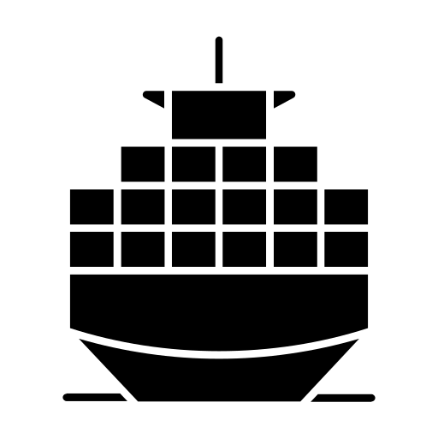

Contribution to the Blue Economy
Towards Viksit Bharat 2047
India and its Blue Economy
India’s Infrastructure Leverages
95%
70%
12
200+
11,098 km
By trade volume
By trade value
Major Ports
Non-major Ports
Total length of India’s coastline
India’s Vessel Advantage
India is emerging as the leader of the Blue Economy in the world with multiple initiatives focusing on infrastructure, business and the overall economy
India has 1,520+ merchant vessels with 13 mn+ GT capacity
Port-led Development
Ports for Prosperity
Policy reforms driving EoDB, modern infrastructure and multi-modal logistics
India ranks 18th globally in flag registration and 19th globally in carrying capacity
Notes:
Contribution of the Blue Economy
The Blue Economy lies at the heart of India’s economic and strategic rise, accounting for 95% of trade by volume and 70% by value. With 12 major ports, 200+ non-major ports, and an extensive coastline of 11,098 km, India possesses one of the largest maritime infrastructures in the world, giving it a natural advantage in connecting markets and enabling prosperity.
India’s fleet strength has also grown steadily, with 1,520+ merchant vessels aggregating over 13 million GT capacity. On the global stage, India now ranks 18th in flag registration and 19th in carrying capacity, underscoring its expanding role in global shipping while contributing significantly to supply chain resilience.
The Government has positioned the Blue Economy as a pillar of Viksit Bharat 2047, with a strong emphasis on port-led development, multimodal logistics, and ease of doing business reforms. Initiatives under Sagarmala, Harit Sagar, and Maritime India Vision 2030 have transformed ports into hubs of efficiency, green practices, and integrated logistics.
Thus, India’s Blue Economy is not just about scale, but about direction, moving towards sustainability, competitiveness, and strategic influence. As the world transitions towards cleaner and more resilient maritime operations, India’s leadership in the Blue Economy offers a model of how infrastructure, business, and policy can be aligned to deliver long-term growth and global impact.

Slide 6
Global Competitiveness
2
0.9 days
Top 3
2nd
Indian Ports in Global top 30 Ports (Mundra & Visakhapatnam), 2023
TAT ahead of many leading maritime nations (JNPA),2022
In trained manpower,
2025 with >3.2 Lakh Indian Seafarers
Rank in global ship recycling, 2024
(3rd rank in 2017)
(No Indian Port in Top 30 in 2015)
(4 days in 2015)
(1.2 lakh Seafarers in 2014)
16th
41st
14th
38th
Largest ship building sector globally with rapid capability expansion,2024
Rank in World Competitiveness Index, 2025
Rank in Liner Shipping Connectivity Index, 2024
Rank in Logistics Performance Index, 2023
(23rd Rank in 2016)
(71st Rank in FY 2015)
(30th Rank in 2014)
(54th Rank in 2014)
Notes:
Global Competitiveness
India’s maritime sector has undergone a significant transformation in global rankings, reflecting improvements in efficiency, manpower, recycling, and overall competitiveness. From ports and logistics to shipbuilding and seafarer supply, India today stands as a pivotal player in global maritime trade.
Ports in Global Top 30: In 2015, no Indian port featured among the world’s leading container hubs. By 2023, Mundra and Visakhapatnam have both entered the global top 30 ports, a testament to capacity expansion, operational efficiency, and international connectivity.
Turnaround Time (TAT): Vessel turnaround time at JNPA improved from 4 days in 2015 to just 0.9 days in 2022, placing India ahead of many advanced maritime nations and showcasing the results of digitalisation and port modernisation.
Trained Manpower: With more than 3.2 lakh Indian seafarers in 2025, up from 1.2 lakh in 2014, India ranks in the global top 3 for maritime manpower. This includes a growing strength of women seafarers, reinforcing India’s role as the second-largest supplier of trained seafarers worldwide.
Global Ship Recycling: India has strengthened its global leadership in ship recycling, moving from 3rd rank in 2017 to 2nd rank in 2024. With over 115 Hong Kong Convention–compliant yards at Alang, India’s recycling practices now directly contribute to safe and sustainable global tonnage disposal.
Shipbuilding Sector: India’s shipbuilding industry has advanced from 23rd globally in 2016 to 16th in 2024, backed by financing reforms, capacity expansion, and the recent ₹69,725 crore package aimed at building a globally competitive ecosystem.
World Competitiveness Index: India’s steady economic reforms and maritime sector efficiencies have elevated its position from 71st in FY 2015 to 41st in 2025, signalling stronger global competitiveness across infrastructure, logistics, and trade facilitation.
Liner Shipping Connectivity Index: India’s connectivity to global trade routes has improved dramatically, climbing from 30th in 2014 to 14th in 2024, driven by expanded port capacity, greater container handling efficiency, and integration into global liner networks.
Logistics Performance Index: On the World Bank LPI, India has risen from 54th in 2014 to 38th in 2023, particularly excelling in vessel turnaround and port efficiency. This improvement enhances India’s role in global supply chains and strengthens its credibility as a logistics hub.
Taken together, these eight indicators highlight a decade of policy-driven transformation and operational improvements. India has shifted from being a lagging participant to an emerging global maritime leader — building resilience, strengthening competitiveness, and aligning with its vision of becoming a top maritime nation by Viksit Bharat 2047.

Slide 7
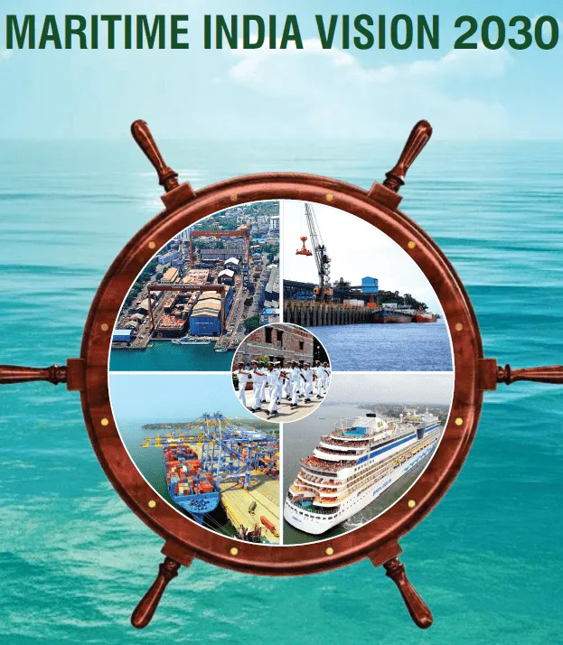
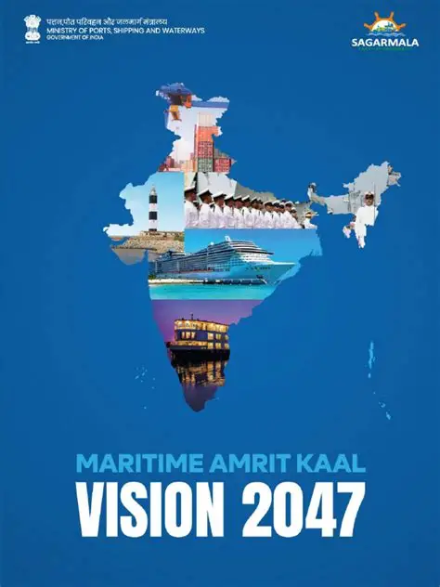
India’s Vision for the Maritime Sector
Maritime India Vision (MIV) 2030
Production Targets: Increase from current 30k GT to 500k+ GT annually by 2030
Maritime Amrit Kaal Vision 2047
Advanced phase targeting Top 5 global position in shipbuilding and maintaining 1 position in ship recycling
Investment: INR 20,000+ Crores
Employment Generation: 1,00,000+ additional jobs (direct and indirect)
Position India Globally in the Top 10 Shipbuilding, repair nations
69% Indian-Built Ships Share (up from current 5%)
300+ Strategic Initiatives across 11 key maritime areas
Financial Assistance: 20-30% assistance for green vessels (including retrofitting)
Notes:
India’s Vision for the Maritime Sector
India’s maritime strategy is anchored in two long-term frameworks - Maritime India Vision 2030 (MIV 2030) and Maritime Amrit Kaal Vision 2047 (MAKV 2047), which together chart a pathway for transforming India into a global maritime power.
Maritime India Vision 2030 sets a 10-year blueprint aimed at positioning India among the world’s top 10 shipbuilding and repair nations. It seeks to raise production from the current 30,000 GT to over 500,000 GT annually by 2030, supported by an investment of ₹20,000+ crore. The vision also targets the creation of over 1,00,000 new jobs (direct and indirect) while strengthening domestic repair, recycling, and logistics ecosystems.
Looking further ahead, Maritime Amrit Kaal Vision 2047 is an advanced phase of India’s maritime ambitions, aligned with the country’s goal of becoming a developed economy by 2047. It aspires to secure a top 5 global position in shipbuilding while maintaining India’s leadership in ship recycling. With more than 300 strategic initiatives spanning 11 key areas, MAKV 2047 envisions raising the share of Indian-built ships from 5% to nearly 69%, backed by 20–30% financial assistance for green vessels and retrofitting.
These visions are not limited to infrastructure growth but also focus on sustainability, innovation, and global integration. By 2047, India’s maritime sector is expected to be a major contributor to GDP growth, employment generation, and global supply chain resilience. Together, MIV 2030 and MAKV 2047 reaffirm India’s commitment to becoming a leading Blue Economy, driven by green growth, digitalization and strategic partnerships.

Slide 8


Current Indian Maritime Sector Overview
Ports
Shipping
Waterways
Total Ports In India
Major Ports: 12
Other than Major Ports: 200+
Total Cargo Handling Capacity: 2,762 MTPA
Total Cargo Traffic Handled: 1,600 MTPA
Indian flagged vessels: 1,549
Seafarers: 3.2 lakh+
Lighthouses: 200+
Over 18 lakh tourist footfall in last year
No. of operational National Waterways (NWs): 29 (Length 4,862 km)
Cargo handled 146 MTPA
Cargo growth in the past decade: 359%
MMTPA: Million Metric Tonnes per Annum || DWT: Dead Weight Tonnage || GT: Gross Tonnage
Notes:
Current Indian Maritime Sector Overview
“Before delving into policy and sustainability aspects, it is important to understand the scale and scope of India’s maritime sector today.”
India’s maritime ecosystem is among the largest and most diverse in the world, encompassing ports, shipping and inland waterways, each playing a crucial role in supporting the country’s trade, connectivity, and economic growth.
Let’s begin with Ports. India operates 12 major ports and over 200 non-major or minor ports spread across its extensive coastline. Together, these ports have a combined cargo handling capacity of 2,762 million tonnes per annum, handling around 1,600 million tonnes of cargo last year. This capacity expansion reflects India’s consistent focus on modernisation, digitalisation, and port-led industrial growth under the Sagarmala and Harit Sagar initiatives.
Moving to Shipping - the core of our maritime identity. India today has over 1,500 Indian-flagged vessels, supporting domestic and international trade. More importantly, India is one of the largest contributors of seafarers to the global maritime workforce, with over 3.2 lakh trained professionals serving across international fleets. Our network of 200+ lighthouses ensures navigational safety along the coasts, while maritime tourism — a growing area, recorded over 18 lakh visitors in the past year, highlighting the sector’s expanding socio-economic reach.
Lastly, Waterways - the most efficient and eco-friendly mode of transport. India has 29 operational National Waterways, covering approximately 4,862 kilometres, handling 146 million tonnes of cargo annually. What’s remarkable is that in the last decade alone, inland waterway cargo traffic has grown by nearly 360%, reflecting a strong modal shift toward greener logistics and reduced carbon emissions.
Together, these three pillars, Ports, Shipping, and Waterways form the foundation of India’s maritime strength. They support 95% of India’s trade by volume and nearly 70% by value, directly contributing to around 4–5% of the national GDP.
“This integrated growth across our maritime ecosystem is what positions India to lead the next phase of the global Blue Economy — one that is competitive, sustainable, and inclusive.”

Slide 9

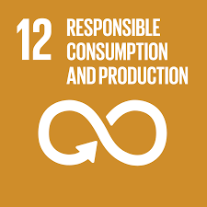
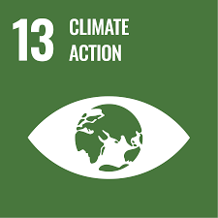
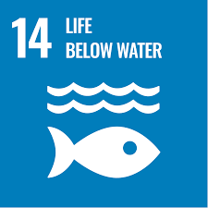
Synergy Between DGS and UN Ocean Centre
How DGS is Connected:
India’s apex maritime regulator, implementing IMO conventions and National shipping policy.
Direct role in safety, seafarers, environment, and sustainable shipping.
Key driver of India’s maritime vision – MIV 2030, MAKV 2047, Viksit Bharat 2047.
Why Partnership Matters:
Knowledge Exchange: Bridges global UN expertise with India’s field experience (MMDs).
Capacity Building: Strengthens skills of officers in shipping, ports, fisheries, aquaculture.
Policy Alignment: Connects India’s initiatives (NGSP, Harit Sagar, OPS, Ship Recycling) with UN SDG goals.
Global Visibility: Enhances India’s role in ocean governance and Blue Economy & Green Economy transition.
Relevant UN SDGs :
SDG 14 – Life Below Water (sustainable use of oceans).
SDG 13 – Climate Action (decarbonisation & green shipping).
SDG 8 – Decent Work & Economic Growth (seafarer welfare, just transition, circular economy).
SDG 12 – Responsible Consumption & Production (ship recycling, marine plastics).
Notes:
Synergy Between DGS and UN Ocean Centre
“This slide captures the core connection between the Directorate General of Shipping and the United Nations Ocean Centre — a partnership that is both natural and strategic.”
The Directorate General of Shipping, as India’s apex maritime regulator, is the principal authority responsible for implementing IMO conventions, enforcing national shipping legislation, and driving maritime sustainability policies across the country.
Our mandate extends well beyond regulation. It includes safety of ships, welfare of seafarers, and the promotion of environmentally responsible and sustainable shipping.
We are also a key driver of India’s broader maritime vision, through initiatives under Maritime India Vision 2030, Maritime Amrit Kaal Vision 2047, and the overarching national objective of Viksit Bharat 2047.
Now, this partnership with the UN Ocean Centre is especially relevant because it helps bridge global expertise with India’s vast on-ground implementation capacity. The Directorate’s nationwide field presence, through 14 Mercantile Marine Departments and extensive stakeholder networks, makes it a natural partner in the practical realization of UN-led ocean sustainability initiatives.
There are four pillars that make this collaboration meaningful:
Knowledge Exchange: It allows us to combine UN’s global frameworks and analytical depth with India’s local field experience, technical insights, and regulatory infrastructure.
Capacity Building: It helps strengthen the skills of officers and professionals in areas such as shipping, port operations, fisheries, and aquaculture, thereby nurturing a workforce aligned with global maritime sustainability standards.
Policy Alignment: It ensures that India’s flagship initiatives, including the upcoming National Green Shipping Policy, Harit Sagar Guidelines, Onshore Power Supply projects and Ship Recycling frameworks are aligned with UN Sustainable Development Goals.
Global Visibility: Through such collaborations, India’s efforts gain international recognition, enhancing our leadership role in the transition toward a Blue Economy and a Green Economy.
This partnership directly contributes to several UN SDGs :
SDG 14 (Life Below Water) through the sustainable use and conservation of ocean resources;
SDG 13 (Climate Action) by advancing maritime decarbonization and green fuel transitions;
SDG 8 (Decent Work and Economic Growth) through seafarer welfare, just transition, and circular economy models; and
SDG 12 (Responsible Consumption and Production) through ship recycling and marine waste reduction.
“In essence, the DGS–UN Ocean Centre partnership exemplifies the spirit of global cooperation — combining India’s maritime experience with the UN’s knowledge ecosystem to drive collective progress towards safer, greener, and more inclusive oceans.”

Slide 10
Blue Economy
Growth with Sustainability
Key Focus Areas :
Fisheries & Aquaculture
Maritime Transport & Ports
Livelihood Generation
Tourism & Coastal Development
Marine Renewable Energy
Shipbuilding & Recycling
Marine Biotechnology & Research
Sustainable use of ocean resources for economic growth, improved livelihoods, and jobs while preserving the marine ecosystem.
Balances economic development, environmental sustainability, and social inclusion.
Recognized as a key pillar under MAKV 2047 and MIV 2030.
India’s Vision :
Target to be a leading Blue Economy nation by 2047.
Enhance ocean-based GDP contribution while ensuring net-zero pathways.
Integrate Harit Sagar Guidelines for green port practices.
Promote regional cooperation (IORA, BIMSTEC, ASEAN, IMO initiatives).
Impact :
Economic diversification with inclusive growth for coastal communities.
Strengthened ecosystem resilience & biodiversity protection.
Positioning India as a global maritime hub in sustainable trade and logistics.
Notes:
Blue Economy – Growth with Sustainability
“The Blue Economy represents the bridge between ocean health and human prosperity, and for India, it is both a developmental priority and a moral responsibility.”
At its core, the Blue Economy refers to the sustainable use of ocean resources for economic growth, job creation, and improved livelihoods, while preserving the marine ecosystem. It recognizes that the ocean is not merely a resource, but a shared global heritage that demands balance between economic development, environmental stewardship and social inclusion.
Under India’s strategic maritime frameworks, the Maritime Amrit Kaal Vision 2047 and the Maritime India Vision 2030, the Blue Economy has been recognized as a key pillar of long-term national growth. These visions aim to align ocean-based industries with the goals of sustainability, decarbonization, and community development.
The approach is holistic, encompassing the key focus areas:
Fisheries and Aquaculture, ensuring food security and livelihood resilience;
Maritime Transport and Ports, the backbone of India’s trade and logistics;
Tourism and Coastal Development, enhancing economic opportunities while protecting fragile ecosystems;
Marine Renewable Energy, including offshore wind and tidal energy;
Shipbuilding and Recycling, integrating circular economy principles; and
Marine Biotechnology and Research, promoting innovation and sustainable resource use.
Our vision is clear ie. to make India a leading Blue Economy nation by 2047. This means increasing the ocean-based contribution to GDP while following a net-zero growth trajectory. We are integrating the Harit Sagar Guidelines to ensure green and resilient port operations, and actively promoting regional cooperation through platforms like IORA, BIMSTEC, ASEAN, and IMO-led initiatives.
The impact of this transition is multidimensional:
It drives economic diversification and creates inclusive growth opportunities for coastal communities;
It strengthens ecosystem resilience and biodiversity protection; and
It positions India as a global maritime hub for sustainable trade, logistics, and innovation.
“In essence, the Blue Economy embodies our collective resolve — to use the oceans responsibly, to grow equitably, and to leave behind seas that are cleaner, safer, and more productive for future generations.”

Slide 11
Impacts of Climate Change
Economic Loss
8.7% of India’s GDP
As per ADB, global failure to addresses climate chat could result in economic losses
Sea Level Rise & Flooding
36 Million People
Flooding & sea level rise could displace millions of people along the coasts in India
Agricultural Productivity
30% Decline As per Intergovernmental Panel on Climate Change, agricultural production in India could fall if emissions remain high
Water Scarcity
40% of Population
If trends continue, the population facing water scarcity in India would increase from 33% to 40%
Glacier Reserves
70% Decline
A huge decline in western Himalayan reserves could be faced
Notes:
Impacts of Climate Change
“When the coastlines retreat, so does the confidence of a maritime nation.”
Climate change is no longer a future threat. it is a lived reality for India. As one of the world’s most climate-vulnerable nations, India faces multidimensional risks that directly affect its economy, coastal communities, food security, water systems, and maritime infrastructure.
Economic Impact
The Asian Development Bank (ADB) estimates that unchecked climate change could reduce India’s GDP by up to 8.7% by 2100. Extreme weather events, disruption of supply chains, damage to coastal port assets, and loss of productivity will place immense pressure on national development goals.
Sea Level Rise & Coastal Displacement
Over 36 million Indians are at risk of displacement due to sea-level rise and coastal flooding, particularly in low-lying states such as West Bengal, Odisha, Tamil Nadu, and Gujarat. India’s 7,500 km coastline and major ports are increasingly exposed to storm surges and saline water intrusion, threatening maritime trade and livelihoods.
Agricultural Productivity Decline
The IPCC projects a 30% decline in India’s agricultural output if high-emission trends persist. Heat stress, erratic monsoons, and shifting rainfall patterns endanger food security and rural incomes, further intensifying migration pressure on coastal and urban zones.
Water Stress
Today, one-third of India’s population faces water scarcity. By 2050, this number could rise to 40%, as Himalayan ice melt, reduced river flows, and rising evaporation diminish freshwater availability. Climate-linked water stress will aggravate interstate river disputes and strain urban water systems.
Glacier Loss & Himalayan Risk
The Western Himalayan glaciers may witness up to a 70% decline, jeopardizing perennial river systems such as the Ganga, Brahmaputra, and Indus. This impacts drinking water, irrigation, hydropower, and ecological stability, directly affecting India’s long-term maritime and riverine logistics.

Slide 12
UNFCCC Framework
Purpose: Stabilize greenhouse gas (GHG) concentrations in the atmosphere to prevent dangerous anthropogenic interference with the climate system
Key Principles:
Common but differentiated responsibilities (CBDR)
Precautionary principle
Sustainable development integration
Present-Day Evolution:
Over 197 Parties ratified, including India
Serves as the umbrella framework for subsequent agreements: Kyoto Protocol (1997), Paris Agreement (2015)
Ongoing initiatives: Nationally Determined Contributions (NDCs), climate finance mechanisms, capacity building, technology transfer
Notes:
UNFCCC Framework
The United Nations Framework Convention on Climate Change (UNFCCC), adopted at the Earth Summit in 1992, serves as the foundational global treaty to address climate change. Its core mission is to stabilize greenhouse gas concentrations to prevent dangerous human interference with the climate system.
Core Principles of UNFCCC
Common But Differentiated Responsibilities (CBDR): Recognizes that all countries share the responsibility to combat climate change, but developed nations must lead due to their historical emissions and greater capabilities.
Precautionary Principle: Calls for preventive action against climate risks, even when full scientific certainty is lacking — prioritizing protection over delay.
Sustainable Development Integration: Climate action must align with development goals, ensuring that economic growth, poverty eradication, and environmental protection proceed together.
Evolution Under the UNFCCC Umbrella
The UNFCCC acts as an umbrella legal framework, under which major climate agreements have been established:
Kyoto Protocol (1997): Introduced legally binding emission reduction targets for developed countries.
Paris Agreement (2015): Shifted to a universal pledge system, requiring all 197 Parties, including India, to submit Nationally Determined Contributions (NDCs).
Ongoing Work Streams:
Climate finance (Green Climate Fund)
Technology transfer & capacity building
Global Stocktake & mitigation adaptation balance
India’s Role and Commitments
India has actively shaped the narrative of climate justice, asserting that development must not be compromised. Through its NDCs, India has committed to:
45% reduction in emissions intensity of GDP by 2030
50% installed power from non-fossil fuel sources
Net Zero by 2070 commitment announced at COP26
India continues to uphold climate equity and the right to growth for developing nations.
Relevance to Maritime Sector
UNFCCC principles, especially CBDR, now influence negotiations at the International Maritime Organization (IMO), where India advocates that developing countries should have fair transition timelines and access to green fuel technologies.

Slide 13
Maritime Sustainability down the Years Efforts by the IMO
MARPOL 1973 / 1978 Prevention of pollution from ships (oil, chemicals, sewage, garbage)
London Convention 1972 & Protocol 1996
Regulation of dumping of wastes at sea
Harmful Anti-fouling Systems 2001
Bans harmful organotin compounds on ship hulls
Convention on Ship Recycling (HKC) 2009
Safe and environmentally sound recycling of ships
IMO Polar Code 2017
Safety and environmental standards for ships operating in polar waters
Initial GHG Strategy 2018
Targets for reducing greenhouse gas emissions from shipping
Civil Liability for Oil Pollution Damage 1969 Liability for oil spill damages
Ballast Water Convention 2004
Prevent transfer of invasive aquatic species
Energy Efficiency Design Index 2011
Mandatory energy efficiency standards for new ships
Ship Energy Efficiency Management Plan 2011 Operational efficiency measures for all ships
MARPOL Annex VI 1997 Limits air emissions from ships: SOx, NOx, particulate matter, greenhouse gasses
Notes:
Maritime Sustainability down the Years Efforts by the IMO
The journey of maritime sustainability under the International Maritime Organization (IMO) reflects a progressive evolution, from controlling visible marine pollution to addressing invisible emissions and ultimately steering global shipping toward decarbonization. Each milestone represents a deliberate expansion of responsibility: from oil spills, to toxic chemicals, invasive species, ship recycling, operational efficiency, and today, climate change.
Foundation Years : collectively established that oceans are not dumping grounds. Neither for waste, nor unregulated emissions. IMO’s role evolved from navigational safety to environmental stewardship.
MARPOL 1973/78 laid the very foundation of maritime environmental regulation. It sought to prevent the discharge of harmful substances — oil, chemicals, sewage, garbage — and established pollution control as a core shipping obligation.
The Civil Liability Convention (1969) introduced legal and financial accountability for oil pollution damage, marking a critical shift from mere prevention to compensation for environmental harm.
MARPOL Annex VI (1997) extended IMO’s mandate into the air pollution domain, setting limits on sulphur oxides (SOx), nitrogen oxides (NOx), and particulate matter from ships, and laying early groundwork for greenhouse gas control.
The London Convention (1972) and London Protocol (1996) regulated dumping of wastes at sea, using a ‘reverse list’ approach that bans dumping unless explicitly allowed. Later, the Protocol expanded to address new risks like Carbon Capture and Storage (CCS) and marine geoengineering.
Targeted Ecological Protections - From Sea Life to End-of-Life : IMO transitioned from land-sea protection to tackling environmental harm across the life cycle of a ship, covering design, operation and dismantling.
Anti-Fouling Systems Convention (2001) prohibited harmful organotin compounds like TBT from ship hulls due to their toxic impact on marine life, forcing the industry to shift to environmentally safe coatings.
Ballast Water Management Convention (2004) addressed one of the most silent global threats — transportation of invasive aquatic species. It introduced the D-1 and D-2 discharge standards and mandated onboard treatment systems.
Hong Kong Convention (2009) brought sustainability full circle by ensuring that ships are safely and responsibly recycled at the end of their operational life, requiring inventoried hazardous materials and certified recycling yards.
Energy Efficiency Design Index (EEDI) – 2011 became the first global legally binding climate standard on any industrial sector, requiring all newbuild ships to meet minimum energy efficiency performance.
Operational & Climate Governance - The Decarbonisation Era : The environmental journey moved from cleanup and containment, to efficiency and accountability, to systemic decarbonisation. IMO is today the only UN agency with a sector-wide Net Zero transition underway.
Ship Energy Efficiency Management Plan (SEEMP) 2011 introduced operational controls, making every voyage accountable through better planning, speed management, and performance monitoring.
IMO Polar Code (2017) expanded IMO’s jurisdiction to ecologically fragile polar regions, setting stringent ship safety and environmental protection norms in newly accessible waters due to ice melt.
Initial IMO GHG Strategy (2018) marked a historic turning point calling for at least 50% reduction in total GHG emissions from international shipping by 2050, on a pathway to zero. This strategy paved the way for ongoing development of the IMO Net Zero Framework, including measures such as GFI (fuel intensity limits), CII (carbon intensity indicator), and GHG pricing mechanisms.

Slide 14
India’s Panchamrit Action Plan
The Panchamrit action plan is a five-fold strategy proposed by India to address climate change.
Reach 500 GW of non-fossil energy capacity by 2030.
Meet 50% of India’s energy requirement from renewable energy sources by 2030.
Reduce total projected carbon emissions by around 1 billion tonnes by 2030.
Increase the forest cover to enhance carbon sinks.
Achieve net-zero emissions by 2070
Notes:
India’s Panchamrit Action Plan at COP-26
India’s announcement of the “Panchamrit” at COP-26 in Glasgow marked a defining moment in global climate negotiations, positioning the country not as a reluctant participant, but as a proactive leader among developing nations. Rooted in the principles of equity, climate justice, and Common but Differentiated Responsibilities (CBDR-RC), the Panchamrit provides a strategic, five-fold blueprint for India’s long-term transition towards a low-carbon economy.
The first commitment is to achieve 500 GW of non-fossil energy capacity by 2030, demonstrating India’s intent to become one of the world’s largest renewable power generators. Parallelly, India pledged that 50% of its total energy requirements will come from renewable sources by 2030, signalling a structural shift away from coal dependency. These targets align with major domestic initiatives such as the National Solar Mission, Green Hydrogen Mission, and large-scale offshore wind development.
In quantitative terms, India has committed to reducing projected carbon emissions by 1 billion tonnes by 2030, indicating a measurable contribution towards the global carbon budget. This is reinforced by a pledge to reduce the carbon intensity of its GDP by 45% from 2005 levels, reflecting a focus on economic efficiency rather than absolute caps, essential for a developing economy still pursuing growth and poverty eradication.
The long-term anchor of Panchamrit is the goal of reaching net-zero emissions by 2070, a timeline that balances developmental imperatives with climate responsibility. India has argued at COP forums that developed nations must reach net-zero well before 2050, as they have historically consumed a disproportionate share of the global carbon budget.
Beyond mitigation, India used the Panchamrit platform to highlight systemic concerns faced by developing countries. India firmly reiterated that climate finance and technology transfer must be tracked as seriously as emissions reductions, calling for accountability on the USD 100 billion annual pledge by developed countries. The concept of LIFE – Lifestyle for Environment was introduced as a behavioural movement, encouraging mindful consumption and sustainable living as a collective global responsibility.
Through Panchamrit, India has effectively linked climate action with climate justice, committing to ambitious goals while demanding an equitable global framework that neither penalises development nor ignores historical responsibility. The international response to Panchamrit has been largely positive, with multiple nations acknowledging India’s pragmatic yet visionary approach.

Slide 15
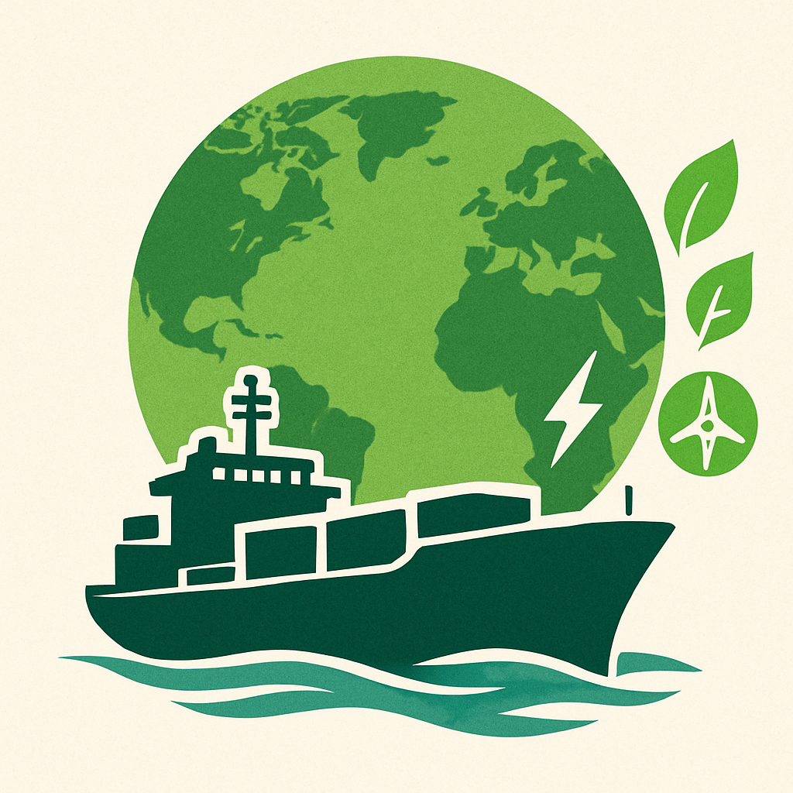
Green Shipping – The Big Picture
Shipping is the backbone of global trade – carrying 80% of goods worldwide.
Shipping contributes to ~3% of global CO₂ emissions.
Green Shipping = making ships, ports, and supply chains cleaner, smarter, and future-ready.
It’s not just about compliance — it’s about staying competitive in a low-carbon economy.
Vision & Commitments:
Aligned with Maritime India Vision 2030 & Maritime Amrit Kal Vision 2047.
Supports IMO’s Net Zero 2050 ambition.
Anchored in India’s Panchamrit Pledge – 500 GW non-fossil capacity by 2030, Net Zero by 2070.
“The future of shipping is green — by necessity, not by choice.”
Notes:
Green Shipping – The Big Picture
Shipping is the backbone of world trade, carrying nearly 80% of global goods. But it is also responsible for ~3% of global CO₂ emissions, making decarbonisation one of the most pressing challenges of our time.
Green Shipping is not just about compliance, it is about transforming ships, ports, and supply chains into cleaner, smarter, and future-ready systems. In a low-carbon economy, sustainability is synonymous with competitiveness, and the maritime sector cannot afford to lag behind.
India’s approach aligns ambition with action:
Maritime India Vision 2030 and Maritime Amrit Kaal Vision 2047 embed sustainability into long-term growth strategies.
India supports the IMO’s Net Zero 2050 ambition, strengthening its role as a responsible maritime nation.
Through the Panchamrit Pledge, India has committed to 500 GW of non-fossil capacity by 2030 and Net Zero by 2070, anchoring maritime decarbonisation within the national clean energy agenda.
The future of shipping is green by necessity, not by choice. Green shipping is not a burden but an opportunity: to reduce costs, attract green finance, and ensure India remains at the forefront of global maritime competitiveness.

Slide 16
India’s Green Shipping Initiatives
Structured Roadmap for decarbonization (currently under review)
NGSP
NPSC metrics include Green Port Index (GPI), Port Readiness Level (PRL), Smart Port Shore Power Index (SPSPI), Environmental Ship Index (ESI), and GHG Emissions Inventory to benchmark sustainability and readiness of Indian ports
National Port Sustainability Council (NPSC)
Alternate Fuel Transition
Guidelines for LNG, Biofuels, Methanol, Ammonia
Green Shipping
Ship Recycling
Sustainability Indexing of Ships
Structure to rate ships on their environmental performance, linked to age norms.
With the Hong Kong Convention now in force, India leads globally with 115 compliant yards at Alang.
Shore Power (OPS)
Use of clean shore electricity by ships while berthed at port, reducing fuel burning.
Notes:
India’s Green Shipping Initiatives
India’s maritime decarbonization roadmap is evolving from isolated compliance measures into an integrated national strategy under the broader vision of “Samudra Shuddhih, Rāṣṭrasya Vr̥iddhih.” This transformation is being driven by coordinated initiatives that target vessels, ports, fuel ecosystems, and regulatory governance.
At the institutional level, the formation of the National Port Sustainability Council (NPSC) reflects a shift toward performance-based benchmarking in port operations. The council employs indicators such as the Green Port Index (GPI), Port Readiness Level (PRL), Environmental Ship Index (ESI) and GHG Emissions Inventory, ensuring Indian ports are globally aligned on sustainability, electrification, and green infrastructure standards.
A central pillar of green transition is the National Green Shipping Plan (NGSP), which provides a structured roadmap for decarbonisation of both ports and ships. The plan not only sets targets for reducing port emissions but also outlines future bunkering corridors for alternative fuels such as LNG, biofuels, methanol, and green ammonia. These fuels are being introduced through detailed guidelines to support a phased shift from transitional to zero-carbon fuels.
On the vessel front, Sustainability Indexing of Ships (SIS) is being introduced to rate ships based on environmental performance, integrating parameters such as fuel type, age, emissions, and onboard energy efficiency. This index will be directly linked to regulatory incentives and port access policies, encouraging shipowners to modernise fleets and retire obsolete, high-emission tonnage.
Shore Power (Onshore Power Supply - OPS) forms another critical component, aimed at eliminating auxiliary engine use while ships are docked. By supplying clean electricity directly at berth, OPS significantly reduces particulate emissions, sulphur oxides, and carbon output in port cities. Pilot installations at major ports such as VOC and JNPA are now being expanded to create OPS-enabled green corridors.
Ship recycling also contributes to India’s green leadership. With the Hong Kong Convention now in force, India leads the world with over 115 HKC-compliant recycling yards at Alang, integrating environmentally safe dismantling practices and hazardous waste management. This positions India as a responsible global hub in the circular economy for ships.
Together, these initiatives illustrate India’s transition from a compliance-driven maritime nation to a climate-responsible maritime power. By integrating policy (NGSP), infrastructure (OPS), market readiness (alt-fuels), and regulatory reform (SIS, NPSC), India is preparing not only to meet IMO’s 2050 targets but to set new benchmarks for green maritime leadership.

Slide 17
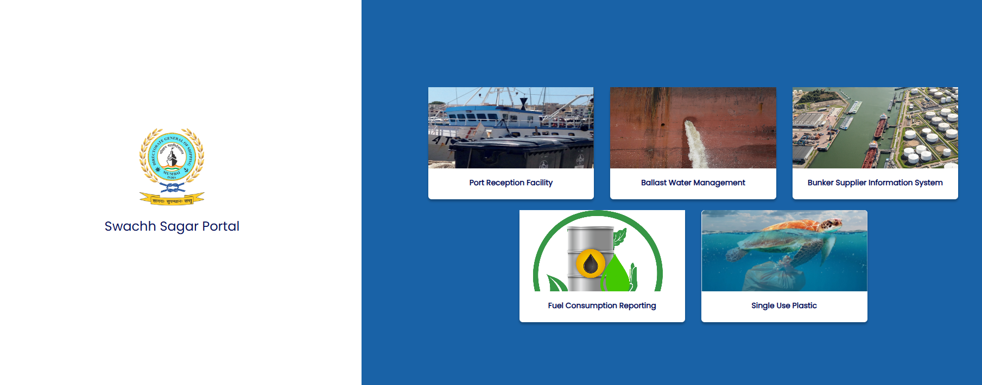
Swachh Sagar Portal
Monitoring & Reporting – First Step towards Green Future
India’s digital platform for clean seas and maritime decarbonization.
Developed and Managed by IRS on behalf of DGS.
Port Reception Facility
Module for vessel waste declaration, vendor linkages and disposal coordination
Fuel Consumption Reporting
Enables MARPOL Annex VI fuel consumption reporting for vessels.
Single Use Plastics
Enables ships to report plastic usage and disposal via SEP plans, ensuring compliance with National sustainability mandates
E- BDN & Bunker Suppliers
Central database of approved bunker suppliers with electronic BDN records for transparency and fuel quality assurance
Ballast Water Reporting
Real time Ballast Water data submission by all ships and compliance oversight
Notes:
Swachh Sagar Portal –
Monitoring & Reporting – First Step towards Green Future
The Swachh Sagar Portal is India’s unified digital platform for maritime environmental compliance, developed to support clean seas, transparent reporting and decarbonisation efforts. It consolidates all pollution control and sustainability mandates under a single national system, enabling ships, ports, and regulatory authorities to operate within a structured, real-time governance framework. Each module within the portal addresses a specific environmental obligation under MARPOL and IMO conventions, ensuring data integrity, traceability and enforcement consistency.
Port Reception Facility (PRF) Module
The Port Reception Facility module establishes a structured digital system for vessels to declare ship-generated waste prior to port arrival. It links ships with authorised waste collection vendors and enables real-time approval, tracking and disposal coordination, reducing delays and eliminating informal handling. By digitally recording every waste transaction, it ensures full transparency under MARPOL Annex V and prevents sea dumping. This module supports State Maritime Boards, Port Authorities and Pollution Control Boards in monitoring compliance, while creating auditable records for IMO and port State control inspections.
Fuel Consumption Reporting
This module captures fuel consumption data for all vessels required to report under DGS regulations, including those below the IMO’s global Data Collection System threshold of 5,000 GT. It enables national compliance with MARPOL Annex VI carbon intensity and energy efficiency requirements. All operational fuel data, type, quantity, voyage consumption, is digitally lodged, enabling India to build a national emissions database. This data will support policy development for future MBM mechanisms and ensure readiness for IMO’s Net-Zero Framework implementation.
Single Use Plastics (SUP) Module
The Single Use Plastics module operationalises DGS Order No. 05 of 2019 by mandating ships to submit a Ship Execution Plan (SEP) identifying plastic items onboard, their phase-out measures and disposal methods. It enables tracking of plastic usage, recycling and substitution with sustainable alternatives. By capturing ship-level data, this module enforces India’s national ban on certain plastic categories and contributes to IMO’s Action Plan on Marine Litter. It shifts plastic control from advisory to mandatory digital reporting, enhancing accountability.
e-BDN & Bunker Supplier Information System
This module creates a national registry of licensed bunker suppliers and mandates issuance of electronic Bunker Delivery Notes (e-BDN) for every fuel transaction. Each e-BDN is time-stamped, digitally signed and serialised, preventing manipulation or use of unregistered suppliers. It improves traceability of marine fuels and helps detect off-spec or adulterated bunkers. By integrating supplier verification and fuel documentation, the portal strengthens maritime fuel governance and directly supports enforcement of fuel quality standards under MARPOL Annex VI.
Ballast Water Reporting Module (BWM Convention Alignment)
The Ballast Water module requires all ships, Indian and Foreign Flagged, to electronically report ballast operations upon every arrival and departure. It captures data on ballast uptake, exchange, treatment and discharge, enabling continuous monitoring in line with IMO’s experience-building phase. This allows authorities to assess invasive species risk, treatment plant functionality and compliance behaviour. By linking with GISIS reporting, it elevates India’s oversight role under the Ballast Water Management Convention and prepares ports for future biological discharge standards.
Together, these five modules establish India’s first end-to-end maritime environmental registry , shifting compliance from manual declarations to auditable, technology-driven oversight. By integrating reporting on waste, fuel, plastics, bunkers and ballast water, the portal strengthens India’s role in global maritime regulation and positions the country to lead international initiatives on green shipping corridors, blue economy and marine pollution control. Swachh Sagar is not just a compliance tool, but a strategic instrument for India’s transition to a cleaner, future-ready maritime ecosystem.

Slide 18
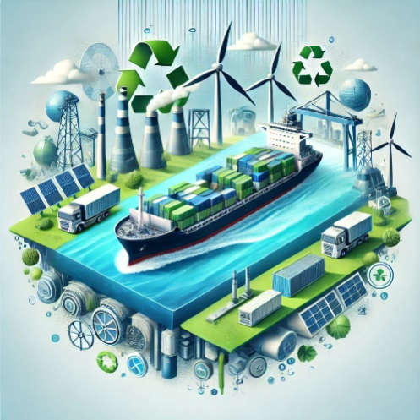
National Green Shipping Policy
Maritime Vision for a Green Future
The NGSP is India’s strategic response to the global decarbonization mandate, a policy blueprint designed to secure maritime growth while transitioning towards clean energy, sustainable ships and climate-resilient ports.
Key Transition Pillars:
Green Ships
Green Ports
Green Fuels
Green Recycling
Green Financing & Collaborations
Strategic Intent
To position India as a global hub for green shipping and future fuels, enabling industry to move from regulatory compliance to global competitiveness and leadership.
Draft NGSP Document under Review
Notes:
The National Green Shipping Policy (NGSP) is India’s comprehensive roadmap to align the maritime sector with global decarbonization goals while ensuring economic growth and competitiveness. As highlighted in the consultative document (2025), NGSP is not just an environmental initiative, but a strategic shift to position India as a global hub for green shipping, green fuels, green ports, and maritime innovation. It builds on international mandates such as the IMO’s 2023 GHG Strategy and domestic commitments announced under COP-26 Panchamrit.
The policy integrates sustainability across the maritime value chain, focusing on low-emission vessel technologies, alternative fuel infrastructure, regulatory reform, and green financing mechanisms. It also aligns with major national frameworks – Maritime India Vision 2030, Amrit Kaal Vision 2047, Sagarmala and Harit Sagar guidelines – creating a unified and future-ready maritime strategy.
Key Transition Pillars
Green Ships: Promotion of energy-efficient vessel designs, retrofits, zero-emission propulsion, and mandatory green certification. NGSP envisions India becoming a shipbuilding and retrofit hub for low-carbon vessels.
Green Ports: Port decarbonization through shore power (OPS), electrified equipment, green corridors, emission monitoring, and renewable integration (solar, wind, hydrogen bunkering).
Green Fuels: Adoption of biofuels, LNG, methanol, hydrogen and ammonia under a phased fuel transition plan. The policy promotes domestic fuel production and bunkering hubs to make India a future fuel supply nation.
Green Recycling: Modernization of Alang and other ship recycling yards under HKC-compliant practices, with circular economy principles, hazardous waste control, and global recycling leadership.
Green Finance & Collaboration: Creation of national green maritime funds, tax incentives, ESG-linked financing, PPP models, and international partnerships to support innovation and equitable transition.
Strategic Intent
The core objective of NGSP is to shift India from regulatory compliance to global leadership in green shipping. By integrating technology, sustainability, and economy, India seeks to become a maritime nation that exports solutions, not emissions. The policy emphasizes a just and equitable transition, ensuring inclusion of industry, labour, MSMEs, and coastal communities.

Slide 19
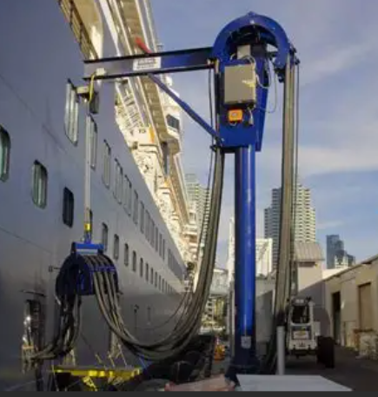
Shore to Ship
What is Shore Power?
Electricity supplied from the shore to berthed ships, allowing engines to be switched off and eliminating fuel combustion while docked.
Why It Matters
Cuts CO₂, NOx, SOx and Particulate Matter emissions in port zones
Improves Air Quality and ESG scores for Indian ports
Supports compliance with IMO CII, GHG & Green Port Index
Implementation Status in Indian Ports
Kamarajar Port - 500 kW, 400V, 50-60 Hz in Coal Berth 1 & 2
VO Chidambaranar Port - 305 kW, 400V 60Hz in VOC Berth 2 & 3
Jawaharlal Nehru Port Authority - SPS used for Tugs. SPS for all terminals planned (45MVA; INR 600 crore expected)
Possible Financing options
Blended finance → govt + MDBs + private capital.
Green/blue bonds → specifically earmarked for OPS infra.
PPP models → private players co-invest in OPS roll-out.
Notes:
Shore-to-Ship Power (OPS)
Shore-to-Ship Power (Onshore Power Supply – OPS), commonly referred to as cold ironing, enables vessels to switch off their diesel auxiliary engines and draw electricity directly from port infrastructure while berthed. This significantly reduces emissions of CO₂, NOₓ, SOₓ and Particulate Matter, addressing one of the most concentrated sources of pollution in port cities.
OPS is central to India’s maritime decarbonisation strategy under Harit Sagar, supporting compliance with IMO’s CII and aligning with national climate commitments under the Panchamrit and Net Zero 2070 vision. Beyond emissions reduction, OPS improves ESG scores, port sustainability ratings, and promotes health benefits for coastal communities.
Implementation Progress in Indian Ports
Kamarajar Port (Ennore) – 2024 Commissioning
Commissioned OPS facility in November 2024, at a cost of ₹20.5 crore.
Capacity: 500 kW, 400V, 50–60 Hz, serving Coal Berths 1 & 2
Developed under Harit Sagar Guidelines, promoting green port practices.
KPL is actively encouraging vessels to retrofit and connect, supported by trials and coordination with Paradip Port for a Green Shipping Corridor (Paradip–Ennore).
VO Chidambaranar Port (Tuticorin)
OPS installed at Berths 2 & 3 (305 kW units), supporting auxiliary load supply and positioning VOC as a green maritime pilot port.
Jawaharlal Nehru Port Authority (JNPA)
Currently uses OPS for port tugs.
₹600 crore, 45 MVA national terminal OPS plan under formulation to become India’s largest cold ironing hub.
Challenges & Opportunities
While ships are currently hesitant due to retrofitting and administrative costs, OPS offers long-term operational benefits:
Reduced fuel consumption and engine wear
Lower carbon intensity scores (CII/GHG Index compliance)
Eligibility for global green incentives and carbon credits
Financing the Transition
Blended Finance – Government + MDBs + private capital
Green/Blue Bonds – Infrastructure-specific debt mechanisms
PPP Models – Terminal operators & energy companies co-investing

Slide 20
Alternate Fuels for Maritime (1/2)
LNG
Current Use: Operational for select Indian coastal and LNG carriers; IGF Code compliant
Biofuel
Marine Trials: Successfully tested on marine engines
Ammonia
Export Positioning: Kandla to produce green ammonia (L&T + Itochu JV) for Singapore bunkering
Methanol
Port Pilot: VOC Port launched India's first Green Hydrogen Pilot Plant (5 Sep 2025)
Infrastructure: LNG terminals at Dahej, Hazira, Kochi; feasibility for bunkering at JNPA
Maritime Role: Transition fuel till 2035 under IMO GHG transition
Limitation: Methane slip & future carbon costs reduce long-term advantage
Supply Base: Drop in Blends. Domestic production. Blending with FAME, HVO
Distribution: Can use existing bunkering infrastructure without port redesign
Advantage: Short-term compliance option for Indian fleet under CII/GHG without retrofits
Hydrogen
Marine Use: Dual-fuel methanol engines already ordered by global majors
Breakthrough: India's first Green Methanol Bunkering Hub under construction at VOC Port (Tuticorin) – 750 m³ terminal (SOPAN Group)
Production Shift: India transitioning from coal-based brown methanol to green methanol (hydrogen + CO₂ capture)
Maritime Suitability: Engine-ready (Maersk, MAN ES technology) – early adopter fuel under IMO
Role: Likely first large-scale alternative fuel to enter Indian ports post-2030
Maritime Use: Target fuel for deep-sea vessels (tankers, bulk carriers) post-2035
Challenges: High Toxicity, safety standards, crew training, IMO safety code under development
Strategic Role: India positioning as future fuel exporter, not just consumer
Use in Maritime: Not direct – used to produce ammonia/methanol as bunkering fuels
Infrastructure Need: Electrolysers, Liquefaction, port pipelines; High CAPEX
Long-Term Role: Backbone fuel for synthetic maritime fuels; export market focus
Notes:
Alternate Fuels for Maritime
India’s maritime fuel transition will not be “one fuel for all,” but a sequenced multi-fuel pathway that matches IMO’s Net-Zero Framework and the Green Fuel Intensity (GFI) curve. Near-term compliance will lean on drop-in biofuels and limited LNG; the first scalable alternative expected in Indian ports is green methanol; ammonia follows for deep-sea ships post-2035; and green hydrogen underpins methanol/ammonia production and long-term export play. The strategy links three levers: (i) domestic fuel manufacture, (ii) bunkering hubs & safety codes, and (iii) demand signals created by IMO pricing (RUs) and India’s NGSP/Harit Sagar policies.
1) LNG - Transitional Fuel
Current role : Deployed on select Indian coastal/LNG carriers; compliant under IGF Code.
Infrastructure : Import/LNG terminals at Dahej, Hazira, Kochi; feasibility for marine bunkering studied at Kochi & JNPA.
Why transitional : LNG reduces CO₂ but faces methane-slip.
Methane slip is the escape of unburned methane gas into the atmosphere, typically from engines running on natural gas, where incomplete combustion occurs. This phenomenon is a significant concern because methane is a potent greenhouse gas, with a much higher global warming potential than carbon dioxide over the short term. It can occur in a wide range of applications, including marine engines, stationary engines, and across the entire natural gas supply chain
2) Biofuels - Immediate, Drop-in Compliance
Technical fit : Blends (B20–B100) run on existing marine engines; trials by Indian Navy & fleet operators demonstrate operational feasibility.
Supply base : Domestic streams from ethanol, biodiesel, HVO , FAME under the National Biofuel Policy; strongest near-term pathway to lower well-to-wake GHG without retrofits.
Ports : Minimal infrastructure change. can use current bunkering networks with sustainability certification.
Role : Near-term CII/GFI relief for Indian fleets; ideal for tugs, OSVs, coastal and inland segments while methanol/ammonia scale up.
3) Methanol
Breakthrough project : India’s first Green Methanol Bunkering & Refuelling Hub is under construction at VOC Port, Tuticorin - 750 m³ terminal (SOPAN Group). This is the country’s first dedicated maritime methanol node and a key plank of the Coastal Green Shipping Corridor (Kandla–Tuticorin).
Why methanol first : Dual-fuel engines are commercially available (MAN ES, widely ordered by global liners), handling is simpler than ammonia/hydrogen, and safety codes are mature.
Production shift : India must pivot from coal-based “brown” methanol to green methanol (renewable H₂ + captured CO₂). VOC’s port-based green hydrogen pilot is a feeder step.
Role & Timing : Likely the first large-scale alternative marine fuel to appear regularly in Indian ports post-2030, enabling ships to meet tightening GFI thresholds at competitive abatement cost.
4) Ammonia (Green Ammonia)
Strategic positioning : Kandla is being developed by L&T Energy GreenTech with ITOCHU to produce green ammonia (~300 KTPA) with offtake for bunkering in Singapore. ITOCHU is also developing a 5,000 m³ ammonia bunkering vessel (2027) , evidence of real demand creation in the region.
Maritime use : Target fuel for deep-sea tankers/bulkers post-2035, once IMO’s dedicated safety code and crew-training standards are finalised.
Challenges : High toxicity handling, new port safety zones, emergency response, and specialised storage/transfer systems.
India’s role : Strong export economics (renewables + electrolyser scale). India can be a fuel supplier to Asian bunkering hubs while gradually enabling domestic corridors.
5) Hydrogen (Green H₂)
Port pilot : VOC Port commissioned India’s first port-based Green Hydrogen pilot (10 Nm³/hr) on 5 Sep 2025; foundation stone also laid for the 750 m³ methanol facility.
Maritime : Direct shipboard hydrogen (LH₂ at −253 °C or high-pressure gas) is niche in the near term; the primary role is upstream, as feedstock for green methanol and green ammonia.
Infrastructure : Electrolysers, renewable power, desalination, compression/liquefaction and pipelines. High CAPEX but central to India’s export ambition under the National Green Hydrogen Mission.
Role : Backbone energy for synthetic maritime fuels; supports India’s positioning as a net green energy exporter.
Cross-cutting Enablers India Must Move On
Standards & Safety : Fast-track Indian codes (storage, transfer, firefighting, crew competence) harmonised with IMO/IGF; publish methanol and ammonia bunkering SOPs for pilot ports.
Fuel Certification : Well-to-wake sustainability verification to claim GFI reductions and generate Surplus Units (SU) under the IMO scheme.
Finance : Use green/blue bonds, viability-gap/interest subvention, and PPP to de-risk first terminals; align with NGSP and Harit Sagar incentives.
Domestic Manufacture : Anchor H₂, CO₂ capture, and e-fuel plants near high-renewables clusters and port industrial estates to reduce delivered fuel cost.
Early-Mover Demand : Government-linked charters (PSU cargoes, coastal programs) to specify biofuel/methanol blends from FY26–27 to seed predictable offtake.
How This Meets IMO GFI Trajectory
2028–2030: Biofuels and limited LNG provide immediate GFI relief; pilots for methanol bunkering (VOC) mature.
2030–2035: Methanol scales in Indian ports; India begins green ammonia exports; OPS and efficiency measures cut berth emissions.
Post-2035: Ammonia fuels deep-sea segments; hydrogen-based derivatives dominate; India emerges as a regional bunker/export hub for future fuels.

Slide 21
Alternate Fuels for Maritime (2/2)
Shipping today contributes around 3% of global CO₂ emissions. The IMO has locked in a target of net-zero by 2050 → which means fuels like HFO and MDO are on their way out.
For India, the next 25 years are about switching the fuel mix:
Nuclear – Long Term Option
Current Readiness : No commercial maritime Nuclear vessel. Only Indian Navy operates Nuclear vessels.
No policy framework yet for nuclear fuel for maritime.
Strategic Potential : Ultra long endurance fuel, zero CO2 emission
Financial : Very High CAPEX Estimate $700-900 million per vessel (3x cost of LNG vessel)
No IMO civilian Nuclear code (under development)
Fuel | Demand in 2030 | Demand in 2050
Hydrogen | 0.026 MT | 0.3 MT
Ammonia | 0.025 MT | 4.4 MT
Methanol | 0.037 MT | 0.272 MT
LNG | 0.66 MT | 0.3 MT (to be replaced by bio/e-LNG).
​​India can produce these fuels cheaper than almost anyone.​
Green Hydrogen cost by 2030:
India $1.5–2.0/kg.​
Middle East: $2.0–2.5/kg.​
Europe/East Asia: $3.0–6.0/kg.​ This is the base case for India becoming the lowest-cost Global hub for Green Maritime Fuels and an Energy Surplus Nation.​
Notes:
Green Fuel Transition
The maritime sector, responsible for nearly 3 percent of global CO₂ emissions, is entering a decisive phase of energy transition to align with the IMO’s Net Zero 2050 ambition. This transition demands a structured exit from conventional fuels such as HFO and MDO, and an accelerated shift towards a diversified portfolio of green fuels.
For India, the coming 25 years represent a carefully sequenced fuel substitution strategy. By 2030, LNG is expected to dominate with an estimated demand of 0.66 MT, before gradually transitioning to bio/e-LNG. Simultaneously, emerging fuels such as hydrogen, ammonia and methanol will scale significantly, with hydrogen rising from 0.026 MT to 0.3 MT, and ammonia from 0.025 MT to 4.4 MT by 2050 , reflecting both global decarbonization trends and domestic industrial capability.
India's strategic advantage lies in fuel economics. By 2030, green hydrogen production costs in India are projected at $1.5–2.0/kg, far below Europe and East Asia. This cost leadership positions India to become a global hub for green maritime fuels, enabling both domestic fleet transition and export opportunities.
Looking further ahead, nuclear marine propulsion is emerging as a potential long-term option for deep-sea and high-endurance operations. With unmatched energy density and zero operational emissions, nuclear could complement the green fuel mix for specific vessel categories — subject to future international regulatory frameworks on safety, liability and waste management.
Therefore, India’s fuel transition is not only a compliance response but a strategic opportunity — to secure energy autonomy, build green shipping supply chains and lead the global maritime decarbonisation narrative.
Nuclear Propulsion - Long-Term Strategic Prospect for India Nuclear propulsion remains a long-term, exploratory option for maritime decarbonisation, with no commercial nuclear vessels currently operating under the Indian flag. India’s only experience with nuclear-powered ships lies within the defence sector, through the Indian Navy’s nuclear submarines (INS Arihant class), which demonstrates indigenous capability in naval nuclear engineering. However, there is no existing policy or regulatory framework under DG Shipping or MoPSW for the civilian use of nuclear fuel at sea. While nuclear propulsion offers unmatched strategic potential- ultra-long endurance and near-zero CO₂ emissions without the need for refuelling. it comes with significant barriers. The capital expenditure is extremely high, estimated at USD 700–900 million per vessel, almost three times the cost of LNG-powered ships, making commercial viability a major concern. Additionally, IMO has not yet finalised a civilian nuclear safety code, with guidelines for Small Modular Reactors (SMRs) still under development. For India, nuclear remains a speculative option beyond 2040, contingent upon global regulatory consensus, public acceptance, liability legislation, and strong international safeguards.

Slide 22
India as a Net Green Energy Exporter & Bunkering Destination
From energy importer to future maritime fuel hub
Strategic Advantage
Long coastline with major ports on East–West shipping lanes
Abundant renewable energy for green hydrogen, ammonia, methanol
Cost advantage in solar + wind production, lowering fuel export price
Fuel Export Readiness
Green Ammonia : Kandla supply to Singapore (L&T–Itochu JV)
Green Methanol : VOC Port bunkering hub under development
Hydrogen Derivatives : Mission to export through maritime corridors
Port Infrastructure Transformation
Dedicated Green Bunkering Terminals (VOC Port, Kandla, JNPA)
Upcoming Green Shipping Corridors: Tuticorin – Kandla – Singapore – Rotterdam
Integration of renewable power, storage & safety systems
Economic & Diplomatic Impact
Reduces dependency on oil imports
Positions India as fuel supplier to global shipping lines
Enhances maritime influence under Global South leadership
Policy Backing
Supported by National Green Hydrogen Mission & NGSP
Incentivized by Harit Sagar & MIV 2030
Aligned with Make in India & Energy Security Vision 2047
India is not just preparing for Green Fuels —
it is preparing to Fuel The World.
Notes:
India as a Net Green Energy Exporter & Bunkering Destination
India is at the crossroads of a major strategic shift, from being one of the world’s largest importers of fossil fuels to emerging as a future global supplier of green maritime fuels such as green ammonia, green methanol, and hydrogen derivatives. This transition is not isolated; it is rooted in domestic policy reforms, renewable energy leadership, and a geopolitical push for energy independence by 2047 and Net Zero by 2070.
1. Strategic Maritime Advantage
With its extensive coastline and central position on major East–West shipping corridors, India is geographically primed to become a bunkering and refueling hub for global shipping. India has one of the world’s largest solar and wind power expansion programmes, which provides a cost advantage in producing green fuels, making exports competitive.
2. Fuel Export Capacity in Motion
India is already laying the groundwork for maritime fuel exports:
Green Ammonia (Export-Oriented Production) At Kandla, a JV between L&T and Itochu (Japan) is setting up a large-scale green ammonia plant (~300 KTPA), with committed offtake to Singapore’s bunkering market.
Green Methanol (First Bunkering Hub in India) At VOC Port, Tuticorin, construction of a 750 m³ green methanol bunkering terminal is underway (SOPAN Group). This is India’s first dedicated alternative fuel facility for shipping.
Hydrogen Derivatives for Maritime Corridors Under the National Green Hydrogen Mission, India targets 5 MMT green hydrogen by 2030, largely to convert into exportable derivatives (ammonia/methanol) through maritime corridors like Kandla–Singapore, Tuticorin–Rotterdam, etc.
3. Port Infrastructure Transformation
Ports are evolving from cargo hubs to energy export platforms:
Dedicated green fuel terminals at VOC Port, Kandla, JNPA
Coastal Green Shipping Corridors being piloted (Tuticorin–Kandla–Singapore–Rotterdam)
Integration of renewable power, desalination, safety systems, and bunkering pipelines into port estates under Harit Sagar Guidelines and NGSP
4. Economic & Diplomatic Impact
India’s leadership in green fuel exports has a threefold strategic impact:
Reduces dependence on crude oil imports (currently 85% import-driven energy market)
Positions India as a fuel supplier to global shipping lines transitioning under IMO Net-Zero framework
Strengthens India's diplomatic role as a provider of clean energy to the Global South, reinforcing leadership at forums such as OPEC, G20, and COP
5. Strong Policy Backing
Backed by National Green Hydrogen Mission and Draft National Green Shipping Policy (NGSP)
Incentives via Harit Sagar, Maritime India Vision 2030, and Make in India–Energy Security 2047
PIB statements (July 2025, OPEC Summit): “India will not only be energy independent by 2047, but will also fuel the world with green energy exports.”
Conclusion
India is not simply decarbonizing its ports and ships, it is building a green energy export economy around its maritime sector. With methanol bunkering, ammonia export hubs, and hydrogen corridors already initiated, India is setting the stage to become the refuelling station of a net-zero maritime world.
India is not just preparing for Green Fuels………… It is preparing to Fuel the World.

Slide 23
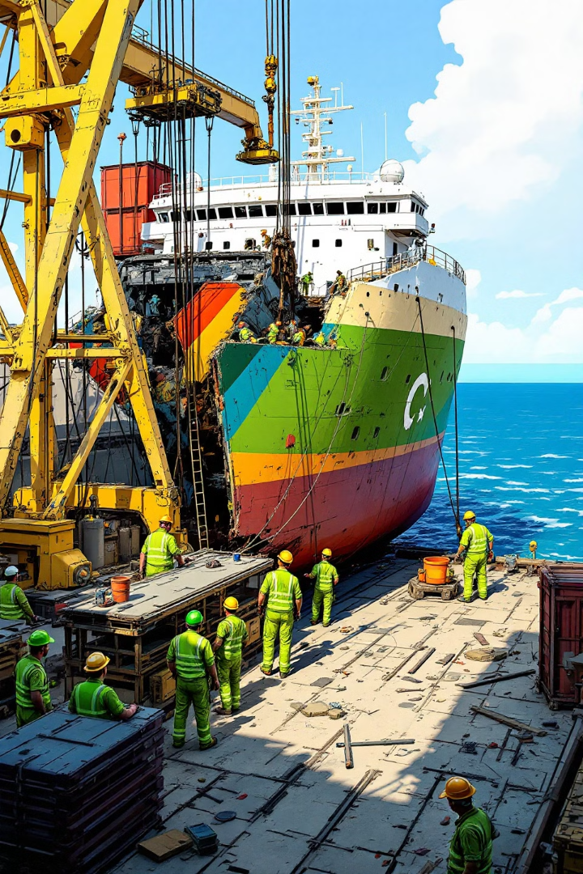
Ship Recycling
Process of dismantling end-of-life ships to recover steel and other valuable materials.
India is a global leader, with Alang–Sosiya in Gujarat being the world’s largest ship recycling cluster.
Governed internationally by the Hong Kong Convention (HKC), which came into force on 26 June 2025.
Integral to the circular economy, reducing the demand for virgin raw materials.
India’s Role & Importance
Handles 30% - 35% of global ship recycling tonnage annually.
Provides 20 - 25% of India’s ferrous scrap requirement, reducing dependence on imports.
India is the only country with 100+ HKC Compliant Recycling Yards. [115 HKC Compliant Yards at Alang]
Supplies input material for the Green Steel ecosystem, boosting India’s low-carbon transition.
Generates direct employment for 15000+ workers and indirect livelihood opportunities for thousands more in logistics, scrap processing, and allied services.
Strengthens India’s position in global maritime sustainability.
INDIA is a Global Leader with 115 HKC Compliant Ship Recycling Yards
Notes:
Ship Recycling – India’s Global Leadership
Ship recycling is not just an industry - it is a strategic pillar of India’s maritime economy and the global circular economy. The process dismantles end-of-life ships to recover steel and other valuable materials, reducing the demand for virgin raw inputs while cutting costs and emissions.
India today stands as the global leader in ship recycling, with the Alang–Sosiya cluster in Gujarat being the world’s largest ship recycling facility. The entry into force of the Hong Kong Convention (HKC) on 26 June 2025 has further elevated India’s role, as it is the only nation with more than 100 HKC-compliant yards (115 facilities).
This sector contributes significantly to India’s industrial ecosystem by:
Handling 30–35% of global ship recycling tonnage annually, consolidating India’s leadership.
Meeting 20–25% of India’s ferrous scrap demand, reducing import dependency and saving valuable forex.
Feeding the Green Steel ecosystem, providing low-carbon inputs that align with India’s net-zero ambitions.
The impact is equally socio-economic. Ship recycling directly employs 15,000+ workers, while creating indirect livelihood opportunities for thousands more in logistics, scrap processing, and allied services. The industry has become a driver of inclusive growth, while embedding high safety and environmental standards under HKC compliance.
By anchoring itself as the hub of HKC-compliant recycling, India not only ensures sustainable resource recovery but also strengthens its position as a global leader in maritime sustainability.

Slide 24
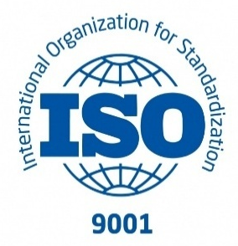
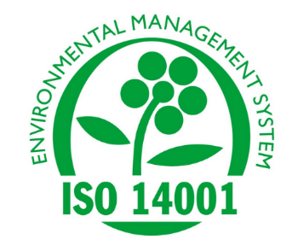
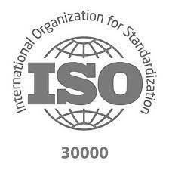
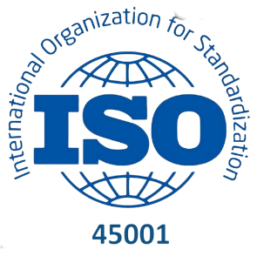
Ship Recycling Portal
An upcoming unified national digital platform under DGS to implement the Hong Kong Convention (HKC) and Recycling of Ships Act (2019), ensuring real-time, transparent and accountable governance of India’s ship recycling ecosystem.
Importance of Portal
Transparency : Digitally traceable inspections, certifications & audits
Accountability : Role-based actions with time-stamped compliance trails
Real-time Monitoring : Central oversight by DGS & State Authorities
Global Credibility : Auditable records for IMO, foreign Flag States & shipowners
Stakeholder Integration : Connects DGS, GMB, ROs, yards, service suppliers
Core Functional Modules
Yard Registration & Licensing
Inventory of Hazardous Materials Inventory
RRC Certification Registry
SRP Submission & Approval
Inspection, Audit & ISO Compliance Tracking (ISO 9001, 14001, 30000, 45001)
Incident & Non-Conformity Reporting
Worker Training & Competency Records
GISIS / IMO Reporting Integration
ISO 9001
Quality Management System (QMS)
ISO 14001
Environmental Management System (EMS)
ISO 30000
Ship Recycling Management System (RSMS)
ISO 45001
Occupational Health & Safety
Management System (OHSMS)
Notes:
Ship Recycling Portal
The Ship Recycling Portal is being developed as India’s national digital command platform for implementing the Hong Kong Convention (HKC) and the Recycling of Ships Act, 2019. Its purpose is to centralize every regulatory, safety and environmental function into a unified digital architecture, replacing fragmented documentation and manual oversight with real-time, auditable governance. Post-HKC entry into force, digital traceability will be essential to retaining India’s leadership in global ship recycling.
The portal will enable complete life-cycle governance, from yard registration and licensing to issuance of Ready-for-Recycling Certificates (RRC), monitoring of hazardous materials and oversight of ISO-certified processes. Role-based access and time-stamped actions will ensure accountability by DGS, Gujarat Maritime Board and State Pollution Control Boards. Integration with GISIS and IMO reporting systems will provide global credibility by ensuring transparent access for foreign Flag States, classification societies and shipowners.
Beyond compliance, the portal institutionalises digital monitoring of inspections, surveillance logs, incident reporting and corrective actions. Worker training records, safety drills, waste disposal data and non-conformity reports will be digitally stored, building a permanent regulatory archive. This transition marks a strategic shift from physical inspection dependency to data-driven environmental governance, positioning India as the first digitally governed ship recycling nation under HKC.
ISO Standards
To operationalise HKC requirements, Indian recycling yards are adopting a comprehensive ISO framework that strengthens transparency, worker safety and environmental stewardship.
ISO 9001 – Quality Management System Ensures procedural discipline, documentation integrity and continuous improvement across recycling operations. It is the baseline for demonstrating reliability to international shipowners.
ISO 14001 – Environmental Management System Addresses pollution prevention, hazardous waste handling and resource control. It demonstrates alignment with global expectations for safe dismantling and coastal environmental protection.
ISO 30000 – Ship Recycling Management System The core ISO standard specific to ship recycling under HKC. It governs implementation of IHM, Safe-for-Hot-Work certifications, containment of toxic substances and controlled dismantling protocols.
ISO 45001 – Occupational Health & Safety Management System Protects workers through structured risk assessment, PPE enforcement, emergency response planning and health surveillance. It elevates human safety to audit-ready international standards.
Collectively, these ISO certifications move Indian yards from compliance demonstration to institutional credibility, assuring shipowners, classification societies and global regulators that end-of-life vessels are dismantled with full environmental and human safety assurance.

Slide 25
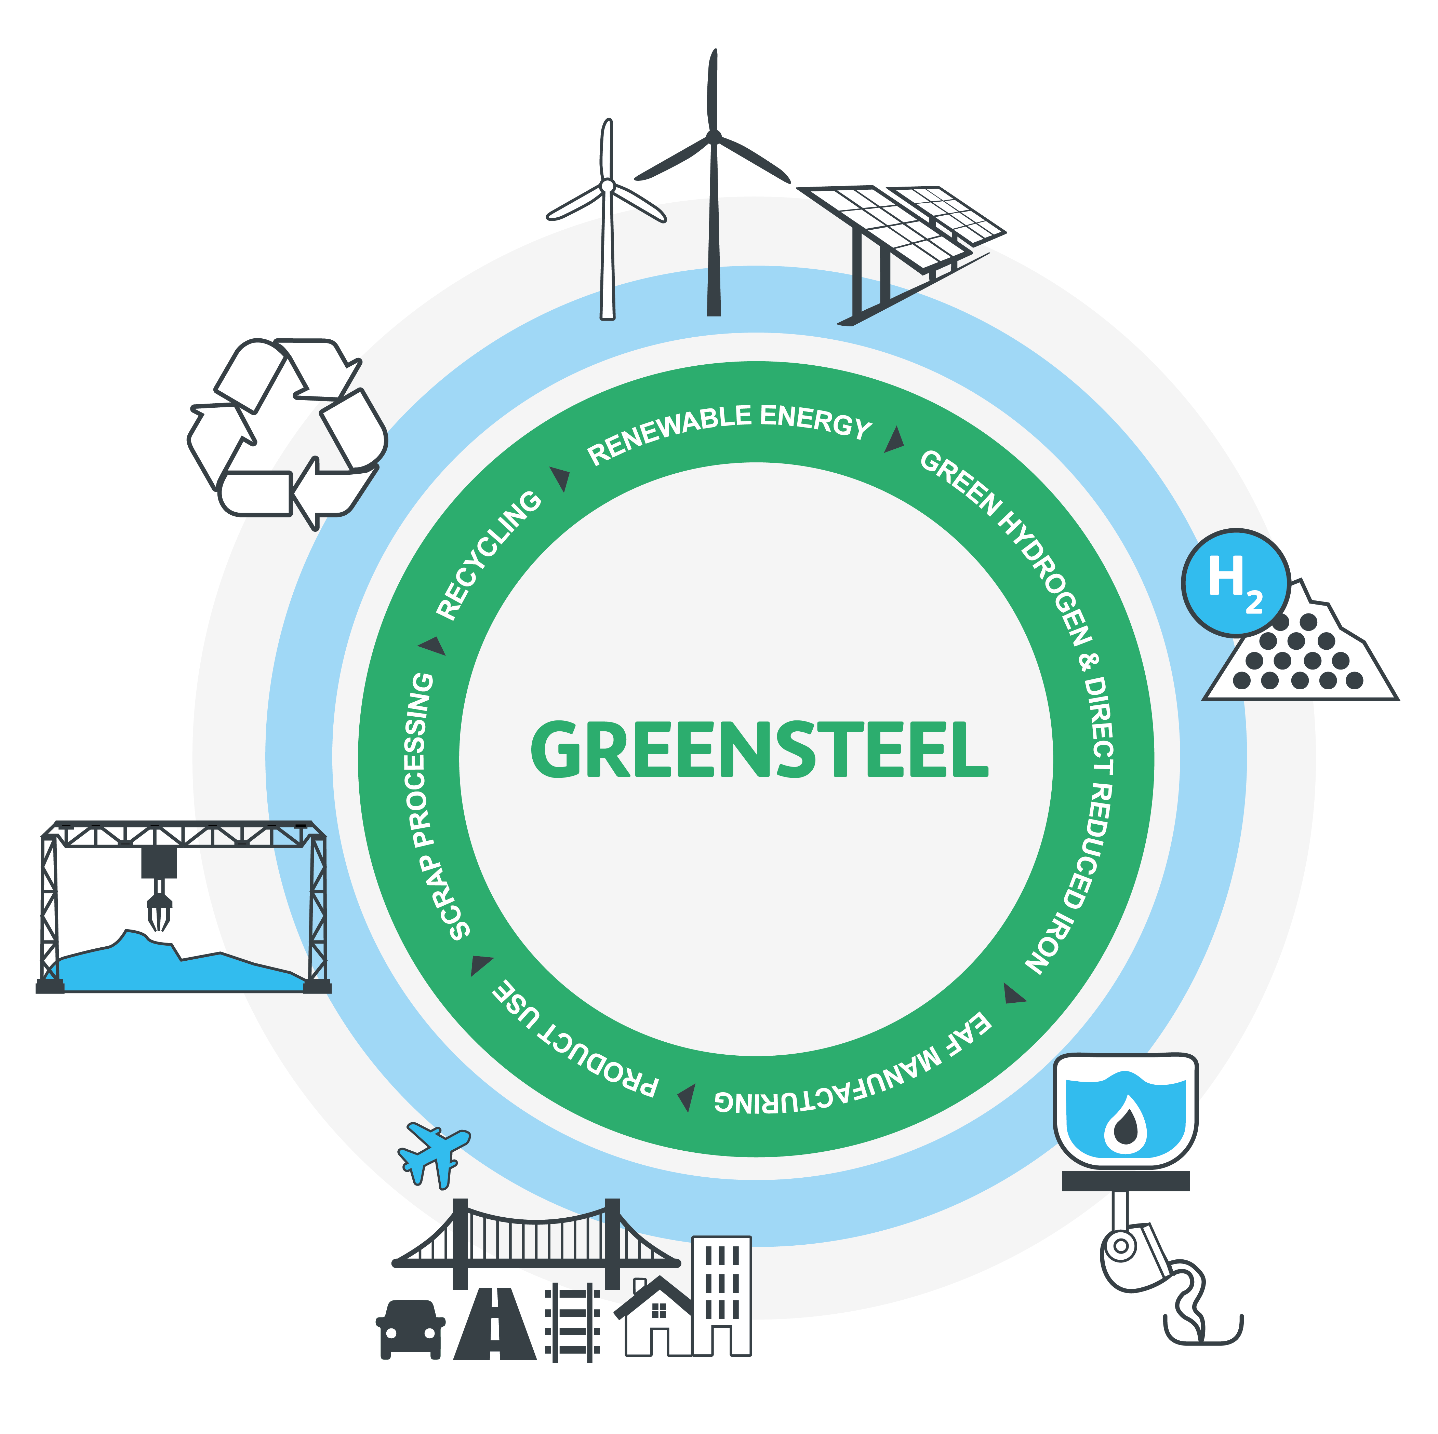

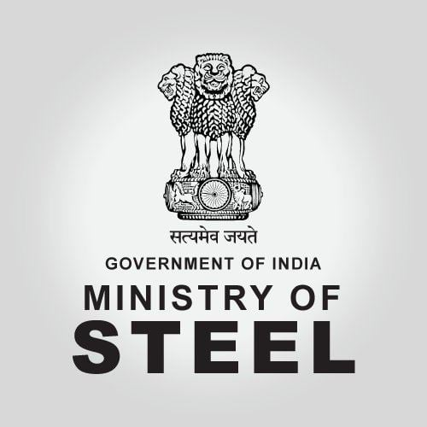
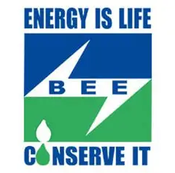
Green Steel
• “Green Steel” is defined by its CO₂ emission intensity — less than 2.2 tonnes CO₂ emission per tonne of finished steel (tfs).
• Greenness is expressed as a percentage reduction below the threshold of 2.2 2.2 tonnes CO₂ emission per tonne of finished steel
• The certification done via NISST (National Institute of Secondary Steel Technology) under the Bureau of Energy Efficiency (BEE) Measurement, Reporting and Verification (MRV) methodology.
Star Rating System
Five-Star: < 1.6 tCO₂e/tfs
Four-Star: 1.6 – 2.0 tCO₂e/tfs
Three-Star: 2.0 – 2.2 tCO₂e/tfs
> 2.2 tCO₂e/tfs → Not eligible for green rating
(Threshold reviewed every 3 years)
Notes:
Green Steel : Driving Low-Carbon Industrial Transition
Steel is the backbone of infrastructure and shipbuilding, but it is also one of the most carbon-intensive industries. The concept of “Green Steel” aims to transform this challenge into an opportunity by reducing the CO₂ emission intensity below 2.2 tonnes of CO₂ per tonne of finished steel (tfs).
Greenness is measured as the percentage reduction in emissions below this threshold. Certification is carried out by the National Institute of Secondary Steel Technology (NISST) under the Bureau of Energy Efficiency (BEE), using global-standard Measurement, Reporting and Verification (MRV) methodologies.
A star rating system makes this framework transparent and globally competitive:
Five-Star: < 1.6 tCO₂e/tfs
Four-Star: 1.6 – 2.0 tCO₂e/tfs
Three-Star: 2.0 – 2.2 tCO₂e/tfs
Above 2.2 tCO₂e/tfs: Not eligible for green certification
The threshold will be reviewed every three years, ensuring constant ambition in line with climate goals.
Green Steel is not just about lowering emissions,it is about embedding recycling, renewable energy, hydrogen and energy efficiency into steel production, linking ship recycling and scrap recovery directly with India’s circular economy vision. This makes India’s maritime sector a critical contributor to the Green Steel ecosystem, reinforcing both industrial competitiveness and sustainability.
Emissions Covered : Scope 1 : Direct emissions from steel making Scope 2 : Indirect emissions from purchased electricity
Scope 3 : Agglomeration, pellet making, coke making, beneficiation, raw materials

Slide 26
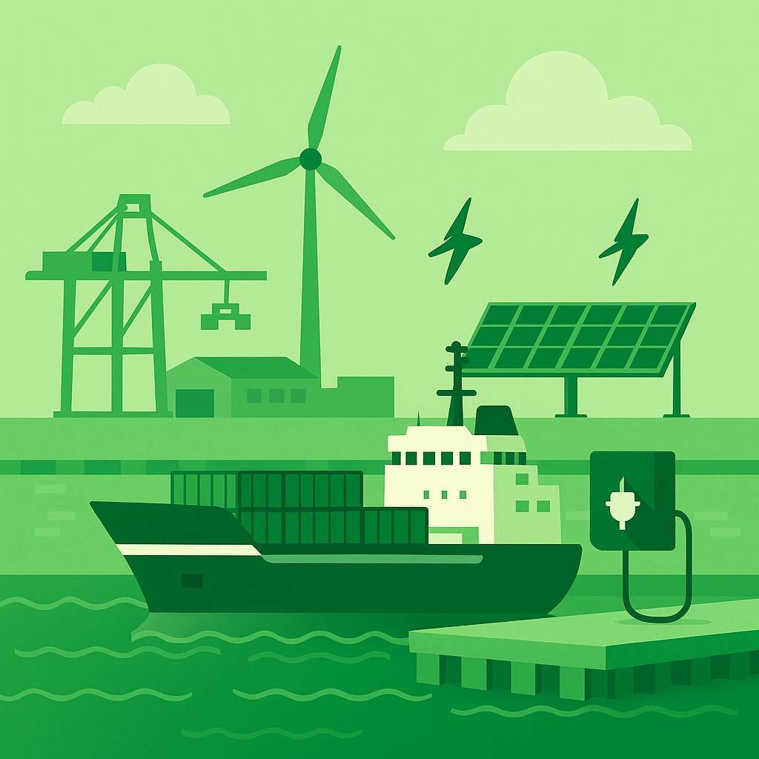
Green Ports
Driving Sustainable Maritime Growth
Concept of Green Ports
Ports designed & operated with minimal environmental impact.
Integration of clean energy, efficiency, and circular economy practices.
Key Initiatives in India
Harit Sagar Guidelines (2023): National framework for green port development.
Proposed National Port Sustainability Code (NPSC): Metrics for emissions, energy, waste, and community impact.
Onshore Power Supply (OPS): Cut ship emissions at berth by connecting to shore electricity.
Waste & Plastics Management: Port reception facilities for MARPOL Annex V compliance.
Benefits
Reduces GHG emissions & pollution.
Improves air quality in port cities.
Promotes India’s Blue Economy & Green Economy transition.
Aligns with IMO decarbonization goals & India’s Viksit Bharat 2047 vision.
Notes:
Green Ports – Driving Sustainable Maritime Growth
“Ports are the beating hearts of global trade, but they are also significant contributors to emissions. The idea of ‘Green Ports’ is to transform these engines of growth into anchors of sustainability.”
The concept of Green Ports focuses on designing and operating ports with minimal environmental impact. This means integrating clean energy, resource efficiency, and circular economy practices into every aspect of port planning, operation, and logistics.
India has already taken pioneering steps in this direction through several flagship initiatives.
The Harit Sagar Guidelines, launched in 2023, provide a national framework for green port development, setting out principles for clean energy adoption, pollution control, waste management, and biodiversity protection.
Building upon this, the National Port Sustainability Council (NPSC) , envisaged, will establish measurable metrics for emissions, energy use, waste, and community impact, ensuring that environmental performance becomes a benchmark for all Indian ports.
The next major enabler is Onshore Power Supply (OPS), which allows ships at berth to connect directly to the grid and switch off their auxiliary engines. This single intervention can drastically reduce CO₂, NOx, and SOx emissions in port zones, improving air quality and public health in surrounding cities.
Complementing this, the Directorate is driving Waste and Plastics Management under MARPOL Annex V compliance, ensuring that port reception facilities can handle ship-generated waste and prevent marine pollution.
Together, these efforts yield tangible benefits:
Reduction in greenhouse gas emissions and pollution,
Improved air quality in port-adjacent areas, and
A major boost to India’s Blue and Green Economy transition.
Importantly, these initiatives are fully aligned with IMO’s decarbonisation goals and India’s long-term national vision , Viksit Bharat 2047.
“In essence, Green Ports are not just an environmental necessity — they are the next competitive advantage for India’s maritime sector. They signal that economic growth and ecological responsibility can, and must, advance together.”

Slide 27




Sustainable Indicators for Indian Ports
Green Port Index (GPI)
Port Readiness Level (PRL)
Evaluates ports based on carbon footprint, alternative fuels adoption, energy efficiency, sustainable logistics, and waste management practices.
Assesses ports' preparedness for energy transition, digitalization, and compliance with global environmental regulations.
Shore Power Readiness Indicator (SPRI)
Environmental Ship Index (ESI)
Measures infrastructure for cold ironing and renewable energy integration to reduce emissions from berthed ships.
Incentivizes ship operators to reduce emissions through a rating system that evaluates NOx, SOx, and CO₂ emissions.
These indicators create a robust framework to measure and enhance the environmental performance of Indian ports. By institutionalizing them, India positions itself as a global frontrunner in green maritime logistics & unlocks access to international green shipping corridors and drive long-term net-zero ambitions.
Notes:
Sustainable Indicators for Indian Ports
To translate the sustainability vision into measurable action, a structured set of indicators has been developed to evaluate and benchmark the environmental and operational performance of Indian ports.
The first is the Green Port Index, which assesses ports on their overall carbon footprint, energy efficiency, use of alternative fuels, and adoption of sustainable logistics and waste management practices. This index provides a clear picture of how each port contributes to reducing emissions and improving environmental stewardship.
The Port Readiness Level, or PRL, measures how prepared ports are for the transition to cleaner energy systems and digital operations. It evaluates their compliance with global environmental standards and their readiness to adopt emerging technologies.
The third parameter is the Shore Power Readiness Indicator, which reflects the extent to which ports are equipped with shore-to-ship power infrastructure. This is a crucial enabler in reducing emissions from berthed ships, allowing vessels to draw renewable electricity instead of using onboard auxiliary engines.
Finally, the Environmental Ship Index encourages ship operators to voluntarily reduce emissions by adopting cleaner fuels and technologies. It introduces a transparent rating system that accounts for NOx, SOx, and CO₂ performance, rewarding environmentally responsible operations.
Collectively, these four indicators form a comprehensive framework for driving measurable sustainability across the Indian port ecosystem. By institutionalising these benchmarks, India is positioning its ports as global frontrunners in green logistics and opening pathways for participation in international green shipping corridors under its long-term Net Zero vision.”

Slide 28
GHG Emission Scope at Ports
Scope 1 : Direct Emissions
From port owned/controlled sources
Diesel generators, cranes, dredgers, tugs, vehicles, fuel machinery
Scope 2 : Indirect Emissions (Purchased Electricity)
Power consumed but generated elsewhere (state grid)
Lighting, pumps, reefer containers, terminal operations
Coal-based power grid
Scope 3 : Other Indirect Emissions (Value Chain)
Ships at berth using auxiliary engines
Trucks, trains, barges transporting cargo
Business travel, investments, waste treatment
Notes:
GHG Emission Scope at Ports
“To address decarbonization effectively, it is essential that we first understand where emissions actually come from within the port ecosystem.”
The Greenhouse Gas (GHG) emission inventory at ports is categorized under three internationally recognized scopes - Scope 1, Scope 2 and Scope 3, as per global reporting standards.
Scope 1 – Direct Emissions: These are emissions that originate from port-owned or controlled sources. They include diesel generators, cranes, dredgers, tugs, vehicles, and other fuel-based machinery operating within the port premises. Essentially, these are emissions under the port authority’s direct operational control, and therefore, the easiest to measure, monitor, and manage.
Scope 2 – Indirect Emissions: These arise from the purchase of electricity that is generated elsewhere, typically from the state grid. Although the port does not produce these emissions directly, they are linked to the energy consumed for lighting, pumping systems, refrigerated containers, and terminal operations. In countries where grid power is largely coal-based, Scope 2 emissions form a substantial part of the port’s total carbon footprint — highlighting the importance of shifting towards renewable energy and solar-based supply for port operations.
Scope 3 – Other Indirect Emissions (Value Chain): These are the most complex and far-reaching. They include emissions from ships at berth using auxiliary engines, trucks, trains, and barges transporting cargo, as well as business travel, waste treatment, and upstream investments associated with port operations.
Though these emissions occur outside the direct boundary of the port, they represent the largest share of overall carbon impact — making stakeholder coordination and value-chain partnerships crucial for achieving real decarbonisation.
“Recognizing these three scopes allows ports to move from a fragmented to a holistic approach — one where emissions are mapped, mitigated, and monitored across the entire logistics chain.”

Slide 29
Green Tug Transition Program
To replace/retrofit conventional diesel-powered tugs with green tugs powered by alternative fuels (like LNG, methanol, hydrogen, or hybrid-electric systems).
At least 50% of all tugs in major ports to be green tugs by 2030.
100% transition by 2047
Current Status
~ 400 + tugs are operating in Indian Waters (Coastal & Offshore Tugs)
~ 45% of tugs are 20 + years
~ 20% of tugs are 30 + years
Problem
Older tugs generate higher emissions and operate with lower efficiency compared to modern green tugs.
Opportunity and Way Forward
Replacing / retrofitting old fleet
Deployment of hybrid & green-fuel powered tugs
Incentivize adoption of LNG, Methanol, Hydrogen & Electric tugs
Notes:
Green Tug Transition Program
“Tugs are among the most vital assets in port operations, yet they also remain some of the most carbon-intensive. The Green Tug Transition Program represents India’s commitment to make even these workhorses of the harbour cleaner, smarter, and future-ready.”
Today, more than 400 tugs operate in Indian waters, serving both coastal and offshore operations. However, nearly 45% of these tugs are over 20 years old, and about one-fifth are more than 30 years old.
These older vessels operate with lower fuel efficiency, higher maintenance costs, and significantly higher emissions, especially of carbon dioxide, nitrogen oxides, and particulate matter.
Recognizing this challenge, the Ministry of Ports, Shipping and Waterways under the Harit Sagar Guidelines (2023) has mandated a phased transition towards green and low-emission port crafts.
The goal is ambitious yet achievable :
To ensure that at least 50% of all tugs operating in major ports are green tugs by 2030, and
To achieve a 100% transition by 2047.
Under these guidelines, all ports are required to retrofit or replace existing diesel-powered tugs with vessels powered by alternative fuels such as LNG, methanol, hydrogen, or hybrid-electric propulsion systems.
These clean-energy conversions align with India’s National Green Hydrogen Mission and the targets for port decarbonization set under Maritime Amrit Kaal Vision 2047.
The opportunity here is multifold:
Retrofitting the old fleet not only cuts emissions but also extends vessel life and reduces operational costs.
Deploying hybrid and fuel-flexible tugs creates resilience in fuel sourcing and operational efficiency.
And most importantly, it opens pathways to incentivize early adopters, by offering tariff rebates or priority berthing for cleaner vessels, as recommended in the Harit Sagar framework
.
In the long term, India’s ports are expected to develop the infrastructure for bunkering and refuelling of green fuels, including green hydrogen and ammonia, by 2035. This will enable a seamless green transition not only for tugs but for all port craft and coastal vessels.
“In essence, the Green Tug Transition Program is more than a fleet upgrade. It is a statement of intent. It signals that India’s ports will lead by example, proving that sustainability and operational efficiency can move together, powered by innovation and responsibility.”

Slide 30
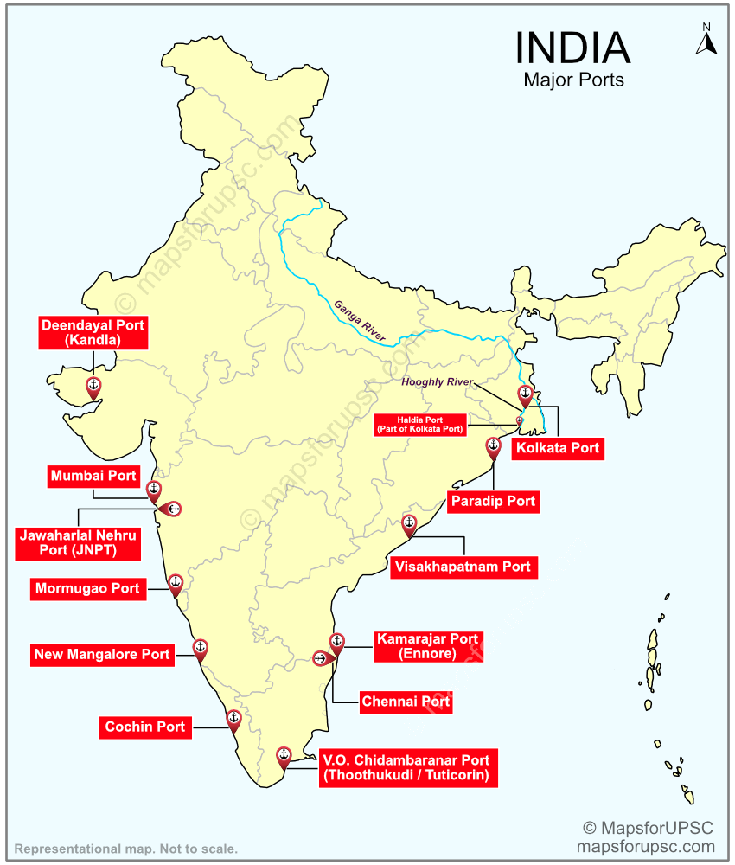
East - West Coastal Ports
India has major coastal ports on both East and West coasts essential for offshore hydrocarbon logistics and transportation. These ports play a vital role in India’s offshore oil exploration, crude oil imports, and LNG terminal operations. India hosts 12 major ports and around 200 minor ports.
West Coast Ports
East Coast Ports
such as Kandla, Mumbai, Jawaharlal Nehru Port (Nhava Sheva), Mormugao, New Mangalore, and Kochi support offshore oil and gas supply chains.
Include Chennai, Tuticorin, Ennore, Visakhapatnam, Paradip, Haldia, Kolkata, and Port Blair, facilitating imports and exports for hydrocarbon industries.
74 ports
ISPS compliant, overseen by DG Shipping and proposed Bureau of Port Security (BoPS) for centralized security audit and risk management
Notes:
East–West Coastal Ports
“India’s maritime strength lies not only in its scale but also in its strategic geography, with two vibrant coastlines forming the backbone of our ocean economy.”
India is uniquely positioned with major ports along both the East and West coasts, each playing a complementary role in supporting the nation’s trade, energy logistics, and offshore industries. Collectively, India operates 12 major ports and over 200 non-major ports, connecting the country’s hinterland to global shipping routes and energy corridors.
Starting with the West Coast, ports such as Kandla, Mumbai, Jawaharlal Nehru Port (Nhava Sheva), Mormugao, New Mangalore, and Kochi handle a substantial share of crude oil, LNG, and offshore hydrocarbon logistics. These ports are crucial nodes in India’s energy import and refining network, and many are being developed as multi-fuel energy hubs under the Harit Sagar and Maritime Amrit Kaal Vision 2047 frameworks.
On the East Coast, ports including Chennai, Ennore, Tuticorin, Visakhapatnam, Paradip, Haldia, Kolkata, and Port Blair serve as gateways for bulk exports, hydrocarbon industries, and offshore exploration in the Bay of Bengal. They are also central to India’s Act East policy, connecting with Southeast Asian markets through BIMSTEC and ASEAN maritime corridors.
Altogether, India’s major and minor ports across both coasts play a decisive role in ensuring supply chain continuity for offshore energy, coastal shipping, and LNG terminal operations.
A total of 74 ports in India are ISPS-compliant, overseen by the Directorate General of Shipping, ensuring adherence to international port and ship security standards. Plans are also underway for establishing a centralised Bureau of Port Security (BoPS) to strengthen security audits, risk management, and cyber-security systems, fully aligned with international frameworks and IMO guidelines.
“Through balanced development of both coastlines, west for hydrocarbons and energy logistics, and east for trade and connectivity — India is creating a resilient and sustainable coastal ecosystem, essential for a secure and thriving Blue Economy.”

Slide 31
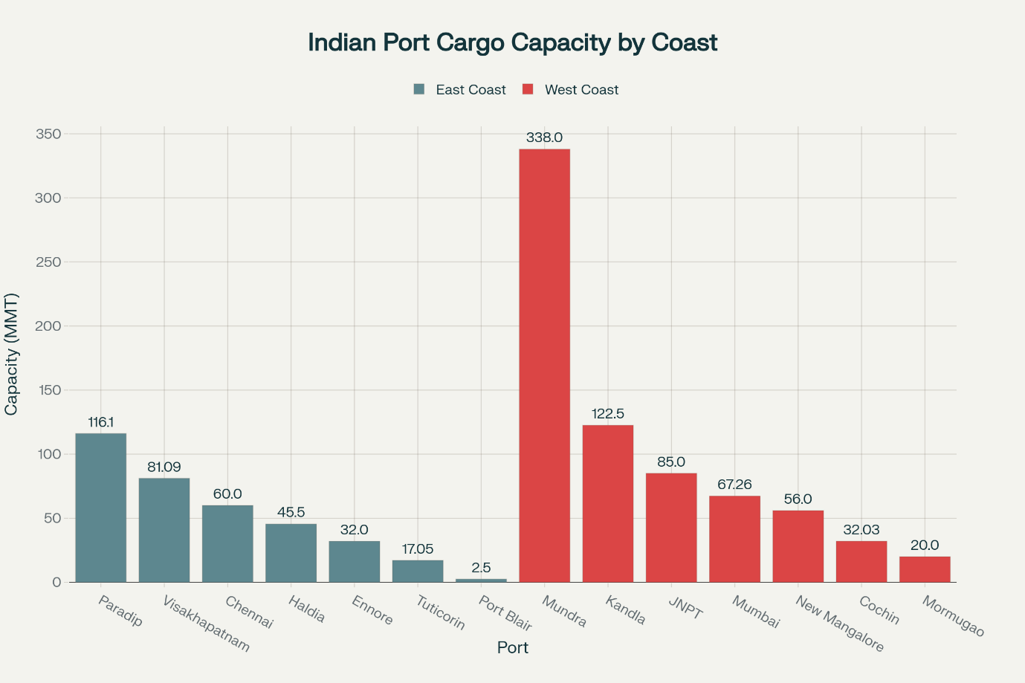
Cargo Handling Capacity of Major Indian Ports by Coast
(Million Metric Tonnes)
Notes:
Cargo Handling Capacity of Major Indian Ports by Coast
“This chart illustrates the comparative cargo handling capacity across India’s major ports, clearly reflecting both our scale and regional strengths.”
India’s major ports together handle over 1,600 million metric tonnes (MMT) of cargo annually, with a total installed capacity exceeding 2,700 MMT per year. What’s evident here is the balance and complementarity between the East and West coasts — each playing distinct yet interlinked roles in India’s maritime economy.
On the East Coast, ports like Paradip (116 MMT), Visakhapatnam (81 MMT), and Chennai (60 MMT) are among the largest, serving as primary gateways for coal, iron ore, fertilizers, and coastal bulk cargo. These ports also anchor India’s trade with ASEAN and East Asian economies, reinforcing the country’s “Act East” trade corridors.
On the West Coast, we see some of the highest capacities and throughput levels, particularly Mundra Port with 338 MMT, followed by Kandla (122.5 MMT), JNPT (85 MMT), and Mumbai Port (67 MMT). These ports dominate in crude oil imports, containerized trade, and energy logistics, forming the lifeline for India’s hydrocarbon and refinery supply chains.
Together, these figures highlight that the West Coast currently handles a larger share of India’s maritime traffic, owing to higher industrial density and export-linked infrastructure. However, with ongoing capacity expansions and modernization under Sagarmala, Harit Sagar, and the National Port Sustainability Code (NPSC), the East Coast is rapidly catching up — particularly in the green and multi-fuel terminal segment.
What’s also important to note is that ports like Tuticorin, Ennore, and Cochin are increasingly diversifying into clean energy logistics, including LNG, hydrogen, and offshore wind components, which aligns directly with India’s Maritime Amrit Kaal Vision 2047.
“So, while the West Coast continues to drive India’s trade and energy imports, the East Coast is emerging as the new frontier for green growth, coastal connectivity, and international integration.”

Slide 32
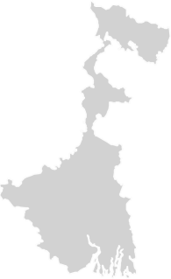
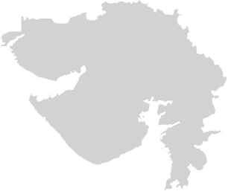
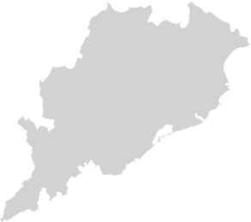
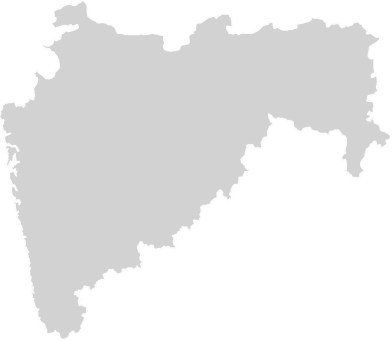
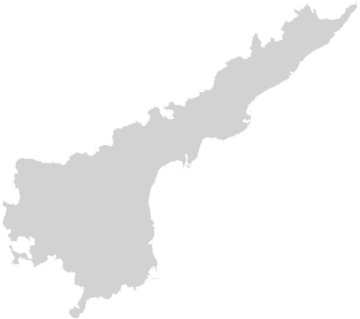



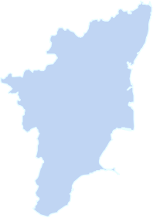
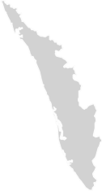
Shipbuilding Scenario in India
53*
30,000
GT
State-wise Shipbuilding capacities
Gujarat
436300 DWT
West Bengal
44000 DWT
Current Annual Tonnage Produced
Total Number of Shipyards
*Annual Report, MoPSW
Maharashtra
94300 DWT
Approved Financial Package to unlock 4.5M GT shipbuilding capacity, create ~ 30 lakh jobs and attract ₹ 4.5 lakh cr investments.
Goa
130000 DWT
Andhra Pradesh
80000 DWT
Karnataka
41000 DWT
Tamil Nadu
26000 DWT
Kerala
253600 DWT
Notes:
Shipbuilding Scenario in India
India’s shipbuilding sector is at a nascent but strategically critical stage. Despite having a long coastline and 53 shipyards (as per MoPSW Annual Report), the country currently produces only 30,000 GT annually, which is a small fraction compared to global leaders like China, South Korea, and Japan.
State-wise Capacities
Gujarat leads the sector with 436,300 DWT, thanks to strong industrial clusters and its coastal industrial base.
Kerala (253,600 DWT) and Goa (130,000 DWT) follow, with a mix of public and private yards catering to both defence and commercial orders.
Other contributors include Maharashtra (94,300 DWT), Andhra Pradesh (80,000 DWT), West Bengal (44,000 DWT), Karnataka (41,000 DWT), and Tamil Nadu (26,000 DWT).
This distribution highlights both the geographic spread of capacity and the under-utilisation of existing infrastructure.
Yard Capacities & Capabilities
India has a handful of large shipyards capable of handling vessels >200m in length — such as Cochin Shipyard Limited (CSL), Hindustan Shipyard Ltd. (HSL), L&T Shipbuilding, and
Central/State-run units like CMSRU and CKSRU.
Medium shipyards like Timblo, Chowgule, Titagarh Marine, CSL’s smaller yards and others handle repair, retrofits, and mid-sized vessels.
However, compared to international peers, India suffers from low productivity, high financing costs, and limited scale economies.
Policy & Investment Push
The Government has approved a financial package to unlock 4.5 million GT of shipbuilding capacity, with the potential to:
Generate ~30 lakh direct and indirect jobs,
Attract ₹4.5 lakh crore in investments,
Enable India to become a competitive global player while reducing dependence on foreign-built ships.
Strategic Importance
Shipbuilding is not just an industrial sector, it is a strategic enabler:
Strengthens national security by ensuring domestic capacity for defence and merchant fleets.
Boosts exports of vessels and green technology in the long run.
Creates linkages with allied industries — steel, engineering, design, marine electronics, and services.
Positions India to capture a share of the $70 billion global shipbuilding market.
India’s shipbuilding potential is large but untapped. With policy support, financing reforms, and capacity unlocking, the sector can shift from a marginal 30,000 GT output today to millions of GT tomorrow, creating jobs, saving forex, and boosting strategic autonomy.

Slide 33

Four Pillar Approach
Cabinet approves ₹ 69,725 crore Package to Revitalize India’s Shipbuilding and Maritime Sector
Data Source : PIB Press Release 24 SEP 2025 3:08PM
01
02
03
04
Shipbuilding Financial Assistance scheme
Maritime Development Fund
Shipbuilding Development Scheme (SbDS)
Legal, Policy and Process Reforms
Allocation: ₹24,736 crore
Allocation: ₹25,000 crore
Allocation: ₹19,989 crore
Overcome cost differential vis-a-vis foreign shipyards.
Credit note for new builds against ship scrapping in India
Establish National Shipbuilding Mission
Enable long-term financing to maritime sector through equity & debt-based funding:
Maritime Investment Fund
Interest Incentivization Fund
Credit Guarantee Fund
Greenfield cluster creation
Brownfield capacity expansion to 4.5 million GT
Risk outlay for shipyards
Setting up of India Ship Technology Centre (ISTC) as Apex body under IMU
Demand aggregation
Large Ships as infrastructure
Taxation issues
Flagging reforms
Notes:
Four Pillar Approach
The Government of India has approved a ₹69,725 crore revitalization package for the shipbuilding and maritime sector. This approach rests on four strategic pillars, each addressing a critical gap in India’s maritime ecosystem- finance, infrastructure, capacity building, and regulatory reform.
Pillar 1: Shipbuilding Financial Assistance Scheme (₹24,736 crore)
Designed to bridge the cost differential between Indian and foreign shipyards, ensuring domestic yards remain competitive.
Provides credit notes for new shipbuilding linked to ship recycling in India, integrating sustainability with incentives.
Includes the establishment of a National Shipbuilding Mission to provide long-term policy continuity.
Pillar 2: Maritime Development Fund (₹25,000 crore)
Aims to enable long-term, low-cost financing for the maritime sector via equity and debt funding.
Includes sub-funds such as:
Maritime Investment Fund – to channel capital into greenfield projects.
Interest Incentivization Fund – to reduce borrowing costs for shipyards.
Credit Guarantee Fund – to reduce lender risk and unlock financing for vessel owners and builders.
Pillar 3: Shipbuilding Development Scheme (SbDS) (₹19,989 crore)
Focused on capacity expansion and technology development:
Establishment of greenfield shipbuilding clusters.
Brownfield expansion to raise capacity to 4.5 million GT.
Risk outlay provision to protect shipyards from financial exposure.
Setting up the India Ship Technology Centre (ISTC) under IMU as an apex R&D and training body for advanced shipbuilding technologies.
Pillar 4: Legal, Policy, and Process Reforms
Demand aggregation across PSU, defence, and private shipping to secure consistent order books for Indian shipyards.
Recognition of large ships as infrastructure, unlocking easier access to long-term credit and incentives.
Addressing taxation anomalies and simplifying GST/customs regimes for shipbuilders.
Flagging reforms to incentivize Indian ownership of ships and reduce outflow of foreign exchange.
The four-pillar approach provides a holistic framework for India’s shipbuilding revival. With financing support, capacity expansion, institutional R&D, and regulatory reforms, the package seeks to transform India into a globally competitive shipbuilding hub, aligned with Maritime India Vision 2030 and Maritime Amrit Kaal Vision 2047.

Slide 34
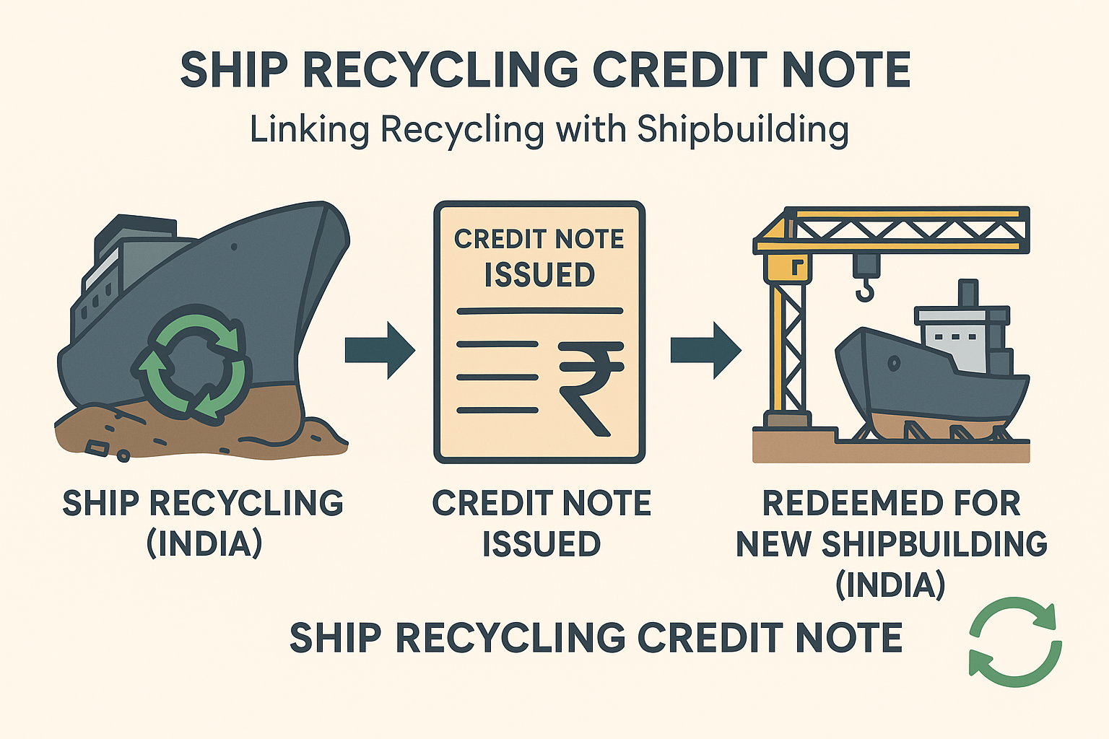
Ship Recycling Credit Note
Introduced under Ship Building Financial Assistance Scheme 2.0 (SBFA 2.0)
Incentivizes ship owners to recycle in India and build new ships in Indian shipyards
Allocation of : ₹ 4,001 crore
(under SBFA)
How It Works
When a vessel is recycled in a certified Indian yard, the ship owner receives a Credit Note for 40% of scrap value.
The Credit Note remains valid until the owner builds a new vessel/ ship in an Indian shipyard
Redeemed as financial assistance/ subsidy under SBFA 2.0
Expected Benefits
Encourages safe and HKC compliant ship recycling in India
Provides direct business boost for Indian shipyards
Attracts new players to India’s ship recycling and shipbuilding ecosystem
Strengthens India’s circular economy : recycling feeds into new shipbuilding
Positions India as a leader in Green and Sustainable Maritime Growth
Notes:
Ship Recycling Credit Note
The Ship Recycling Credit Note (SRCN) is one of the most innovative financial instruments introduced under the Shipbuilding Financial Assistance Scheme 2.0 (SBFA 2.0) with an allocation of ₹4,001 crore. It directly links India’s ship recycling strength with the growth of its shipbuilding industry.
How It Works
When a vessel is dismantled in a certified Indian ship recycling yard, the shipowner is issued a Credit Note worth 40% of the vessel’s scrap value.
This Credit Note remains valid until the shipowner invests in building a new vessel in an Indian shipyard.
The note is then redeemed as financial assistance/subsidy under SBFA 2.0, lowering the effective cost of new builds in India.
Expected Benefits
Boosts HKC-compliant recycling: Encourages safe, environmentally sound, and Hong Kong Convention (HKC) aligned ship recycling practices.
Strengthens shipbuilding: Directly channels recycling activity into new orders for Indian shipyards, ensuring business continuity.
Expands ecosystem participation: Incentivizes new players—both domestic and foreign—to engage with India’s recycling and shipbuilding ecosystem.
Promotes circular economy: Scrap steel and materials from recycling feed into the production of new ships, cutting raw material dependence.
Sustainability leadership: Positions India as a global leader in green and sustainable maritime growth, combining recycling, green steel, and shipbuilding.
Strategic Importance
SRCN acts as a bridge policy, ensuring that India’s dominance in recycling (30–35% of global share) translates into a thriving shipbuilding industry.
It enhances India’s image as the only country with over 100 HKC-compliant yards while simultaneously supporting its ambition to become a shipbuilding hub.
By tying together scrap recovery, circular economy, and green shipbuilding, it creates a self-sustaining maritime growth cycle.
The Ship Recycling Credit Note is a game-changer, as it uniquely integrates recycling with new construction, creating a virtuous cycle of sustainability, industrial growth, and employment.

Slide 35
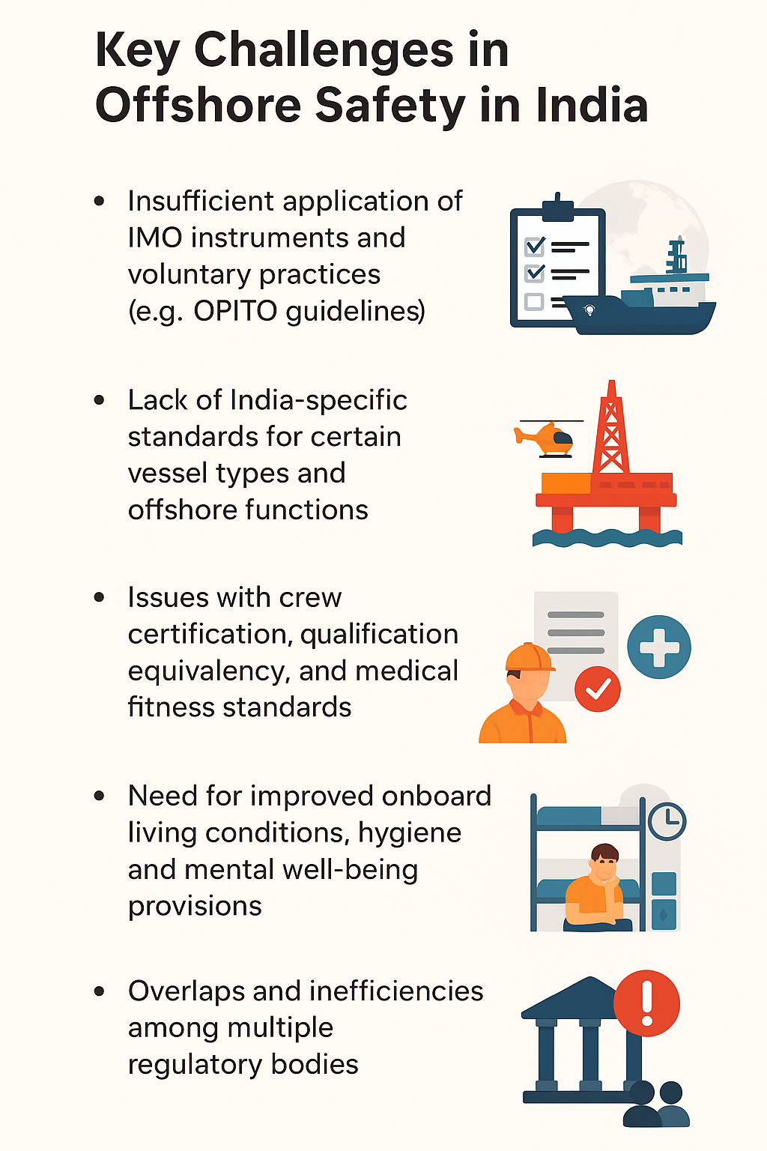
Key Challenges in Offshore Safety in India
Insufficient application of IMO instruments and voluntary practices (e.g., OPITO guidelines)
Lack of India-specific standards for certain vessel types and offshore functions
Issues with crew certification, qualification equivalency, and medical fitness standards
Need for improved onboard living conditions, hygiene, and mental well-being provisions
Overlaps and inefficiencies among multiple regulatory bodies
Rapid growth in offshore sectors like wind energy and seabed mineral exploration necessitates updated safety protocols
Notes:
Key Challenges in Offshore Safety in India
“India’s offshore footprint is expanding rapidly—from hydrocarbons to offshore wind and seabed resources. That growth must be matched with a safety framework that is modern, harmonised and enforced consistently.”
1) Patchy application of IMO instruments & voluntary best practices
On many offshore units and support vessels, ISM/SOLAS/MARPOL compliance is uneven, especially for non-SOLAS craft and special purpose vessels supporting offshore projects.
Best-practice frameworks (e.g., OPITO for workforce safety, emergency response and helicopter ops) aren’t uniformly embedded in contracts or audits.
2) India-specific standards gaps for certain vessel types & functions
Grey areas persist for construction/support craft, DP vessels, accommodation barges, jack-ups/MODUs, cable-lay, and geotechnical survey vessels.
Interface with port rules and coastal regulation often leaves SIMOPS (simultaneous operations) under-specified. Message: publish a cross-walk code that localises IMO/ILO/OPITO/Class requirements for Indian conditions (environment, met-ocean, cyclone, monsoon).
3) Crew certification, equivalency & medical standards
Inconsistent recognition of specialist competencies (DP, rigger/lifting, H2S awareness, banksman, helideck team, confined-space & hot-work).
Medical fitness: variation in offshore-specific medicals, fatigue management, and mental-wellbeing protocols for long hitches. Message: a national competency matrix for offshore roles with mutual recognition, minimum refresher cycles, and offshore-specific medical standard aligned to MLC/ILO.
4) Living conditions, hygiene & wellbeing on board
Older units fall short on accommodation standards, potable water, HVAC, hygiene, recreation and connectivity, impacting safety culture and retention. Message: enforce minimum habitability standards for all offshore units operating in Indian waters; link to permit-to-work and contract scorecards.
5) Fragmented oversight & overlaps
Multiple bodies (DGS, MoPNG/OISD, DGH, Coast Guard, Flag/ROs, state maritime boards) create gaps at the interfaces: design approvals, SIMOPS, EER (evacuation, escape & rescue), and post-incident learning. Message: operationalise a single coordination window (ODAG-style) with shared audits, unified checklists, and a common incident taxonomy to pool lessons learned.
6) SIMOPS & high-risk task control (Explicit Addition)
Lifting operations, hot work, confined space entry, diving, ROV, bunkering, and helicopter operations need stronger permit-to-work discipline and toolbox talk culture during multi-contractor campaigns. Message: mandate SIMOPS plans and Golden Rules; require independent lifting & DP assurance on critical jobs.
7) Emergency preparedness & pollution response
Alignment with NOS-DCP for oil spills, mass-casualty medevac, cyclone/hurricane plans and SAR with Coast Guard is uneven in exercises and equipment pre-positioning. Message: drill calendar with joint exercises; publish time-to-respond KPIs by basin.
8) Cyber-physical security of offshore assets
Increasing automation/DP/OT systems raise cyber risk to safety-critical functions. Message: adopt OT-cyber baselines (access control, patching, logging, incident drills) as part of statutory audits.
9) Data, near-miss reporting & transparency
Under-reporting of near misses dulls learning loops; incident data isn’t always comparable across agencies. Message: create a national offshore safety dashboard (anonymised) with leading indicators (training currency, PTW quality, SIMOPS audits, medevac readiness) in addition to lagging indicators.
“Our objective is simple: one risk standard, applied everywhere—regardless of flag, function or contractor. That is how we protect lives, protect the ocean, and protect India’s energy transition.”

Slide 36

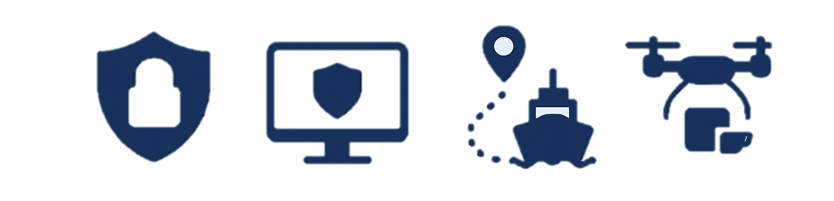
Key Initiatives of DGS for Health & Safety
Bureau of Port Security (BoPS): Statutory port security, SoCs, AIS, drones, CCTV, multi-agency command.
On the port side, the integration of the Bureau of Port Security will establish a dedicated statutory body. Security Operation Centres in every major port will use AIS, drone surveillance, VHF, and CCTV systems to provide real-time tracking and multi-agency coordination with CISF, Customs, Port Police, and intelligence services.
Occupational Safety & Medical Response:
On the port side, the integration of the Bureau of Port Security will establish a dedicated statutory body. Security Operation Centres in every major port will use AIS, drone surveillance, VHF, and CCTV systems to provide real-time tracking and multi-agency coordination with CISF, Customs, Port Police, and intelligence services.
Notes:
Key Initiatives of DGS for Health & Safety
“Safety and security form the foundation of a resilient maritime ecosystem. The Directorate has therefore prioritized two critical interventions, port security and occupational health, to safeguard both infrastructure and personnel.”
The first initiative is the Bureau of Port Security, or BoPS. This will be a statutory body under the Directorate General of Shipping, designed to ensure a unified national framework for port security. The Bureau will establish Security Operation Centres in every major port, integrating multiple systems — Automatic Identification System (AIS), VHF, drone surveillance, CCTV networks, and multi-agency command platforms.
These centres will enable real-time vessel and cargo tracking, early warning, and coordinated responses across CISF, Customs, Port Police, and intelligence services.
BoPS will also serve as the nodal authority for ISPS compliance and will oversee standard operating procedures (SoCs) for port security audits, risk assessments, and emergency drills. In the long term, it will evolve into an integrated national maritime safety and security grid, aligning with the objectives of the Maritime Amrit Kaal Vision 2047.
The second pillar is Occupational Safety and Medical Response.
This focuses on strengthening health and emergency preparedness across ports and maritime establishments. Every major port is being directed to establish a 24x7 medical emergency response system, supported by trained first responders, telemedicine facilities, and tie-ups with nearby hospitals. These systems will ensure immediate assistance for incidents such as fire, toxic exposure, falls, or mechanical injuries, particularly in high-risk port and shipyard zones.
The Directorate is also working on integrating occupational safety data, including incident reports, training coverage, and near-miss analytics, into a centralised dashboard for better monitoring and prevention.
“Together, these initiatives, BoPS and the Occupational Safety Framework, represent a paradigm shift from reactive to proactive safety. They will allow India’s ports to not only meet global standards but set new ones in maritime security, resilience, and worker welfare.”

Slide 37
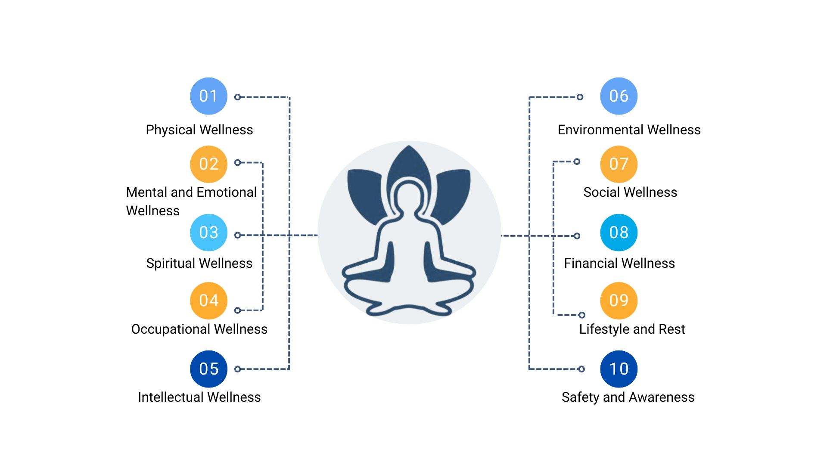
Sagar Mein Yog
Seafarers may face multiple challenges in coping with the challenges of life at sea. Hence, the Sagar Mein Yog initiative has been taken to cater to the complete wellness of seafarers.
About Sagar Mein Yog
10 components of Sagar Mein Yog
A flagship initiative by the DGS, India, aimed at promoting physical and mental well-being among seafarers through yoga and mindfulness practices.
Programme seeks to provide complete wellness at Sea/Shore
LMS training program modules have been prepared and would be launched
In the second phase, the SMY training through the LMS to be made mandatory for all serving seafarers.
Stepping Stone towards a Safe & Sustainable Ocean Economy in India
Notes:
Sagar Mein Yog
“Behind every vessel that sails safely across our oceans stands a seafarer, an individual who spends months away from home, facing isolation, stress, and unpredictable working conditions. The ‘Sagar Mein Yog’ initiative was conceived to care for that individual, to bring balance, wellness, and mindfulness to life at sea.”
The Sagar Mein Yog (SMY) programme is a flagship initiative of the Directorate General of Shipping, dedicated to promoting the physical, mental, and emotional well-being of Indian seafarers. It recognizes that the challenges faced at sea are not only technical but also human, long working hours, isolation, fatigue, and anxiety often take a toll on the body and mind.
Through yoga, meditation, and mindfulness practices, Sagar Mein Yog seeks to nurture holistic wellness , addressing both physical health and mental resilience. It is designed to support seafarers at all stages of their service, whether onboard a ship or stationed ashore.
The programme is structured around ten key dimensions of wellness:
Physical wellness, through guided routines for flexibility and strength;
Mental and emotional wellness, promoting mindfulness and stress management;
Spiritual wellness, focusing on inner peace and stability;
Occupational and intellectual wellness, improving focus and awareness;
Environmental and social wellness, encouraging harmony and teamwork at sea;
Financial wellness, ensuring stability and security; and
Lifestyle, rest, and safety awareness, which complete the holistic approach.
To make this accessible to all, the Directorate has developed dedicated Learning Management System (LMS) training modules. These are being rolled out as part of the national e-learning framework for seafarers, and in the next phase, participation in the SMY course will be mandatory for all serving Indian seafarers.
“Sagar Mein Yog is not just a programme — it’s a promise. A promise that as India strengthens its maritime capability, it will also safeguard the mind, body, and spirit of those who keep our seas moving.”

Slide 38
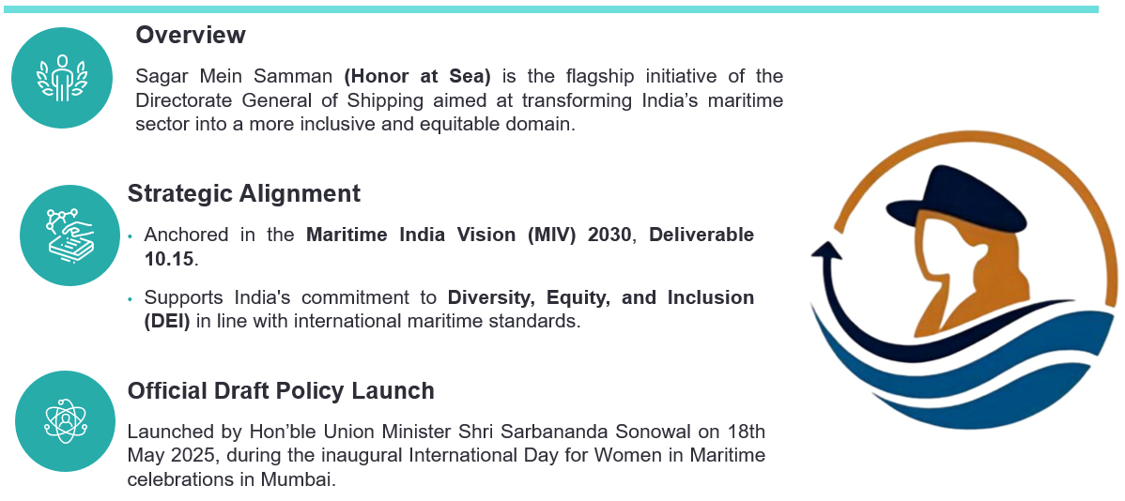
Sagar Mein Samman
Stepping Stone towards a Safe & Sustainable Ocean Economy in India
Notes:
Sagar Mein Samman
“If Sagar Mein Yog focuses on the wellness of the individual, Sagar Mein Samman focuses on the dignity of the profession. It represents the human side of maritime reform — respect, equality, and opportunity for all who serve at sea.”
Sagar Mein Samman, or “Honor at Sea,” is a flagship inclusivity initiative of the Directorate General of Shipping.
It aims to transform India’s maritime sector into a more equitable, diverse, and inclusive domain, one where every seafarer, regardless of gender or background, is treated with respect, safety, and equal opportunity.
This initiative is anchored within the Maritime India Vision 2030, under Deliverable 10.15, which calls for enhancing diversity, equity, and inclusion across the maritime workforce.
The policy is fully aligned with international frameworks, particularly the IMO’s and ILO’s evolving focus on DEI (Diversity, Equity, and Inclusion) in shipping and port operations.
Under Sagar Mein Samman, DGS envisions the creation of an ecosystem that:
Ensures safe and respectful working environments onboard ships;
Promotes gender diversity and leadership opportunities for women;
Encourages inclusive recruitment and training frameworks; and
Establishes mechanisms to address harassment, discrimination, or bias in the maritime workplace.
The draft policy was officially launched by Hon’ble Union Minister Shri Sarbananda Sonowal on 18th May 2025, coinciding with the International Day for Women in Maritime, during a special event held in Mumbai.
The launch marked a symbolic and practical milestone — showcasing India’s commitment to embedding inclusion not as an aspiration, but as a statutory principle in its maritime governance.
“Through Sagar Mein Samman, India sends a clear message — that the strength of our maritime community lies not only in ships and ports, but in the people who serve them, with dignity, equality, and honor.”

Slide 39
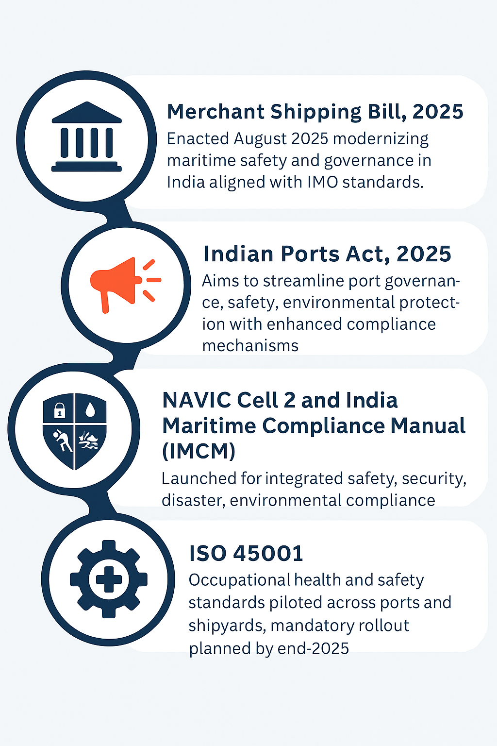
Regulatory & Institutional Initiatives 2025
Stepping Stone towards a Safe & Sustainable Ocean Economy in India
Notes:
Regulatory & Institutional Initiatives 2025
“The year 2025 marks a pivotal phase in India’s maritime governance — one defined by modernization, accountability, and safety. Several landmark legislative and institutional reforms are now reshaping the framework of how India governs its seas.”
Let me begin with the Merchant Shipping Bill, 2025. This Bill, enacted in August 2025, represents the first major overhaul of India’s maritime law in over six decades. It replaces outdated provisions, simplifies compliance, and brings India’s maritime governance fully in line with IMO conventions and global best practices. The Bill also emphasizes digital certification, environmental responsibility, and accountability in ship management, ensuring that India remains a credible and progressive flag administration.
Parallel to this, the Indian Ports Act, 2025 is being rolled out. This Act aims to streamline port governance, strengthen oversight mechanisms, and embed sustainability and safety standards into the operations of both major and non-major ports. It introduces uniform compliance mechanisms for environmental protection, port security, and worker safety — ensuring every port operates with transparency and responsibility. Together, these two legislative reforms lay the foundation for an integrated, modern maritime legal architecture.
Another milestone is the establishment of NAVIC Cell 2 and the launch of the India Maritime Compliance Manual (IMCM). These initiatives serve as the backbone of a national compliance ecosystem, covering safety, security, environmental protection, and disaster response. They enable real-time coordination between the Directorate General of Shipping, Coast Guard, Navy, and port authorities, ensuring that compliance is not just reactive but predictive and technology-driven.
Finally, the Directorate has piloted the ISO 45001 Occupational Health & Safety Standards across several ports and shipyards. This initiative aims to institutionalize safe working practices and hazard prevention across India’s maritime workplaces. The certification will become mandatory for all shipyards and port facilities by end-2025, aligning national operations with international occupational safety benchmarks.
“These initiatives together mark a decisive shift — from regulation to reform, from compliance to culture, and from fragmented oversight to integrated maritime governance. The result is a safer, smarter, and globally aligned maritime India.”

Slide 40
MS Act 2025
Offshore Relevance
Purpose: Consolidates Indian shipping law, repealing the MS Act 1958 and Coastal Vessel 1838 Act.
Global Alignment: Compliance with IMO conventions and international treaties.
Applicability: Covers all Indian-registered vessels, including offshore; applies to foreign vessels in Indian waters.
Regulatory Strengthening: Expands powers of DG Shipping & Government to regulate operations and protect national interests.
Continuity: Existing registrations, licenses, and certificates remain valid until replaced.
Safety & Welfare: Stronger provisions on abandonment, repatriation, and seafarer welfare.
National Interest: Promotes Indian shipping growth, efficient mercantile marine, and offshore energy logistics.
Offshore Relevance of MS Act 2025:
Applicability: Covers offshore supply ships, drill ships, floating platforms, and construction vessels registered in India or operating in Indian waters.
Safety & Certification: Offshore vessels must meet updated safety, manning, and survey norms aligned with SOLAS, MARPOL, Load Line and other IMO conventions.
Seafarer Welfare: Stronger safeguards on abandonment, repatriation, and welfare for offshore crews.
Jurisdiction: Strengthens India’s flag state control and port/coastal state jurisdiction over offshore and EEZ operations.
Energy Integration: Provides legal support for offshore hydrocarbons, LNG, and renewable projects such as offshore wind.
Notes:
MS Act 2025 (Offshore Relevance)
“The Merchant Shipping Act 2025 is not just a legislative update — it is a complete modernization of India’s maritime legal architecture. It reflects India’s commitment to safe, sustainable, and globally aligned maritime governance.”
The Merchant Shipping Act 2025 consolidates and modernizes Indian shipping law by repealing outdated legislations such as the Merchant Shipping Act of 1958 and the Coastal Vessels Act of 1838. This reform brings all aspects of Indian shipping, from ship registration to manning, certification, and welfare — under one comprehensive and internationally harmonized framework.
A key aspect of this new Act is its direct relevance to the offshore sector.
For the first time, offshore supply ships, drill ships, floating platforms, and construction vessels operating in Indian waters are formally covered within the national regulatory framework. This ensures that safety, manning, and survey standards for offshore vessels are fully aligned with IMO conventions such as SOLAS, MARPOL, and the Load Line Convention.
The Act also enhances flag state control and port/coastal state jurisdiction, strengthening India’s oversight of offshore and EEZ operations.
By expanding the powers of the Directorate General of Shipping, it ensures regulatory continuity and swift enforcement, particularly in areas concerning crew certification, vessel survey, and environmental compliance.
Another important dimension is seafarer welfare. The Act introduces stronger provisions for crew protection, including mechanisms for abandonment and repatriation, and ensures that offshore workers enjoy the same welfare and safety protections as mainstream seafarers. It reinforces India’s commitment to the Maritime Labour Convention (MLC) principles.
From an economic standpoint, the Act supports India’s energy and offshore ambitions. It provides legal clarity and institutional backing for activities involving offshore hydrocarbons, LNG bunkering, and renewable energy projects such as offshore wind farms, helping India diversify its energy mix while maintaining maritime safety and environmental integrity.
“In essence, the Merchant Shipping Act 2025 redefines maritime governance — making it adaptive to new technologies, responsive to the offshore energy transition, and anchored firmly in global best practices.”

Slide 41
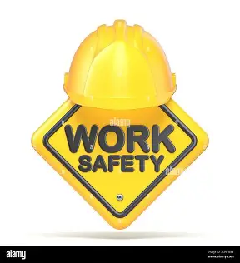

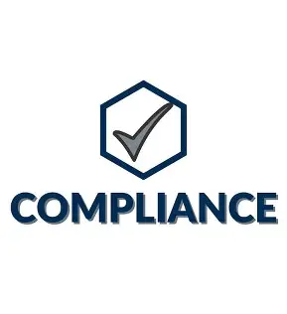


Occupational Safety and Health (OSH)
A multidisciplinary field concerned with the safety, health, and welfare of people at work.
Ensuring safe working conditions, preventing workplace accidents, injuries, and illnesses.
Protecting workers physical, mental, and social well-being in all occupations.
Key Elements of OSH
Workplace Safety –
Preventing accidents, hazards, and unsafe conditions.
Occupational Health
monitoring health risks like chemicals, noise, stress, ergonomics.
Compliance & Standards
Following national laws and international guidelines (ILO conventions, ISO 45001)
Training & Awareness
safety drills, use of protective equipment, hazard reporting.
Welfare Measures
Ensuring first aid, rest breaks, proper working hours, and mental health support.
Training and Awareness
Notes:
Occupational Safety and Health (OSH)
“Safety is not just a compliance requirement — it is a culture, a value system that protects lives and sustains productivity across every port, shipyard, and offshore operation.”
Occupational Safety and Health, or OSH, represents a multidisciplinary framework that safeguards the physical, mental, and social well-being of workers across all maritime domains. It encompasses every aspect of workplace protection, from preventing accidents and exposure to harmful substances, to ensuring proper working hours, welfare amenities, and psychological support.
At its core, OSH rests on five interconnected pillars:
Workplace Safety – This covers proactive hazard identification, accident prevention, and ensuring that work environments meet established safety design and operation standards. The focus is on eliminating unsafe practices through inspection, supervision, and a culture of vigilance.
Occupational Health – Beyond safety, health management plays an equal role. It involves monitoring risks from noise, vibration, chemicals, ergonomics, and stress, ensuring workers’ long-term health is not compromised by their work environment.
Compliance and Standards – India’s maritime OSH framework is now being aligned with ILO conventions and ISO 45001, which emphasize structured risk management, emergency preparedness, and continuous improvement. This alignment ensures that ports and shipyards adopt uniform health and safety benchmarks comparable to global standards.
Training and Awareness – The most effective safeguard is an informed workforce. Regular safety drills, use of personal protective equipment (PPE), and reporting mechanisms empower workers to identify and mitigate risks themselves, turning compliance into habit.
Welfare Measures – Finally, OSH extends to rest periods, nutrition, mental health support, and family well-being — particularly critical for seafarers and port workers exposed to prolonged stress or isolation.
In the maritime sector, these elements are being institutionalized through the ISO 45001 certification program, recently piloted across major ports and shipyards under the Directorate General of Shipping.
This initiative not only strengthens accountability but also positions India as a leader in workforce safety and welfare in the global maritime domain.
“Through OSH, India is setting a precedent — that economic growth and worker welfare are not competing goals, but parallel priorities. Safe workers build resilient nations.”

Slide 42
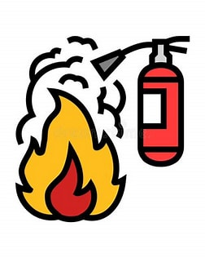





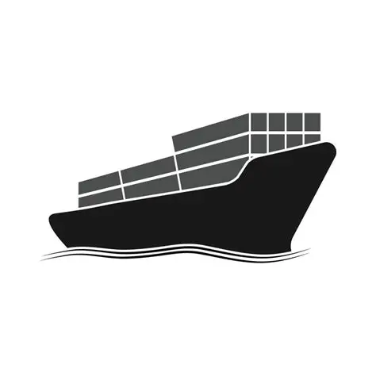
OSH in Shipping and Maritime Context
Importance of OSH in Maritime
OSH in Shipping and Maritime Context
Seafarers face hazardous working and living conditions: confined spaces, heavy machinery, extreme weather, long hours, and isolation.
Ensures compliance with international conventions like:
Onboard Safety Drills
Prevention of occupational hazards
Seafarers’ mental well-being
Maritime Labour Convention (MLC, 2006) – covers health, safety, and welfare.
STCW Convention – training and watchkeeping requirements that indirectly support safety.
SOLAS (Safety of Life at Sea) – mandatory safety standards
ILO
Compliance with ILO Maritime Labour Convention (MLC, 2006)
Use of PPE
STCW
Medical care and telemedical
support
SOLAS
Safe cargo and machinery
operations
Notes:
OSH in Shipping and Maritime Context
“The maritime sector presents one of the most challenging work environments in the world — one that demands not just skill and discipline, but also resilience and protection.”
Occupational Safety and Health (OSH) in the maritime context carries unique complexities because of the very nature of seafaring. Seafarers often operate in hazardous and isolated conditions, dealing with confined spaces, heavy machinery, extreme weather, and long shifts away from home. This combination of physical strain and psychological isolation makes the industry particularly vulnerable to accidents, fatigue, and mental health concerns.
Recognizing these challenges, OSH in the maritime domain is anchored in international conventions and mandatory frameworks that together ensure holistic protection of maritime workers.
The Maritime Labour Convention (MLC, 2006), adopted by the International Labour Organization, is the cornerstone. It covers health, safety, and welfare — ensuring decent working and living conditions, onboard accommodation standards, medical care, and social protection for seafarers. India’s full compliance with the MLC demonstrates our commitment to maintaining international parity in seafarer welfare.
Complementing this, the STCW Convention (Standards of Training, Certification and Watchkeeping) defines the training and competency benchmarks that underpin safety. It ensures that all seafarers are adequately trained for emergency response, equipment handling, and fatigue management — which indirectly but powerfully support workplace safety.
Then comes SOLAS — the Safety of Life at Sea Convention, one of the oldest and most fundamental IMO instruments. SOLAS mandates safety drills, fire control systems, lifesaving appliances, and emergency preparedness as core operational requirements — saving countless lives every year.
In practical application, India’s OSH framework translates these conventions into daily operational safety measures:
Regular onboard safety drills and hazard prevention protocols.
Provision of PPE and safety signage across shipboard and port operations.
Telemedical assistance and onboard medical care for emergencies.
Proactive emphasis on mental well-being, addressing stress and isolation through training, peer support, and initiatives like Sagar Mein Yog.
And finally, safe cargo and machinery operations, aligned with the ISM Code and MARPOL safety management systems.
“When we talk about maritime safety, it is not just about ships and cargo — it is about people. A safe and cared-for seafarer ensures a safe ship, a compliant company, and a stronger maritime nation.”

Slide 43
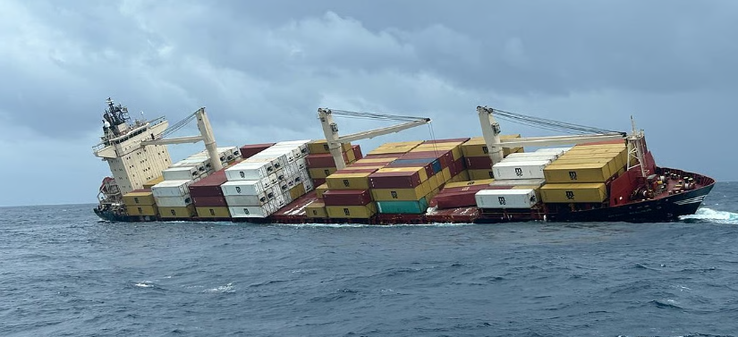
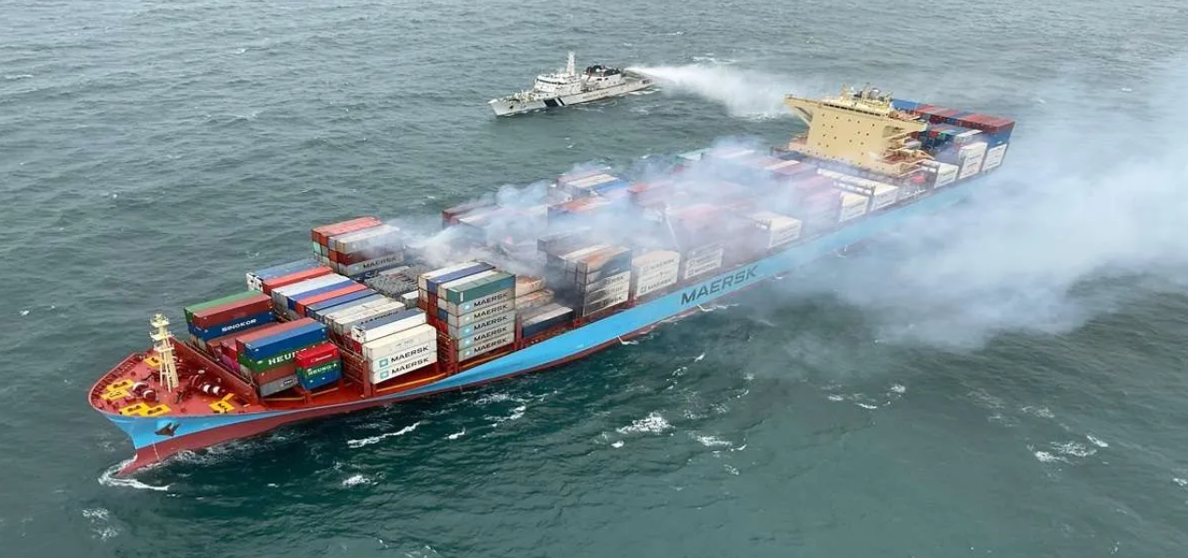
Need for OSH in Maritime Sector (1/2)
High-risk working environment: long voyages, harsh weather, hazardous cargo
Physical & mental health challenges for seafarers
Recent incidents highlight need for stronger safety standards
Essential for environmental protection & emergency preparedness
Ensures dignity, welfare, and productivity of India’s 2.5+ lakh seafarers
May 2025: MSC Elsa III, containing hazardous chemicals, capsized off the shore of Kochi
July 2024: Major Fire erupted on a merchant ship MV Maersk Frankfurt off the Karnataka coast
Notes:
Need for OSH in Maritime Sector (1/2)
“Every maritime accident is not just a loss of cargo or infrastructure — it’s a reminder of the human cost that underscores why safety cannot be optional in our sector.”
The maritime sector is inherently high-risk. A domain where nature, machinery, and human endurance intersect every single day. Seafarers routinely work in extreme conditions: long voyages, harsh weather, and exposure to hazardous cargo. Confined environments, fatigue, and physical isolation make their work among the most demanding in any industry.
This reality has been reinforced by recent maritime incidents, including:
The MSC Elsa III incident in May 2025, which capsized off Kochi carrying hazardous chemicals, highlighting the scale of environmental and safety challenges that can arise from one vessel casualty.
The Maersk Frankfurt fire off the Karnataka coast in July 2024, a reminder that even modern ships are vulnerable to onboard emergencies — particularly those involving flammable or chemical cargo.
Such cases are not isolated; they reflect systemic vulnerabilities in operational safety, emergency response readiness, and crew fatigue management. They underline the need for a robust Occupational Safety and Health framework tailored specifically for maritime and offshore conditions.
OSH in this context is not limited to compliance — it is a strategic necessity. It directly supports:
Environmental protection, by minimizing the likelihood and impact of marine pollution incidents.
Emergency preparedness, ensuring ports and ships can respond swiftly and effectively to crises.
Crew welfare and productivity, by ensuring that India’s 2.5+ lakh seafarers work with dignity, safety, and access to mental health and medical support systems.
The message is clear: a safe seafarer is the foundation of a safe ship, and a safe ship sustains global trade. India’s leadership in implementing stronger OSH mechanisms — from port operations to offshore installations — will be key to preventing recurrence and strengthening our maritime resilience.
“Every step we take in OSH today protects not just our people and coasts, but also the credibility of India’s maritime commitment to the world.”

Slide 44
Need for OSH in Maritime Sector (2/2)
Maritime Incidents
Casualties in 2024
153
186
21.6%
83
61
In 2023
In 2024
Increase in incidents
Deaths
Injuries
Most incidents involved vessels flagged in Marshall Islands, Panama, and India where Indian flagged vessels see a decline in fire/explosion cases from
7 (2023) to 1 (2024)
Absence of Single Institution for Safety Oversight
Notes:
Need for OSH in Maritime Sector (2/2)
“The numbers before us are not just statistics — they represent incidents that could have been prevented through stronger safety oversight, better preparedness, and coordinated institutional action.”
The data presents a clear and concerning trend. India recorded 186 maritime incidents in 2024, marking a 21.6% increase compared to 153 cases in 2023. While such figures mirror a global rise in marine traffic and operational intensity, they also underscore the gaps in proactive safety management — particularly in areas of occupational health, training, and emergency response.
In terms of casualties, 83 lives were lost and 61 injuries reported across international and coastal operations in 2024. These are not abstract figures — each represents a seafarer, a family, a community affected.
They emphasize why Occupational Safety and Health (OSH) must move from being a compliance topic to an operational priority across every vessel and port.
Interestingly, despite this global rise, Indian-flagged vessels have shown measurable improvement.
Fire and explosion cases, for instance, declined from 7 in 2023 to just 1 in 2024, demonstrating the impact of enhanced inspections, improved crew training, and the introduction of preventive maintenance frameworks. This positive shift validates the direction of India’s maritime administration under the Directorate General of Shipping — where safety culture is being institutionalized through both regulatory and behavioral reform.
However, the data also brings out a structural weakness ie the absence of a single, dedicated institution for safety oversight. Currently, multiple agencies handle aspects of port, offshore, and crew safety, leading to overlaps and inefficiencies.
A unified framework or National Maritime Safety Authority could bridge these gaps — ensuring standardized audits, centralized incident tracking, and faster policy response.
“As India’s fleet grows and our maritime footprint expands, safety must remain non-negotiable. The vision ahead is clear — zero preventable incidents, a protected workforce, and an accountable institutional framework.”

Slide 45
Port-wise Distribution of Marine Incidents
2019-2024
Table: Marine Incidents Registered at Ports (2019-2024)
Key Insights:
Deendayal Port Authority recorded the highest incidents: 28
Followed by Chennai (19), Cochin (18), and Visakhapatnam (15)
These four ports account for nearly 74% of all incidents
Ports like Tuticorin (2) and Jawaharlal Nehru (1) have minimal incidents
Incidents correlate strongly with vessel traffic density and cargo handling complexity
Port | Total Incidents
Deendayal Port Authority | 28
Chennai Port Authority | 19
Cochin Port Authority | 18
Visakhapatnam Port Authority | 15
Paradip Port Authority | 10
New Mangalore Port Authority | 8
Murmugao Port Authority | 4
Kolkata Port Authority | 3
Tuticorin Port Authority | 2
Jawaharlal Nehru Port Authority | 1
Impact of Marine Incidents
Endanger human lives
Disrupt trade and operational efficiency
Undermine India’s global maritime competitiveness
Notes:
Port-wise Distribution of Marine Incidents (2019–2024)
“When we analyze safety performance across India’s ports, we begin to see clear correlations — between operational scale, cargo complexity, and the frequency of marine incidents.”
This data covers a five-year period from 2019 to 2024, tracking incident reports submitted by port authorities across India.
At the top of the list is the Deendayal Port Authority (Kandla), which recorded 28 marine incidents, the highest in the country.
It is followed by Chennai (19), Cochin (18), and Visakhapatnam (15) — together accounting for nearly three-fourths of all recorded incidents. These are high-traffic, multi-cargo ports that handle bulk chemicals, petroleum products, and containerized trade — categories inherently prone to operational risk.
By contrast, ports such as Tuticorin (2) and Jawaharlal Nehru Port Authority (1) show minimal incident frequency, largely due to more standardized container operations, advanced traffic systems, and better-established safety management frameworks.
This pattern indicates a strong correlation between vessel density, cargo handling complexity, and incident likelihood.
Ports with diverse cargo profiles — particularly hazardous or bulk cargo — require enhanced monitoring mechanisms, stricter compliance audits, and continuous safety drills.
From an operational standpoint, these incidents have three direct impacts:
They endanger human lives — especially seafarers, pilots, and port workers.
They disrupt trade flow, causing downtime, insurance escalations, and congestion.
They undermine India’s global competitiveness, particularly when benchmarking port reliability against major regional hubs like Singapore or Rotterdam.
“The path forward is clear — our major ports must evolve from reactive incident reporting to proactive risk management. Integrating predictive analytics, training programs, and unified oversight under DGS can help India transition to a zero-incident maritime ecosystem.”

Slide 46
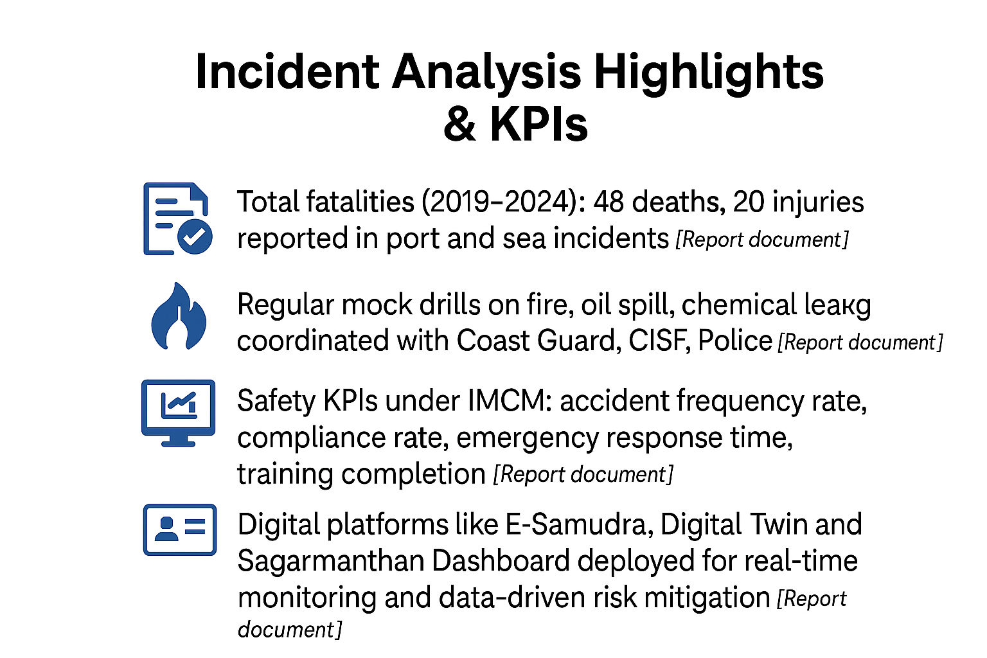
Incident Analysis Highlights & KPIs
NAVIC Cell 2 (2025) Report
Key Findings (2019–2024)
Total fatalities (2019-2024): 48 deaths, 20 injuries reported in port and sea incidents
195
77
Incidents reported
Marine Casualties
Incident locations: Berth/Jetties (31), port roads (29), navigation channels (14)
87
48
Safety KPIs under IMCM: accident frequency rate, compliance rate, emergency response time, training completion
Occupational Accidents Injuries
Occupational Accidents Fatalities
Digital platforms like E-Samudra, Digital Twin and Sagarmanthan Dashboard deployed for real-time monitoring and data-driven risk mitigation
11
04
Fire and explosions Fatalities
Man-overboard Accidents Fatalities
Notes:
Incident Analysis Highlights & KPIs
“Behind every statistic here lies an operational story, one that helps us understand where interventions are needed, and where our systems are already beginning to respond effectively.”
This slide presents an overview of incident trends compiled through NAVIC Cell 2’s 2025 report, covering the period 2019 to 2024.
During this timeframe, India recorded 195 maritime incidents, of which 77 were classified as marine casualties. Out of these, 48 fatalities and 20 serious injuries occurred across both port and sea operations — with the highest concentration at berths, jetties, and port access roads. These locations alone account for nearly 60% of all reported accidents, underscoring the risk associated with high-density cargo and berthing activities.
Even navigation channels, though less frequent in incident count, remain sensitive zones due to congestion, dredging, and pilotage challenges.
The data also reveals a gradual but consistent improvement in response and reporting discipline — something achieved through the Integrated Maritime Compliance Manual (IMCM) framework.
Under the IMCM, DGS has instituted measurable Safety KPIs, including:
Accident frequency rate,
Compliance rate of port and vessel audits,
Emergency response time, and
Training completion rate for safety personnel.
These indicators are critical for tracking how effectively safety culture is being institutionalized across ports and shipping lines.
Importantly, DGS has also integrated digital monitoring platforms such as E-Samudra, Digital Twin models, and the Sagarmanthān Dashboard. These tools enable real-time data collection, predictive alerts, and data-driven risk mitigation, helping authorities intervene before incidents escalate.
The NAVIC Cell findings show encouraging progress —
Occupational injuries: 87
Occupational fatalities: 48
Fire and explosion fatalities: 11
Man-overboard fatalities: 4
While these numbers still indicate areas of concern, they also reflect a maturing reporting culture and a foundation for evidence-based policy.
“The objective now is not only to reduce incidents but to build foresight — anticipating risk through digital intelligence, training, and unified governance under DGS.”

Slide 47
Safety First
‘Suraksha Sarvapratham’
DGS is focused on promoting safety on vessels and is set to launch a campaign called the Suraksha Sarvpratham, ensuring that the seafarers are able to discharge their duties in a risk-free manner.
To reduce accidents and minimize risks aboard ships.
Detailed documentation of incidents that occur at sea and during port operations.
Systematic recording and analysis of incidents will help identify patterns, understand root causes, and implement preventative strategies.
Instill a culture of safety among seafarers.
Web-based learning management systems for training.
Free online courses will be developed.
To create a safer working environment for seafarers by reducing the frequency and severity of accidents at sea and in ports.
Comprehensive incident documentation, strict adherence to safety protocols, and innovative AI-based safety videos--- to establish Safety Culture
Notes:
Safety First – Suraksha Sarvpratham
“Safety is not a procedure; it is a mindset. The Directorate General of Shipping is embedding this mindset across the maritime sector through the Suraksha Sarvpratham campaign — safety, above all else.”
This national safety initiative reflects DGS’s long-term commitment to zero-incident maritime operations. The campaign, titled Suraksha Sarvpratham, focuses on creating a proactive and preventive safety culture among seafarers and port professionals alike.
The objective is :
To reduce accidents and minimise risks aboard ships, by moving from incident response to risk anticipation.
To institutionalise a continuous learning ecosystem, using web-based training and AI-enabled awareness tools.
To strengthen the safety reporting and documentation process, so that every incident, however small, contributes to systemic improvement.
Every accident is now to be systematically recorded and analysed. Not only to determine cause, but to identify recurring patterns and areas for early intervention. These insights will feed into preventive strategies, emergency preparedness plans, and the upcoming Maritime Safety Information System.
On the human-capital side, free online safety courses and LMS-based training modules are being developed to ensure accessibility for all ranks of seafarers. This includes visual learning aids, case-based lessons, and AI-based safety videos — practical, interactive, and available on-demand.
The larger aim is to instil safety as a professional value, rather than as a compliance requirement. When every officer, rating, or pilot treats safety as integral to their duty, we move closer to a self-sustaining safety culture across ships and ports.
“Through Suraksha Sarvpratham, India’s maritime workforce will lead by example — demonstrating that growth and safety are not trade-offs, but partners in progress.”

Slide 48
Offshore Oil & Gas Development and Safety Framework in India
India’s offshore oil and gas ecosystem is supported by a multi-tiered institutional framework that ensures safe, efficient, and sustainable operations across exploration, production, and workforce training.
1. Safety and Competency Standards (OPITO):
OPITO serves as the global benchmark for offshore workforce training and safety certification.
India hosts OPITO-approved centers like Suraksha Marine, WOISO, and iMost Academy, offering over 25 internationally recognized safety courses such as BOSIET, HUET, and FOET.
Standardized training enhances emergency preparedness, hazard management, and offshore operational safety.
2. Strategic Coordination (ODAG):
The Offshore Defence Advisory Group (ODAG) acts as the strategic interface between offshore hydrocarbon operations, maritime logistics, and national defence.
It coordinates with DGS for regulatory compliance, crew welfare, and environmental oversight while supporting port operations and offshore supply chains.
ODAG also promotes international certifications and capacity building for India’s maritime workforce.
3. Technical Oversight (OISD):
The Oil Industry Safety Directorate (OISD), under MoPNG, sets and monitors over 120 safety standards for upstream, midstream, and downstream operations.
It conducts audits, accident investigations, and compliance inspections for onshore and offshore installations.
OISD advances safety culture and continuous improvement through policy guidelines and stakeholder collaboration.
4. Exploration and Resource Governance (DGH):
The Directorate General of Hydrocarbons (DGH) is the nodal agency for upstream oil and gas exploration and production policies.
Oversees offshore exploration programs, reservoir management, and data-driven resource evaluation across Indian sedimentary basins.
DGH facilitates technology collaborations, contract management, and the implementation of schemes such as NELP, HELP, and OALP.
Notes:
Offshore Oil & Gas Development and Safety Framework in India
“India’s offshore ecosystem stands at the intersection of energy, environment, and safety. As we expand our offshore footprint, the need for a cohesive safety and competency framework becomes critical.”
India’s offshore oil and gas domain operates through a multi-tiered institutional structure with each agency playing a defined but interconnected role across exploration, production, logistics, and workforce safety.
Let’s look at these four pillars briefly:
1. Safety and Competency Standards (OPITO): OPITO serves as the global benchmark for offshore workforce training and certification. India is home to several OPITO-accredited training centres, including Suraksha Marine, WOISO, and iMost Academy, offering more than 25 internationally recognised safety courses such as BOSIET, HUET, and FOET. These programs ensure emergency preparedness, hazard awareness, and operational discipline in offshore environments — aligning Indian workforce competency with global standards.
2. Strategic Coordination (ODAG): The Offshore Defence Advisory Group (ODAG) functions as the strategic bridge between offshore energy operations, maritime logistics, and national defence. It coordinates closely with the Directorate General of Shipping to strengthen regulatory compliance, crew welfare, and environmental safety. ODAG also supports international certification programs and capacity-building initiatives to prepare Indian seafarers and offshore workers for complex, cross-domain operations.
3. Technical Oversight (OISD): The Oil Industry Safety Directorate (OISD), under the Ministry of Petroleum and Natural Gas, formulates and enforces over 120 safety standards for upstream, midstream, and downstream operations. OISD conducts safety audits, accident investigations, and compliance inspections across both onshore and offshore installations. It is also leading efforts in policy harmonisation, ensuring that safety culture and continuous improvement become integral to India’s hydrocarbon governance.
4. Exploration and Resource Governance (DGH): The Directorate General of Hydrocarbons (DGH) serves as the nodal authority for upstream oil and gas policy — overseeing exploration programs, reservoir management, and resource mapping across India’s sedimentary basins. DGH plays a key role in enabling technology transfer, managing contracts under NELP, HELP, and OALP, and ensuring environmental safeguards during offshore drilling and production activities.
Collectively, these four institutions ensure that India’s offshore operations are safe, efficient, and globally aligned. However, as offshore activity diversifies into LNG bunkering, offshore wind, and seabed mineral exploration, a stronger inter-agency coordination mechanism — under the leadership of the Directorate General of Shipping — will be crucial for unified safety oversight.
“The vision is to establish India not just as a major offshore player, but as a model of sustainable and safe offshore governance — where energy growth and environmental responsibility advance together.”

Slide 49
Coastal Shipping
Coastal shipping is the movement of goods and passengers along a country’s coast using sea routes, offering a cost-effective and eco-friendly alternative to road and rail transport.
India’s Potential
11098 km coastline & 14,000 km navigable waterways.
Underutilised compared to road & rail.
Trends & Growth
Coastal cargo in 2023–24: 187.22 million tonnes (+1.97%).
Major commodities: POL, crude, containers, iron ore.
Paradip & Deendayal Ports lead in volumes.
Coastal Shipping Reforms
Coastal Shipping Bill, 2025: modern legal framework, aligned with global cabotage standards.
Targets 230 million tonnes by 2030.
National Coastal & Inland Shipping Strategic Plan + National Database for Coastal Shipping.
Supports Atmanirbhar Bharat & Viksit Bharat 2047 vision.
Benefits of Maritime Shipping
Most Carbon-Efficient Mode
Shipping has the lowest CO₂ emissions per tonne-km compared to road, rail, and air.
Reduced Pollution & Congestion
Shifting freight from trucks/trains to ships cuts urban air pollution.
Less congestion on highways and rail networks.
Green Logistics
Supports low-carbon supply chains and climate commitments.
Essential for achieving India’s net-zero & IMO 2050 targets.
Large-Scale Impact
Moving bulk cargo by sea reduces fossil fuel consumption.
Coastal shipping = key enabler of Blue Economy + Green Economy transition.
Notes:
Coastal Shipping
“Coastal shipping represents one of India’s greatest untapped logistics assets — a cleaner, cheaper, and more efficient alternative to road and rail transport.”
India’s coastline spans over 11,000 kilometres, complemented by nearly 14,000 kilometres of navigable waterways. Despite this vast potential, coastal shipping remains underutilised compared to land-based modes of transport.
However, the trend is shifting. In FY 2023–24, India’s coastal cargo volume reached 187.22 million tonnes, marking a 1.97% increase over the previous year. The primary commodities moved through this mode include POL, crude, containers, and iron ore, with Paradip and Deendayal Ports emerging as leading hubs for coastal freight.
Policy and Reform Landscape
The upcoming Coastal Shipping Bill, 2025, is set to transform this sector by introducing a modern legal and regulatory framework aligned with global cabotage standards. It aims to simplify licensing, enhance port coordination, and promote private participation — all directed toward achieving the national target of 230 million tonnes of coastal cargo by 2030.
Parallelly, the National Coastal & Inland Shipping Strategic Plan, along with a National Database for Coastal Shipping, is being formulated to provide a single source of verified data for planning, investment, and performance tracking. Together, these reforms directly support the vision of Atmanirbhar Bharat and Viksit Bharat 2047, integrating maritime transport into India’s sustainable logistics architecture.
Environmental and Economic Advantages
Coastal shipping stands out as the most carbon-efficient mode of transport, producing the lowest CO₂ emissions per tonne-kilometre compared to road, rail, or air. By shifting freight from highways and railways to sea routes, India can significantly cut urban air pollution, reduce highway congestion, and lower logistics costs.
This transition is also central to green logistics — enabling low-carbon supply chains, supporting India’s Net Zero commitments, and aligning with IMO’s 2050 decarbonization goals.
Strategic Impact
Every tonne of cargo shifted from road to coastal shipping translates into measurable savings in fuel, emissions, and congestion costs. Beyond economics, it also strengthens port connectivity, coastal employment, and intermodal integration — positioning coastal shipping as a key enabler of India’s Blue Economy and Green Growth vision.
“The Coastal Shipping Act 2025 is not just a reform — it’s a signal of intent to make maritime logistics the backbone of India’s sustainable transport future.”

Slide 50

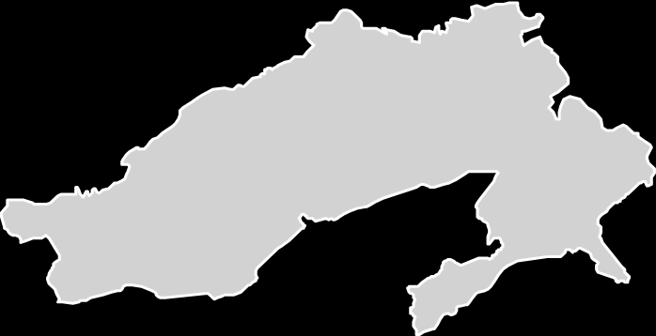























Multi Component Ecosystem for Indian Maritime Sector
Key components of the Indian Maritime Sector
11,098 km long Indian coastline dotted with Major Ports and National Waterways
EXIM Ports | 55
Non- EXIM Ports | 23
Total cargo handling ports | 78
NW-1
NW-2
Kandla/
Deendayal Port
Kandla/
Deendayal Port
Syama Prasad Mookerjee Kolkata Port
Cargo type | Cargo handled-Ports MMT (FY25)
Coastal | 331
Overseas | 1,262
Total | 1,593
NW-100
NW-5
NW-64
Paradip Port
Mumbai Port
Mumbai Port
NW-10
Jawahar Lal Nehru Port
NW-91
Visakhapatnam Port
Jawahar Lal Nehru Port
Ship type | No. of Ships (FY24) | Capacity Mn GT (FY24)
Coastal | 1,056 | 1.6
Overseas | 489 | 11.8
Total | 1,545 | 13.5
Mormugao Port
NW-4
New Mangalore Port
Chennai Port
Ennore/ Kamarajar Port
Cochin Port
NW-3
Tuticorin/ V. O. Chidambaranar Port
Number of Waterways | Cargo handled MMT (FY25)
111 (29 operational) | 145
Major Ports
National Waterways (NWs)
Notes:
Multi Component Ecosystem for Indian Maritime Sector
“India’s maritime sector is a vast, interconnected system, linking ports, shipping, and inland waterways into one unified logistics and economic ecosystem.”
India’s coastline extends 11,098 kilometres, dotted with major ports, non-major ports, and national waterways — all functioning as critical nodes in trade, energy transport, and logistics.
At the heart of this system are 78 cargo-handling ports — comprising 55 EXIM ports that manage international trade and 23 non-EXIM ports that cater primarily to domestic and regional cargo flows.
Cargo Handling and Throughput
During FY 2024–25, India’s ports handled a combined 1,593 million metric tonnes (MMT) of cargo —
1,262 MMT from overseas trade, and
331 MMT from coastal movement.
This represents the strength of India’s dual maritime character — global in scale, yet deeply rooted in domestic logistics. It also underlines how coastal and EXIM sectors complement each other — the former ensuring national supply chain resilience, and the latter anchoring India’s position in global trade.
Fleet Strength and Capacity
As of FY 2023–24, India’s registered merchant fleet stood at 1,545 vessels, with a cumulative capacity of 13.5 million gross tonnage (GT). Of these:
1,056 ships serve the coastal segment, with 1.6 million GT, and
489 ships operate in overseas trade, with 11.8 million GT capacity.
This composition reflects both India’s growing coastal connectivity and its continued expansion in international shipping tonnage.
National Waterways Integration
Inland and coastal connectivity is reinforced through 111 National Waterways, of which 29 are currently operational, handling about 145 MMT of cargo in FY 2025. The integration of port infrastructure with waterways through initiatives like Sagarmala, PM Gati Shakti, and Harit Sagar ensures last-mile multimodal connectivity and reduced logistics costs.
Strategic Vision
This multi-component structure — spanning ports, shipping, and waterways — underpins the transition toward a Green and Blue Economy. It ensures seamless flow of goods, diversified trade routes, and balanced development across both coasts and hinterlands.
“The maritime sector today is not a set of isolated components — it is a single, synchronized ecosystem driving India’s trade competitiveness and sustainable growth.”

Slide 51

Coastal Shipping Act, 2025 (1/2)
“Coastal Shipping Bill, 2025 aims to boost coastal cargo up to 230 million metric tonnes by 2030” - Shri Sarbananda Sonowal, Hon’ble Union Minister MoPSW “National Coastal and Inland Shipping Strategic Plan to Steer Future Infrastructure and Policy Under new Act” - Shri Sarbananda Sonowal, Hon’ble Union Minister MoPSW
In a landmark move to strengthen India’s coastal economy, the Coastal Shipping Bill, 2025 was passed by the Rajya Sabha, marking a significant step toward unlocking the vast potential of India’s 11,098 km coastline, which spans nine coastal states and four union territories.
The bill was introduced by Sarbananda Sonowal, Union Minister of Ports, Shipping & Waterways.
Previously approved by the Lok Sabha on April 3, 2025, the legislation aims to modernize and simplify the legal framework governing coastal shipping.
It replaces Part XIV of the Merchant Shipping Act, 1958 with a progressive, globally aligned law that reflects contemporary cabotage standards and supports the growth of coastal trade.
Notes:
Coastal Shipping Act, 2025 (1/2)
“The Coastal Shipping Act, 2025 marks a defining reform in India’s maritime sector — one that transforms our coastline into a dynamic corridor of trade, connectivity, and green growth.”
The Coastal Shipping Bill, 2025, recently passed by the Rajya Sabha, is a landmark step to unlock the full potential of India’s 11,098-kilometre coastline, which stretches across nine coastal states and four Union Territories.
This Bill, introduced by Hon’ble Union Minister Shri Sarbananda Sonowal, strengthens India’s position as a maritime nation by creating a modern, simplified, and globally aligned legal framework for coastal shipping.
Legislative Milestone
The Bill was earlier approved by the Lok Sabha on April 3, 2025, and subsequently cleared by the Rajya Sabha, signalling Parliament’s commitment to modernising India’s maritime laws.
It replaces Part XIV of the Merchant Shipping Act, 1958, bringing in a progressive and internationally benchmarked legal structure. This shift aligns India’s coastal shipping governance with global cabotage and trade standards, while also promoting ease of doing business for Indian operators.
Core Objectives and Features
The Coastal Shipping Act, 2025, is designed to:
Create a robust regulatory framework for the commercial activity of coastal trade.
Simplify licensing by eliminating the requirement for Indian vessels to obtain separate permissions for engaging in coastal operations.
Establish a National Database for Coastal Shipping, consolidating information on licenses, vessels, and operators — ensuring transparency and data-driven decision-making.
Enable a framework of updated regulations consistent with international maritime norms, thereby boosting investor confidence and operational efficiency.
Strategic Vision
This Act underpins the government’s broader goal to boost coastal cargo volumes to 230 million tonnes by 2030, as envisioned by Hon’ble Minister Shri Sarbananda Sonowal. It also supports the National Coastal and Inland Shipping Strategic Plan, which will steer future infrastructure and policy development under this new legislative framework.
“The Coastal Shipping Act is not just a legal reform — it is a national strategy to make coastal shipping the backbone of India’s sustainable logistics network.”

Slide 52
Coastal Shipping Act, 2025 (2/2)
The Coastal Shipping Bill, 2025, passed by both Houses of Parliament, marks a major reform in India’s maritime sector.
It replaces outdated provisions of the Merchant Shipping Act, 1958, introducing a modern legal framework aligned with global cabotage standards.
The Bill includes 6 chapters and 42 clauses, simplifying licensing and regulating foreign vessels in coastal trade.
It mandates a National Coastal and Inland Shipping Strategic Plan to guide infrastructure and policy development.
A National Database for Coastal Shipping will provide real-time, transparent data to support investment and planning.
The legislation aims to boost Indian ship participation, reduce reliance on foreign vessels, and curb foreign exchange outflow.
It supports the vision of Atmanirbhar Bharat and Viksit Bharat, promoting local economic growth and employment in coastal regions.
With this Bill, India completes a trio of key maritime reforms alongside the Merchant Shipping Bill and Carriage of Goods by Sea Bill, paving the way for a modern, efficient, and self-reliant maritime ecosystem.
Notes:
Coastal Shipping Act, 2025 (2/2)
“The passage of the Coastal Shipping Bill, 2025 by both Houses of Parliament marks a historic milestone in India’s maritime reform journey — one that aligns domestic law with global maritime standards and future growth priorities.”
The Coastal Shipping Act, 2025 replaces outdated provisions of the Merchant Shipping Act, 1958, establishing a modern, streamlined, and globally compliant framework that governs coastal trade and vessel operations.
Key Structural Provisions
The Act is structured into six chapters and forty-two clauses, covering the full lifecycle of coastal operations — from licensing and compliance to vessel registration and enforcement. It simplifies licensing procedures, particularly for Indian vessels, and rationalises the regulation of foreign participation in coastal trade. This approach balances domestic fleet promotion with international competitiveness, ensuring ease of operation without compromising sovereignty or safety.
Institutional and Digital Reforms
A major innovation under this Act is the creation of a National Coastal and Inland Shipping Strategic Plan — a long-term blueprint for infrastructure, connectivity, and capacity enhancement. Additionally, the National Database for Coastal Shipping will introduce real-time, transparent data systems — enabling accurate tracking of vessel movements, operational licensing, and investment planning. These digital initiatives will make India’s coastal sector data-driven, investor-friendly, and globally benchmarked.
Strategic Outcomes
The legislation directly supports the Government’s Atmanirbhar Bharat and Viksit Bharat 2047 vision by:
Encouraging Indian ship participation, thereby reducing dependence on foreign vessels.
Conserving foreign exchange through reduced charter costs.
Promoting employment and industrial activity in coastal regions.
Broader Reform Context
With this Bill, India completes a trilogy of transformative maritime legislations — alongside the Merchant Shipping Bill and the Carriage of Goods by Sea Bill. Together, these laws pave the way for a modern, efficient, and self-reliant maritime ecosystem — one that seamlessly integrates shipping, ports, and inland waterways under a unified vision of sustainable logistics.
“The Coastal Shipping Act, 2025 thus signifies not just legal reform — but a decisive policy shift toward making India’s coasts the engines of national growth and green trade.”

Slide 53



Safety of Fishing Vessels
High-Risk Profession: Commercial fishing casualty rate is 10x higher than merchant shipping; ~24,000 lives lost annually worldwide.
Regulatory Gap: No binding global instrument for fishing vessel design, construction, or safety equipment.
Impact: 39 million people in fishing vs 2 million in shipping – yet SOLAS & MLC apply only to shipping, not fishing.
Need: Stronger oversight by flag states, adoption of international instruments, improved monitoring & certification.
Notes:
Safety of Fishing Vessels
“Fishing remains one of the most dangerous professions in the world, and yet, it is among the least regulated from a safety perspective.”
The commercial fishing sector experiences casualty rates ten times higher than merchant shipping, with nearly 24,000 lives lost globally every year. Despite this, the safety framework for fishing vessels remains fragmented — lacking a comprehensive, binding global instrument equivalent to SOLAS or MLC, which apply only to conventional shipping.
Scale and Socio-Economic Impact
The disparity is striking: Over 39 million people are engaged in fishing activities worldwide, compared to just 2 million in shipping. This means the majority of maritime workers operate outside the protection of established international safety conventions, exposing them to high risks of accidents, equipment failure, and poor working conditions.
In India, the stakes are even higher — the fishing fleet forms a vital component of the blue economy, supporting coastal livelihoods and local food security. However, incidents of capsizing, overloading, lack of life-saving appliances, and extreme weather vulnerability continue to claim lives each year.
Regulatory Gaps and Challenges
Currently, there is no globally enforceable convention governing fishing vessel design, construction, or equipment standards. While frameworks like SOLAS (Safety of Life at Sea) and MLC (Maritime Labour Convention) cover shipping, they exclude the fishing sector. This has created a significant regulatory void, especially in developing countries where artisanal and small mechanized fishing vessels dominate.
Way Forward
The situation calls for:
Stronger oversight by flag states and coastal authorities.
Adoption of international instruments such as the Cape Town Agreement (2012) and FAO/ILO/IMO Guidelines on fishing vessel safety.
Mandatory certification, crew training, and vessel registration systems to standardize safety compliance.
Integration of digital monitoring tools — including GPS tracking, distress alert systems, and inspection databases — to improve traceability and accountability.
“Protecting those who harvest from the sea is not only a matter of safety — it is a matter of dignity and sustainability.”
Enhancing fishing vessel safety will strengthen coastal resilience, safeguard livelihoods, and align India’s fisheries sector with the UN Sustainable Development Goals, particularly SDG 14 – Life Below Water.

Slide 54




Major International Conventions / Agreements
Cape Town Agreement (2012) – Safety standards for fishing vessels ≥24m; design, construction, stability, fire safety, equipment. (Not in force yet).
STCW-F Convention (1995) – Certification & minimum training standards for fishing vessel personnel. (In force, 31 States parties).
ILO Work in Fishing Convention (C188, 2007) – Decent working & living conditions on fishing vessels. (In force, 14 States parties).
FAO Port State Measures Agreement (PSMA, 2009) – Prevents IUU fishing vessels from using ports/landing catches. (In force, 55 States parties).
Notes:
Major International Conventions / Agreements
“The international community has recognized that fishing vessel safety, crew welfare, and sustainable fishing practices cannot be addressed in isolation — they must be governed by a coherent global framework.”
This slide highlights the four principal international instruments that collectively shape the safety, labour, and compliance architecture for the global fishing sector. Together, they aim to close long-standing gaps in vessel safety, crew protection, and illegal fishing oversight.
1. Cape Town Agreement (2012) – IMO
The Cape Town Agreement, adopted by the International Maritime Organization, sets safety standards for fishing vessels of 24 metres and above. It covers vessel design, construction, stability, fire safety, and life-saving equipment — areas where fishing vessels have historically lacked uniform regulation. However, the Agreement is not yet in force, as it awaits ratification by a sufficient number of States. Once implemented, it will serve as the fishing sector’s equivalent to SOLAS, dramatically improving vessel integrity and crew survival rates.
India has expressed its support for the objectives of the Agreement and continues to strengthen domestic safety codes in alignment with its principles.
2. STCW-F Convention (1995) – IMO
The STCW-F Convention establishes minimum certification and training standards for fishing vessel personnel, ensuring competency at sea and safer operations. It is in force with 31 State Parties and complements the Cape Town Agreement by addressing the human factor — skill, awareness, and emergency preparedness.
Incorporating STCW-F principles into national training modules would greatly enhance the safety performance of India’s coastal and deep-sea fishing fleets.
3. ILO Work in Fishing Convention (C188, 2007) – ILO
The Work in Fishing Convention by the International Labour Organization sets out decent working and living conditions for fishers, covering accommodation, hours of rest, medical care, and repatriation rights. It is in force with 14 State Parties and focuses on crew welfare, complementing the technical safety obligations of IMO conventions.
As India modernizes its fishing sector under the Blue Economy vision, alignment with C188 would reinforce social sustainability alongside economic gains.
4. FAO Port State Measures Agreement (PSMA, 2009) – FAO
The FAO’s PSMA combats Illegal, Unreported, and Unregulated (IUU) fishing by preventing non-compliant vessels from accessing ports and landing catches. It is the first binding international agreement targeting IUU fishing, currently in force with 55 State Parties. This agreement strengthens global maritime law enforcement and promotes responsible fisheries management.
India’s active engagement with PSMA mechanisms will be crucial to safeguarding marine resources and maintaining traceable, sustainable seafood exports.
“Together, these four conventions create the foundation for safer seas, fairer work, and sustainable fisheries — a triad essential for the Blue Economy era.”

Slide 55

IUU Fishing
A Global Challenge
What is IUU Fishing?
Illegal: Fishing in violation of national or international laws.
Unreported: Failure to report catches or misreporting to authorities.
Unregulated: Fishing by vessels not under effective control, often “stateless.”
Why It Matters:
Major threat to marine ecosystems & fish stocks.
Causes economic losses for licensed fishers and coastal communities.
Linked to organized crime, forced labour, and trafficking.
Impact:
Undermines sustainability and food security.
Leads to collapse of local fisheries and loss of livelihoods.
Difficult to monitor due to weak surveillance & reporting systems.
Controls & Responses:
MCS Tools: Monitoring, Control, and Surveillance.
Vessel Tracking: IMO Numbers, AIS, VMS, LRIT.
Port State Measures (FAO PSMA 2009): Block IUU vessels from landing catches.
Fishing Vessel Casualty (2023-2024)
16
Total Number of Collision
Delay in Reporting
Min
Max
4 hrs.
196 hrs.
Notes:
IUU Fishing – A Global Challenge
“Illegal, Unreported, and Unregulated (IUU) fishing has emerged as one of the gravest threats to ocean sustainability — undermining fisheries management, maritime security, and coastal livelihoods.”
Understanding IUU Fishing
The term IUU Fishing covers three interlinked dimensions:
Illegal: Fishing activities conducted in violation of national or international laws — for example, operating without licences or entering prohibited zones.
Unreported: Failure to report catches or deliberate misreporting to fisheries authorities to evade quotas or taxes.
Unregulated: Fishing by vessels not under the control of a flag state or operating in areas where governance frameworks are absent.
Together, these practices create systemic data gaps, making it difficult for nations to manage marine resources or enforce conservation measures.
Why It Matters
IUU fishing poses a major ecological threat, depleting fish stocks and damaging fragile marine ecosystems.
It results in significant economic losses for licensed fishers and coastal communities, eroding legitimate market share.
It has deep social and security dimensions — frequently linked to organized crime networks, forced labour, and human trafficking.
Estimates suggest IUU fishing costs the global economy more than USD 20 billion annually, with developing coastal states bearing the brunt.
Impact on India and the Region
For India, IUU fishing undermines food security, fisheries sustainability, and livelihood resilience across its 11,000 km coastline.
The collapse of local fisheries due to illegal overexploitation directly affects small-scale coastal fishers.
Weak reporting and surveillance mechanisms make it challenging to detect, trace, or deter such activities.
Between 2023 and 2024, 16 fishing vessel casualties were recorded, often associated with poor reporting practices. Incident reporting delays ranged from 4 hours to 196 hours, highlighting the urgent need for digital surveillance and immediate incident reporting protocols.
Global Controls and India’s Response
To tackle this challenge, the international community relies on three key instruments:
MCS Tools – Monitoring, Control, and Surveillance systems for data-driven enforcement.
Vessel Tracking Systems – Including IMO numbers, AIS, VMS, and LRIT, for traceability and transparency of fishing operations.
FAO Port State Measures Agreement (PSMA, 2009) – Which prevents IUU vessels from landing or transshipping catches in compliant ports.
India’s growing use of electronic tracking and inter-agency coordination through the Directorate General of Shipping and the Department of Fisheries is a decisive step toward regional compliance with FAO and IMO frameworks.
“IUU fishing is not merely an environmental issue — it is a governance challenge. Effective implementation of monitoring and port state controls will be key to securing India’s fisheries and its blue economy.”

Slide 56


Marine Waste Dumping
– Plastics & ALDFG
Pollution by Plastics :
Persistent, non-biodegradable → damages marine ecosystems.
Enters food chain → risk to fish, humans & biodiversity.
Major sources: packaging, cargo residues, single-use plastics from vessels & ports.
ALDFG (Abandoned, Lost, Discarded Fishing Gear) :
Nets, ropes & traps left at sea → cause “ghost fishing”.
Entangles turtles, dolphins, seabirds, and marine mammals.
Often linked to IUU fishing (gear discarded to avoid detection).
Impacts :
Environmental: Habitat destruction, species mortality.
Economic: Loss to fisheries & tourism.
Safety: Hazards to ships & navigation.
Controls & Solutions :
MARPOL Annex V – prohibits dumping plastics at sea.
Port Reception Facilities for waste disposal.
IMO & FAO initiatives: GloLitter, Fishing Gear Marking.
National programs: Recycling & waste management at ports.
Notes:
Marine Waste Dumping – Plastics & ALDFG
“Marine litter — particularly plastics and abandoned fishing gear — represents one of the most visible and pressing environmental challenges facing our oceans today.”
Context and Scale
Marine waste is no longer an isolated problem; it is a global transboundary issue directly affecting biodiversity, navigation safety, and coastal economies. Every year, 8–10 million tonnes of plastic enter the oceans — a large share originating from land-based activities, port operations, and vessels.
In the maritime context, this pollution manifests primarily in two forms:
Plastic Waste from packaging, single-use items, and cargo residues.
ALDFG (Abandoned, Lost, or Discarded Fishing Gear) — one of the deadliest yet least regulated forms of marine debris.
Pollution by Plastics
Plastics are persistent and non-biodegradable, fragmenting into microplastics that infiltrate marine food webs. These fragments are ingested by fish and plankton, ultimately entering the human food chain and posing serious health and ecological risks. Sources include vessels, ports, and coastal infrastructure, where inadequate waste reception or improper disposal remains common.
The issue extends beyond pollution — it is an indicator of poor compliance and operational inefficiency across maritime supply chains.
ALDFG – Abandoned, Lost, and Discarded Fishing Gear
ALDFG includes nets, ropes, and traps that continue to catch and kill marine life long after being lost — a phenomenon known as “ghost fishing.” This gear entangles turtles, dolphins, seabirds, and marine mammals, leading to widespread mortality and habitat damage. It is often linked to IUU fishing, as operators discard gear to evade detection or enforcement.
It is estimated that ALDFG accounts for nearly 10% of all marine litter but causes over 70% of macro-plastic entanglements involving marine megafauna.
Impacts
Environmental: Habitat destruction, biodiversity loss, and contamination of coral ecosystems.
Economic: Damage to tourism and fisheries, estimated losses exceeding USD 1 billion annually worldwide.
Safety: Navigational hazards from drifting nets and floating debris that endanger vessels and offshore installations.
Controls and Solutions
MARPOL Annex V – Prohibits discharge of plastics and synthetic fishing gear at sea; mandates onboard waste management plans.
Port Reception Facilities – Enable proper waste collection and disposal from ships, a key compliance point under MARPOL.
IMO & FAO Initiatives:
GloLitter Partnerships – supporting developing countries in reducing marine litter from shipping and fisheries.
Fishing Gear Marking Guidelines – enabling identification and recovery of lost gear.
National Measures:
Implementation of port waste management plans.
Recycling programs and circular economy initiatives for fishing gear and plastic waste.
Integration with Swachh Sagar and Green Port programs in India to ensure coordinated marine waste reduction.
“From ghost nets to single-use plastics, marine waste is not just an eyesore — it is a systemic challenge requiring behavioural change, regulatory enforcement, and technology-driven monitoring.”
India’s alignment with MARPOL, GloLitter, and national waste management programs positions it to play a leadership role in regional marine litter mitigation and sustainable port practices.

Slide 57

Coastal State Workshops
Coastal state workshops are proposed to be organized to advance welfare, ship recycling, shipbuilding, and repair initiatives in collaboration with State Maritime Boards.
The Coastal State Workshops will be structured around six key pillars :
Pillar 1 : Maritime Safety and Casualty Response
Pillar 2 : Coastal States- Ship Building and Ship Recycling Opportunities
Pillar 3 Maritime Training, Skilling and Zero Corruption in Maritime
Pillar 4 : Maritime Crewing and Employment Opportunities & Zero Tolerance in Crewing and Manning
Pillar 5 : Decarbonization, Sustainability & Sea and Environment Protection
Pillar 6 : Coastal Shipping & Opportunities in Coastal, Inland Navigation and Multimodal Shift
It is proposed that the SWFS may contribute to such coastal state workshops from the funds budgeted towards the crew welfare events (Rs. 20 lakh/annum split as Rs. 5 lakhs/quarter) to foster interaction and joint projects, strengthening the maritime domain through focused discussions and capacity-building engagements.
Upcoming Pilot Coastal State Workshop in Andhra Pradesh
Notes:
Coastal State Workshops
“Coastal State Workshops are envisioned as a unifying platform to build state-level maritime capacity, align local initiatives with national maritime reforms, and foster collaboration between central authorities and State Maritime Boards.”
Purpose and Context
The Directorate General of Shipping, in collaboration with State Maritime Boards and coastal administrations, plans to conduct Coastal State Workshops aimed at improving welfare, safety, and sustainability in India’s coastal and offshore maritime domains.
These workshops are a strategic mechanism to strengthen policy execution at the grassroots level — bringing together shipyards, training institutes, port authorities, and local maritime clusters under a single, structured dialogue.
They serve as the operational bridge between central maritime policy and coastal implementation — where policies translate into projects.
Structure: Six Pillars Framework
The workshops will be built around six key thematic pillars, each addressing a critical dimension of India’s coastal maritime ecosystem:
Maritime Safety and Casualty Response – Strengthening coastal preparedness, search and rescue (SAR), and casualty management protocols. – Building coordination frameworks among DG Shipping, Coast Guard, and State Maritime Boards.
Shipbuilding and Ship Recycling Opportunities – Identifying new ship repair and recycling capacities, particularly in eastern and southern states. – Facilitating PPP investments and green shipyard models aligned with HKC and NGSP frameworks.
Maritime Training, Skilling, and Zero Corruption in Maritime – Expanding skilling networks for coastal seafarers, surveyors, and shipyard workers. – Promoting ethical practices and digital governance to ensure transparency and zero tolerance for corruption.
Maritime Crewing and Employment Opportunities – Creating state-specific seafarer employment portals and promoting inclusion in crewing and manning sectors. – Encouraging gender diversity and equitable access, aligning with the Sagar Mein Samman initiative.
Decarbonization, Sustainability, and Sea & Environmental Protection – Mainstreaming green shipping practices, port electrification, and pollution control mechanisms at the state level. – Encouraging port-level implementation of Green Port Index and Harit Sagar Guidelines.
Coastal Shipping & Multimodal Shift – Promoting intermodal connectivity between coastal, inland, and road-rail networks. – Supporting coastal cargo growth through regional industrial corridors and port-linked logistics hubs.
Pilot Workshop – Andhra Pradesh
The first pilot workshop is proposed in Andhra Pradesh, leveraging its strategic east coast location, shipyard infrastructure, and expanding blue economy footprint.
The focus will be on shipbuilding, green recycling, and skill development, in collaboration with the Andhra Pradesh Maritime Board and local port authorities.
Additionally, it is proposed that the Seafarers’ Welfare Fund Society (SWFS) may allocate funds — approximately ₹20 lakh annually (₹5 lakh/quarter) — to support these workshops as part of crew welfare and engagement initiatives. This funding model will foster joint projects and inter-agency collaboration for long-term maritime capacity building.
“The Coastal State Workshops are more than events — they are frameworks for state empowerment, knowledge sharing, and coordinated action. Through them, India’s nine coastal states can collectively anchor the next phase of maritime growth under the Maritime Amrit Kaal Vision 2047.”

Slide 58



IMO Led Projects
Green Voyage 2050 :
Advancing IMO GHG Reduction Strategies
GloNoise :
Reducing Underwater Radiated Noise Pollution
GloLitter :
Tackling Plastics and Marine Litter
Notes:
IMO Led Projects
“India’s maritime sustainability journey aligns closely with the International Maritime Organization’s global initiatives under the Glo-series projects — addressing marine litter, greenhouse gas emissions, and underwater noise pollution.”
Overview
The IMO, in partnership with the United Nations Development Programme (UNDP) and the Food and Agriculture Organization (FAO), is leading a series of global environmental partnerships — collectively referred to as the Glo-initiatives. Each project addresses a critical challenge to the marine environment and supports capacity building, technical assistance, and policy development across member states.
India’s participation in these projects demonstrates its commitment to the IMO Initial GHG Strategy, MARPOL, and the UN Sustainable Development Goals (SDGs 13, 14, and 17).
1. GloLitter Partnerships – Tackling Plastics and Marine Litter
Launched jointly by IMO and FAO, GloLitter focuses on reducing sea-based plastic litter originating from ships, ports, and fishing activities. It assists partner countries in developing policies, port reception systems, and awareness programs for waste segregation and recycling.
Core Objective: Preventing marine plastic leakage into the ocean through improved waste management in shipping and fisheries sectors.
Key Focus Areas: Port reception facilities, recycling of fishing gear, and implementation of MARPOL Annex V.
India’s Relevance: Supports initiatives such as Swachh Sagar, Harit Sagar Guidelines, and national port waste management frameworks.
“Through GloLitter, India can strengthen its circular economy model for maritime waste, reducing the environmental footprint of ports and vessels.”
2. Green Voyage 2050 – Advancing IMO GHG Reduction Strategies
Green Voyage 2050, implemented in partnership with Norway’s Ministry of Climate and Environment, accelerates the decarbonization of the maritime sector in developing countries. It provides technical support for implementing IMO’s Initial GHG Strategy, including EEXI, CII, and carbon-intensity reduction measures.
Focus: Promoting pilot projects on low- and zero-carbon fuels, port electrification, and GHG monitoring frameworks.
Impact: Establishes National Action Plans (NAPs) for maritime decarbonization and fosters private-sector collaboration for technology adoption.
India’s Alignment: Complements the National Green Shipping Policy (NGSP) and pilot projects under Green Port Index, shore power, and biofuel bunkering initiatives.
“This partnership directly reinforces India’s target to achieve net-zero by 2070 and IMO’s global ambition of reducing GHG emissions by 100% by or around 2050.”
3. GloNoise Partnerships – Reducing Underwater Radiated Noise Pollution
The most recent initiative under the IMO’s environmental portfolio, GloNoise addresses the growing concern of underwater radiated noise (URN) from ships, which disrupts marine life, especially cetaceans and fish.
Objective: Develop practical mitigation measures, guidelines, and technical innovations to reduce URN from ship design, operation, and propeller noise.
Impact: Improves habitat health, biodiversity, and ecosystem balance — contributing to SDG 14.1 (Life Below Water).
India’s Future Scope: Pilot URN baseline studies along major shipping corridors, in coordination with research institutions and classification societies.
“GloNoise marks the next frontier of marine environmental protection — where sound, not just emissions or litter, becomes a focus of sustainable shipping.”
“Together, GloLitter, Green Voyage 2050, and GloNoise exemplify the IMO’s integrated approach to ocean sustainability — addressing waste, carbon, and acoustic pollution in a unified framework. India’s engagement with these initiatives not only elevates its maritime environmental standards but also positions it as a regional leader in implementing the IMO’s decarbonization and blue economy agenda.”

Slide 59


संगच्छध्वं
संवदध्वं
सं वो मनांसि जानताम्।
“Move together,
speak together,
may your minds
be in harmony.”
(Rigveda 10.191.2)

