Slide 1
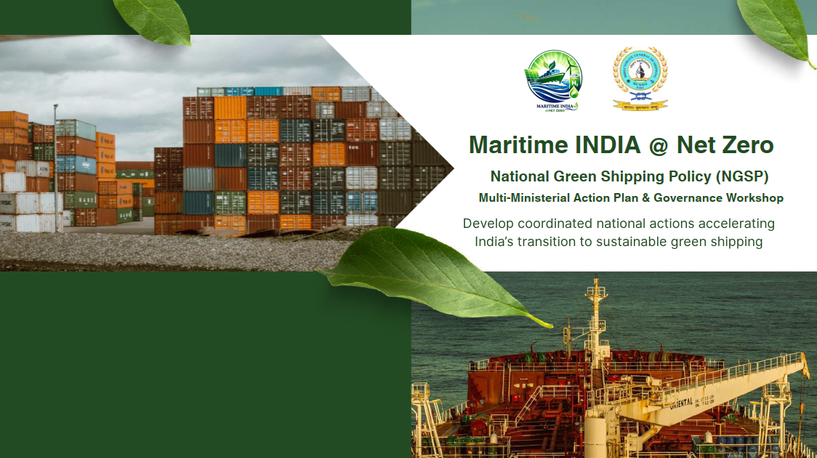
Thematic Address by the
Director General of Shipping
India Habitat Centre, New Delhi | 14th Jan 2026 | 9:40 am to 9:50 am

Slide 2
India’s Dependence on Hydrocarbons and a Changing Global Energy Order
1. Global Reality
Hydrocarbon dependence dominates global energy
Markets shaped by geopolitics, sanctions, conflicts
2. India’s Vulnerability
High fossil-fuel import dependence
Exposure to price shocks & supply disruptions
Energy insecurity = national security risk
3. Strategic Imperative
Transition to cleaner, domestic & diversified energy
Green fuels in shipping = resilience, autonomy, competitiveness
Core pillar of Atmanirbhar Bharat
Green maritime energy is not just climate action—it is strategic self-reliance.

Slide 3
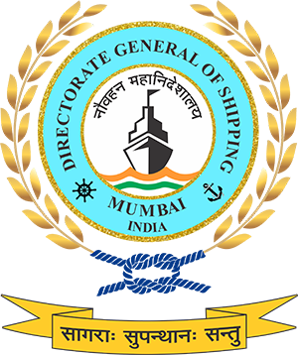
Alternate Fuels for Maritime (1/2)
Shipping today contributes around 3% of global CO₂ emissions. The IMO has locked in a target of net-zero by 2050 → which means fuels like HFO and MDO are on their way out.
For India, the next 25 years are about switching the fuel mix:
Nuclear – Long Term Option
Current Readiness : No commercial maritime Nuclear vessel. Only Indian Navy operates Nuclear vessels.
No policy framework yet for nuclear fuel for maritime.
Strategic Potential : Ultra long endurance fuel, zero CO2 emission
Financial : Very High CAPEX Estimate $700-900 million per vessel (3x cost of LNG vessel)
No IMO civilian Nuclear code (under development)
Fuel | Demand in 2030 | Demand in 2050
Hydrogen | 0.026 MT | 0.3 MT
Ammonia | 0.025 MT | 4.4 MT
Methanol | 0.037 MT | 0.272 MT
LNG | 0.66 MT | 0.3 MT (to be replaced by bio/e-LNG).
​​India can produce these fuels cheaper than almost anyone.​
Green Hydrogen cost by 2030:
India $1.5–2.0/kg.​
Middle East: $2.0–2.5/kg.​
Europe/East Asia: $3.0–6.0/kg.​ This is the base case for India becoming the lowest-cost Global hub for Green Maritime Fuels and an Energy Surplus Nation.​
Notes:
Green Fuel Transition
The maritime sector, responsible for nearly 3 percent of global CO₂ emissions, is entering a decisive phase of energy transition to align with the IMO’s Net Zero 2050 ambition. This transition demands a structured exit from conventional fuels such as HFO and MDO, and an accelerated shift towards a diversified portfolio of green fuels.
For India, the coming 25 years represent a carefully sequenced fuel substitution strategy. By 2030, LNG is expected to dominate with an estimated demand of 0.66 MT, before gradually transitioning to bio/e-LNG. Simultaneously, emerging fuels such as hydrogen, ammonia and methanol will scale significantly, with hydrogen rising from 0.026 MT to 0.3 MT, and ammonia from 0.025 MT to 4.4 MT by 2050 , reflecting both global decarbonization trends and domestic industrial capability.
India's strategic advantage lies in fuel economics. By 2030, green hydrogen production costs in India are projected at $1.5–2.0/kg, far below Europe and East Asia. This cost leadership positions India to become a global hub for green maritime fuels, enabling both domestic fleet transition and export opportunities.
Looking further ahead, nuclear marine propulsion is emerging as a potential long-term option for deep-sea and high-endurance operations. With unmatched energy density and zero operational emissions, nuclear could complement the green fuel mix for specific vessel categories — subject to future international regulatory frameworks on safety, liability and waste management.
Therefore, India’s fuel transition is not only a compliance response but a strategic opportunity — to secure energy autonomy, build green shipping supply chains and lead the global maritime decarbonisation narrative.
Nuclear Propulsion - Long-Term Strategic Prospect for India Nuclear propulsion remains a long-term, exploratory option for maritime decarbonisation, with no commercial nuclear vessels currently operating under the Indian flag. India’s only experience with nuclear-powered ships lies within the defence sector, through the Indian Navy’s nuclear submarines (INS Arihant class), which demonstrates indigenous capability in naval nuclear engineering. However, there is no existing policy or regulatory framework under DG Shipping or MoPSW for the civilian use of nuclear fuel at sea. While nuclear propulsion offers unmatched strategic potential- ultra-long endurance and near-zero CO₂ emissions without the need for refuelling. it comes with significant barriers. The capital expenditure is extremely high, estimated at USD 700–900 million per vessel, almost three times the cost of LNG-powered ships, making commercial viability a major concern. Additionally, IMO has not yet finalised a civilian nuclear safety code, with guidelines for Small Modular Reactors (SMRs) still under development. For India, nuclear remains a speculative option beyond 2040, contingent upon global regulatory consensus, public acceptance, liability legislation, and strong international safeguards.

Slide 4
Alternate Fuels for Maritime (2/2)
LNG
Current Use: Operational for select Indian coastal and LNG carriers; IGF Code compliant
Biofuel
Marine Trials: Successfully tested on marine engines
Ammonia
Export Positioning: Kandla to produce green ammonia (L&T + Itochu JV) for Singapore bunkering
Methanol
Port Pilot: VOC Port launched India's first Green Hydrogen Pilot Plant (5 Sep 2025)
Infrastructure: LNG terminals at Dahej, Hazira, Kochi; feasibility for bunkering at JNPA
Maritime Role: Transition fuel till 2035 under IMO GHG transition
Limitation: Methane slip & future carbon costs reduce long-term advantage
Supply Base: Drop in Blends. Domestic production. Blending with FAME, HVO
Distribution: Can use existing bunkering infrastructure without port redesign
Advantage: Short-term compliance option for Indian fleet under CII/GHG without retrofits
Hydrogen
Marine Use: Dual-fuel methanol engines already ordered by global majors
Breakthrough: India's first Green Methanol Bunkering Hub under construction at VOC Port (Tuticorin) – 750 m³ terminal (SOPAN Group)
Production Shift: India transitioning from coal-based brown methanol to green methanol (hydrogen + CO₂ capture)
Maritime Suitability: Engine-ready (Maersk, MAN ES technology) – early adopter fuel under IMO
Role: Likely first large-scale alternative fuel to enter Indian ports post-2030
Maritime Use: Target fuel for deep-sea vessels (tankers, bulk carriers) post-2035
Challenges: High Toxicity, safety standards, crew training, IMO safety code under development
Strategic Role: India positioning as future fuel exporter, not just consumer
Use in Maritime: Not direct – used to produce ammonia/methanol as bunkering fuels
Infrastructure Need: Electrolysers, Liquefaction, port pipelines; High CAPEX
Long-Term Role: Backbone fuel for synthetic maritime fuels; export market focus
Notes:
Alternate Fuels for Maritime
India’s maritime fuel transition will not be “one fuel for all,” but a sequenced multi-fuel pathway that matches IMO’s Net-Zero Framework and the Green Fuel Intensity (GFI) curve. Near-term compliance will lean on drop-in biofuels and limited LNG; the first scalable alternative expected in Indian ports is green methanol; ammonia follows for deep-sea ships post-2035; and green hydrogen underpins methanol/ammonia production and long-term export play. The strategy links three levers: (i) domestic fuel manufacture, (ii) bunkering hubs & safety codes, and (iii) demand signals created by IMO pricing (RUs) and India’s NGSP/Harit Sagar policies.
1) LNG - Transitional Fuel
Current role : Deployed on select Indian coastal/LNG carriers; compliant under IGF Code.
Infrastructure : Import/LNG terminals at Dahej, Hazira, Kochi; feasibility for marine bunkering studied at Kochi & JNPA.
Why transitional : LNG reduces CO₂ but faces methane-slip.
Methane slip is the escape of unburned methane gas into the atmosphere, typically from engines running on natural gas, where incomplete combustion occurs. This phenomenon is a significant concern because methane is a potent greenhouse gas, with a much higher global warming potential than carbon dioxide over the short term. It can occur in a wide range of applications, including marine engines, stationary engines, and across the entire natural gas supply chain
2) Biofuels - Immediate, Drop-in Compliance
Technical fit : Blends (B20–B100) run on existing marine engines; trials by Indian Navy & fleet operators demonstrate operational feasibility.
Supply base : Domestic streams from ethanol, biodiesel, HVO , FAME under the National Biofuel Policy; strongest near-term pathway to lower well-to-wake GHG without retrofits.
Ports : Minimal infrastructure change. can use current bunkering networks with sustainability certification.
Role : Near-term CII/GFI relief for Indian fleets; ideal for tugs, OSVs, coastal and inland segments while methanol/ammonia scale up.
3) Methanol
Breakthrough project : India’s first Green Methanol Bunkering & Refuelling Hub is under construction at VOC Port, Tuticorin - 750 m³ terminal (SOPAN Group). This is the country’s first dedicated maritime methanol node and a key plank of the Coastal Green Shipping Corridor (Kandla–Tuticorin).
Why methanol first : Dual-fuel engines are commercially available (MAN ES, widely ordered by global liners), handling is simpler than ammonia/hydrogen, and safety codes are mature.
Production shift : India must pivot from coal-based “brown” methanol to green methanol (renewable H₂ + captured CO₂). VOC’s port-based green hydrogen pilot is a feeder step.
Role & Timing : Likely the first large-scale alternative marine fuel to appear regularly in Indian ports post-2030, enabling ships to meet tightening GFI thresholds at competitive abatement cost.
4) Ammonia (Green Ammonia)
Strategic positioning : Kandla is being developed by L&T Energy GreenTech with ITOCHU to produce green ammonia (~300 KTPA) with offtake for bunkering in Singapore. ITOCHU is also developing a 5,000 m³ ammonia bunkering vessel (2027) , evidence of real demand creation in the region.
Maritime use : Target fuel for deep-sea tankers/bulkers post-2035, once IMO’s dedicated safety code and crew-training standards are finalised.
Challenges : High toxicity handling, new port safety zones, emergency response, and specialised storage/transfer systems.
India’s role : Strong export economics (renewables + electrolyser scale). India can be a fuel supplier to Asian bunkering hubs while gradually enabling domestic corridors.
5) Hydrogen (Green H₂)
Port pilot : VOC Port commissioned India’s first port-based Green Hydrogen pilot (10 Nm³/hr) on 5 Sep 2025; foundation stone also laid for the 750 m³ methanol facility.
Maritime : Direct shipboard hydrogen (LH₂ at −253 °C or high-pressure gas) is niche in the near term; the primary role is upstream, as feedstock for green methanol and green ammonia.
Infrastructure : Electrolysers, renewable power, desalination, compression/liquefaction and pipelines. High CAPEX but central to India’s export ambition under the National Green Hydrogen Mission.
Role : Backbone energy for synthetic maritime fuels; supports India’s positioning as a net green energy exporter.
Cross-cutting Enablers India Must Move On
Standards & Safety : Fast-track Indian codes (storage, transfer, firefighting, crew competence) harmonised with IMO/IGF; publish methanol and ammonia bunkering SOPs for pilot ports.
Fuel Certification : Well-to-wake sustainability verification to claim GFI reductions and generate Surplus Units (SU) under the IMO scheme.
Finance : Use green/blue bonds, viability-gap/interest subvention, and PPP to de-risk first terminals; align with NGSP and Harit Sagar incentives.
Domestic Manufacture : Anchor H₂, CO₂ capture, and e-fuel plants near high-renewables clusters and port industrial estates to reduce delivered fuel cost.
Early-Mover Demand : Government-linked charters (PSU cargoes, coastal programs) to specify biofuel/methanol blends from FY26–27 to seed predictable offtake.
How This Meets IMO GFI Trajectory
2028–2030: Biofuels and limited LNG provide immediate GFI relief; pilots for methanol bunkering (VOC) mature.
2030–2035: Methanol scales in Indian ports; India begins green ammonia exports; OPS and efficiency measures cut berth emissions.
Post-2035: Ammonia fuels deep-sea segments; hydrogen-based derivatives dominate; India emerges as a regional bunker/export hub for future fuels.

Slide 5
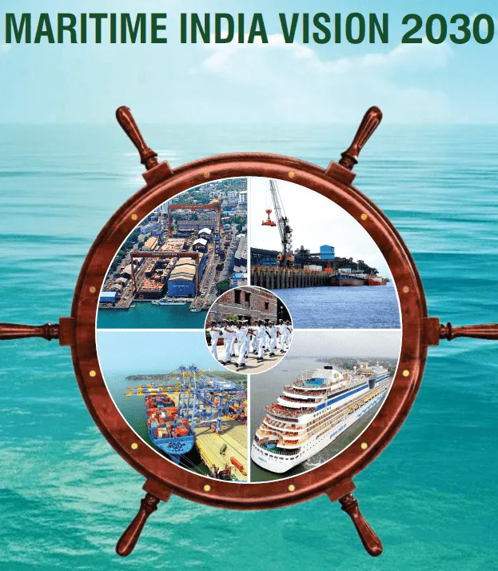
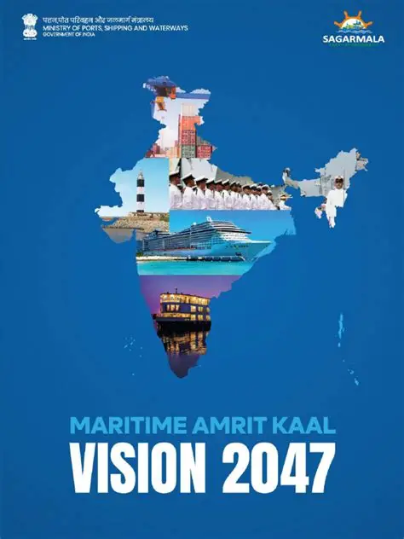
India’s Vision for the Maritime Sector
Maritime India Vision (MIV) 2030
Renewable Energy Share at Major Ports : >60%
Maritime Amrit Kaal Vision 2047
Advanced phase targeting Top 5 global position in shipbuilding and maintaining 1 position in ship recycling
Investment: INR 20,000+ Crores
Employment Generation: 1,00,000+ additional jobs (direct and indirect)
Position India Globally in the Top 10 Shipbuilding, repair nations (from 30k GT to 500k + GT.
Carbon neutral ports (green fuel, electrification, SPS). ≥ 60 % renewable-energy share, create hydrogen hubs, emission & resource monitoring toolkits for ports.
300+ Strategic Initiatives across 11 key maritime areas
Financial Assistance: 20-30% assistance for green vessels (including retrofitting)
Promote Waste to Wealth through ship recycling. India from #2 to #1 ship recycling nation.
Encourage green belt development (plantations) : Atleast 33% of port area
Promote Alternate/ Green Fuels, Bunkering infrastructure, green framework for terminal operations, introduce incentives in port duties for low emission vessels .
Notes:
India’s Vision for the Maritime Sector
Focus: Decarbonization & Sustainability – MIV 2030 and MAKV 2047
India’s maritime growth strategy is deeply anchored in sustainability and green transition. Both the Maritime India Vision 2030 and Maritime Amrit Kaal Vision 2047 outline clear, actionable pathways to decarbonize the sector.
Under Maritime India Vision 2030, the focus is on immediate-term transformation, positioning India among the world’s top ten shipbuilding nations while driving sustainability across ports and shipping. The plan calls for achieving over 60% renewable energy share at Major Ports, promoting Waste-to-Wealth through ship recycling, and green belt development covering at least 33% of port areas. These measures are aimed at reducing emissions, improving air quality, and making ports self-reliant in clean power.
Moving forward, Maritime Amrit Kaal Vision 2047 builds on this foundation to deliver carbon-neutral ports powered by green fuels, electrification, and shore power supply. It envisions the creation of Hydrogen hubs, emission and resource monitoring toolkits, and strong incentive mechanisms such as port dues discounts for low-emission vessels.
Both MIV & MAKV, emphasizes the integration of alternate fuels, including LNG, biofuels, hydrogen, ammonia and plan to extend 20–30% financial assistance for green vessels and retrofitting initiatives. Together, these steps ensure that India’s maritime sector transitions towards a low-carbon, resilient, and future-ready ecosystem , aligned with IMO’s Net Zero 2050 ambition and India’s national climate commitments.

Slide 6
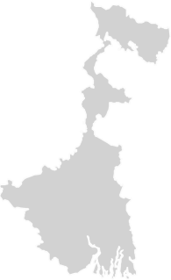
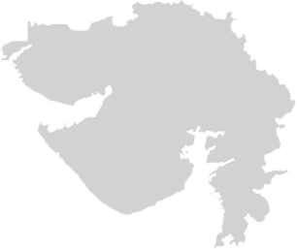
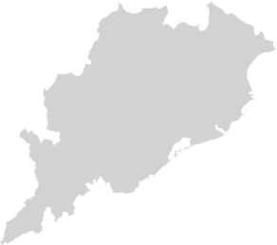
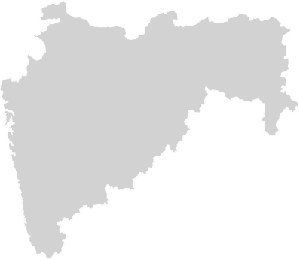
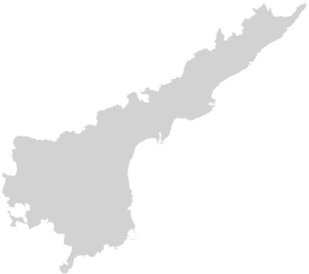



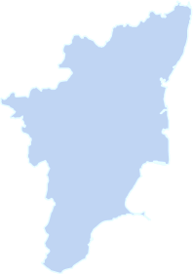
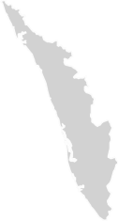
Shipbuilding Scenario in India
53*
30,000
GT
State-wise Shipbuilding capacities
Gujarat
436300 DWT
West Bengal
44000 DWT
Current Annual Tonnage Produced
Total Number of Shipyards
*Annual Report, MoPSW
Maharashtra
94300 DWT
Approved Financial Package to unlock 4.5M GT shipbuilding capacity, create ~ 30 lakh jobs and attract ₹ 4.5 lakh cr investments.
Goa
130000 DWT
Andhra Pradesh
80000 DWT
Karnataka
41000 DWT
Tamil Nadu
26000 DWT
Kerala
253600 DWT
Notes:
Shipbuilding Scenario in India
India’s shipbuilding sector is at a nascent but strategically critical stage. Despite having a long coastline and 53 shipyards (as per MoPSW Annual Report), the country currently produces only 30,000 GT annually, which is a small fraction compared to global leaders like China, South Korea, and Japan.
State-wise Capacities
Gujarat leads the sector with 436,300 DWT, thanks to strong industrial clusters and its coastal industrial base.
Kerala (253,600 DWT) and Goa (130,000 DWT) follow, with a mix of public and private yards catering to both defence and commercial orders.
Other contributors include Maharashtra (94,300 DWT), Andhra Pradesh (80,000 DWT), West Bengal (44,000 DWT), Karnataka (41,000 DWT), and Tamil Nadu (26,000 DWT).
This distribution highlights both the geographic spread of capacity and the under-utilisation of existing infrastructure.
Yard Capacities & Capabilities
India has a handful of large shipyards capable of handling vessels >200m in length — such as Cochin Shipyard Limited (CSL), Hindustan Shipyard Ltd. (HSL), L&T Shipbuilding, and
Central/State-run units like CMSRU and CKSRU.
Medium shipyards like Timblo, Chowgule, Titagarh Marine, CSL’s smaller yards and others handle repair, retrofits, and mid-sized vessels.
However, compared to international peers, India suffers from low productivity, high financing costs, and limited scale economies.
Policy & Investment Push
The Government has approved a financial package to unlock 4.5 million GT of shipbuilding capacity, with the potential to:
Generate ~30 lakh direct and indirect jobs,
Attract ₹4.5 lakh crore in investments,
Enable India to become a competitive global player while reducing dependence on foreign-built ships.
Strategic Importance
Shipbuilding is not just an industrial sector, it is a strategic enabler:
Strengthens national security by ensuring domestic capacity for defence and merchant fleets.
Boosts exports of vessels and green technology in the long run.
Creates linkages with allied industries — steel, engineering, design, marine electronics, and services.
Positions India to capture a share of the $70 billion global shipbuilding market.
India’s shipbuilding potential is large but untapped. With policy support, financing reforms, and capacity unlocking, the sector can shift from a marginal 30,000 GT output today to millions of GT tomorrow, creating jobs, saving forex, and boosting strategic autonomy.

Slide 7

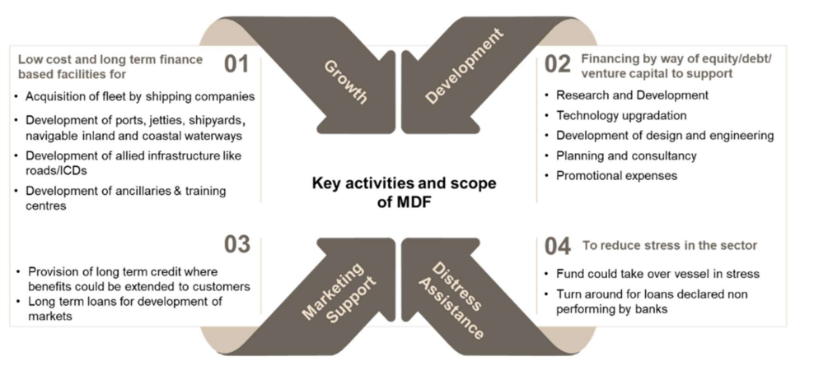
SBFA 2.0 and MDF
MDF
SBFAS 2.0 (2026 – 2036)
Total Allocation: ₹24,736 crore
Subsidy Rates:
Standard vessels: 14–15%; Large vessels (>₹100 crores): 20% ; Green fuel: 30% ; Electric/ hybrid: 20%
Maritime Development Fund
Maritime Development Fund (₹ 25,000 cr): Includes ₹ 20,000 cr Maritime Investment Fund (49% GoI) & ₹ 5,000 cr Interest Incentivization Fund to cut financing costs.
Data Source : PIB Press Release 24 SEP 2025
Notes:
SBFA 2.0 and MDF
The Government has announced two major financial interventions—the Shipbuilding Financial Assistance Scheme (SBFAS 2.0) and the Maritime Development Fund (MDF)—to reduce cost disadvantages, incentivize green shipbuilding, and unlock long-term financing for the maritime sector.
SBFA 2.0 (2026–2036)
Total Allocation: ₹24,736 crore over 10 years.
Purpose: To make Indian shipyards globally competitive by addressing cost differentials with foreign yards.
Subsidy Rates:
Standard vessels: 14–15% subsidy.
Large vessels (>₹100 crore): 20%.
Green fuel-based vessels: 30%.
Electric / hybrid vessels: 20%.
Impact: Directly reduces build costs for shipowners, incentivizes investment in next-generation and sustainable vessels, and creates demand for domestic shipbuilding.
Maritime Development Fund (MDF)
Total Allocation: ₹25,000 crore.
₹20,000 crore Maritime Investment Fund (Govt. share 49%).
₹5,000 crore Interest Incentivization Fund to reduce financing costs.
Scope and Activities:
Growth & Development – Financing fleet acquisition, shipyards, ports, jetties, inland/coastal waterways, and allied infrastructure like roads and training centres.
Equity/Debt Support – R&D, technology upgradation, design and engineering, planning & consultancy, promotional expenses.
Market Support – Long-term credit facilities for market development, expansion of ancillary industries, and customer-side financing.
Distress Assistance – MDF can step in to rescue vessels or shipyards under stress, refinance loans declared NPAs, and stabilize the sector.
Together, SBFA 2.0 and MDF provide a two-pronged strategy :one that directly reduces shipbuilding costs via subsidies, and another that enables affordable, long-term financing to fuel growth, innovation, and resilience in India’s shipbuilding ecosystem. These measures mark a transformational shift from ad-hoc incentives to a structured financial framework aligned with Maritime India Vision 2030 and MAKV 2047.

Slide 8
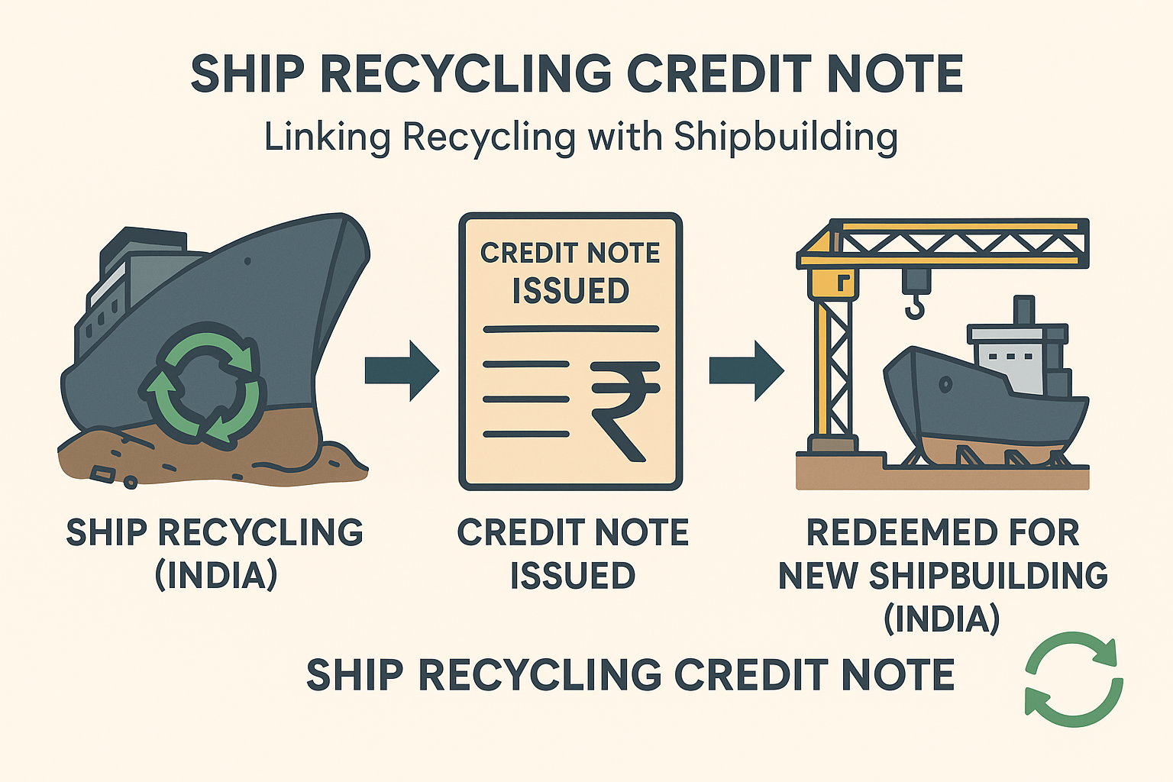
Ship Recycling Credit Note
Introduced under Ship Building Financial Assistance Scheme 2.0 (SBFA 2.0)
Incentivizes ship owners to recycle in India and build new ships in Indian shipyards
Allocation of : ₹ 4,001 crore
(under SBFA)
How It Works
When a vessel is recycled in a certified Indian yard, the ship owner receives a Credit Note for 40% of scrap value.
The Credit Note remains valid until the owner builds a new vessel/ ship in an Indian shipyard
Redeemed as financial assistance/ subsidy under SBFA 2.0
Expected Benefits
Encourages safe and HKC compliant ship recycling in India
Provides direct business boost for Indian shipyards
Attracts new players to India’s ship recycling and shipbuilding ecosystem
Strengthens India’s circular economy : recycling feeds into new shipbuilding
Positions India as a leader in Green and Sustainable Maritime Growth
Notes:
Ship Recycling Credit Note
The Ship Recycling Credit Note (SRCN) is one of the most innovative financial instruments introduced under the Shipbuilding Financial Assistance Scheme 2.0 (SBFA 2.0) with an allocation of ₹4,001 crore. It directly links India’s ship recycling strength with the growth of its shipbuilding industry.
How It Works
When a vessel is dismantled in a certified Indian ship recycling yard, the shipowner is issued a Credit Note worth 40% of the vessel’s scrap value.
This Credit Note remains valid until the shipowner invests in building a new vessel in an Indian shipyard.
The note is then redeemed as financial assistance/subsidy under SBFA 2.0, lowering the effective cost of new builds in India.
Expected Benefits
Boosts HKC-compliant recycling: Encourages safe, environmentally sound, and Hong Kong Convention (HKC) aligned ship recycling practices.
Strengthens shipbuilding: Directly channels recycling activity into new orders for Indian shipyards, ensuring business continuity.
Expands ecosystem participation: Incentivizes new players—both domestic and foreign—to engage with India’s recycling and shipbuilding ecosystem.
Promotes circular economy: Scrap steel and materials from recycling feed into the production of new ships, cutting raw material dependence.
Sustainability leadership: Positions India as a global leader in green and sustainable maritime growth, combining recycling, green steel, and shipbuilding.
Strategic Importance
SRCN acts as a bridge policy, ensuring that India’s dominance in recycling (30–35% of global share) translates into a thriving shipbuilding industry.
It enhances India’s image as the only country with over 100 HKC-compliant yards while simultaneously supporting its ambition to become a shipbuilding hub.
By tying together scrap recovery, circular economy, and green shipbuilding, it creates a self-sustaining maritime growth cycle.
The Ship Recycling Credit Note is a game-changer, as it uniquely integrates recycling with new construction, creating a virtuous cycle of sustainability, industrial growth, and employment.

Slide 9
India as a Net Green Energy Exporter & Bunkering Destination
From energy importer to future maritime fuel hub
Strategic Advantage
Long coastline with major ports on East–West shipping lanes
Abundant renewable energy for green hydrogen, ammonia, methanol
Cost advantage in solar + wind production, lowering fuel export price
Fuel Export Readiness
Green Ammonia : Kandla supply to Singapore (L&T–Itochu JV)
Green Methanol : VOC Port bunkering hub under development
Hydrogen Derivatives : Mission to export through maritime corridors
Port Infrastructure Transformation
Dedicated Green Bunkering Terminals (VOC Port, Kandla, JNPA)
Upcoming Green Shipping Corridors: Tuticorin – Kandla – Singapore – Rotterdam
Integration of renewable power, storage & safety systems
Economic & Diplomatic Impact
Reduces dependency on oil imports
Positions India as fuel supplier to global shipping lines
Enhances maritime influence under Global South leadership
Policy Backing
Supported by National Green Hydrogen Mission & NGSP
Incentivized by Harit Sagar & MIV 2030
Aligned with Make in India & Energy Security Vision 2047
India is not just preparing for Green Fuels —
it is preparing to Fuel The World.
Notes:
India as a Net Green Energy Exporter & Bunkering Destination
India is at the crossroads of a major strategic shift, from being one of the world’s largest importers of fossil fuels to emerging as a future global supplier of green maritime fuels such as green ammonia, green methanol, and hydrogen derivatives. This transition is not isolated; it is rooted in domestic policy reforms, renewable energy leadership, and a geopolitical push for energy independence by 2047 and Net Zero by 2070.
1. Strategic Maritime Advantage
With its extensive coastline and central position on major East–West shipping corridors, India is geographically primed to become a bunkering and refueling hub for global shipping. India has one of the world’s largest solar and wind power expansion programmes, which provides a cost advantage in producing green fuels, making exports competitive.
2. Fuel Export Capacity in Motion
India is already laying the groundwork for maritime fuel exports:
Green Ammonia (Export-Oriented Production) At Kandla, a JV between L&T and Itochu (Japan) is setting up a large-scale green ammonia plant (~300 KTPA), with committed offtake to Singapore’s bunkering market.
Green Methanol (First Bunkering Hub in India) At VOC Port, Tuticorin, construction of a 750 m³ green methanol bunkering terminal is underway (SOPAN Group). This is India’s first dedicated alternative fuel facility for shipping.
Hydrogen Derivatives for Maritime Corridors Under the National Green Hydrogen Mission, India targets 5 MMT green hydrogen by 2030, largely to convert into exportable derivatives (ammonia/methanol) through maritime corridors like Kandla–Singapore, Tuticorin–Rotterdam, etc.
3. Port Infrastructure Transformation
Ports are evolving from cargo hubs to energy export platforms:
Dedicated green fuel terminals at VOC Port, Kandla, JNPA
Coastal Green Shipping Corridors being piloted (Tuticorin–Kandla–Singapore–Rotterdam)
Integration of renewable power, desalination, safety systems, and bunkering pipelines into port estates under Harit Sagar Guidelines and NGSP
4. Economic & Diplomatic Impact
India’s leadership in green fuel exports has a threefold strategic impact:
Reduces dependence on crude oil imports (currently 85% import-driven energy market)
Positions India as a fuel supplier to global shipping lines transitioning under IMO Net-Zero framework
Strengthens India's diplomatic role as a provider of clean energy to the Global South, reinforcing leadership at forums such as OPEC, G20, and COP
5. Strong Policy Backing
Backed by National Green Hydrogen Mission and Draft National Green Shipping Policy (NGSP)
Incentives via Harit Sagar, Maritime India Vision 2030, and Make in India–Energy Security 2047
PIB statements (July 2025, OPEC Summit): “India will not only be energy independent by 2047, but will also fuel the world with green energy exports.”
Conclusion
India is not simply decarbonizing its ports and ships, it is building a green energy export economy around its maritime sector. With methanol bunkering, ammonia export hubs, and hydrogen corridors already initiated, India is setting the stage to become the refuelling station of a net-zero maritime world.
India is not just preparing for Green Fuels………… It is preparing to Fuel the World.

Slide 10
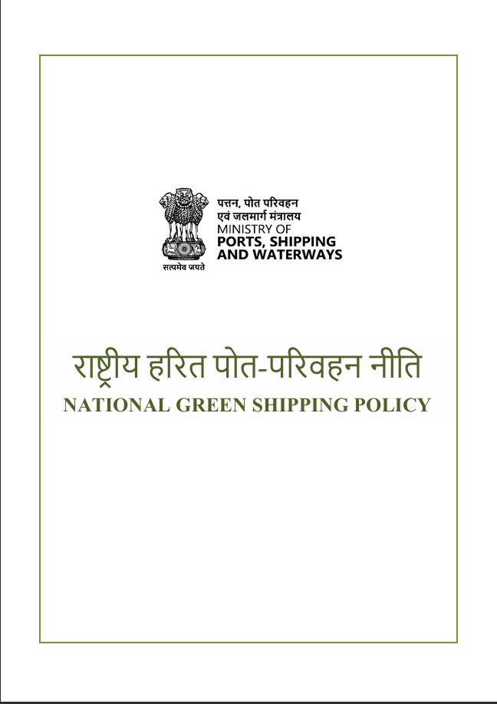
National Green Shipping Policy
Maritime Vision for a Green Future
The NGSP is India’s strategic response to the global decarbonisation mandate, a policy blueprint designed to secure maritime growth while transitioning towards clean energy, sustainable ships and climate-resilient ports.
Key Transition Pillars:
Green Ships
Green Ports
Green Fuels
Green Recycling
Green Financing
Green Skill Development
Green Technology
Strategic Intent
To position India as a global hub for green shipping and future fuels, enabling industry to move from regulatory compliance to global competitiveness and leadership.
Notes:
National Green Shipping Policy
The National Green Shipping Policy (NGSP) is India’s comprehensive roadmap to align the maritime sector with global decarbonisation goals while ensuring economic growth and competitiveness. As highlighted in the consultative document (2025), NGSP is not just an environmental initiative, but a strategic shift to position India as a global hub for green shipping, green fuels, green ports, and maritime innovation. It builds on international mandates such as the IMO’s 2023 GHG Strategy and domestic commitments announced under COP-26 Panchamrit.
The policy integrates sustainability across the maritime value chain, focusing on low-emission vessel technologies, alternative fuel infrastructure, regulatory reform, and green financing mechanisms. It also aligns with major national frameworks – Maritime India Vision 2030, Amrit Kaal Vision 2047, Sagarmala and Harit Sagar guidelines – creating a unified and future-ready maritime strategy.
Key Transition Pillars
Green Ships: Promotion of energy-efficient vessel designs, retrofits, zero-emission propulsion, and mandatory green certification. NGSP envisions India becoming a shipbuilding and retrofit hub for low-carbon vessels.
Green Ports: Port decarbonisation through shore power (OPS), electrified equipment, green corridors, emission monitoring, and renewable integration (solar, wind, hydrogen bunkering).
Green Fuels: Adoption of biofuels, LNG, methanol, hydrogen and ammonia under a phased fuel transition plan. The policy promotes domestic fuel production and bunkering hubs to make India a future fuel supply nation.
Green Recycling: Modernisation of Alang and other ship recycling yards under HKC-compliant practices, with circular economy principles, hazardous waste control, and global recycling leadership.
Green Finance & Collaboration: Creation of national green maritime funds, tax incentives, ESG-linked financing, PPP models, and international partnerships to support innovation and equitable transition.
Strategic Intent
The core objective of NGSP is to shift India from regulatory compliance to global leadership in green shipping. By integrating technology, sustainability, and economy, India seeks to become a maritime nation that exports solutions, not emissions. The policy emphasises a just and equitable transition, ensuring inclusion of industry, labour, MSMEs, and coastal communities.

Slide 11
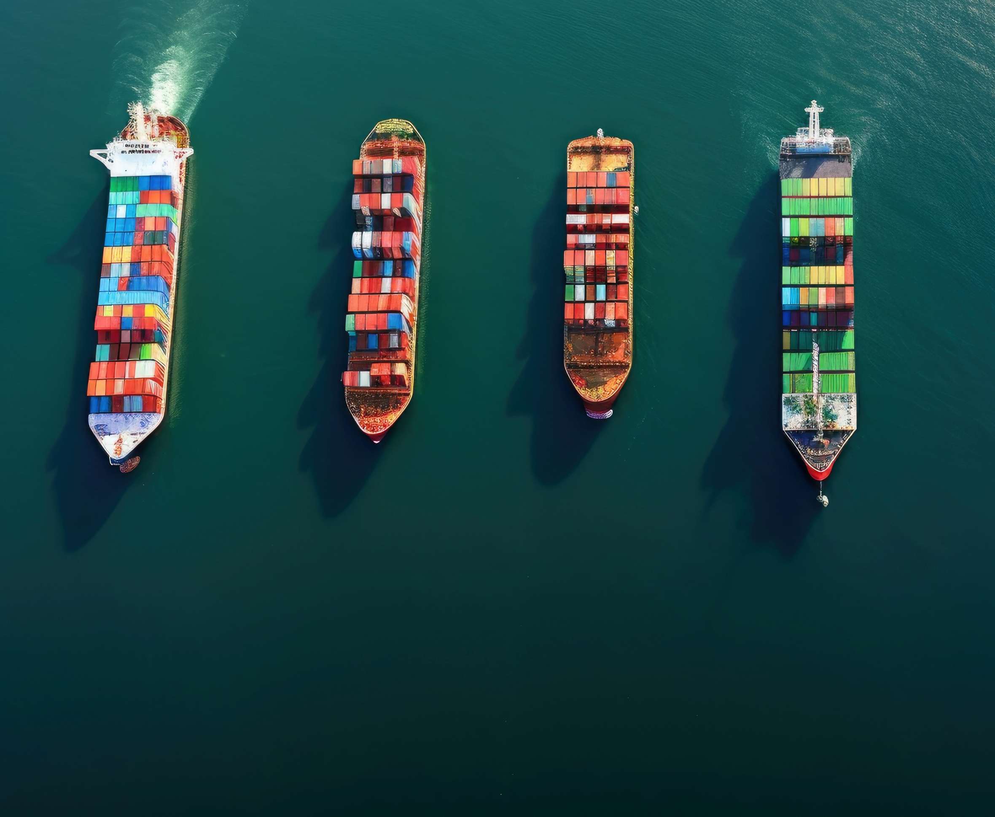
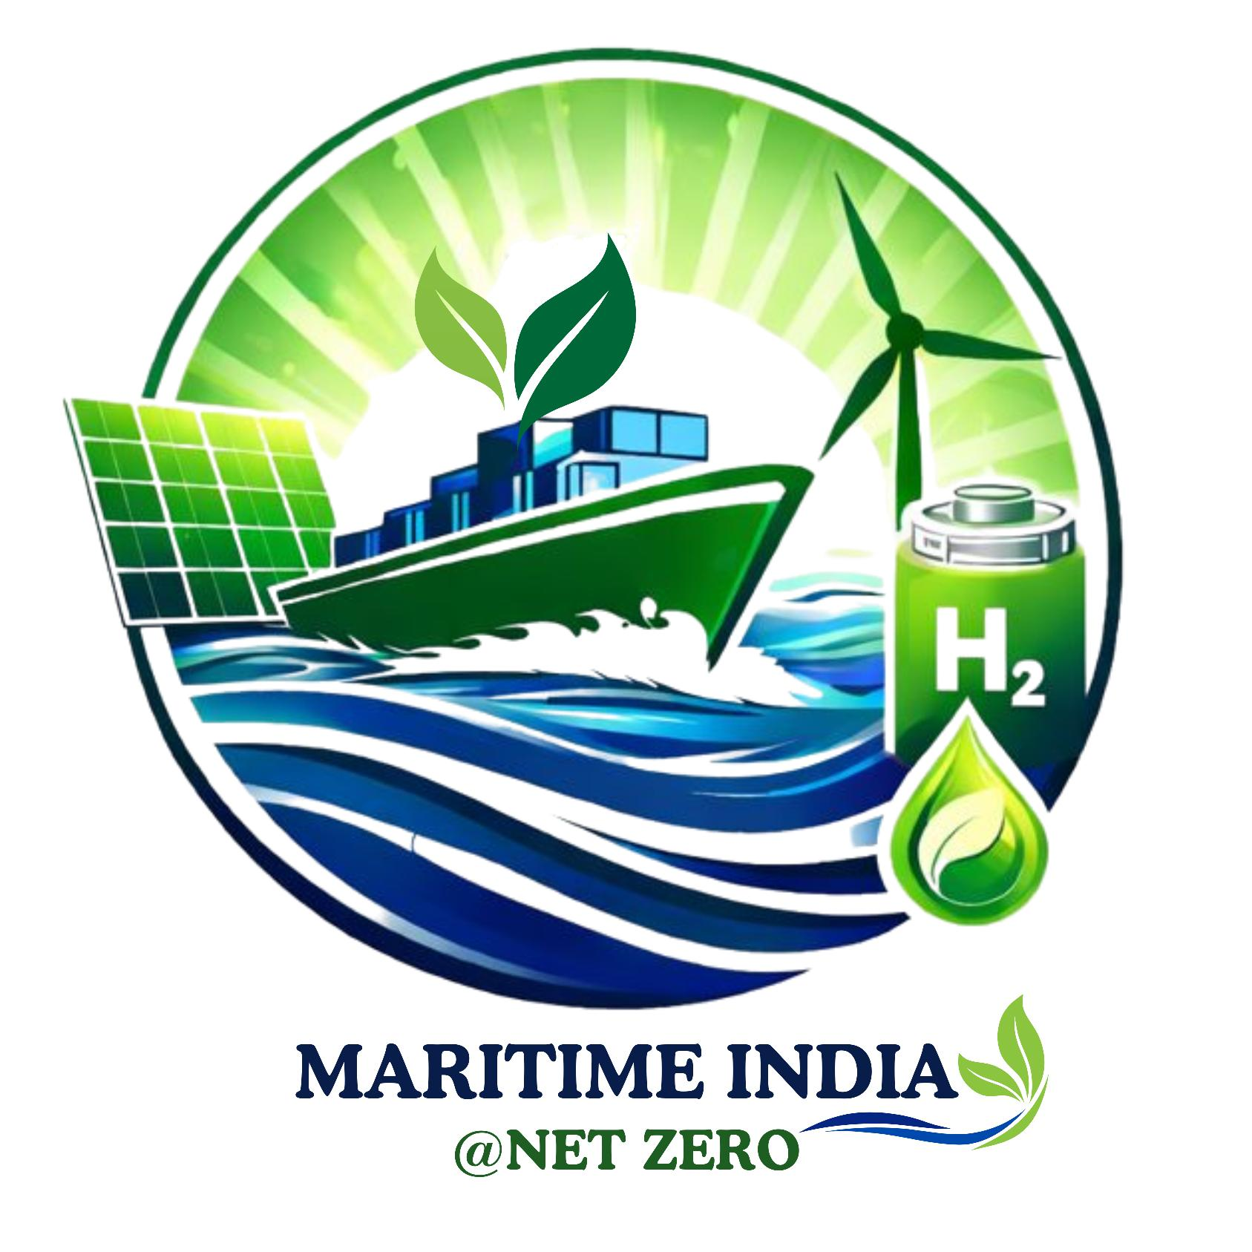
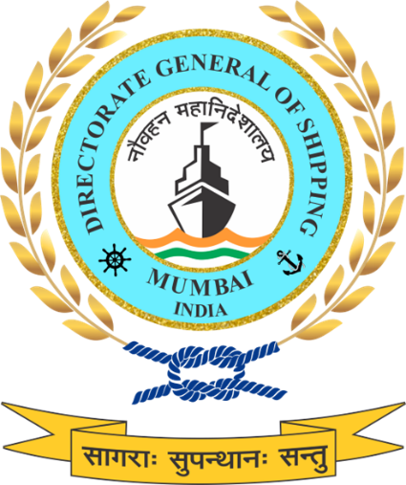
Thank You

