Slide 1
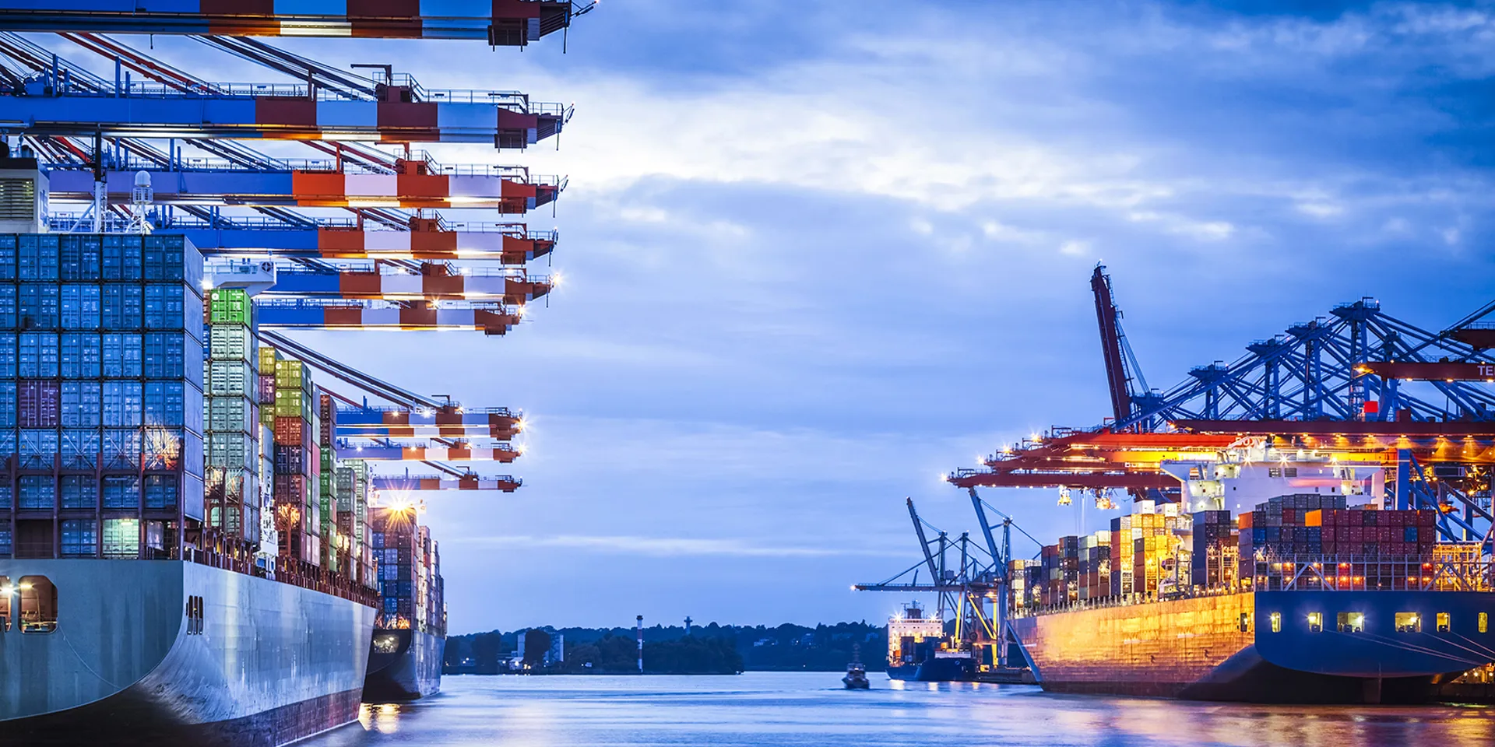
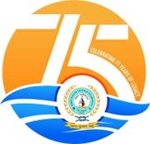
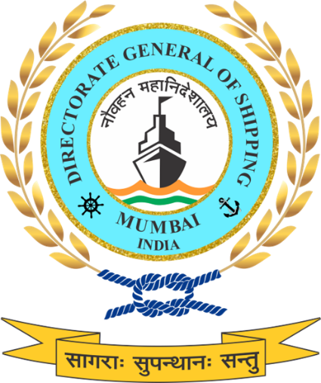
Public – Private Dialogue on
Maritime Anti-Corruption Network (MACN)
Directorate General of Shipping
22nd December 2025 | Mumbai
Notes:
Public–Private Dialogue on Maritime Anti-Corruption (MACN)
Directorate General of Shipping | 22 December 2025 | Mumbai
Good afternoon.
This Public–Private Dialogue is being convened at a time when integrity in maritime operations has become a critical enabler of safety, efficiency and national credibility. Maritime corruption is not merely a compliance issue; it directly affects ease of doing business, operational predictability, crew welfare and India’s standing as a responsible maritime nation.
The Government of India has repeatedly emphasised a zero-tolerance approach to corruption, aligned with broader national objectives of good governance, transparency and institutional accountability. These principles are central to India’s aspirations under Atmanirbhar Bharat, Viksit Bharat and Amrit Kaal, and are particularly relevant in a sector as internationally integrated as shipping.
In this context, the Maritime Anti-Corruption Network (MACN) has emerged as a significant global collective action platform, bringing together shipowners, operators and stakeholders to address corruption risks in a structured and practical manner. MACN is a recognised industry association, acknowledged by the International Maritime Organization, and represents a substantial share of global shipping tonnage.
Over the past three and a half years, MACN-India has been actively engaging with Indian port stakeholders, shipping companies and public authorities to supplement national efforts against maritime corruption. Initiatives such as structured recommendations, outreach programmes and the operationalisation of the MACN Help Desk have demonstrated that coordinated public–private action can deliver tangible outcomes, including faster incident resolution and reduced operational friction.
Today’s dialogue is intended to provide an open platform for discussion between government agencies, industry representatives and maritime associations. The objective is to deepen and institutionalize collaboration, identify practical measures to strengthen integrity at ports and ship-shore interfaces and align India’s maritime governance framework with international best practices, including IMO guidance on preventing and addressing maritime corruption.
This engagement reflects the Directorate General of Shipping’s commitment to transparent, rule-based enforcement, protection of seafarers and creation of a fair and predictable maritime operating environment.

Slide 2
Directorate General of Shipping
India’s Maritime Regulator
Established: 3 September 1949 as an attached office under Ministry of Commerce; now functions under the Ministry of Ports, Shipping & Waterways (MoPSW).
Mandate: Formulates and enforces shipping policies and legislations in India.
Global Role: Serves as India’s Maritime Administration, representing the country at the IMO and other international maritime forums.
Presence: Headquarters in Mumbai, supported by 14 Mercantile Marine Departments (MMDs) PAN India.
Core Functions :
⚖️ Policy & Regulation :
  Formulates shipping policy, enforces national & international legislations.
🚢 Ship Safety :
  Surveys, inspections, and certification of vessels.
👨‍✈️ Seafarers
  Training, competency certification, and welfare.
🌍 Environment & Green Shipping :
  Implements MARPOL, promotes decarbonisation & alternate fuels.
🛠️ Ship Recycling :
  Regulates and monitors yards, ensures HKC compliance.
🤝 International Engagement :
  Represents India at IMO & global maritime forums.
Key Wings & Branches :
Engineering
Nautical
Naval Architecture
Coastal Shipping
Crew
Shipping Development
Administration
Training
Notes:
Directorate General of Shipping
(India’s Maritime Regulator)
Allow me to briefly introduce the Directorate General of Shipping, the apex maritime regulatory authority of India.
Established in 1949, the Directorate has evolved over the decades from a small office under the Ministry of Commerce into a full-fledged maritime administration under the Ministry of Ports, Shipping and Waterways. It continues to serve as the central institution responsible for formulating, implementing, and enforcing national and international shipping policies and legislation in India.
Our mandate is broad and holistic — covering every dimension of India’s maritime domain. We are responsible for ship safety, seafarer training and welfare, environmental protection, and the promotion of green and sustainable shipping practices. At the same time, we ensure compliance with conventions of the International Maritime Organization (IMO) and other global instruments.
From our headquarters in Mumbai, we operate through a network of 14 Mercantile Marine Departments strategically located across the country — from Kandla and Kochi to Kolkata, Chennai, and Port Blair. These MMDs act as our field arms for inspections, surveys, certification, and maritime governance, ensuring that the standards we uphold in New Delhi and Mumbai are implemented uniformly across all Indian ports and coasts.
The Directorate’s work is organized across key functional wings and branches - Engineering, Nautical, Naval Architecture, Crew, Administration, Coastal Shipping, and Training. Together, these verticals form the operational backbone of India’s maritime ecosystem.
Our core functions reflect both our regulatory mandate and developmental vision:
We formulate and enforce policy, keeping pace with global maritime law.
We ensure ship safety through surveys, inspections, and certification.
We oversee seafarers’ training, competency, and welfare, enabling India to remain one of the top seafarer-supplying nations in the world.
We are driving the green shipping transition, implementing MARPOL and promoting alternate fuels and decarbonization.
We also regulate ship recycling, with India leading globally in Hong Kong Convention–compliant yards.
And finally, we play a pivotal role in international engagement, representing India at the IMO and multiple global maritime forums.
In essence, the Directorate General of Shipping stands at the confluence of policy, regulation, sustainability, and international cooperation — ensuring that India’s maritime growth remains both safe and sustainable, aligned with the UN Sustainable Development Goals and the vision of a Viksit Bharat by 2047.
“We are not just regulators; we are enablers of India’s maritime future.”

Slide 3
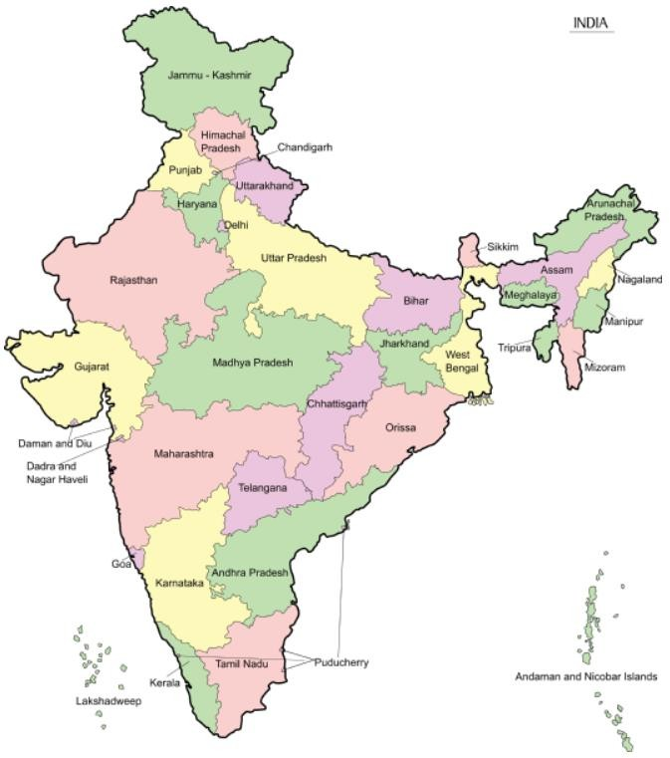













Mercantile Marine Departments
MMD,
Kandla
MMD
Noida
MMD,
Jamnagar
DGS & MMD,
Mumbai
MMD,
Goa
MMD
Kolkata
& MMD Haldia
MMD,
Paradip
MMD,
Vizag
MMD,
Mangalore
MMD,
Kochi
MMD,
Chennai
MMD,
Andaman & Nicobar
MMD,
Tuticorin
Notes:
Mercantile Marine Departments
“This map illustrates the national footprint of the Directorate General of Shipping through its network of Mercantile Marine Departments, or MMDs.”
The Directorate operates through 14 Mercantile Marine Departments strategically located along India’s vast coastline and inland regions. These offices act as the operational arms of the Directorate, ensuring that all statutory functions related to safety, certification, inspection, training, and compliance are executed efficiently and uniformly across the country.
From Kandla and Jamnagar in the west, to Kolkata, Haldia, and Paradip in the east, and from Tuticorin and Kochi in the south to Noida in the north, each MMD serves as a crucial link in India’s maritime administration framework. The presence of an MMD in the Andaman and Nicobar Islands also ensures regulatory coverage of India’s strategic island territories.
Each of these departments is headed by a Principal Officer, supported by technical and administrative staff from diverse disciplines—engineering, nautical, and naval architecture—working in close coordination with the Directorate in Mumbai.
Their role is not merely administrative but also regulatory and service-oriented. They conduct surveys of Indian and foreign ships, issue certificates of competency to seafarers, carry out port State and flag State inspections, and ensure the implementation of international maritime conventions such as SOLAS, MARPOL, and STCW at the regional level.
Together, this network ensures nationwide maritime governance, providing accessibility and uniformity in the enforcement of shipping laws and safety standards, irrespective of where a vessel or seafarer is located in India.
“In short, these MMDs form the backbone of our field operations — ensuring that every port and coastal state in India remains connected to the Directorate’s regulatory framework, and that the standards we uphold internationally are implemented locally with equal rigour.”

Slide 4
Context & National Imperative
Why This Matters
Maritime corruption is not a standalone issue.
It directly affects safety, seafarer welfare and the efficiency of global trade flows.
Ports as Strategic Gateways
Ports are the first and last interface between ships and the State
Any lack of integrity at ports has system-wide ripple effects across shipping and logistics
Integrity as a National Priority
Integrity in port operations is essential to:
Ease of Doing Business
Reduction of logistics costs
India’s credibility as a trusted maritime nation
Notes:
Context & National Imperative
“Before we discuss solutions, it is important to recognise why this issue matters at a national level.”
Maritime corruption is not an isolated procedural problem.
It has direct and far-reaching consequences for maritime safety, the welfare and dignity of seafarers, and the overall efficiency of global trade.
Ports occupy a strategic position in the maritime ecosystem.
They represent the first and last point of contact between ships and the State. Every interaction at a port — whether related to entry, inspection, documentation or exit — shapes how India is perceived as a maritime nation.
When integrity at ports is compromised, the impact is systemic.
It affects not only one vessel or one operator, but entire supply chains, logistics costs, and confidence in regulatory predictability.
This is why integrity in port operations must be seen as a national imperative.
Transparent, rule-based and predictable port processes are fundamental to:
improving Ease of Doing Business,
reducing logistics and transaction costs, and
strengthening India’s credibility as a trusted and responsible maritime nation.
“Integrity at ports is therefore not optional. It is central to India’s maritime growth story.”
Why ports are uniquely sensitive to corruption
Ports involve multiple agencies, high discretion and time-sensitive operations
Even small delays have disproportionate economic impact
Ships are mobile and time-bound — coercive practices thrive under pressure
Link to national priorities
Ease of Doing Business: Predictable port processes reduce uncertainty and informal costs
Logistics cost reduction: Corruption adds hidden costs that inflate freight and insurance
Global credibility: Flag, port and regulatory reputation directly influence trade choices
Strategic framing
Corruption ≠ moral failure alone
Corruption = efficiency loss + safety risk + reputational damage

Slide 5
MACN: A Strategic Partner
Maritime Anti-Corruption Network (MACN)
Global, industry-led collective action platform addressing maritime corruption
220+ member companies, representing ~60% of global shipping tonnage
Recognised and referenced by the International Maritime Organization (IMO)
Works through structured public–private engagement and evidence-led interventions
Supports members with tools, reporting pathways and prevention measures
Why MACN Matters for India
Helps identify port-side risk points using data and incident patterns
Acts as a neutral and trusted interface between industry and government
Complements national regulatory efforts through data, collaboration and trust-based engagement
Accelerates systemic solutions that reduce discretion, delays and opacity
Aligns with India’s priorities on transparency, governance and ease of doing business
MACN strengthens governance outcomes through capacity building, collective action and integrity culture.
Notes:
MACN: A Strategic Partner
This slide explains why MACN is not just another industry forum, but a strategic partner in addressing maritime corruption.
MACN is a global, industry-led collective action platform that brings together over 220 shipping companies, representing nearly 60 percent of global shipping tonnage. This scale gives credibility to the data, patterns and insights it generates.
Importantly, MACN is recognised and referenced at the International Maritime Organization, which places its work firmly within the global maritime governance ecosystem.
What makes MACN particularly relevant for regulators is its evidence-based approach. It does not work on anecdotes, but on structured incident reporting, trend analysis and practical prevention tools.
For India, MACN offers value in three key ways.
First, it helps identify port-side and ship-shore risk points using real operational data, allowing us to focus reforms where discretion and opacity are highest.
Second, it acts as a neutral and trusted interface between industry and government, enabling issues to be discussed constructively without attribution or confrontation.
Third, MACN’s work complements national regulatory efforts by supporting collaboration, transparency and system-level solutions rather than isolated enforcement actions.
In this sense, engagement with MACN aligns well with India’s broader priorities on transparency, good governance and ease of doing business, while also strengthening safety and trust across the maritime ecosystem.

Slide 6
MACN - Government Collaboration in India
Purpose of Engagement
Address corruption risks across the maritime ecosystem — ports and ships
Move from incident-driven responses to systemic prevention
Protect seafarer welfare, safety and dignity alongside operational integrity
Scope of Collaboration
Ports: inspections, clearances, documentation and intermediaries
Ships: crew exposure to coercion and informal demands
Training: ethical and safe response by seafarers
Reporting: secure, confidential escalation mechanisms
Mode of Engagement
Evidence-based inputs from industry and seafarer experiences
Neutral, non-attributive platform enabling open dialogue
Capacity building initiatives for crews, companies and stakeholders
Alignment with international guidance and best practices
Value for India
Strengthens seafarer protection and confidence
Improves consistency and credibility of maritime governance
Supports Ease of Doing Business and global trust in Indian ports
Reinforces India’s zero-tolerance stance through collaboration
Notes:
MACN–Government Collaboration in India
This slide outlines how engagement with MACN is structured and why it is relevant in the Indian context.
The purpose of engagement is to address corruption risks across the entire maritime ecosystem—both at ports and on board ships. The intent is to move away from isolated, incident-driven responses and instead focus on systemic prevention. A key consideration throughout is the protection of seafarer welfare, safety and dignity, while maintaining operational integrity and regulatory effectiveness.
In terms of engagement, MACN operates as a neutral, non-attributive platform. This allows evidence-based inputs to be drawn from industry experience and seafarer feedback without naming or targeting individual agencies or officers. The emphasis is on open dialogue, capacity building and alignment with international guidance and best practices rather than fault-finding.
The scope of collaboration spans both port-side and ship-side realities. On the port side, this includes inspections, clearances, documentation and the role of intermediaries. On the ship side, it recognizes the pressures faced by crews, including coercion and informal demands. Training and awareness are therefore essential, along with secure and confidential reporting and escalation mechanisms.
For India, this collaboration adds value by strengthening seafarer protection and confidence, improving consistency and credibility in maritime governance and supporting ease of doing business at Indian ports. Importantly, it reinforces India’s zero-tolerance stance on corruption through structured, cooperative and system-level action.”

Slide 7
MACN : The Three Cs Framework
Capacity Building
Monitoring threats and reporting patterns
Information sharing and awareness tools
Strengthening internal compliance systems of member companies
Collective Action
Sustainable collaboration with governments and port stakeholders
Shared accountability across the maritime value chain
Higher participation, stronger consistency in action on ground
Culture of Integrity
Open dialogue with key stakeholders
Building awareness of industry challenges
Promoting integrity as an operating norm, not an exception
The Three Cs translate intent into systems, partnerships and behaviour change.
Notes:
MACN : The Three Cs Framework
This slide explains the core framework through which MACN approaches maritime anti-corruption work, referred to as the Three Cs.
The first pillar is Capacity Building. This focuses on strengthening the ability of organisations and individuals to recognise and respond to corruption risks. It includes monitoring threat patterns, analysing incident data and sharing information and awareness tools. For member companies, this also means strengthening internal compliance systems so that responses are structured, consistent and aligned with best practices.
The second pillar is Collective Action. Corruption risks in the maritime sector often sit at shared interfaces—between ports, ships, agents and authorities. Collective action brings governments, port stakeholders and industry together to address these risks jointly. The emphasis is on shared accountability across the maritime value chain and ensuring higher participation and consistency in how issues are addressed on the ground.
The third pillar is Culture of Integrity. This focuses on long-term behavioural change. It involves open dialogue with key stakeholders, increasing awareness of industry challenges and promoting integrity as an operating norm rather than an exception. The objective is to embed ethical conduct into everyday decision-making rather than relying only on enforcement after incidents occur.
Taken together, the Three Cs translate intent into practical systems, partnerships and behavioural change, supporting sustainable and credible anti-corruption outcomes in the maritime sector.

Slide 8
Port-Side Corruption: Where Risks Arise
Pre-Arrival & Port Entry
Documentation submission
Initial regulatory interface
Berthing, Cargo & Terminal Operations
Cargo handling
Terminal-level interactions
Statutory Inspections & Surveys
Flag State / statutory surveys
Interface with enforcement authorities
Documentation, Certification & Port Exit
Shore passes and crew movements
Port departure formalities
Arrival clearances
Berth allocation
Port State Control inspections
Clearance certificates
Corruption risks emerge where discretion, delays and opacity intersect across port processes
Notes:
Port-Side Corruption: Where Risks Arise
“To address maritime corruption effectively, we must first understand where and how risks arise.”
Port-side corruption does not occur randomly.
It tends to emerge at predictable points across the port lifecycle, where ships interact with multiple authorities under time pressure and operational constraints.
The first point of vulnerability is during pre-arrival and port entry, where documentation, clearances and initial regulatory interfaces take place. These are often time-sensitive processes, and any delay can have immediate operational consequences.
The second stage is berthing, cargo and terminal operations. Decisions relating to berth allocation, cargo handling and terminal-level interactions involve coordination across multiple stakeholders, which can create points of discretion if processes are not fully standardised.
The third stage is statutory inspections and surveys, including Port State Control inspections and flag State or statutory surveys. These inspections are critical for safety and compliance, but when discretion is misused, they can become points of pressure rather than protection.
The final stage is documentation, certification and port exit, including clearance certificates, shore passes and crew movements. Delays or lack of transparency at this stage can disrupt vessel schedules and crew welfare.
“Across all these stages, corruption risks emerge where discretion, delays and opacity intersect.”
This understanding is essential because it allows us to design systemic solutions, rather than reacting to isolated incidents.
Why a lifecycle approach matters
It avoids blaming any single agency
It shows corruption as a process risk, not a personnel issue
It aligns with MACN’s methodology and international best practice
Why these four stages are critical
Pre-arrival & entry: High paperwork load, regulatory interfaces, time pressure
Berthing & cargo: Commercial urgency, coordination complexity
Inspections & surveys: Enforcement authority + discretion = high-risk zone
Exit & documentation: Crew welfare and vessel schedules most vulnerable
Corruption risk increases when:
Decisions are discretionary
Processes are manual or opaque
Delays carry financial or human cost

Slide 9
Port-Side Corruption: Agencies & Interfaces
Port Operations Ecosystem
Port Authorities & Terminal Operators
Customs & Allied Regulatory Agencies
Immigration & Shore pass System
Port State Control
Flag State & Statutory Survey
Agents & Intermediaries
Berthing
Cargo handling
Terminal-level processes
Documentation handling
Interface between vessel and authorities
Cargo clearance
Compliance verification
Documentation checks
Certification
Survey and compliance oversight
Crew movement
Shore access permissions
Safety and compliance inspections
Deficiency reporting
Integrity must be ensured across the entire port ecosystem — not in silos
Notes:
Port-Side Corruption: Agencies & Interfaces
“Having identified where corruption risks arise across the port lifecycle, it is equally important to understand how port operations actually function in practice.”
Ports do not operate in silos. They function as a complex operational ecosystem, where multiple public authorities, service providers and intermediaries interact with the same vessel during a single port call.
We are deliberately presenting this as an ecosystem view, not an accusatory list. Corruption risks do not belong to one agency alone. They typically arise at interfaces, especially where discretion, delays or lack of clarity exist.
At the centre of this ecosystem are port authorities and terminal operators, responsible for berthing, cargo handling and terminal-level sequencing. These are time-critical, commercially sensitive activities where predictability and transparency are essential.
Customs and allied regulatory agencies play a critical role in cargo clearance, compliance verification and documentation checks. These functions are fundamental to trade facilitation. However, where processes are complex or inconsistent, they can become pressure points.
The immigration and shore-pass system directly affects crew movement and shore access. Delays or uncertainty here have an immediate impact on seafarer welfare and dignity, making this a particularly sensitive interface.
Port State Control inspections and flag State or statutory surveys are central to safety and compliance. These inspections must remain objective, consistent and rule-based, so that enforcement strengthens safety rather than becoming a source of coercion.
Finally, agents and intermediaries often act as the interface between vessels and authorities, coordinating documentation and clearances. Where systems are opaque, reliance on intermediaries increases, and with it, vulnerability.
“The key message is simple — integrity must be ensured across the entire port ecosystem, not in silos.”
From a governance standpoint, the solution cannot be agency-specific. Effective prevention requires end-to-end integrity, supported by standardisation, digitisation and accountability across interfaces.
From the DGS perspective, monitoring and assurance work best through a hub-and-spoke model:
Central oversight and policy direction at the hub
Field-level enforcement and reporting at the spokes
Clear escalation pathways back to the hub for review, corrective action and closure
This approach avoids blame, reflects operational reality and reinforces coordinated reform.
Corruption risks increase when:
Responsibilities overlap without clarity
Accountability is fragmented
Information is asymmetrical
Addressing these risks therefore requires system-wide alignment, not isolated interventions.
-----
Port Authorities & Terminal Operators
Berth allocation
Cargo handling operations
Terminal-level permissions and sequencing
Customs & Allied Regulatory Agencies
Cargo clearance
Compliance verification
Import/export documentation checks
Immigration & Shore-Pass System
Crew movement approvals
Shore access permissions
Crew welfare-linked clearances
Port State Control (PSC)
Safety and compliance inspections
Deficiency identification and reporting
Detention decisions where applicable
Flag State & Statutory Survey Interfaces
Certification issuance
Statutory surveys and audits
Compliance oversight
Agents & Intermediaries
Documentation handling
Coordination between vessel and authorities
Process facilitation across agencies
Why this ecosystem framing is important
Prevents attribution of blame to any one agency
Reflects the reality of port operations
Reinforces the need for coordinated reforms
Why intermediaries matter
They emerge where processes are complex or opaque
Reducing discretion and improving transparency reduces over-dependence
Corruption risk increases when:
Responsibilities overlap without clarity
Accountability is fragmented
Information is asymmetrical

Slide 10
How Corruption Manifests in Practice
Observed Risk Patterns at Ports
Threats of unjustified deficiencies or detention
(used as leverage rather than for safety enforcement)
Deliberate procedural delays
(clearances, inspections or documentation)
Cash and in-kind demands
(informal facilitation, goods or favours)
Harassment or intimidation of crew
(particularly during inspections or shore access)
Documentation and clearance bottlenecks
(created or prolonged artificially)
Primary Impact Areas
Seafarers
  Stress, intimidation and loss of dignity
Ship Operators
  Delays, uncertainty and increased costs
Safety & Compliance
  Real deficiencies overshadowed by misuse of process
These are illustrative patterns observed in port operations and are not agency specific.
Notes:
How Corruption Manifests in Practice
“Having mapped the port ecosystem, it is important to understand how corruption actually manifests in day-to-day operations.”
Across ports, corruption does not usually appear as a single overt act.
It manifests through patterns of behaviour, often subtle, that exploit discretion and time pressure.
One such pattern is the threat of unjustified deficiencies or detention, not as a genuine safety intervention, but as leverage. This undermines the credibility of enforcement and shifts focus away from real safety concerns.
Another common manifestation is deliberate procedural delays — in inspections, clearances or documentation — where time itself becomes a tool of pressure.
There are also instances of cash and in-kind demands, often framed informally as facilitation, goods or favours, rather than explicit monetary transactions.
Harassment or intimidation of crew, particularly during inspections or while seeking shore access, is a serious concern. Seafarers are often the most vulnerable stakeholders in port operations.
Finally, documentation and clearance bottlenecks may be artificially created or prolonged, increasing dependence on intermediaries and informal channels.
“The impact of these practices is not limited to one party.”
They place significant stress on seafarers, create uncertainty and costs for ship operators, and most importantly, compromise safety and compliance by diverting attention from genuine deficiencies.
Why these are called ‘patterns’
They recur across ports and contexts
They exploit process design weaknesses
They are rarely isolated or random
Primary impact areas
Seafarers: intimidation, stress, erosion of dignity
Operators: delays, demurrage, unpredictability
Safety: real risks overshadowed by misuse of process
Corruption thrives when:
Processes are opaque
Timelines are discretionary
Accountability is fragmented
Why the disclaimer matters
Protects institutions and individuals
Reinforces that the focus is systemic, not agency-specific
Keeps the discussion constructive and reform-oriented

Slide 11
Why Port-Side Corruption is a Serious Risk
Safety & Governance Impact
Safety compromised through manipulated or selective enforcement
Uneven application of Port State Control undermines Regulatory capability
Human and Operational Impact
Mental stress, harassment and loss of dignity for seafarers
Increased costs, delays and operational uncertainty for ship operators
Reputational & Security Impact
Erosion of trust in Indian port systems
Reputational risk to India as a responsible maritime nation
Corruption creates systemic vulnarabilities that can be exploited by illicit trafficking and organized crime networks
Corruption is not procedural — it is a safety and governance failure
Notes:
Why Port-Side Corruption is a Serious Risk
“This slide explains why corruption at ports cannot be viewed as a procedural or transactional issue.”
First, from a safety and governance perspective, corruption directly undermines regulatory intent.
When enforcement becomes selective or manipulated, safety outcomes are compromised. Equally concerning is the uneven application of Port State Control, which weakens the credibility and capability of the regulatory system as a whole.
Safety regulation works only when it is predictable, rule-based and consistent. Any deviation erodes trust in enforcement and dilutes deterrence.
Second, there is a clear human and operational impact.
For seafarers, corruption translates into stress, harassment and loss of dignity. These are not abstract concerns — they affect morale, decision-making and welfare on board.
For operators, corruption introduces costs, delays and uncertainty, distorting normal commercial operations and increasing reliance on intermediaries. Over time, this weakens compliance culture rather than strengthening it.
Finally, and most critically, there is a reputational and security dimension.
Persistent corruption erodes trust in Indian port systems and creates reputational risk for India as a responsible maritime nation.
More importantly, corruption creates systemic vulnerabilities. These vulnerabilities can be exploited by illicit networks involved in smuggling, trafficking and organised crime, linking governance failures directly to security risks.
“The core message is this — corruption is not procedural. It is a safety, governance and security failure.”
Addressing it therefore requires systemic prevention, not isolated enforcement actions.

Slide 12
Corruption and Maritime Security: The Hidden Link
Why corruption becomes a security risk
Weakens border controls and enforcement credibility
Creates “paid bypass” routes for restricted goods and falsified clearances
Enables organised crime through predictable informal channels
Possible spillovers
Drugs and narcotics trafficking
Arms and explosives movement
Human trafficking and illegal migration facilitation
Terror financing through illicit proceeds and cash ecosystems
Corruption is not only a governance failure. Over time, it can become a security vulnerability.
Notes:
Corruption and Maritime Security: The Hidden Link
“This slide explains why corruption, if left unaddressed, migrates from a governance issue into a security vulnerability.”
Corruption in maritime interfaces does not remain confined to administrative inconvenience or procedural inefficiency. Over time, it systematically weakens border controls and enforcement credibility, which are foundational to maritime security.
When discretion and delays can be influenced, ‘paid bypass’ routes begin to emerge — whether through falsified documentation, selective clearances or informal facilitation. These routes erode the integrity of controls that are designed to regulate the movement of goods, people and vessels.
Once such informal pathways become predictable, they are quickly exploited by organised crime networks. What begins as isolated rent-seeking can evolve into structured, repeatable channels that sit outside formal oversight.
The spillover risks are well recognised:
narcotics trafficking,
arms and explosives movement,
facilitation of illegal migration and human trafficking,
and terror financing through illicit cash and parallel financial ecosystems.
“The maritime domain is particularly sensitive because of volume, velocity and cross-border complexity.”
Ports handle large cargo flows, multiple agencies and compressed timelines. Any compromise in integrity at this interface has disproportionate downstream consequences for national security.
From a governance standpoint, this reinforces a key principle:
corruption prevention is a preventive security function, not merely a compliance or vigilance exercise.
“The core message is simple: corruption may start as a governance lapse, but if tolerated, it matures into a security vulnerability.”
This is why India’s zero-tolerance approach places emphasis on system design, digitisation, standardisation and accountability, ensuring that enforcement remains predictable, rule-based and resistant to manipulation.

Slide 13
Systemic Risk vs Individual Misconduct
Two distinct challenges — two distinct responses
Systemic Risk Factors
High levels of discretion in processes
Manual and paper-based workflows
Opacity in procedures and decision-making
Individual Misconduct
Bribery
Coercion
Harassment and intimidation
DGS Approach
Reform systems to minimize discretion and opacity
Zero tolerance towards individual misconduct
Systemic reform reduces opportunity; zero tolerance addresses intent.
Notes:
Systemic Risk vs Individual Misconduct
“At this point, it is important to make a clear and necessary distinction.”
When we talk about corruption, we are actually dealing with two distinct challenges, and they require two distinct responses.
The first is systemic risk.
Systemic risks arise when processes involve high levels of discretion, rely on manual or paper-based workflows, or lack transparency in procedures and decision-making. These conditions do not automatically imply wrongdoing, but they create vulnerabilities that can be exploited.
The second is individual misconduct.
This includes acts such as bribery, coercion, harassment or intimidation. These are clear violations of law, ethics and professional conduct, and they cannot be justified under any circumstances.
It is important not to conflate the two.
Systemic weaknesses require process reform. Individual misconduct requires firm and decisive action.
This is precisely the approach adopted by the Directorate General of Shipping.
“We are reforming systems to minimize discretion and opacity, and at the same time, we maintain zero tolerance towards individual misconduct.”
Both strands must move together for sustainable change.
Why this distinction matters
Avoids blaming individuals for structural failures
Avoids excusing misconduct as a ‘system issue’
Enables targeted and proportionate responses
Systemic risk indicators
Manual approvals without audit trails
Discretionary timelines
Lack of standardized checklists or SOPs
Limited visibility for senior oversight
Individual misconduct indicators
Demands for cash or in-kind favours
Threats or intimidation
Selective application of rules
Harassment of crew or operators
Governance logic
Fixing systems reduces opportunity
Enforcing accountability addresses intent
Together, they create durable integrity

Slide 14
India’s Institutional Response : Port Side
Zero-Tolerance Framework
Integrity-based enforcement anchored in safety and compliance
Rule-based inspections with consistency and objectivity
Transparency & Standardization
Digital inspection and reporting systems to reduce discretion
Standard Operating Procedures (SOPs) for inspections and detentions with clear documentation
Oversight & Accountability
Centralized monitoring & review of inspections
Audit, oversight and officer rotation mechanisms to ensure fairness and consistency
Deterrence against misconduct through prompt action where established
Notes:
India’s Institutional Response : Port Side
This slide brings together India’s institutional response to corruption in the maritime sector, particularly from a regulatory and enforcement standpoint.
The starting point is a clear zero-tolerance framework. From India’s perspective, enforcement is not about discretion or negotiation; it is about integrity-based, safety-anchored compliance. Inspections are expected to be rule-based, objective and consistent, so that enforcement serves its intended purpose — protecting safety and compliance — and not as a pressure point.
The second pillar is transparency and standardisation. One of the most effective ways to reduce corruption risk is to reduce discretion. This is being addressed through digital inspection and reporting systems, along with well-defined SOPs for inspections and detentions. Clear documentation, traceability and predictable processes reduce ambiguity for both inspectors and ship operators.
The third pillar is oversight and accountability. Here, the emphasis is on centralised monitoring and review of inspection actions, supported by audit mechanisms and officer rotation. This ensures consistency across ports and prevents the build-up of informal influence or familiarity risks. Where misconduct is established, prompt action acts as a deterrent, reinforcing credibility of the system.
Importantly, this framework is not punitive by default. It is designed to separate systemic process reform from individual misconduct, while ensuring that genuine safety enforcement is strengthened and protected.
The broader message is that India’s approach is institutional, structured and preventive — focused on building trust, consistency and fairness across the maritime regulatory ecosystem.”

Slide 15
Corruption in Maritime Recruitment: The Impact of Fraud on Indian Seafarers
India is among the world’s top five seafarer-supplying nations, with an active workforce of nearly 3.2 lakh seafarers.
Rapid growth in seafarer numbers, combined with limited employment opportunities, has increased vulnerability to recruitment fraud and exploitation.
To address these concerns, Gujarat Maritime University (GMU) and the International Seafarers’ Welfare and Assistance Network (ISWAN) jointly conducted a study on the impact of recruitment fraud on Indian seafarers.
Supply Vs Demand
An imbalance between the high number of aspiring seafarers and the limited availability of legitimate contracts
CDC Loophole*
Current policy allows seafarers to get a Continuous Discharge Certificate (CDC) with minimal training, creating an oversupply of underqualified candidates who cannot find legal work.
Drivers of Corruption
* The Directorate General of Shipping is working on a significant policy change on the issuance of Continuous Discharge Certificates (CDCs) in India. Through a new draft DGS Order, DG Shipping is aiming to discontinue the practice of granting Indian CDCs solely on the basis of completing the basic five STCW safety courses except for few sectors such as Cruise Lines.
Notes:
India is among the top five seafarer-supplying nations globally, with nearly 3.2 lakh active seafarers, making it a major contributor to the international maritime workforce.
However, the rapid increase in aspiring seafarers, combined with limited availability of legitimate contracts, has created a structural imbalance. This gap has significantly increased exposure to recruitment fraud, illegal agents, and exploitative practices.
A study jointly conducted by Gujarat Maritime University and ISWAN highlights two key drivers of this problem.
First, the supply–demand mismatch, where far more candidates are entering the system than the market can absorb.
Second, the CDC issuance framework, which currently allows certification with minimal training, leading to an oversupply of underqualified candidates who struggle to find lawful employment.
Recognising this, the Directorate General of Shipping is working on a policy reform to tighten CDC issuance norms, moving away from granting CDCs solely on the basis of basic STCW courses, except in limited sectors.
These insights underline that recruitment fraud is a systemic issue, requiring policy correction alongside enforcement and awareness measures.
If you would like, I can further tighten this to 45 seconds, or adapt it for a ministerial, regulatory, or international audience.

Slide 16
Seafarers face severe operational, legal, financial, and personal consequences due to corruption
Lack of Financial Protection, Invalidates ‘Sea Time’, Visa Complications
Legal and Career Consequences
Operational and Physical Risks
Financial and Personal Ruin
Consequences of Corruption
Abandonment, Sub Standard Vessels, Poor Living Conditions
Crushing Debts, Unpaid Wages, Impact on families, Severe Anxiety
Notes:
Seafarers Face Severe Consequences Due to Corruption
“This slide is important because it brings the discussion back to the human cost of corruption, which is often invisible in policy conversations.
For seafarers, corruption is not an abstract governance issue. It translates directly into operational, legal, financial and personal consequences, many of which can permanently damage a career and a family’s livelihood.
From an operational and physical perspective, corruption can result in vessels being forced to continue operations despite sub-standard conditions, poor living arrangements or unresolved safety deficiencies. In extreme cases, this leads to abandonment, prolonged onboard stays and serious risks to health and safety.
The legal and career consequences are equally severe. When corruption distorts inspections, documentation or clearances, seafarers often become collateral damage. Sea time may be invalidated, certifications questioned and visas complicated or denied. These outcomes are not just administrative setbacks — they can break career progression built over years.
Then there is the financial and personal impact. Informal demands, unpaid wages, mounting debts and prolonged uncertainty place immense pressure on seafarers and their families. The stress, anxiety and loss of dignity that follow are real and long-lasting.
The key point here is that seafarers are rarely the cause of corruption, but they are very often the ones who suffer its consequences most directly.
This is why, from the DGS perspective, tackling corruption is also a matter of seafarer welfare, safety and dignity, not just compliance or enforcement. Any effective anti-corruption framework must therefore place seafarers at the centre — protecting them, empowering them and ensuring they are not forced to navigate informal systems to simply do their job.”

Slide 17
DG Shipping is Strengthening Enforcement, Transparency, and Seafarer Welfare
Heavy Fines for Fraudulent Practices
Blacklisting of Invalid RPSLs
Strict DG Shipping enforcement against maritime fraud
Heavy penalties for fake certificates and illegal recruitment
Deterrence of unethical practices
Protection of India’s maritime credibility
DG Shipping identifies and blacklists fraudulent or non-compliant RPSL agencies
Blacklisted agencies barred from recruitment activities
Public notifications raise awareness among seafarers
Ensures transparency and prevents illegal recruitment
Scheme for Stranded/Abandoned Seafarers
24x7 Grievance Redressal Module
Seafarers’ Welfare Fund Society (SWFS) introduces the Ex-Gratia Support Benefit Scheme (ESBS)
Provides financial relief to families of stranded or abandoned seafarers
Ensures timely support to affected families
Reinforces Government’s commitment to seafarer welfare and protection
Grievances currently managed physically by a dedicated team
24x7 Digital Grievance Redressal Module under development
Features:
  Online lodging of complaints
  Categorization & routing to authorities
  Tracking of grievance status
  Timely resolution & feedback
Enhances transparency, accountability, and responsiveness
Ensures seafarers’ concerns are addressed promptly and effectively
Addressing recruitment corruption requires a multi-faceted approach involving legislative changes, better enforcement, and intensive awareness campaigns for young seafarers.
Notes:
DG Shipping is Strengthening Enforcement, Transparency and Seafarer Welfare
“This slide highlights how the Directorate General of Shipping is translating policy intent into concrete enforcement and welfare measures, particularly in areas where seafarers are most vulnerable.
First, on fraudulent practices, DG Shipping has adopted a strict enforcement posture. This includes heavy financial penalties for fake certificates, illegal recruitment and misrepresentation. The objective is deterrence — to make it clear that unethical practices will carry real consequences, and to protect India’s credibility as a responsible maritime nation.
Second, blacklisting of invalid or non-compliant RPSLs is a critical transparency measure. DG Shipping actively identifies and bars such agencies from recruitment activities. These actions are backed by public notifications, ensuring that seafarers are informed and can avoid illegal or exploitative intermediaries. This directly addresses one of the most common entry points of corruption affecting young seafarers.
Third, on stranded and abandoned seafarers, the Seafarers’ Welfare Fund Society has operationalised the Ex-Gratia Support Benefit Scheme. This provides financial relief to families when seafarers are stranded or abandoned abroad. The intent here is clear — to ensure that families are not left without support while cases are being resolved, and that welfare is treated as a responsibility, not an afterthought.
Finally, on grievance redressal, DG Shipping currently manages complaints through a dedicated team, with a 24x7 digital grievance redressal module under development. This system will allow online lodging of complaints, structured routing to the appropriate authority, tracking of grievance status and time-bound resolution. Once operational, it will significantly strengthen transparency, accountability and responsiveness.
Taken together, these measures reflect a multi-faceted approach — combining enforcement, transparency, welfare support and digital systems.
The underlying message is simple: addressing recruitment-linked corruption and seafarer exploitation requires strong regulation, effective enforcement and accessible grievance mechanisms, supported by sustained awareness among seafarers.
DG Shipping remains committed to ensuring that seafarers are protected, unethical practices are deterred and trust in India’s maritime governance framework is continuously strengthened.”

Slide 18
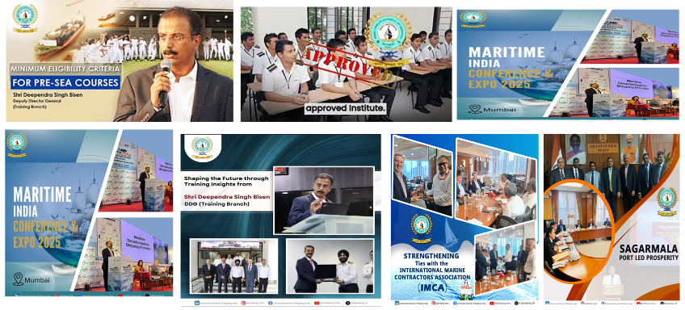
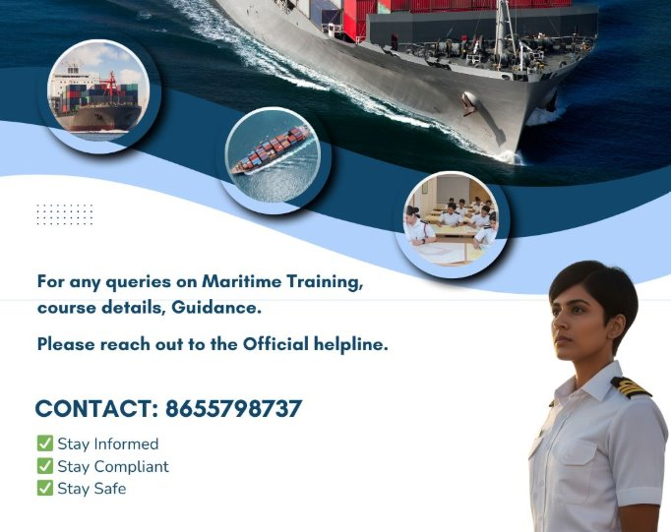
Transparency and Zero Tolerance for Fraud
Raising issue over the Call/SMS/WhatsApp
Helpline between 09:00 AM – 06.00 PM
Escalation mechanism for resolving query
Follow-up
Support and right guidance
Analysis
& Correction
and recurrence
Efforts to provide awareness through Social Media
Notes:
Transparency and Zero Tolerance for Fraud
“This slide explains how DG Shipping has put in place a clear, accessible and accountable mechanism to deal with complaints, fraud and misconduct, particularly in the context of recruitment and training.
At the first level, any stakeholder or seafarer can raise an issue directly through multiple channels — call, SMS or WhatsApp. The emphasis here is on ease of access. Reporting does not require intermediaries, influence or formal representation.
A dedicated helpline operates between 9:00 AM and 6:00 PM, ensuring that complaints are received and acknowledged within defined working hours by an identified team. This removes ambiguity about where and how issues should be reported.
Where matters require further examination, a structured escalation mechanism is in place. Complaints are not left unresolved at the frontline level and are routed appropriately for review and decision-making.
This is followed by systematic follow-up, where complainants are provided support and correct guidance, particularly in cases involving training eligibility, recruitment processes or certification-related concerns. The objective is not only resolution, but also prevention of repeat vulnerability.
Finally, DG Shipping undertakes analysis and corrective action. This includes identifying patterns, addressing systemic gaps and ensuring that similar instances do not recur. This feedback loop is critical to strengthening institutional integrity.
In parallel, DG Shipping has made extensive use of social media and public communication to raise awareness among seafarers. Regular posts, advisories, event outreach and helpline information are disseminated to ensure that seafarers — especially young entrants — are informed, alert and empowered.
The overarching message is clear and consistent: there is zero tolerance for fraud, reporting channels are open and accessible and DG Shipping stands firmly on the side of transparency, fairness and seafarer protection.”

Slide 19
Reporting, Redressal & Whistleblower Protection
There is no justification for informal payments — ever
ENABLERS
Confidential Reporting
Secure and confidential channels
Protection of identity
Collaborative Support
Collaboration with MACN Help Desk
Structured handling of reported incidents
CLEAR MESSAGE
DGS ASSURANCE
Complaints are examined objectively and without prejudice
No adverse action for reporting in good faith
Whistleblowers are protected through institutional safeguards
Timely Resolution
Time-bound escalation
Monitoring until closure
Notes:
Reporting, Redressal & Whistleblower Protection
This slide communicates a clear and unequivocal message from the regulator — there is no justification for informal payments, ever. No matter the circumstance, no matter the perceived urgency, informal payments are not acceptable and should not be normalised.
At the same time, it is important to assure stakeholders that raising concerns is safe, legitimate and encouraged. From the DGS perspective, complaints are examined objectively and without prejudice, based on facts and evidence, not assumptions. There is no adverse action for reporting issues in good faith.
Whistleblower protection is not informal or ad hoc. It is supported through institutional safeguards, ensuring confidentiality of identity and protection against retaliation. This applies equally to seafarers, operators and other stakeholders engaging with the system.
The third element is about enablers that make this framework work in practice. First, there are secure and confidential reporting channels, which allow issues to be raised without fear.
Second, there is collaborative support, including structured engagement with the MACN Help Desk, which provides an additional, trusted pathway for reporting and early issue identification.
Finally, there is an emphasis on timely resolution. Complaints are not meant to disappear into the system. They follow time-bound escalation mechanisms, with monitoring until closure, so that outcomes are visible and confidence in the process is maintained.
The overall intent is to move from silence and informal coping mechanisms to confidence in formal systems — where integrity is protected, concerns are addressed and trust in maritime governance is strengthened.”

Slide 20
Global Tools and Standards that Support Integrity
Internationally Recognised Reference Frameworks
ISO 37001 – Anti-Bribery Management Systems
Provides a structured organisational framework to prevent bribery
Requires leadership commitment, clear policies and accountability
Mandates risk assessment, training and third-party due diligence
Enables reporting, investigation and corrective action
Focus: Prevent, detect and respond to bribery within organizations
IMO (International Maritime Organization) – FAL 44/13
Recognizes corruption as a risk to safety, compliance and fair enforcement
Promotes risk-based identification of corruption-prone port interfaces
Emphasizes transparent procedures, documentation and reporting
Encourages cooperation across flag State, port State, industry and seafarers
Focus: Operational integrity in port and inspection processes
UN SDG Relevance : SDG 16
(Peace, Justice and Strong Institutions) – SDG 16.5 Substantially Reduce Corruption and Bribery.
OECD – Anti-Bribery Frameworks
Establishes international standards against bribery
Strengthens corporate liability and enforcement cooperation
Supports cross-border investigations and information sharing
Reinforces integrity across global supply chains
Focus: Accountability, enforcement cooperation and a level playing field
Notes:
Global Tools and Standards that Support Integrity
“This slide situates India’s integrity efforts within globally recognised governance frameworks.”
Maritime integrity is not being approached in isolation. Internationally, there is a clear convergence around treating corruption as a safety, governance and enforcement risk, not merely an ethical concern.
The IMO, through its Facilitation Committee, explicitly recognises corruption risks at port interfaces and calls for risk-based identification, transparency in procedures and cooperation across flag State, port State, industry and seafarers.
At the organisational level, ISO 37001 provides a structured, auditable framework for companies to prevent, detect and respond to bribery, embedding leadership accountability, risk assessment and reporting mechanisms into daily operations.
Complementing this, OECD anti-bribery frameworks address the cross-border dimension of corruption by strengthening corporate liability, enforcement cooperation and information sharing, ensuring that integrity expectations are consistent across jurisdictions.
“Together, these frameworks reinforce a common principle: integrity must be system-led, evidence-based and internationally aligned.”
For India, alignment with these standards strengthens credibility, predictability and trust, while ensuring that domestic reforms are fully interoperable with global shipping and trade systems.
IMO (International Maritime Organization) – Guidance on Addressing Bribery and Corruption (FAL 44/13)
The International Maritime Organization formally recognises bribery and corruption as risks that directly undermine maritime safety, regulatory compliance and fair enforcement. Through its guidance to the Facilitation Committee (FAL), particularly document FAL 44/13, IMO highlights that corruption is not merely an ethical concern but a systemic operational risk within port and inspection environments
IMO’s guidance places strong emphasis on a risk-based approach, encouraging States and maritime administrations to identify interfaces that are most vulnerable to corruption. These include inspections, clearances, documentation processes and interactions involving intermediaries. The objective is to reduce discretion and unpredictability at these touchpoints through standardisation, transparency and clear procedures.
A key principle in the IMO framework is procedural transparency. The guidance encourages clear articulation of roles and responsibilities of port officials, inspectors and authorities, along with documented procedures, defined timelines and accessible reporting mechanisms. This is intended to ensure that enforcement actions remain safety-driven and rule-based rather than discretionary or negotiable.
IMO also underscores the importance of cooperation across the maritime ecosystem. Flag States, port States, industry, ship operators and seafarers are all recognised as stakeholders in addressing corruption risks. By encouraging information sharing and coordinated action, IMO seeks to reduce fragmentation and prevent isolated practices that enable informal or coercive behaviour.
Overall, the IMO framework provides sector-specific governance guidance, anchoring anti-corruption efforts firmly within the operational realities of ports, inspections and vessel operations, rather than treating corruption as a generic compliance issue.
ISO 37001 – Anti-Bribery Management Systems
ISO 37001 provides a structured organisational framework for preventing, detecting and responding to bribery through the establishment of an Anti-Bribery Management System (ABMS). Unlike sector-specific guidance, ISO 37001 focuses on how organisations design and operate internal control systems to address bribery risks in a systematic manner .
The standard requires leadership commitment at the highest level, making anti-bribery responsibility a governance issue rather than a purely compliance function. Organisations are expected to define clear anti-bribery policies, assign responsibilities, and embed accountability mechanisms across management and operational levels.
A core element of ISO 37001 is risk assessment. Organisations must periodically assess bribery risks based on their activities, geographic exposure, use of intermediaries and interaction with public officials. These assessments then drive proportional controls, ensuring that measures are risk-based rather than purely procedural.
ISO 37001 places strong emphasis on training and awareness, requiring organisations to ensure that employees, management and relevant third parties understand bribery risks, reporting obligations and ethical expectations. This is particularly relevant in maritime operations, where crews, agents and port-side staff often operate across jurisdictions and regulatory environments.
The standard also mandates third-party due diligence, recognising that agents, intermediaries and service providers are common risk vectors. In addition, ISO 37001 requires confidential reporting mechanisms, investigation procedures and corrective actions, enabling organisations to move from intent to operational enforcement.
While ISO 37001 does not replace national laws or enforcement, it provides a globally recognised management system that supports consistency, auditability and continuous improvement in anti-bribery controls.
OECD – Anti-Bribery Frameworks and Convention
The OECD Anti-Bribery Convention establishes the international enforcement architecture for combating bribery of foreign public officials in international business transactions. It is a legally binding framework that requires signatory countries to criminalize bribery and ensure effective investigation, prosecution and sanctions.
A defining feature of the OECD framework is its focus on corporate liability. Companies, not just individuals, can be held accountable for bribery committed on their behalf. This is particularly relevant in maritime trade and shipping, where complex corporate structures and cross-border operations are common.
The OECD framework promotes cross-border enforcement cooperation, including information sharing, mutual legal assistance and coordinated investigations. This recognises that bribery and corruption often span jurisdictions, supply chains and financial systems, making unilateral enforcement ineffective.
Through its peer-review monitoring mechanism, the OECD evaluates how effectively member countries implement and enforce anti-bribery laws. These reviews focus not only on legislation but also on real-world enforcement outcomes, thereby reinforcing accountability and credibility.
From a governance perspective, the OECD framework reinforces the principle of a level playing field, ensuring that companies operating ethically are not disadvantaged by competitors engaging in bribery. It supports integrity across global supply chains and strengthens trust in international trade systems.
In the maritime context, OECD principles complement sectoral and organisational frameworks by providing the legal and enforcement backbone that deters bribery, supports prosecution and reinforces international cooperation.

Slide 21
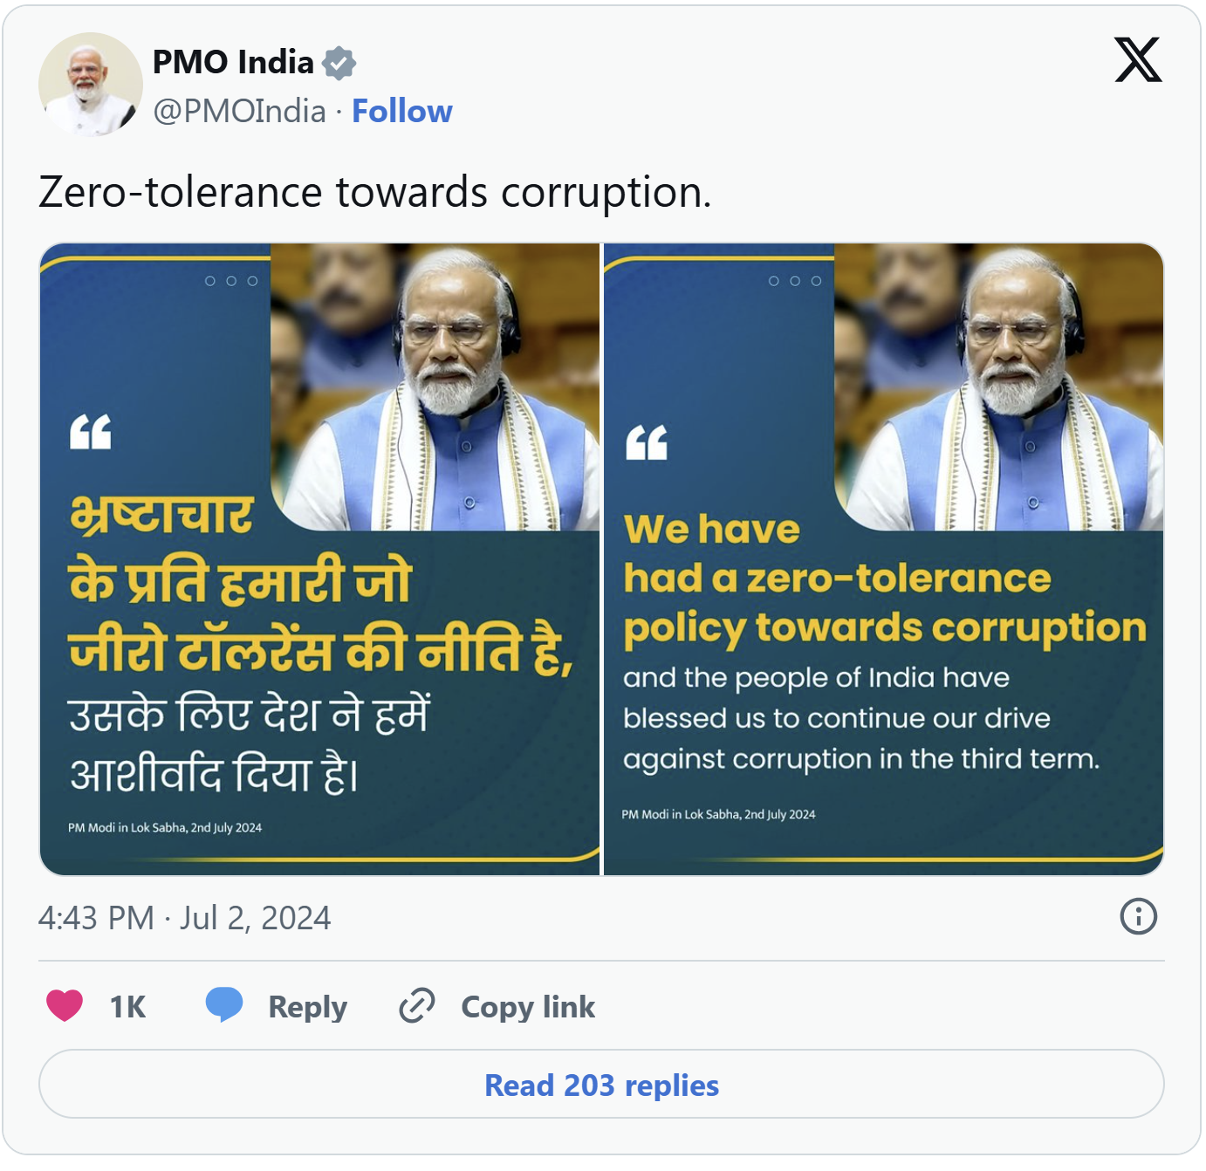
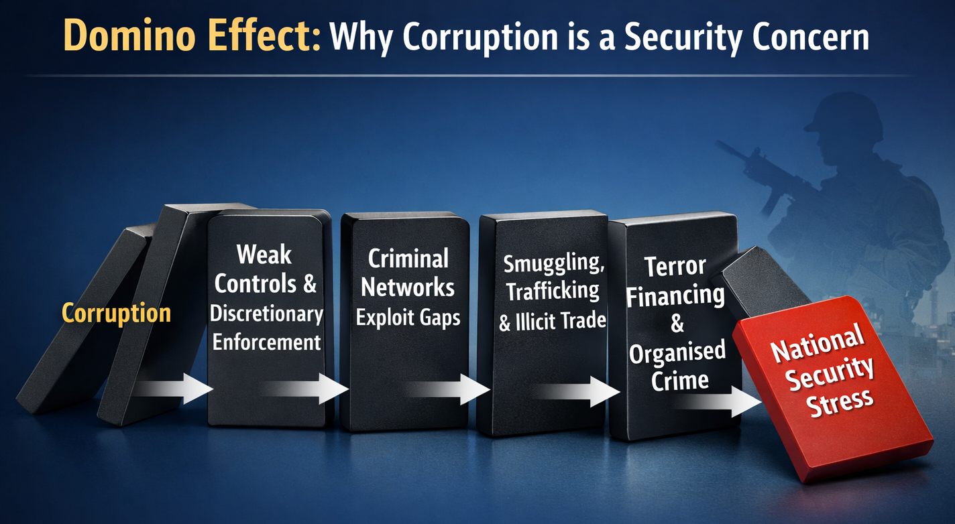
India’s Zero-Tolerance Stance: Corruption as a National Security Risk
Prime Minister’s Stance on Corruption
Zero tolerance against corruption as a core governance principle
Technology-led transparency to eliminate rent-seeking and discretion
Time-bound action and accountability embedded in administration
Corruption viewed not merely as misconduct, but as a systemic threat
Relevant PIB Press Releases
PM’s Address at Vigilance Awareness Week, Vigyan Bhawan , 03 November 2022 | 3:13 PM
PM Addresses G20 Anti-Corruption Ministerial Meet (Kolkata) ,12 August 2023 | 9:29 AM
PM’s Reply to Motion of Thanks on President’s Address (Lok Sabha), 02 July 2024 | 8:46 PM
BRICS Anti-Corruption Ministerial Meet – India’s Position, 13 July 2022 | 6:06 PM
Governance Reforms under PM Modi – Statement by Dr Jitendra Singh, 15 February 2024 | 6:02 PM
Union Home Minister Shri Amit Shah on Extradition of Fugitives & National Security , 16 October 2025 | 4:06 PM
Corruption is not an isolated governance issue, it is a multiplier of crime and a direct risk to national security.
Notes:
India’s Zero-Tolerance Stance: Corruption as a National Security Risk
“This slide situates maritime anti-corruption within India’s broader national governance and security doctrine.”
The Government of India, under the leadership of the Hon’ble Prime Minister Shri Narendra Modi, has articulated zero tolerance against corruption as a core principle of governance, not as a sector-specific initiative.
Across multiple national and international platforms — including Vigilance Awareness Week, the G20 Anti-Corruption Ministerial Meet, BRICS engagements and Parliamentary addresses — corruption has been consistently framed as a systemic threat that undermines trust, distorts markets and weakens institutions.
A key emphasis in the Prime Minister’s PIB-recorded statements is that corruption thrives where discretion, opacity and delays exist. The policy response therefore focuses on technology-led transparency, process standardisation and time-bound decision-making to eliminate rent-seeking opportunities.
Importantly, corruption is not viewed merely as administrative misconduct, but as a multiplier of broader security risks.
The domino illustration on the slide captures this clearly:
corruption weakens controls → criminal networks exploit gaps → smuggling, trafficking and illicit trade expand → terror financing and organised crime gain pathways → national security comes under stress.
This framing has been reinforced not only by the Prime Minister but also by senior ministers, including in PIB statements linking corruption, economic offences, terrorism, arms smuggling and organised crime as interconnected risks.
“From India’s perspective, zero tolerance is therefore not symbolic — it is structural.”
It is reflected in:
technology-enabled governance,
strengthened enforcement and asset recovery,
reduced human discretion,
and clear accountability mechanisms.
For the maritime sector, this means that anti-corruption measures are directly aligned with national security, trade integrity and India’s global credibility as a responsible maritime nation.
“The message is unambiguous: corruption is not an isolated governance issue — it is a direct risk to safety, security and sovereignty.”

Slide 22
Strengthening Maritime Integrity: The Way Forward
Systemic & Institutional Measures
Reduce discretion through digitalization and SOP-driven processes
Automate documentation, clearances and customs interfaces
Strengthen oversight, audits and inspector rotation
Use data and incident reporting to identify risk patterns and drive reform
People, Training & Culture
Build a zero-tolerance culture across ports, ships and companies
Train seafarers, inspectors and port stakeholders on ethical response and rights
Empower crews with confidence, awareness and escalation pathways
Encourage political and leadership commitment for sustained change
Collaboration, Technology & Accountability
Collective action: government, industry and seafarers
Safe reporting: confidential channels and whistleblower protection
Technology enablement: digital platforms, automation and remote monitoring
Transparency: tools to track processes and interactions
Alignment: international standards and best practices
Notes:
Strengthening Maritime Integrity: The Way Forward
“This slide brings together the key actions required to address maritime corruption in a comprehensive and sustainable manner. The emphasis is not on isolated enforcement, but on strengthening systems, people and accountability across the maritime ecosystem.”
Systemic & Institutional Measures
At the core of integrity reform is reducing discretion. Wherever manual processes, ambiguity and delays exist, the risk of corruption increases. Our focus therefore is on digitalisation and SOP-driven processes, particularly in inspections, documentation, clearances and customs interfaces.
Automation and standardisation help ensure that enforcement is rule-based, consistent and transparent, rather than personality-driven. Alongside this, strong oversight mechanisms, audits and inspector rotation are essential to prevent collusion and maintain credibility.
Data and incident reporting play a critical role here. When analyzed properly, they help us identify systemic risk patterns and enable targeted reforms rather than ad-hoc reactions.
People, Training & Culture
Integrity systems will not succeed unless they are supported by people and culture. Building a zero-tolerance culture across ports, ships and companies is therefore fundamental.
Training is not limited to compliance awareness. It is about equipping seafarers, inspectors and port stakeholders with clarity on ethical conduct, rights, responsibilities and escalation mechanisms.
Seafarers, in particular, often face pressure at the front line. Empowering them with confidence, awareness and safe escalation pathways is as much a welfare issue as it is a governance issue.
Finally, sustained change requires leadership commitment — political and administrative — to ensure that integrity reforms are consistently supported over time.
Collaboration, Technology & Accountability
Maritime corruption cannot be addressed by any single actor. Collective action involving government, industry and seafarers is essential to address shared risks.
Safe and confidential reporting mechanisms, along with whistleblower protection, are critical to ensure that concerns are raised without fear of retaliation.
Technology is a strong enabler — digital platforms, automation and remote monitoring reduce human discretion and improve traceability. Transparency tools allow processes and interactions to be tracked, reviewed and audited.
Alignment with international standards and best practices ensures that our approach remains credible, interoperable and globally trusted.
Closing
Ultimately, maritime integrity is strengthened not through one-time actions, but through robust systems, empowered people and sustained collaboration.

Slide 23
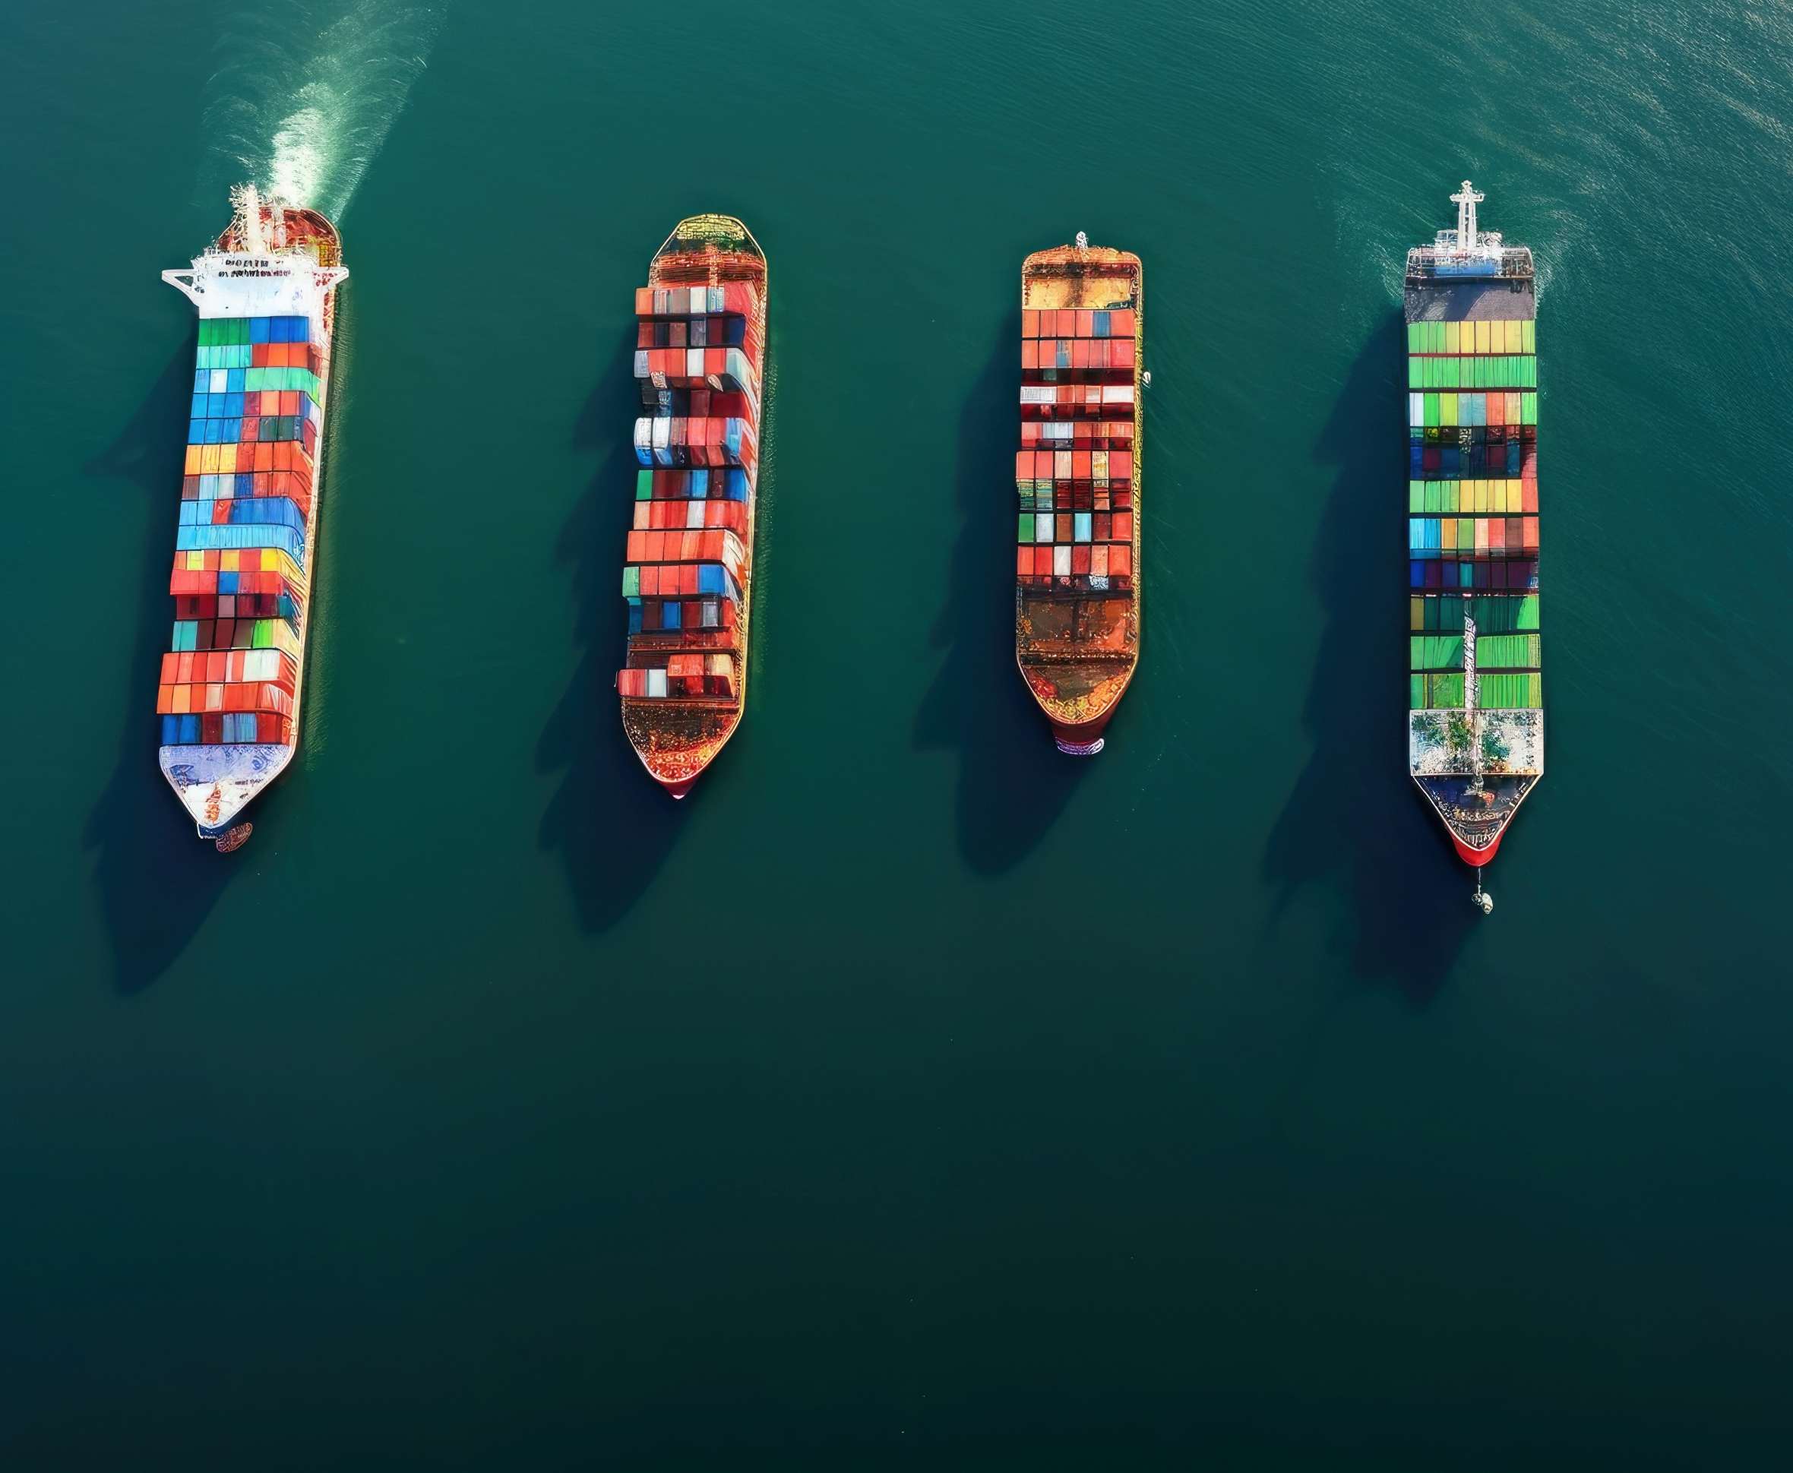
“Integrity is not optional —
It is the bedrock of safe and effective maritime governance.”
Thank you

